Slide 1
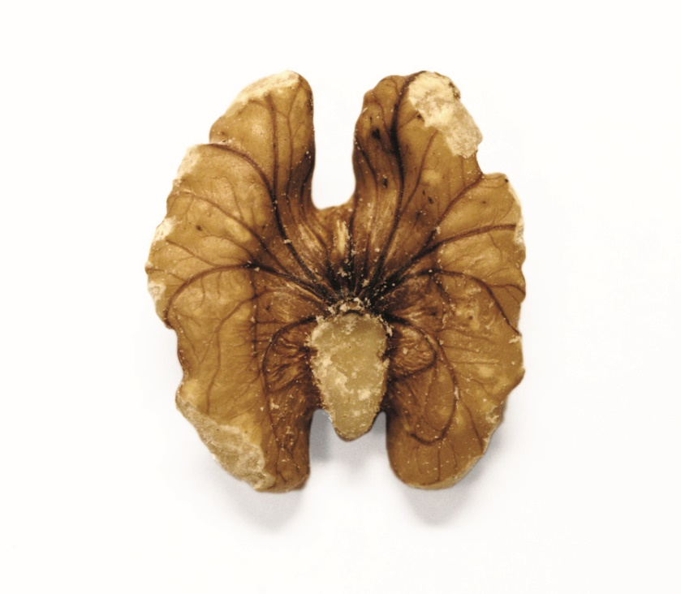
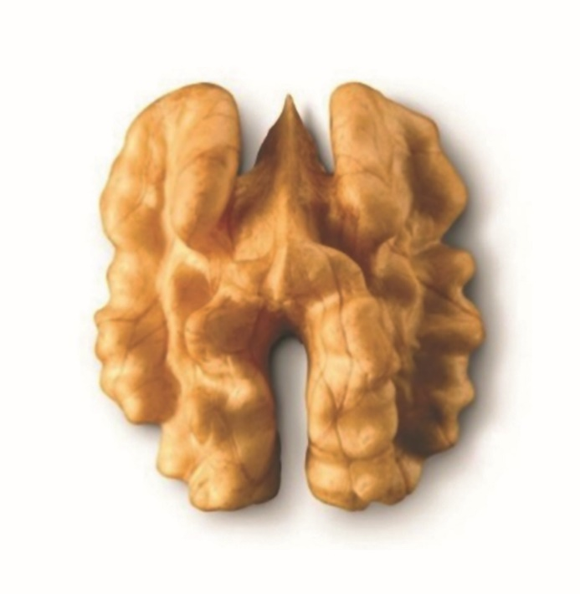
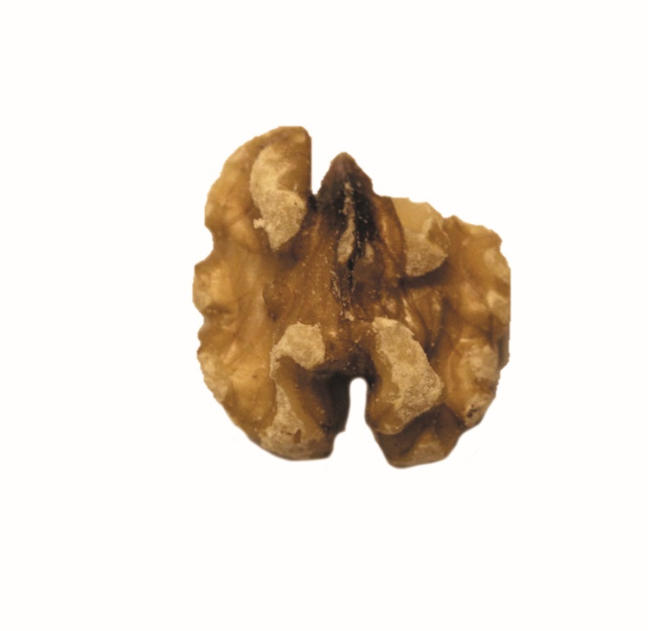
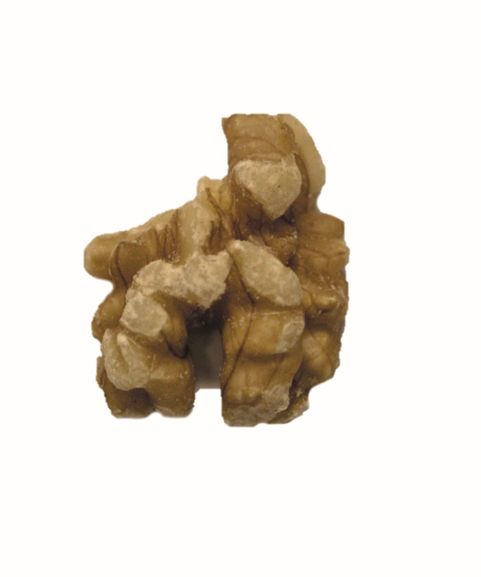
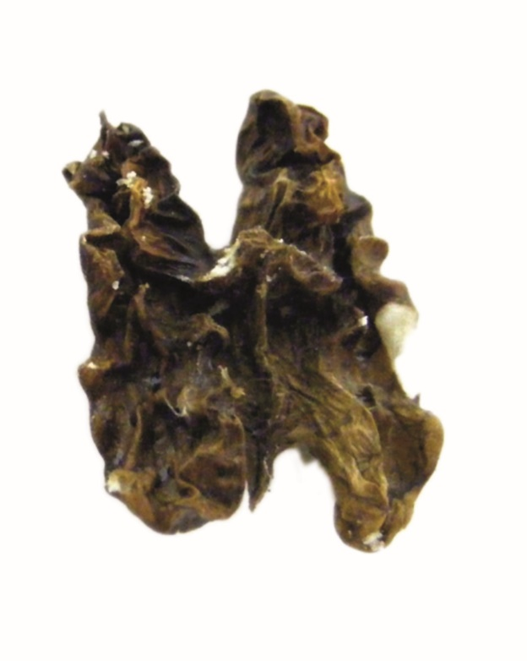
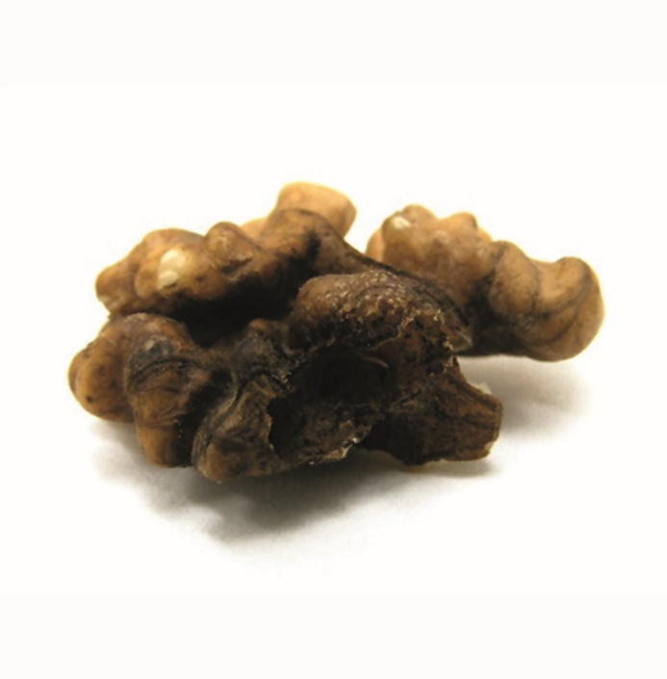
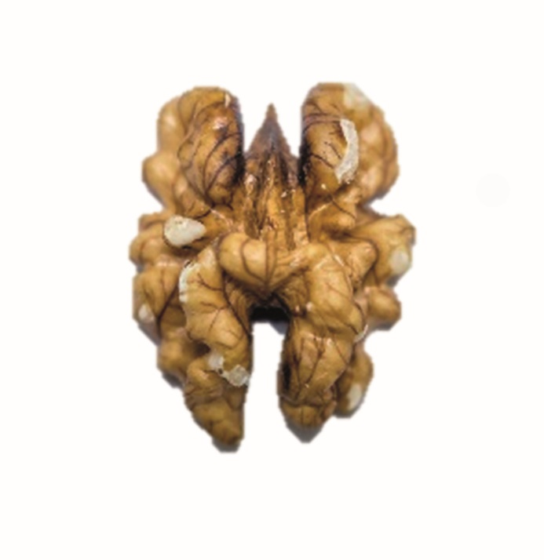
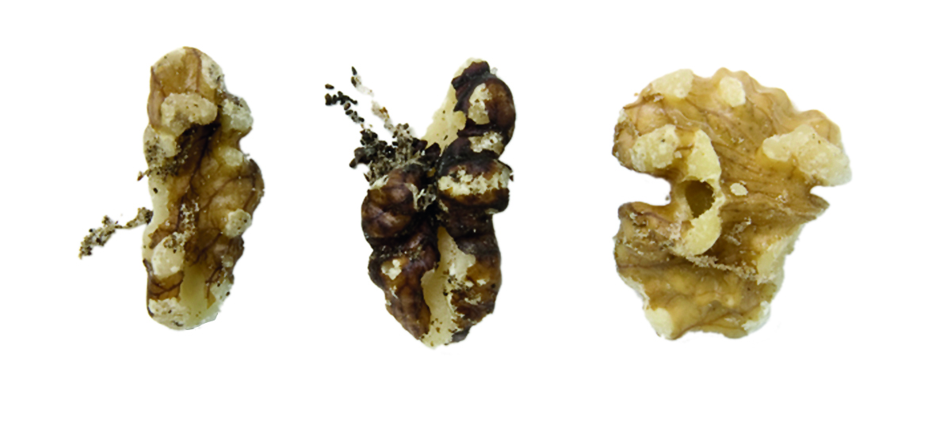
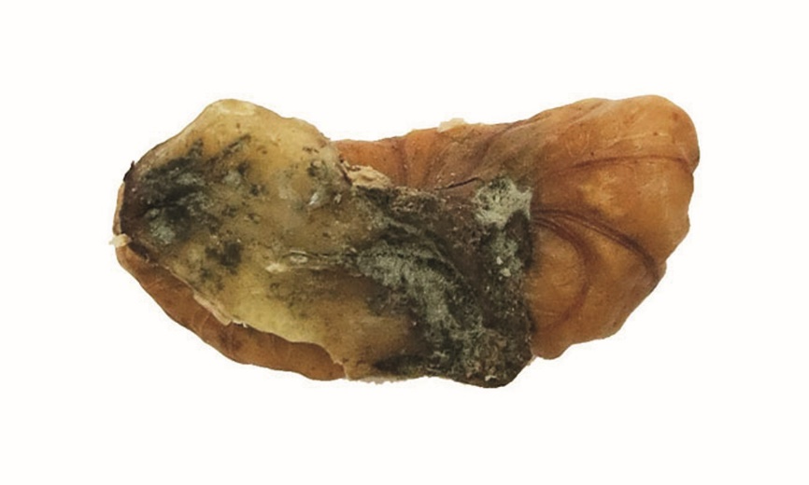
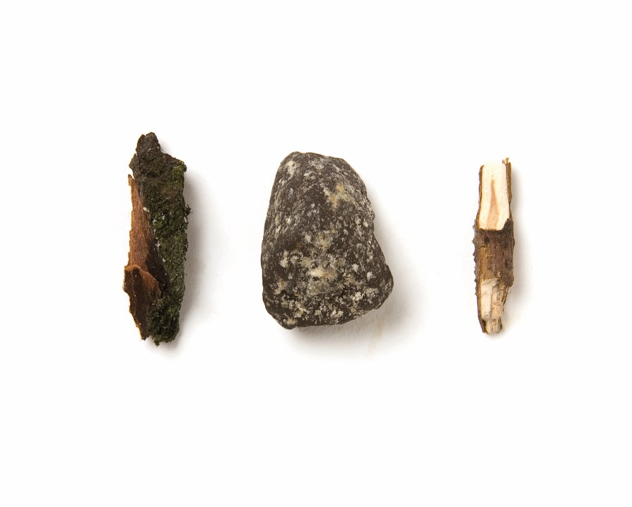
COMMERCIAL AND MARKETING QUALITY OF
WALNUT KERNELS
*
DEFINITION & CLASSIFICATION
The UNECE standard applies to walnut kernels* free from outer husks, of varieties (cultivars) grown from Juglans regia L., intended for direct consumption or for food when intended to be mixed with other products for direct consumption without further processing.
It does not apply to walnut kernels that are processed by salting, sugaring, flavouring, roasting or for industrial processing.
Inshell are classified into the following three classes: Extra Class, Class I and Class II. The classification is determined in accordance with the defects allowed in the Standard's section "IV, Provisions concerning tolerances“.
QUALITY DEFECTS
HALF WALNUT KERNEL
SUFFICIENTLY DEVELOPED
CHIPPED KERNEL
QUARTERS
LARGE PIECES
BROKEN PIECES
SHRUNKEN / SHRIVELED KERNEL
BLEMISHES AND DISCOLOURATION
SCUFFING
INSECT / PEST DAMAGE
MOULD
FOREIGN MATTER
The UNECE standard for walnut kernels and an electronic version of this poster can be retreived from the following addresses. Standard: https://www.unece.org/trade/agr/standard/dry/DDP-Standards.html Poster: https://www.unece.org/publications/oes/welcome.html

