Slide 1
Aid for Trade in Batken: results that last.

Slide 2
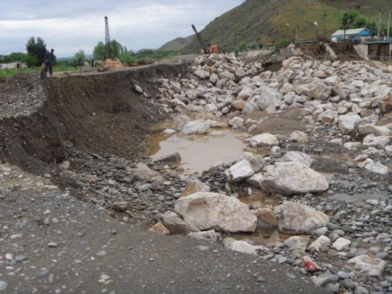
Batken Province
Batken is a region in the south of Kyrgyzstan, which borders with Uzbekistan in the north and Tajikistan in the south. After the demise of the Soviet Union, it suffered from de-industrialization, including the demise of some “mono-towns”, the break-up of collective agriculture and the institutions responsible for collective water and land management; all of which resulted in ever-increasing employment and poverty problems, as well as environmental degradation.

Slide 3
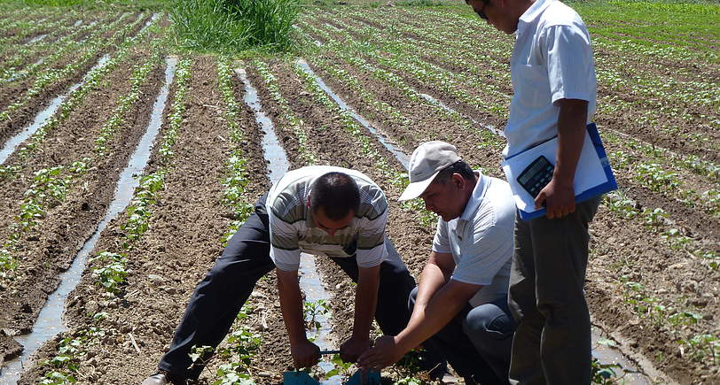
UNDP in Batken Province
2000-2005: communities mobilization and empowerment through access to microfinance
2008-2010: area-based development
2009 (on-going): Aid for Trade

Slide 4
Aid for Trade in Batken
Phase I: 2009 – 2011, budget 269,509 USD
Phase II: 2011 – 2013, budget 514,000 USD
Capacity building of project clients on trade mainstreaming;
Capacity building of Batken Marketing and Information Centre on expansion of access to market information;
Trade capacity building of target farmers associations and cooperatives;
Promotion of environmentally-friendly technologies.

Slide 5
Capacity Building
Very first Trade Development Strategy become integral part of Batken Province Development Strategy
500 beneficiaries participated in trainings on market assessment, standardization, and certification of products and the basics of trade. 60% were able to raise level of income by 8-11%
20 trained brokers helped 450 farmers to market agricultural products

Slide 6
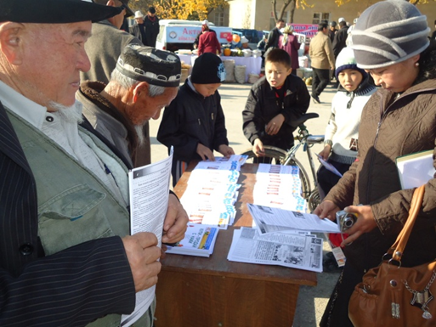
Access to marketing information
Batken Market Information Center (BMIC):
Web-portal (http://batken.agroinfo.kg/): the website contains information on agriculture (equipment, means of production, agricultural methodologies, etc.), and a list of producers and processors in the region;
An agricultural newspaper that is published every two weeks and contains general information on the agricultural sector, as well as market price information on 37 agricultural products from 10 different large markets;
Telephone service where farmers can phone-in for information;
Radio stations in three large markets of the Batken Province.

Slide 7
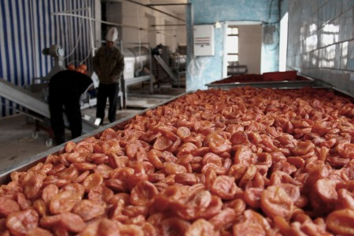
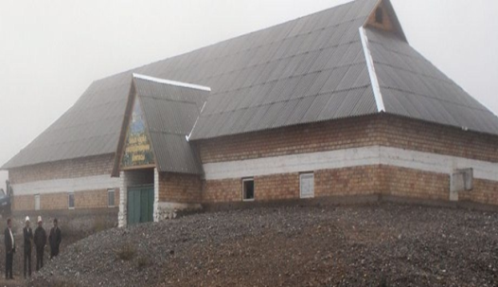
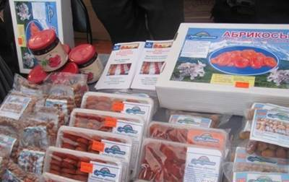
Support to cooperatives and farmers associations
Dary Batkena (Gifts of Batken) trademark was developed and registered
7 pilot cooperatives established production line for processing and packaging of cereals, drying of fruits and vegetables, constructed a standard storage for potato and vegetables with volume of 500 tons, a container storages for fresh fruits and vegetables, and installed lines for processing and packaging of apricot kernels and dried fruits and line for jam producing
Production lines helped farmers to sell 65,4 tonnes of packaged rice, 18,5 tonnes of dry fruits, 189 tonnes of potato, 100 tonnes of fresh fruits and vegetables
Markets expanded to Russia and Kazakstan

Slide 8
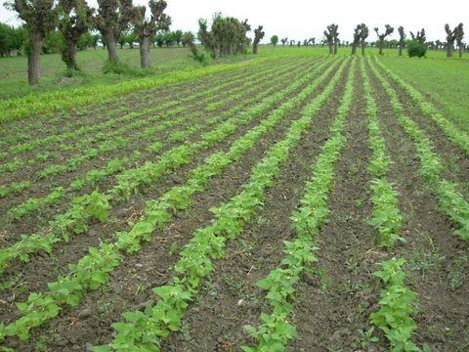
Green is profitable!
A series of trainings on the use of organic fertilizers, biological preparations and stimulants were conducted for the leaders of 20 farmers groups and the leaders of 10 agricultural cooperatives
More than 150 farmers started using biological stimulants and effective micro-organisms.
Crop yield of many agricultural products is now 10-15% higher than with the use of traditional technologies.

