Slide 1
Implementing Aid-for-Trade Road Maps
Strengthening institutions
to make
Aid for Trade work better
4th GR AfT, Geneva, 10 July 2013

Slide 2
Capacity matters!
“The old model has been based on the mistaken assumption
... that it is possible simply to ignore existing capacities and replace them with knowledge and systems produced elsewhere—a form of development as displacement, rather than development as transformation”
Make the most of local resources, people, skills, technologies…
Favor sustainable change
Take an inclusive approach in addressing power inequality
Emphasizes deep, lasting transformations through policy and institutional reforms
Value ‘best fit’ for the context over ‘best practice’

Slide 3
Strengthening Aid for Trade governance to deliver more and better results

Slide 4
Many options, same goal
Sector wide
Approach
(pool funding)
Sector wide
Approach
(budget support)
Coherence
Programmatic
support
Project-based delivery
Sophistication

Slide 5
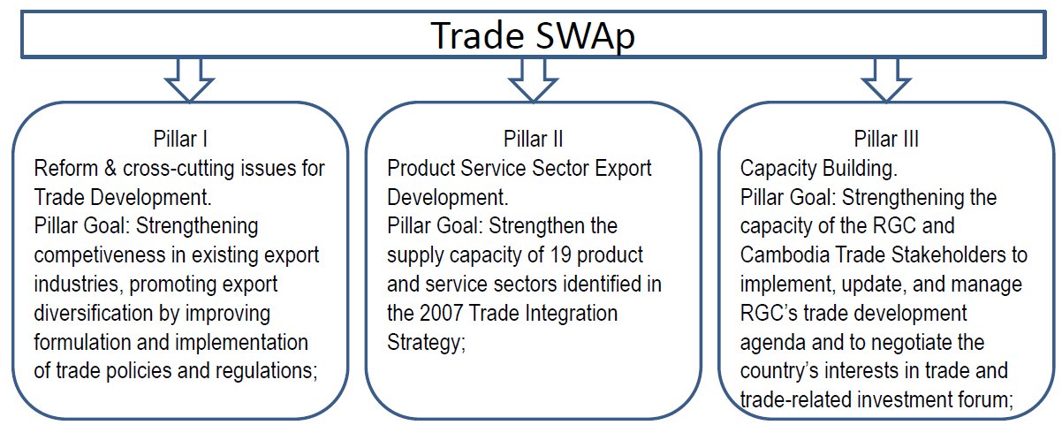
Aid for Trade / EIF in Cambodia
AfT Disb. USD mil.

Slide 6
Delivery platform in Arab States
IDB (ITFC), Sweden, Kuwait, Saudi Arabia partnered with 5 UN agencies to spearhead regional integration contributing to inclusive growth, non-traditional exports and employment creation
Project development facility to realize trade-related aspirations (UNDP led)
Capacity strengthening of regional organizations to implement PAFTA (UNCTAD led)
Support to trade reforms including NTB, TBT, and strengthening of trade support institutions (ITC/UNIDO led)
Skills development strategies in sectors with high export potential (led by ILO)

Slide 7
Lessons learned
Focus on finance vs. strategy is a recipe for disaster
Institutional capacities need to be developed across the board: quick wins and long term investment
Role of lead agency as a champion (national / regional)
Engage private sector
Donor coordination is quicker said than done
Learn from other sectors: health, education, etc.
Focus on implementation, accountability and results
Don’t be over-ambitious, be aware of capacity constraints

Slide 8
Strengthening
institutions to make AfT work
in Central Asia

Slide 9
Trade & allocation of food resources
Trade policy:
Provide instruments for ensuring food security
Provide means for overcoming hunger
Ensure appropriate balancing between short- and long-term impacts of sectoral allocation on
Aggregated national welfare
Value addition/sector, value adding/labour, employment, etc.
Streamlining trade policy to improve frame conditions for increasing productivity of labour, capital, and land

Slide 10
AfT increasing availability of food
Trade support institutions:
Task: increase competitiveness of trade stakeholders
Means: capacity development for stakeholders to raise productivity
Agricultural production: vocational training, demand-oriented short-term courses
Agro-processing: demand-driven management training, support to affordable access to improved technology
Agro marketing: access to & applying market information
Reducing transaction costs: opportunities for clients on feed-back to trade politicians

Slide 11
AfT support to TP (I)
Capacity development for increasing productivity
Trade Policy - support to institutional development
Alignment of legislation and regulations to CU (KGZ)
Trade policy papers on FTAs, WTO, CU accession (KGZ, TJK, UZB)
Legal review of trade documents and WTO requirements
(KGZ, TJK)
Cost-benefit analyses of CU accession (KGZ, TJK, UZB)

Slide 12
AfT support to TP (II)
Capacity development for increasing productivity
Trade Policy - support to institutional development
Expert Working Groups at national and at Oblasts level on trade policy documents (TJK), Inter-ministerial committee on CU (KGZ)
Expertise in formulating trade related policy documents (TJK, UZB)
Implementation of NES Strategy 2013-2017 and action plan (KGZ)
Mainstreaming trade and PEI in national platforms KGZ)

Slide 13
AfT support to TD institutions (I)
Capacity development for increasing productivity
Trade Development – trade support institutions
Needs and capacity assessment of stakeholders (KGZ, TJK, UZB)
Transition from Single Window into Export Promotion Agency (KGZ)
Access to market information through marketing platforms (KGZ, TJK)

Slide 14
AfT support to TD institutions (II)
Capacity development for increasing productivity
Trade development
National and Oblasts Trade Promotion Centres (KGZ, TJK, UZB)
Business Associations and CCI strengthened in lobbying capacity on improving business environment (KGZ, TJK, UZB)
Elaborating trade policy documents at PPD platforms (TJK)
CCI organising participation at trade fairs and biz forums (KGZ, TJK, UZB)

Slide 15
AfT support to BPC institutions
Capacity development for increasing productivity
Building Productive Capacities
Needs and capacity assessment of stakeholders (KGZ, TJK, UZB)
Trade Capability Programme at national and Oblasts level on export standards for agro-processing companies (TJK)
Upgrading value chains through access to improved technology via Small Grants Programme (TJK, UZB)

Slide 16
REGIONAL CENTER for EUROPE AND CIS
Bratislava, Slovakia
http://europeandcis.undp.org/poverty
joern.rieken@undp.org
BUREAU OF DEVELOPMENT POLICY
New York, United States
www.undp.org/poverty/focus_trade_ip_migration.shtml
massimiliano.riva@undp.org
Notes:
16

