Slide 1

Quality control for fresh fruits and vegetables
Catherine BALLANDRAS – Office for the markets of vegetal products and drinks

Slide 2
Levels of regulation
International
Codex alimentarius
UNECE standards with OECD brochures
European
The General standard and the 10 specifics from R(UE) n°543/2011
National
Décrets et arrêtés
general ones (fruits and vegetables sales, indication of price)
specifics (potatoes, shallots...)
Interprofessionnel
Interpro agreements

Slide 3
2 ministries
DGCCRF (economy)
In charge of
The application of the regulation on fresh fruits and veg
Hygienic controls of the first sell on the market in fruits and veg first trasnformation companies
Participates to the elaboration of UNECE and Codex standards
DGAL/SRAL (agriculture)
In charge of
Phytosanitary controls
Hygienic controls at the production stage
Participates to the COM negotations.

Slide 4
Standardisation
Creating the MCO (R(CE) n°1234/2007) – instead of 20 others before
Limitating the number of standards to 10
Simplificate the control regulation
Only one regulation with 11 standards
=> increase the consumption of F&V in Europ

Slide 5
The EU regulation
Regulation(EU) n°1308/2013
Art. 1 : Scope
Fresh fruits and vegetables: Annexe I, part. IX
Processed fruits and vegetables: Part. X
Bananas: part XI

Slide 6
The regulation today
Common organisation of the markets (« COM ») R(UE) 1308/2013 Dec. 13, 2013
Art. 75 keeps standards for F&V
Art. 76 « products of the fruit and vegetables sector which are intended to be sold fresh to the consumer may only be marketed if they are sound, fair and of marketable quality and if the country of origin is indicated. »
The holder of products is in charge of the quality of the products.
Member states check the conformity.
Art. 230 keeps in application art 113 a) 4. from Reg. 1234/2007 :
« check selectively, based on a risk analysis, whether the products concerned conform to the respective marketing standards. These checks shall be focused on the stage prior to dispatch from the production areas when the products are being packed or loaded. For products from third countries, checks shall be done prior to release for free circulation. »

Slide 7
The regulation today
Regulation for the application of COM : R(UE) 543/2011
1 general standard
10 specific standards
Many exceptions
Bases of the risk analysis
Obligation of notification

Slide 8
Regulation (CE) n° 543/2011
  Normes (article 3)
  1 general standard
  10 specific standards
    Apples
    Citrus fruits
    Kiwis
    Salads
    Peachs and nectarins
    Pears
    Strawberries
    Sweet peppers
    Table grapes
    Tomatoes

Slide 9
Regulation (CE) n° 543/2011
  Exceptions (article 4)
  Products for processing
  Sales on the production place
  Ready to eat products
  Producers market
  Some products (wild mushrooms, almonds, pine nuts, walnuts...)
  Products « for jam », in France, these products should respect the general standard.

Slide 10
Regulation (CE) n° 543/2011
Information particulars (Art. 5)
Information shown legibly and obviously on one side of the package
Goods shipped in bulk and loaded directly onto a means of transport, the information shall be given in a document accompanying the goods
For distance contracts, information is available before the sales
Invoices and accompanying documents shall indicate the name and the country of origin of the products and, where appropriate, the class, the variety or commercial type if required in a specific marketing standard, or the fact that it is intended for processing.

Slide 11
Regulation (CE) n° 543/2011
Information at the retail stage (article 6)
Legible and conspicuous.
- country of origin
- where appropriate, class and variety or commercial type in such a way as not to mislead the consumer.
Prepacked products
Net weight
Or number of items instead

Slide 12
Regulation (CE) n° 543/2011
  Mixes (article 7):
    It is possible to mix species until 5kg (ex. mix for soups...)
    The indication of origin is simplified as « EU / Third countries / both »

Slide 13
Regulation (CE) n° 543/2011
General standard (annexe 1 part. A)
Intact
Sound
Clean
Practically free from pests/ damage caused by pests
Free of abnormal external moistures
Free of foreign smell/taste
Sufficiently developed
Tolerance of 10% and 2% of degradation
Indication of the origin

Slide 14
Interprofessional agreements
Rules that are more restictivs than the EU regulation, only for French products
Concerning specific caracteristics (sizing, packaging sizes...)
Only for companies that signed the agreement, can be extended to everybody if the association signing represent a majority
Special control agents from INTERFEL
Limit in time (usually 3 years)

Slide 15
Available texts
10 specific standards + 1 general standard
43 UNECE standards for fresh fruits
20 UNECE syandards for dried fruits
The respect of the UNECE standard is consider conforming the general standard (art.3)
When a product follows the standard (class extra/I/II), it must follow the all standard.

Slide 16
Where to find the UNECE standards?
http://www.unece.org/trade/agr/standard/fresh/FFV-Standards.htm
For fresh F&V
http://www.unece.org/trade/agr/standard/dry/DDP-Standards.htm
For dried F&V

Slide 17
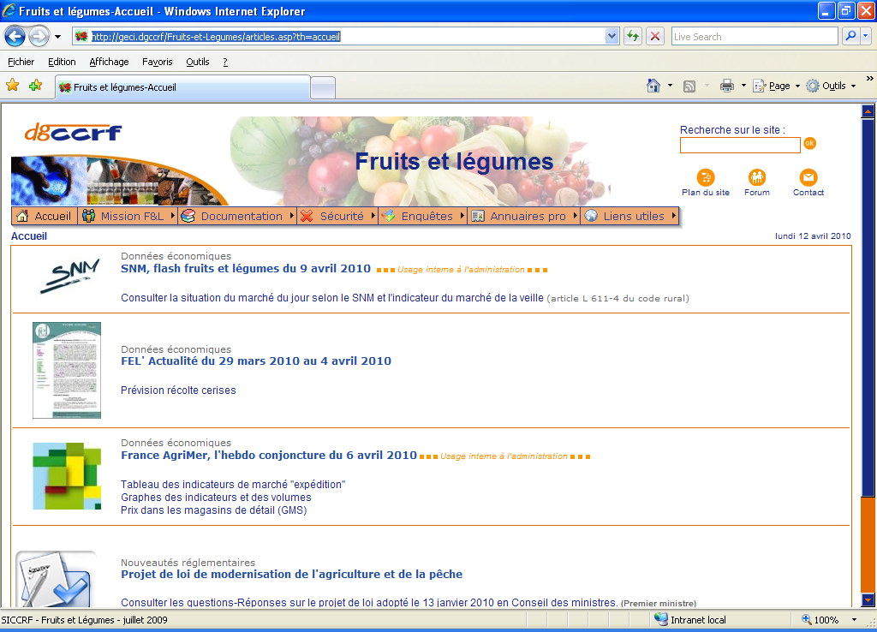
But as well
Our intranet
http://geci.dgccrf/Fruits-et-legumes/articles.asp?th=accueil

Slide 18
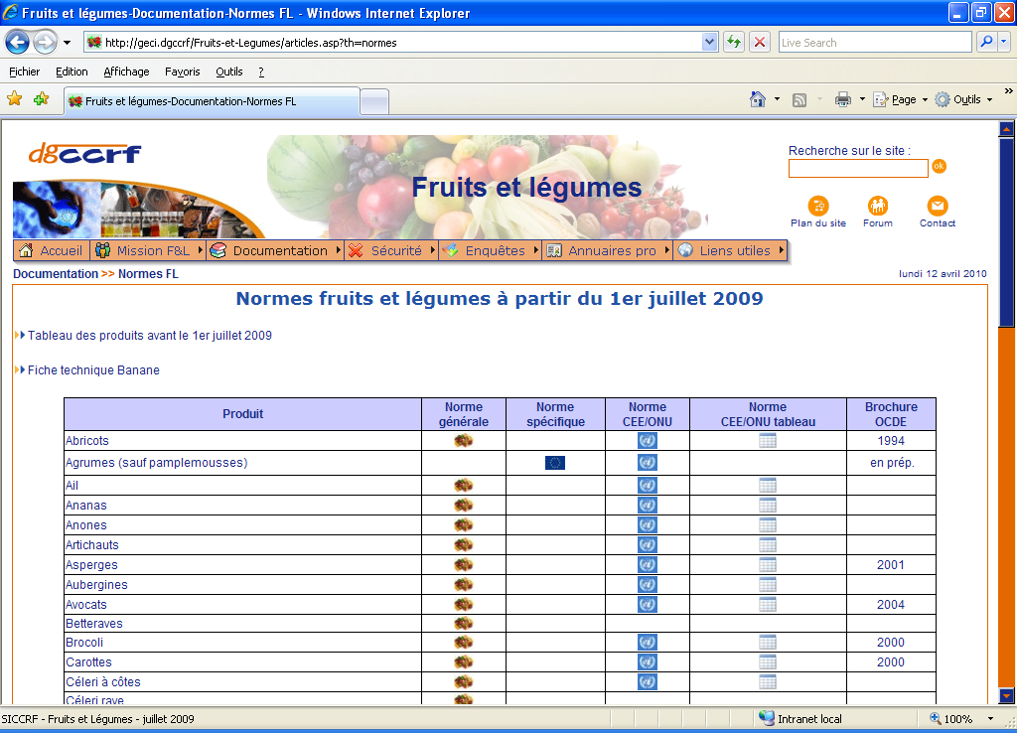

Slide 19
Actions of DGCCRF
How do we control

Slide 20
Control and regulation n°543/2011
Title II – chapitre I
Article 9 : coordinating authorities and inspection bodies
Article 10 : trader data base
Article 11 : criterias of the risk analysis
Article 12 : approved traders - authorisation
Article 14 : certificate of conformity – electronic format
Article 15 : approuved third countries
Article 17 : methods of inspection – see annex V
certificate of conformity and non conformity
Article 18 : notifications

Slide 21
NCC (art.17)
CONSTAT DE NON-CONFORMITE N°
(application du règlement (CE) n° 543/2011)
Stade du contrôle (cocher la case correspondante ) □ Exportation □ Importation □ Marché intérieur
Le à heures en présence de (1)
Avons constaté que le lot suivant ( cocher la case correspondante)
□ détenu en vue de la vente □ exposé en vue de la vente □ :vendu □ commercialisé de toute autre manière
DETAIL DU LOT
Espèce Variété Type commercial
Nombre de colis et type : Poids
Pays d’origine et/ou Pays de provenance
Catégorie de qualité Calibre Marques apposées sur les colis :
Numéro de lot - - Numéro de convention
Identification du moyen de transport (cocher la case correspondante) □ wagon, □ camion, □ bateau, □ avion
N°: ou NOM :
Nom, qualité et Adresse du conditionneur (1)
N° de convention N °de certificat de contrôle
CONFORMÉMENT A L’ECHANTILLONNAGE PREVU À L’ARTICLE 9, IL A ÉTÉ CONSTATÉ LES DÉFAUTS SUIVANTS, EXPRIMÉS EN POURCENTAGE,
□ défauts et dégâts □ décomposition et pourriture □ défauts physiologiques □ calibrage □sain
□ défauts de forme □ propreté □coloration □ maturité □ présentation □Etiquetage
En conséquence, le ( lot ci-dessus ne répond pas aux prescriptions réglementaires en vigueur pour sa commercialisation
Observations et signature de l’opérateur
Destination finale donnée à la marchandise par l’opérateur : ( cocher la case correspondante)
□ refus □ déclassement □ reclassement □ reconditionnement □ Réétiquetage
□ Réexpédition vers un autre État membre □ Destruction □ destination industrielle
Fait à le Nom du contrôleur et signature cachet

Slide 22
Certificate of conformity (annex III)

Slide 23
Sampling in packages

Slide 24
Sampling products in bulk

Slide 25
Control the exportation
Article 13 of the 543/2011
Electronic notification
Approved traders or not: telexport (website)
DGCCRF: FELEX
Notification by the trader, 10 products
Physical control or not based on a risk analysis
- 5% of the lots for approved traders
- 100% of the lots if not approved
An electronic certificat is sent if necessary (depending on the destination)

Slide 26
Control the importation
Electronic notification
Approved traders or not: telimport (website)
DGCCRF: FELIM
Notification by the trader, 10 products + 26 others (+mangoes, pineapples, pomelos between 2009 and 2013)
Physical control or not based on a risk analysis
- 5% of the lots from approved third countries
- 50% for others
An electronic certificate can be sent.

Slide 27
F&V in the actions of DGCCRF
1 -Answer the communautary obligation for France to control the market
Annual plans about food safety
Part of the PNCOPA
(Plan National des Contrôles Officiels Pluri Annuel)
Datas in ISAMM once a year
CNC in AWAI all year long

Slide 28
F&V in the actions of DGCCRF
3 – Check the conformity nd the safety of the products and le loyalty of practicies
Nutritional and health indications
Control of food products in direct sales
European quality signs
Annual quality control plan for fresh F&V
Cotnrol of « francisation »

Slide 29
Actions of DGCCRF – what follows
Avertissement
MPA (Mesure police Administrative)
CNC (Constat Non Conformité)
Procès-verbaux
Alertes (réseau RASFF)- Rapid Alert system for Food and Feed

Slide 30
La politique des suites
NS2012-42
Politique des suites dans le cadre du code de la consommation.

Slide 31
Results in 2013
9 125 companies controled

Slide 32
Risk analysis – new in 2014 for France
Regulation 543/2011 gives a long list of criterias as a base of risk analysis (climate, product, level of control, size of the company...)
French risk analysis used to be based on 1 criteria : level of autocontrol (1,2 or 3)
Not satisfying.

Slide 33
Risk analysis – new in 2014 for France
3 working groups
Exemple of the German risk analysis
Use of another quality document
=> selection of 3 criterias : level of autocontrol, level in the saling chain (producer, importer, supermarket, ...), behaviour in the past year.

Slide 34
 | Éléments de nature à réduire l’estimation du risque : | Note
1 | L’entreprise a mis en place un conventionnement | -6
2 | L’entreprise est en cours de mise en place d’un autocontrôle | -2
3 | L’entreprise a mis en place un autocontrôle autre que le conventionnement | -4
4 | L’entreprise n’a pas d’antécédent sur les 3 dernières années | -4
 | Éléments de nature à accroître l’estimation du risque :
1 | L’entreprise a fait l’objet d’un ou plusieurs CNC depuis 3 ans | 2
2 | L’entreprise a fait l’objet de suites pédagogiques depuis 3 ans | 2
3 | L’entreprise a fait l’objet de mesures de police administratives depuis 3 ans | 4
4 | L’entreprise a fait l’objet de suites contentieuses depuis 3 ans | 6
 | TOTAL L=

Slide 35
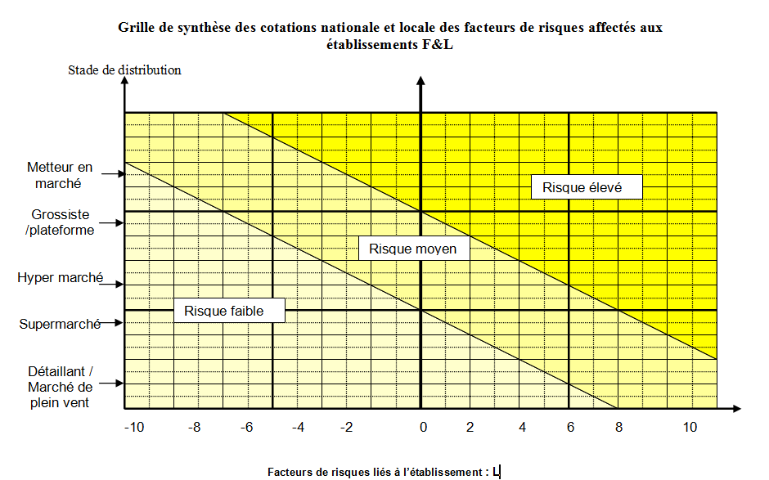

Slide 36
Risk analysis – new in 2014 for France
Update of the database
Focussing on the higher level of the trading chain (import, production, wholesalers)
Starting 2014, resumé in 2015.

