Slide 1
Training flow and structure – where are we?
Components of the training | Content-topics of the training
Intro to the training SFM and green economy principles
Review and analysis skills and methods. Spotlight on data gathering and analysis
Spotlight on wood energy Policy priority negotiation Policy drafting and review
Planning the process and methods for forestry plan/strategy for the green economy development. Training evaluation
Preliminaries and principles
Review and analysis
Policy development
Outcome: Improved understanding and skills

Slide 2
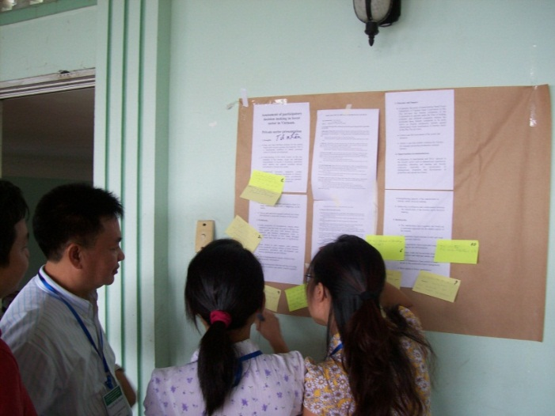
Method for participatory review of policies and strategies
In groups read the print outs you are assigned to.
Each group will then present their part to all participants.
No verbal questions or comments. If you have comments or questions use a sticky note/post it to write a comment on and paste on the sheet of paper.
Once every group has presented, they will then return to their component to spend time discussing the questions and comments.
Each group will briefly present their answers to the questions and comments.
Notes:
Note that a hand out/toolbox is provided to explain both the target scoring and the poster with post-it method. Throughout the training methods will be used that can then be applied to the participants’ own work. This is explained in the afternoon session.

Slide 3
Method for quick assessment, in this case performance of the forest sector against the following criteria
Score: 5= Excellent 4 = Good 3 = Moderate 2= Poor 1 = Very poor.
1. Achieving sustainable production and consumption of forest products
6. Inclusive forest policy processes that result in policies that satisfy all key stakeholder interests
2. Minimizing fossil fuel use and the generation of sustainably produced wood fuel based alternatives
1
2
1
2
3
3
4
4
5
5
5
4
3. Decent forestry jobs and forestry supporting livelihoods of local people
5. Data collection, management and analysis
3
2
1
4. Advancing ecological health, soil and water
Notes:
BIG SHEET: Prepare this on about the size of 3 flip charts. Do not be a perfectionist. Be sure to make the centre ‘5’ ring big enough for lots of X’s.

Slide 4
4. Intro presentation on effective forestry context analysis methods.
Example important topics to analyze in forestry and highlighting the importance of triangulation between social and technical approaches
Economic analysis
‘Social’ approaches –trying to capture subjectively – often more qualitative, values and views.
‘Technical’ approaches – trying to capture objectivity – often more quantitative
Social, rights, tenure, and cultural analysis
Ecological analysis
Silvicultural – forest management analysis
Forest policy, legislation and institutional analysis
Cross-sectoral analysis e.g. agriculture, energy
Notes:
Both technical and social approaches treated as equally valid in this training – some people even argue that perceptions ascertained through social approaches are more important than realities.

Slide 5
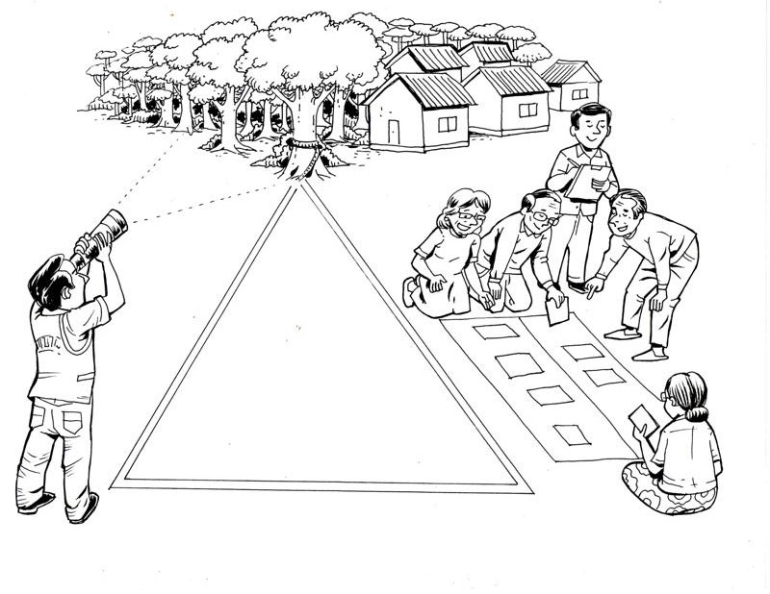
Example of triangulation/verification between social and technical approaches
Technical
‘Having mapped the forest area, there are only a few patches of good quality forest left. Wood use must be banned to protect them from destruction’
Social
‘According to elders the forest patches remain because they have customary rules to manage and use the forest. Stopping use will discourage management’
Also of course technical approaches are often useful to verify social approaches. Both approaches are complementary
Notes:
5

Slide 6
Comparing and contrasting technical and social analysis and review approaches.
 | Example key strengths | Example key limitations
Social analysis | Capture the human dimension – perceptions and reasoning which is key to understanding human behaviour. Subjectivity- what people believe is sometimes more important in determining behaviour than object reality. | Results are often not precise and lack standardisation so are often difficult to synthesis and accurately compare and contrast. Results often challenging to collate
Technical analysis | Aim towards objectivity–with the intention of having results that are free from human perceptions. Results tend to be precise and standardised so easy to compare and contrast. Results usually relatively easy to collate. | Results tend to lack a human dimension so there can be errors when technical data is used to extrapolate to human behaviour ( e.g. what motivates people to wisely manage or not wisely manage forests is not easily ascertained from forest inventories)
Notes:
Highlight the complementarity nature of both.

Slide 7
Comparing and contrasting technical and social policy context analysis approaches, some key characteristics.
Bias towards social methods in the practical exercises within this training.
We have generally found that forestry training is generally weaker in social methods rather than technical methods.
Also social methods often easier to try out in classroom.
This does not mean that we think that social approaches are somehow superior to technical approaches.
Tomorrow’s session on data gathering and management will focus mainly on technical approaches and the importance of rigorous technical assessment.

Slide 8
Social methods tool box for engaging stakeholders and for negotiation of SFM strategies.
Poster with post-it method
Quick target assessment method
We will gradually fill the methods toolbox( See big sheet on wall) during the training – a couple of methods were showcased this morning. These methods are also contained in the handout guide.

Slide 9
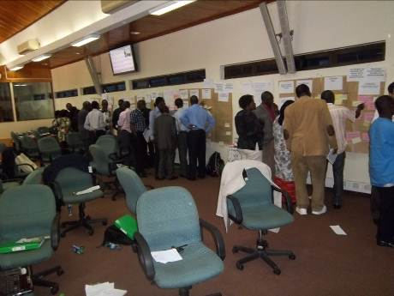
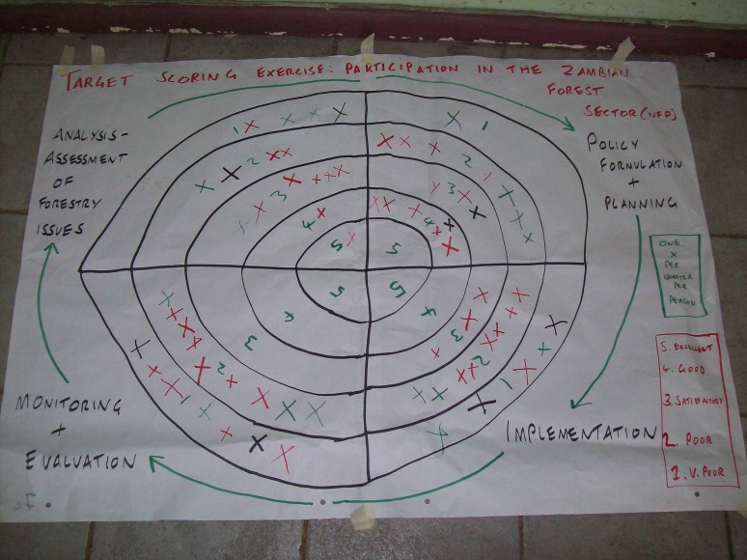
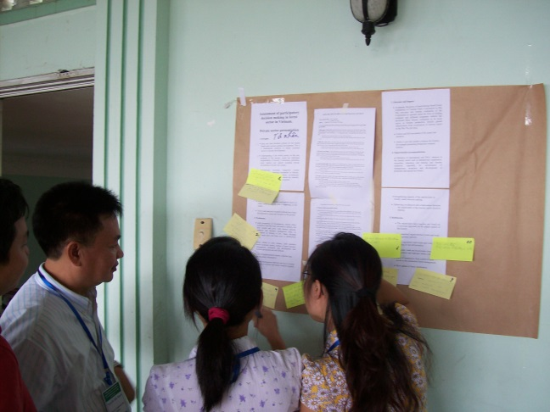
Analysis and adaptation of engagement and negotiation methods for potential use in helping shape SFM strategies in your own countries
1. Poster with post-it method
2. Target Scoring method
Reflect back on the methods. Strengths? Weaknesses? Recommendations for potential practical application/adaptation for use in forest sector reform in your country etc.?

Slide 10
Planning the process of the development of the forestry strategy/plan for a Green Economy
Implementation continues the cycle – maybe starting with pilots
Phase 5. Strategy/Action plan implementation – the strategy/action plan should have broad ownership thus should be easier to implement.
Stakeholder capacity building, communication and participation, monitoring and evaluation throughout
Phase 2. Context analysis – data gathering and analysis and analysing stakeholder perspectives
Phase 3. Action plan priorities negotiation – Enabling multi-stakeholder negotiations on priorities
Phase 1. Preparing for action plan development – identifying information gaps, who to involve and how?
Phase 4. Action plan drafting and review –drafting coherent strategy and seeking validation.

Slide 11
Methods tool box is provided in the handout for tools for engagement of stakeholders and facilitating negotiation in forest policy processes for a greener economy/SFM
Generic policy dev. process steps | Purpose | Methods
Step. 1 Preparing for forest policy development | Participatory review of an existing/old policy. | Poster with post-it.
 | Rapid analysis to identify perceptions on level of progress on development of key building blocks for sustainable forest management. | Target scoring.
 | Identifying who to engage and how in a policy process – i.e. those stakeholders that are affected by or who influence forestry. | Stakeholder mapping and analysis.
Step 2. Policy context analysis | Identifying relationships between stakeholders that are affected by or influence forestry | Relationship mapping
 | Identifying internal Strengths and Weaknesses and external/broader – enabling environment- opportunities and threats for the forest sector | Strengths, Weaknesses, Opportunities and Threats Analysis.
 | Probing to root causes of problems in the forest sector and identifying inter-linkages between causes. | Problem analysis
 | Identifying the balance in key incentives from the perspective of a forest user | Rights, revenue/benefits and responsibilities analysis
Notes:
A hand out will be provided with this toolbox of methods.

Slide 12
Methods tool box is provided in the handout for tools for engagement of stakeholders and facilitating negotiation in forest policy processes for a greener economy/SFM
Generic policy dev. process steps | Purpose | Methods
Step. 3. Policy priorities negotiation | Providing opportunity for all stakeholders to have a voice in a discussion and avoiding domination. | Fish bowl debate
 | Identifying collective priorities according to key criteria | Priority ranking.
Step 4. Policy drafting and review | Structuring policy components so that they feed into a goal | Solution tree
 | Developing a logically structured and realistic policy | Logical Framework approach
Step 5. Policy implementation and monitoring and evaluation | Gathering, analyzing, managing and being responsive to relevant data. | Tips and advice on monitoring and Evaluation
Notes:
PRINT OUT: for HAND out

Slide 13
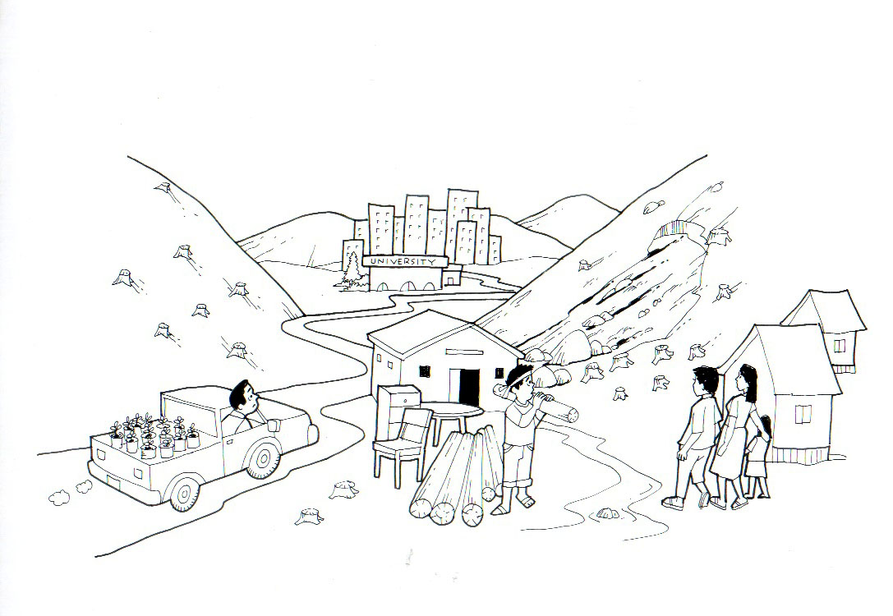
Why stakeholder engagement? There are diverse perspectives and different values in forestry depending on viewpoints.
University
We have to transfer technologies we have developed to fight soil erosion to the farmers
Non government Organisation. Those villagers need to understand the importance of forests to stop erosion. We will educate them and provide seedlings
Wood industry The demand for my furniture is growing and I pay good money for wood but the farmers are not interested in forestry
Forest users
We like forests but have no rights to sell forest products so I am not motivated to protect the forest or to plant trees. It is best to convert to grazing land.
Illuminating the perspectives and interests of different stakeholders is important to build a workable and inclusive and workable policy regarding Sustainable Forest Management for Greener Economy

Slide 14
Key skills in social analysis: The importance of probing
Superficial: Wants and superficial needs. Do you need? type questions
Skills
A key skill in social analysis is probing.
Symptoms: Actions and consequences. How? and What? type questions
Root causes: Deep rooted reasons. Why? type questions.
Sensitively probing
Sensitively probing
Notes:
14
If you ask people what they need, they often come with a superficial shopping list of things. The answer to ‘Why’ type questions usually give an insight into the perspectives of the person you are addressing.

Slide 15
Forestry social analysis methods practical. Hand-outs will be given to provide guidance on the purpose and procedure.
You will shortly be divided into 4 groups to practice/test these 4 different social analysis methods.
I will first describe the method procedure – as you won’t know yet, which group is doing what method, it is important to listen to all
Notes:
15
A handout will be provided with this role play scenario, this will also be the basis of the exercises on Day 2 afternoon and Day 3 morning. The role play provides a common frame of reference so that people from different countries can work together in group work. It also enables people to step back from their own context and in doing so often frees them up to think differently and express themselves more freely.

Slide 16
Forestry social analysis methods workshop
Some useful definitions.
Forestry stakeholder: Any individual, social grouping ( formally organised or an informal social category) or institution that will have influence on, be affected by, or be interested in forestry.
Communication: Mechanisms designed to inform.
Consultation: Mechanisms designed to get feedback from people on ideas.
Participation: Mechanisms designed to engage people in development of ideas.
Notes:
16
As always not definitive.

Slide 17
Stakeholder mapping procedure
Step 1. List 5( only 5 for sake of exercise and time available) categories of forest stakeholders and place names of stakeholders on separate cards. Have a mix of both most influential and affected stakeholders.
Step 2. Within your group consider the criteria on both axis and discuss where the stakeholders fit in the matrix – based on the current situation. Attach with masking tape once agreed.
High
Level of influence over forestry policies.
Low
How affected the stakeholders are by the consequences of those policies.
High
Notes:
BIG SHEET: Prepare one blank matrix – about two flip chart size, with the two Axis labelled as on the picture. Leave the matrix blank the blue cards are to illustrate meta cards to stick on. Then as with all methods like this, print out the slides – 1 page per slide, this one and the next slide as instructions

Slide 18
Stakeholder mapping procedure
Step 3. Within your group discuss where stakeholders should ideally be in the matrix in terms of influence and affectedness over forest policy.
High
Level of Influence on forest policy.
Low
How affected by the consequences of forest policies.
High
Notes:
PRINT OUT THIS and stick to the previous matrix as instruction.

Slide 19
Stakeholder engagement strategy development
Part 2 of the exercise – developing suitable communication, participation and consultation mechanisms.
1. Write down the stakeholders from the stakeholder analysis exercise in the appropriate column in the matrix that follows. Aim to list them in priority, with those with the biggest desired movement/ longest arrow from the previous exercise first.
2. List appropriate communication and participation mechanism/measures/ methods in the other columns.
3. With the purpose in mind( e.g. giving affected stakeholders more influence, or making influential stakeholder more affected/accountable) now try to match up stakeholders with suitable mechanisms/methods by joining them up with arrows.
4. If any stakeholders are not addressed by a suitable method, add more methods. Be innovative – formal and informal methods, but also be realistic.
5. Identify volunteers to present the 1) purpose and procedure of the methods, 2) To present the results of the stakeholders analysis and 3) to present the findings of the stakeholder engagement strategy tool box.
Notes:
PRINT OUT and stick to next slide matrix as instruction.

Slide 20
Stakeholder engagement strategy development toolbox
Participation and consultation tools/ measures | Match tool to stakeholders | 5 categories of stakeholders | Match tool to stakeholders | Communicat-ion tools and measures
Notes:
BIG SHEET: Prepare the blank matrix, about 6 flip charts, 3 wide and 3 deep.

Slide 21
Problem analysis procedure
Effects
Sustainable Forest Management investment( time, effort, resources)not attractive for local people or private sector
Problem
Causes
Root Causes
Notes:
BIG SHEET: Should be prepared on 6 flip chart size. 3 wide and 2 deep. Do not include the cards, leave blank. Leave 3 times as much space below the problem as above it. Then print this slide out and the next 3 and stick on the big sheet for instructions – somewhere convenient.

Slide 22
Problem analysis procedure
Procedure:
Step 1. Give out cards and markers to all and brainstorm on cards to identify causes of the problem – only one clear idea per card. Limit the number of cards per person, 2 cards maximum per person to be democratic.
Step 2. Ask for any necessary clarifications/justifications on what has been written by people. Give cards back to author if ideas are unclear, so that they rewrite.
Step 3. Now collectively arrange cards so that cause- cause linkages are in proper sequence, more immediate causes are closer to the problem and more underlying causes are further down. Group similar cards and label groupings on A4 paper or different coloured cards.
Notes:
Print out and stick to problem analysis

Slide 23
Problem analysis procedure
Procedure:
Step 4. Now think of underlying – root causes. Ask WHY? are the other causes happening? What is causing them? Limit the number of cards per person for example a maximum of 1 -2 cards per person. Try to get as far down to the root causes as possible – keep as WHY?
Step 5. Move onto effects above the problem and in a similar way sort them to show the linkages between effects( although if time is short causes should be prioritized)
Step 6. Once the problem analysis is complete and cards are in order, draw appropriate linkages between cards/groups of cards using arrows. Discuss the logic of the findings.
Notes:
Print out and stick to problem analysis

Slide 24
Problem analysis procedure
Procedure:
Step 8. Solution analysis, inverse the problem statement so that it becomes a Goal statement( e.g. Sustainable Forest Management attractive for local people and private companies). Try to begin with the root causes – and move up through the causes, trying to think of feasible solutions to address them. Write on cards of different colour and add on top of/ or beside the the causes.
Step 9. Select representations to present the
problem analysis purpose and procedure.
results of the problems analysis
Results of the solution analysis
Notes:
Print out and stick to problem analysis

Slide 25
Rights( ownership), revenues( benefits) and responsibilities analysis procedure
 | Rights ( Tenure/ownership) over the forest ( 10 = complete ownership, 0= none) | Revenues and benefits. ( 10 = maximising benefits from sustainable forest management, 0= not realising any benefits from sustainable forest management) | Responsibilities. Motivation for sustainable forest management( 10 = very high, 0= none)
Current situation for forest communities
 | Tenure/ownership over the forest | Revenues and benefits. | Responsibility. Motivation for sustainable Forest Management
Ideal situation for forest communities in ideal Sustainable Forest Management for a Green Economy
Notes:
25
BIG SHEET: Size of 6 flip charts, three wide and two deep. Leave as much space in the white sections as possible, less space in the blue sections. Print this out and the subsequent 2 slides as procedures and paste on.

Slide 26
Rights( ownership), revenues( benefits) and responsibilities analysis procedure
Procedure.
1 Brain storm on what tenure, users rights and responsibilities exist using cards on the top row for the current situation.
2. Now either using counters or numbers assign a score out of 10 according to how you feel about your tenure, user rights and tenure. 10 is complete, 0 is nothing. Work out percentages.
3. Now follow the same procedure for the second row for the ideal situation with sustainable forest management for greener economies fully functioning. What would be the ideal amount and balance of rights, benefits and responsibilities for community members?
Notes:
26
Print out and stick to the sheet with the previous matrix on it

Slide 27
Rights( ownership), revenues( benefits) and responsibilities analysis procedure
4. Identify shift in percentage between present situation and ideal situation.
5. Discuss the connection between the balance in the 3 columns before and after. Are the incentives from rights and revenues sufficient to promote responsibilities for sustainable forest management?
6. Decide at least 3 feasible forest policy recommendations that would help lead to a better balance between rights, revenues and responsibilities with the aim of further developing sustainable forest management. This can be done by brainstorming ideas on cards, then discussing and agreeing on common recommendations that emerge.
7. Write the recommendations on a flip chart.
8. Assign presenters to explain the 1) purpose and procedure of the method, 2) explain the findings and 3) finally explain the feasible policy recommendations.
Notes:
27
Print out and stick to the sheet with the previous matrix on it

Slide 28
Strengths, Weaknesses, Opportunities and Threats(SWOT) Analysis procedure
SWOT analysis of forest sector against Sustainable Forest Management/Green Economy principles
Strengths related to forest management implementation | Weaknesses related to forest management implementation | Opportunities within the broader enabling environment + (e.g. international trends, market forces, other sectors, policies etc.) | Threats within the broader context -(e.g. market forces, other sectors, politics etc.)
Feasible recommendations to mainstream SFM – greener economy in implementation |  | Feasible recommendations to mainstream SFM – greener economy in the enabling environment
Notes:
BIG SHEET: make on 6 flip chart size, 3 across and 2 deep. The headings should not take up as much space as a proportion of the total diagram, rather they should take up as little as possible. The most space should be below the headings. The rectangles are just examples of where the cards should go. Print this out and the next two slides as instructions.

Slide 29
Strengths, Weaknesses, Opportunities and Threats(SWOT) Analysis procedure
1. Within the group give out cards and markers to all.
2. Explain the matrix and procedure, including one idea per card and maximum of two cards per person per column in the matrix.
3. Clearly explain the difference between strengths and weaknesses of implementation –e.g. how is forest management actually implemented now( strengths and weaknesses) and the opportunities and threats in the broader enabling environment that forestry operates within.
Notes:
Print and stick on the SWOT analysis.

Slide 30
Strengths, Weaknesses, Opportunities and Threats(SWOT) Analysis procedure
4. Start with Strengths and Weaknesses, before moving on to Opportunities and Threats.
5. Group similar cards and label key groupings with different coloured card or A4 white paper, this should be done after each column is complete.
6. After completely the Strengths and the Weaknesses have a facilitated discussion of the analysis so far, thinking about either building on strengths or tackling weaknesses develop feasible policy recommendations to better develop sustainable forest management/ a greener economy.
7. Do the same for recommendations below the opportunities and threats column.
8. Assign presenters to explain the 1) purpose and procedure of the method, 2) explain the results of the Strengths, Weaknesses and Recommendations and 3) Explain the Opportunities, Threats and Recommendations.
Notes:
Print out and stick on the SWOT analysis

Slide 31
Group work guidance
1. Appoint a facilitator within the group – they should be neutral and help to organize the participation and analysis within the group . They must carefully read the procedure and explain it to the group.
2. Use cards where possible. This enables all to take part and have their ideas considered.
3. Write on cards first, put the cards up and view them before having discussions.
4. If you disagree on something, try to find compromise, meet in the middle – give and take on a compromise idea. If you can’t find compromise, agree to disagree and go with the majority – hands up. If a disagreement persists write the cause of the disagreement on a card and move to the ‘Parking lot’.
5. Select different presenters, one to present the purpose and procedure of the method, one to or two to present the findings.

Slide 32
Presentation of methods outputs for peer review
1. Either participants move around the 4 presentations or the 4 presentations are brought one by one to the front, whatever is more convenient.
2. Keep the presentation concise( Around 10 minutes in total), you do not have to read out everything, just make key points.
3. Questions should all be asked at once, and answers will all be given at once.

Slide 33
Plenary discussion on findings from forestry context analysis
Similarities in challenges emerging to SFM/Green Economy. Any similarities with regards to the key challenges emerging from the exercises regarding mainstreaming/implementing a greener economy/Sustainable Forest Management? What seems to be the key common challenges?
Similarities in recommendations that have emerged? Any similarities in concrete ideas to address the challenges? What are the main recommendations that have emerged? Are they feasible/realistic?
Would different stakeholders have different perspectives? If these exercises had been conducted with different stakeholders, for example local communities themselves, do you think the findings would be different? How different would they be?

Slide 34
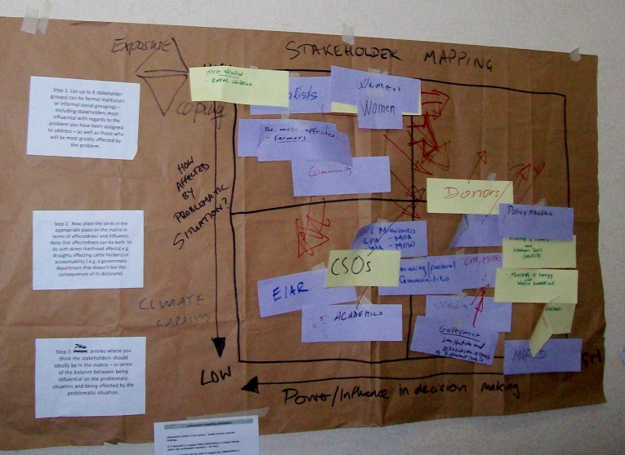
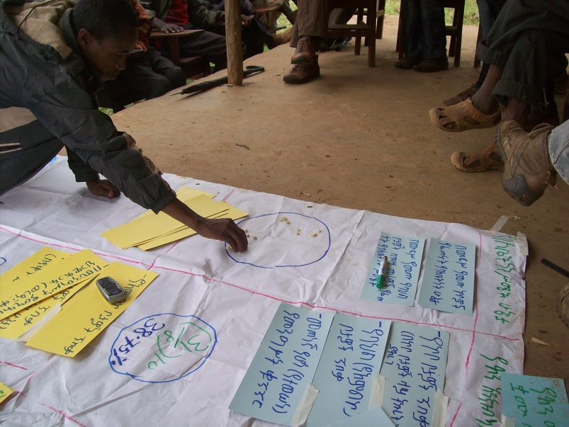
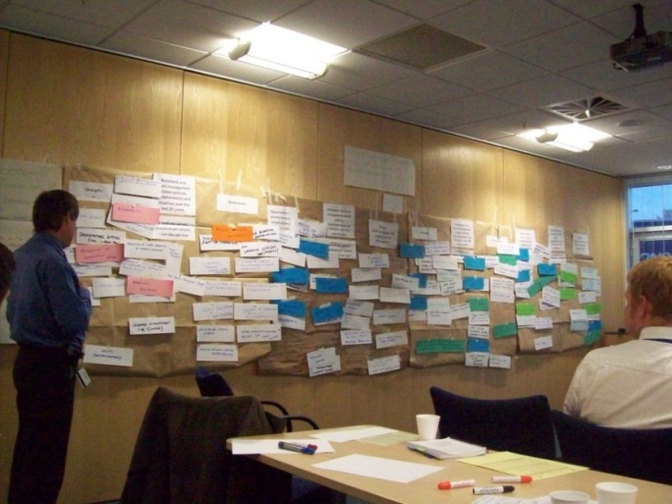
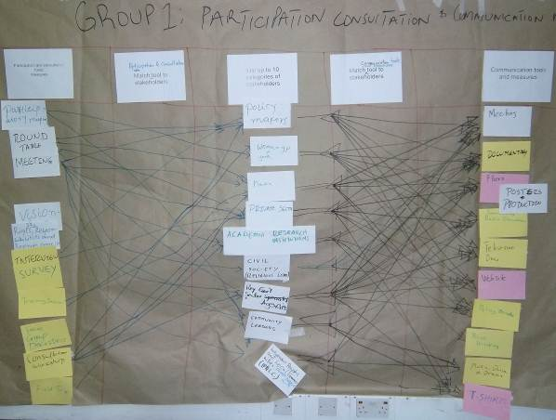
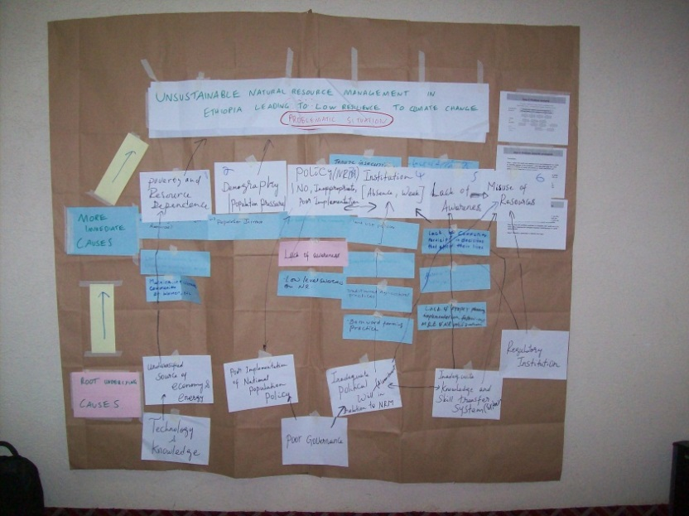
Plenary discussion on social analysis methods used
2. Rights, responsibilities, revenue analysis
Strengths of method?
Weaknesses of method?
1. Stakeholder mapping
4. SWOT analysis
3. Problem analysis
Recommendations for application/adaptation to Kazakhstan?

Slide 35
Social methods tool box for engaging stakeholders and for negotiation of SFM strategies.
Quick target assessment method
Poster with post-it method
Stakeholder mapping
And participation/communication strategy development
Rights, Revenues and responsibilities analysis
Problem Analysis
Strengths, Weaknesses, Opportunities and Threats Analysis
Notes:
BIG SHEET: Make a big sheet shaped like this and have the tools on A4 ready to stick on.

Slide 36
Training delivery/approach reflection
Training delivery reflection team.
In your team discuss the following – write the answers on a flip chart.
What were the key lessons/insights that were generated today?
What training approaches/methods were used today? Which were the most effective for learning and why?
Any recommendations of how to improve the training delivery for today – adapt to your country context more?
Volunteer(s) should present the answers concisely 5 minutes, first thing tomorrow morning.
Notes:
BIG SHEET: Prepare a flip chart with Key relevant lessons from today as a heading

