Slide 1
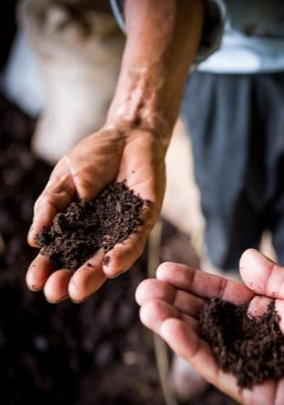
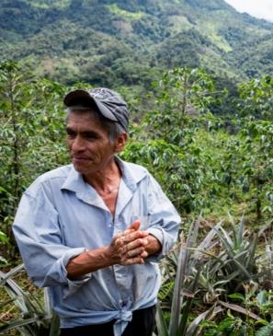
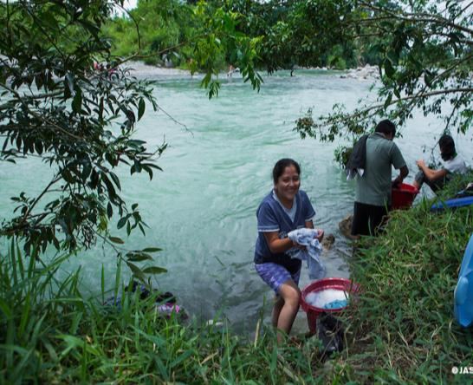
Inspire change so people and nature thrive
Notes:
The greatest challenge to managing forests for food and food for forests might well be human behavior – at least this is what Rare has found over the past 30 years. People act both on reason and emotion – by brining together logic with the powerful emotion of pride — pride of place, pride in community, pride in tradition Rare has developed an approach to inspiring pride in unique natural assets and creating a clear path for local change.
Rare builds the capacity of local partners to motivate behavior change just like the private sector has done for years. Our mission is “to inspire change so people and nature thrive”. What I’d like to share with you today is how we’re involved in the “Food for Forest process” using an example from Latin America, Colombia in particular. This example places local food production and the potential for a more sustainable supply chain within a local development landscape and opportunity for scale. Let me first tell you a little about Rare.
With 150 on staff around the world with offices in Brazil, Mexico, the Philippines, Indonesia and China, we have run more than 300 campaigns with local partners to inspire change in more than 50 countries. Our budget this year is around $25m mostly from philanthropic and some government grants.
Our campaigns are a bit different than conventional resource management programs.
They focus on behaviour change through social marketing – I am not talking about social networking - Facebook or Twitter – although they’re increasingly important.

Slide 2
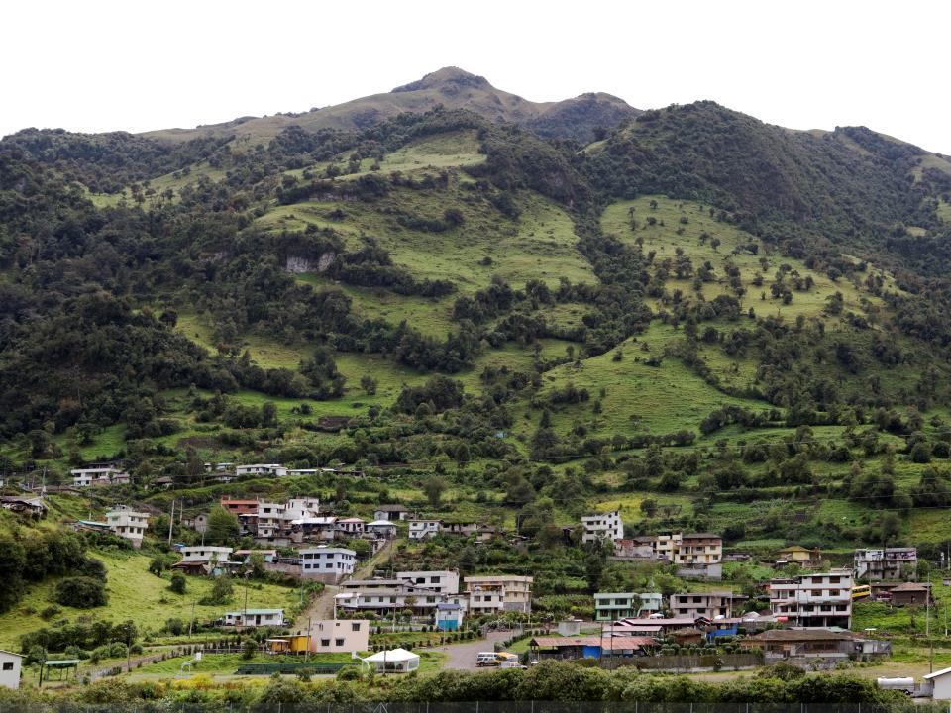
Landowners receive incentives to conserve watershed habitat – like barbed wire to keep cattle out of rivers, bee hives or shade-grown coffee.
Communities take pride in their efforts to conserve forests and grasslands.
Downstream water users pay into a fund, often through their water bill, which finances incentives for upstream landowners to conserve land.
People and nature benefit from a cleaner and more reliable
water supply for farming and drinking.
Notes:
So how does it work? We focus on communities managing natural resources – such as forests and watersheds – just as much as those who depend on those resources. Through personal engagement, we build the capacity of local partners to uncover what people think and feel about a given problem, what motivates them to change and what they need to make a change.
In Colombia, what started as a question about forest conservation became quickly a question of the range of services provided by forests and the connection between upstream and downstream users.
To create the conditions for better managing cloud forest, Rare’s Pride campaign focused on the cultural value of reciprocity – the cultural connection between upstream and downstream communities; CLICK it generates ownership of a local fund and a set of principles that motivate the behaviour change CLICK that provides upstream farmers with the non-cash benefits they need CLICK and it underpins the Pride communities take in their collective success.
In summary, the PRIDE campaign delivers:
Permanent financial mechanism
Local institutionalization
Long-term agreements that generate a wide range of social benefits
A fundamental difference between this and a number of other watershed payment programs is that ARAs do not involve cash payments.

Slide 3
Notes:
So what does this look like by the numbers:
22 Campaigns
8 local water funds
Over 300 Reciprocal Agreements
¾ of a million people as forest and water stewards
But the question we have is how can this ultimately create change on a national scale?
The value of this approach has been recognized by one of the leading regional water authorities in Colombia – the Corporación Valle del Cauca (CVC). This semi-autonomous government entity will be paying for the next phase and becoming our “scale partner”. CVC will essentially double the number of campaigns and impact of the program.
And what’s truly exciting about this model is that it can be applied in watersheds throughout Colombia, the Andes, and we expect in other parts of the world. In Colombia alone there are 33 equivalent organizations like CVC and the Government of Colombia has expressed interest in the model.

Slide 4
Integrated landscapes – climate compatible development
Habitat protection
Food security
Institutional innovation
Improved water quality
Expectation of Impact
Fire control
Species protection
Improved Livelihoods
Flood prevention
Notes:
If we look at the campaigns’ benefits – which include local food security, clean sustainable water, biodiversity benefits, and communities resilient to climate change – we can see the usefulness of working within a more integrated development landscape.
I would suggest that as we adopt and start to implement the post 2015 Sustainable Development Goals this will become increasingly important.
So in closing, I have hopefully provided you with some food for thought, that:
Behaviour change is critical and
At community level, we can usefully place food and forest within a connected landscape and empowering those communities inspire and sustain change

Slide 5
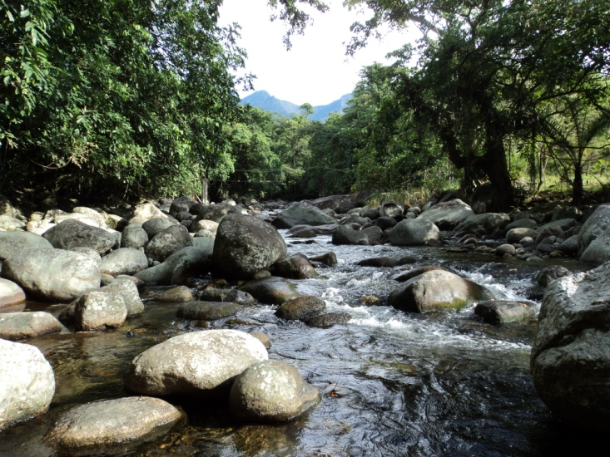
https://www.youtube.com/watch?v=nj7P30Q07F4
Notes:
Let me leave you with the people community leaders who are transforming forest management in their municipalities and the water that is not only connecting ecosystems and fundamental to food supply but is also a source of PRIDE and connecting communities to one another in a lasting way.
Thank you so much for your interest in our work, for the opportunity to present today, and congratulations to FAO and ECE for this celebration of International Forest Day.

