Slide 1
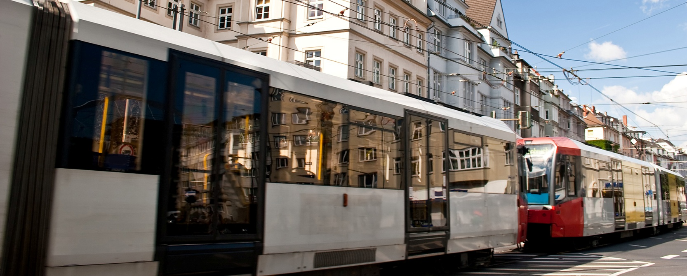
Economic Impacts of Non-Technical Measures for Emisison Reduction in Transport
The PEP Workshop, 27.9.2013, Almaty
Claus Doll, Fraunhofer ISI, Germany

Slide 2
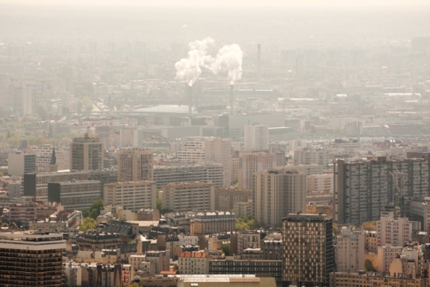
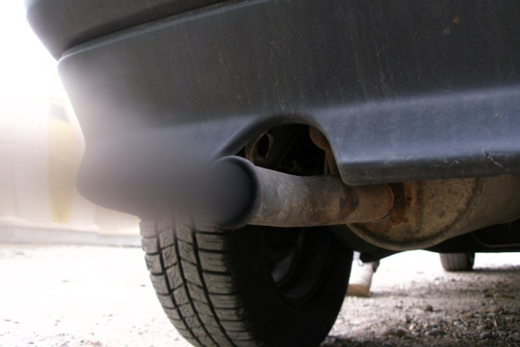
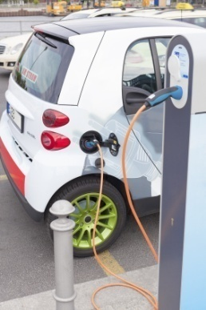
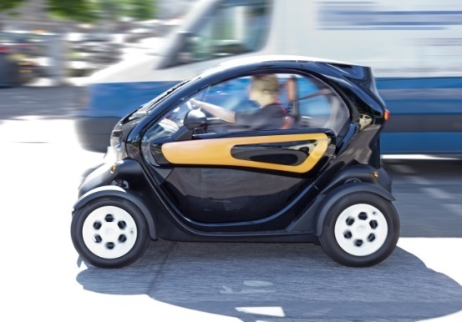
Clean air in cities through clean cars
More efficient motors and new propulsion technology
90% reduction of most pollutants in road transport since 1990
50% reduction in road fatalities

Slide 3
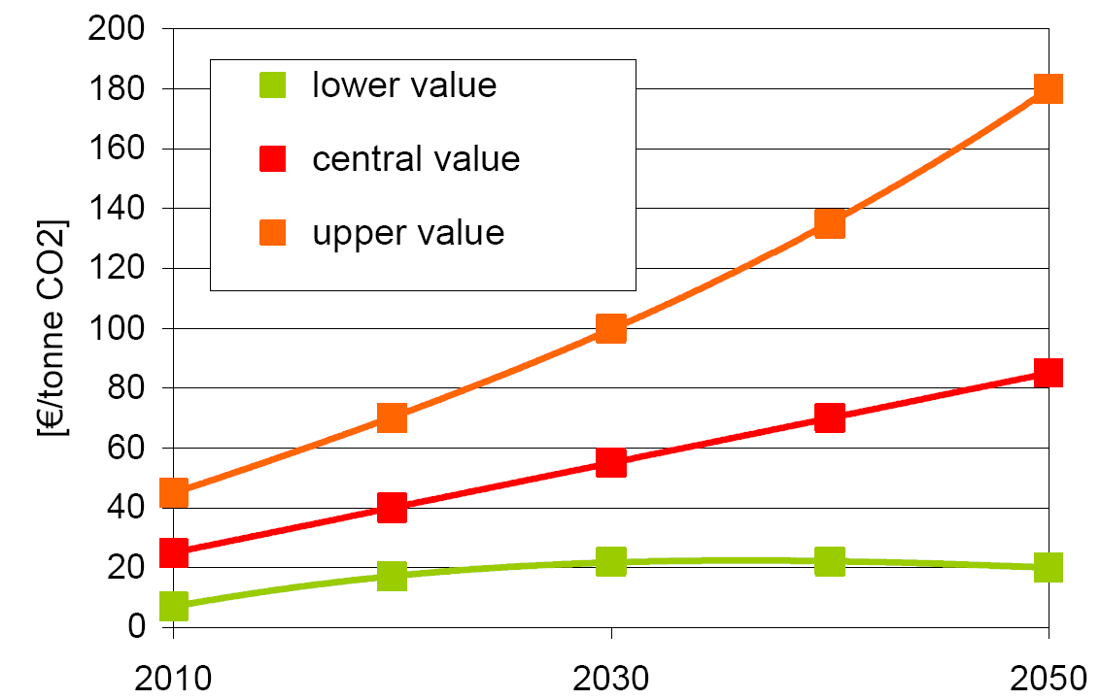
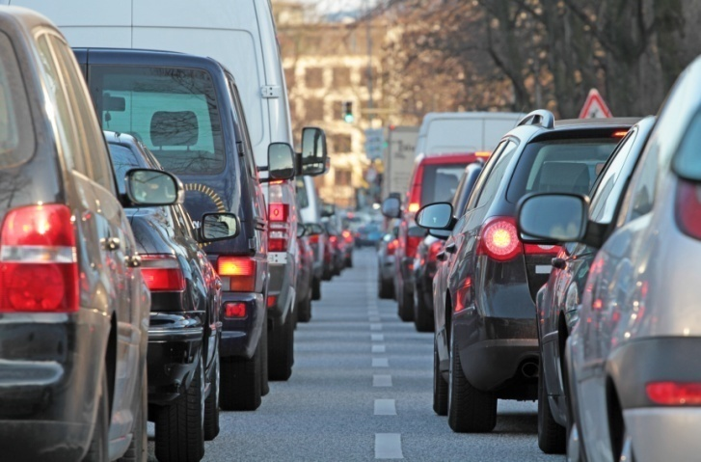
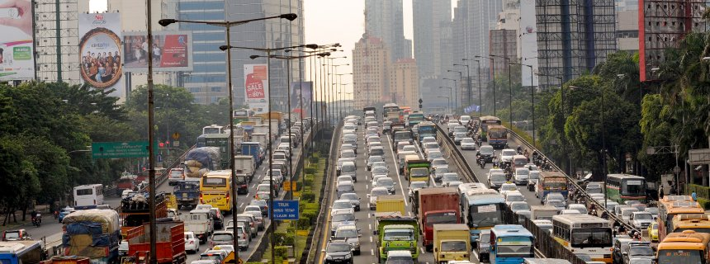
Background: Past and Future of Road Transport‘s Environmental Effects
... but more cars lead to
Congestion and a huge waste of time
Rising CO2 emissions together with increasing damage per ton of CO2
More accidents, particularly with vulnerable road users
More noise pollution with serious health implications
Valuation of CO2 emissions

Slide 4
Total external costs of transport in Europe 2008: 515 bn. € or 1000 € per inhabitant

Slide 5
Estimates of average delay costs in European countries

Slide 6
Decades of fostering car free travel in European cities - no measurable effect
Data source:
Eurostat Urban
Audit Database

Slide 7
The Study „Economic Aspects of Non-Technical Measures for Emission Reduction in Transport“
Core research questions:
Does low emission and sustainable mobility pay off for the user?
Which consequences do sustainable mobility patterns have for society?
By which instruments can we achieve the ecological reconstruction of curent mobility systems?
Client: German Federal Environment Agency (UBA)
Projektteam: Fraunhofer ISI, Karlsruhe (lead)
INFRAS, Zürich
IFEU, Heidelberg
Laufzeit: Nov. 2009 – Oct. 2012
Internet: www.ntm.isi-projekt.de

Slide 8





The case studies: five measures for reducing emissions in transport
Measure1:
10 %-points
more cycling
and walking
in clities
Measure 2:
10 %-points
more bus
and tram
in cities
Measure 3:
10 % shorter
journeys on
all relations
Measure 4:
10 % less
fuel use
per person on
all car trips
Measure 5:
10 %-points
more rail in
long-distance
freight
Individual level:
What do these measures
mean for the user?
Macro-economic level:
Which impacts does the
implementation of the measures
have on the economy?
Policy level:
Which instruments are
suitable to implement
the measures?

Slide 9
Cost categories and data sources
Kategorie | Indikator
Private costs | Total user costs of mobility incl. purchase and maintenance of vehicles: fuel, parking and tickets (ADAC, DB, BVG, Stadtmobil, etc.)
Travel and wait time | Benefit of lower travel time by trip purpose: business: 23,48 €/h, commuting 8,48 €/h, private 7,10 €/h. Social benefits: 3,50€/h. (EU Handbook ext. costs 2008, fed. investm. plan).
Health | Up to 50% lower heart infarct risk with regular exercising. Corresponds to 2000 €/month and person acc. to state of fitness (WHO HEAT Tool, DeStatis)
Traffic safety | External accident costs by means of transport and road type; value of statistical life of 1.6 mill. € (UIC 2011)
Environment, climate. noise | Climate change consequences (80 – 145 €/t CO₂) plus health risks and building damages by air pollutants and noise (UBA methodological convention 2012)

Slide 10
The PExMo mobility cost calculator
Features:
Tool in MS Excel
Multi-modal trip chains
Cars by size and emission class
Single and season tickets for PT, rail and Carsharing
Time costs by trip purpose, mode and level of congestion.
External costs of climate change, air pollution and noise by mode, urban/rural environment and time of day
Frei verfügbar unter:
www.ntm.isi-projekt.de/downloads.php

Slide 11
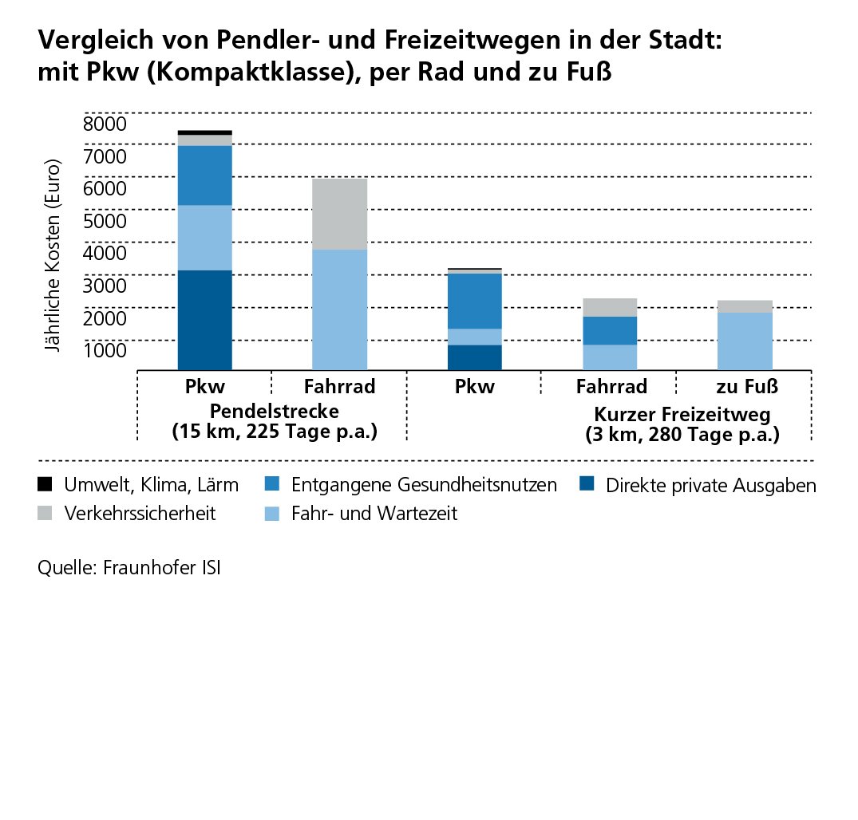
Personal benefits of more cycling and walking
Example:
Commuting (15 km, 250 days/a); cycling instead of driving a car. Direct and indirect annual savings:
Car owning and use: +3100 €
Health benefits +1900 €
Environment, noise + 150 €
Travel and wait time -1700 €
Safety -1900 €
Total +1500 €
Comparing commute and leisure trips in cities with car (compact), PT, bike and walking
Annual costs (euros)
Car Bike
Commuting 15 km
Car Bike Walk
Short leisure trips 3 km
Environment *
Safety
Lost health benefits
Travel & wait time
Direct private costs
* Including climate and noise
Source: PExMO-Tool (Fraunhofer)
Impacts:
Car size, exhaust standard, number of passengers
Length and type of route, state of fitness of the traveller

Slide 12

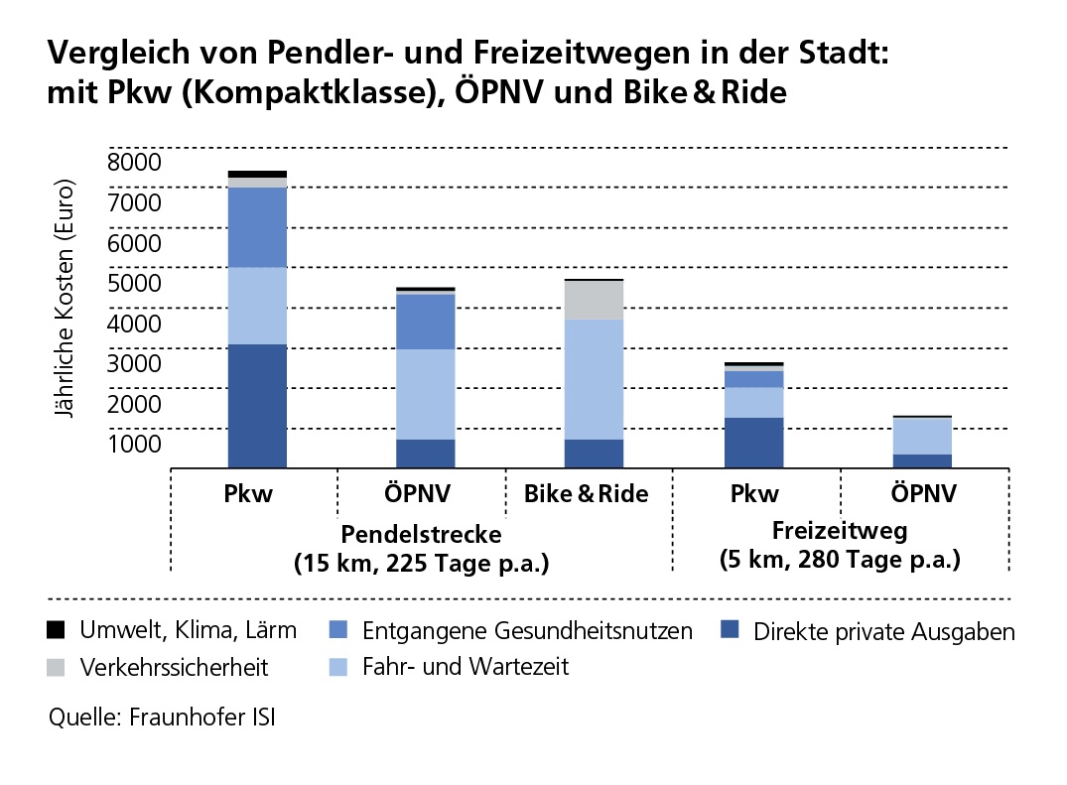
Personal benefits through more public transport use
Example:
Commuting (15 km, 250 days/year) by bus/tram instead of car. Direct and indirect savings per year
Car and tickets:^^ +2300 €
Health impacts + 600 €
Safety: + 200 €
Environment, noise + 100 €
Travel and wait time - 300 €
Total +2900 €
Annual costs (euros)
Car Tram Bike & Tram
Commuting 15 km
Car Tram
leisure trips 3 km
Environment *
Safety
Lost health benefits
Travel & wait time
Direct private costs
* Including climate and noise
Source: PExMO-Tool (Fraunhofer)
Impacts:
Size, age, emission standard and occupancy of the car,
Distance from / to public transport stops, number of interchanges, occupancy rate and
environmental friendliness of bus and tram fleet.

Slide 13
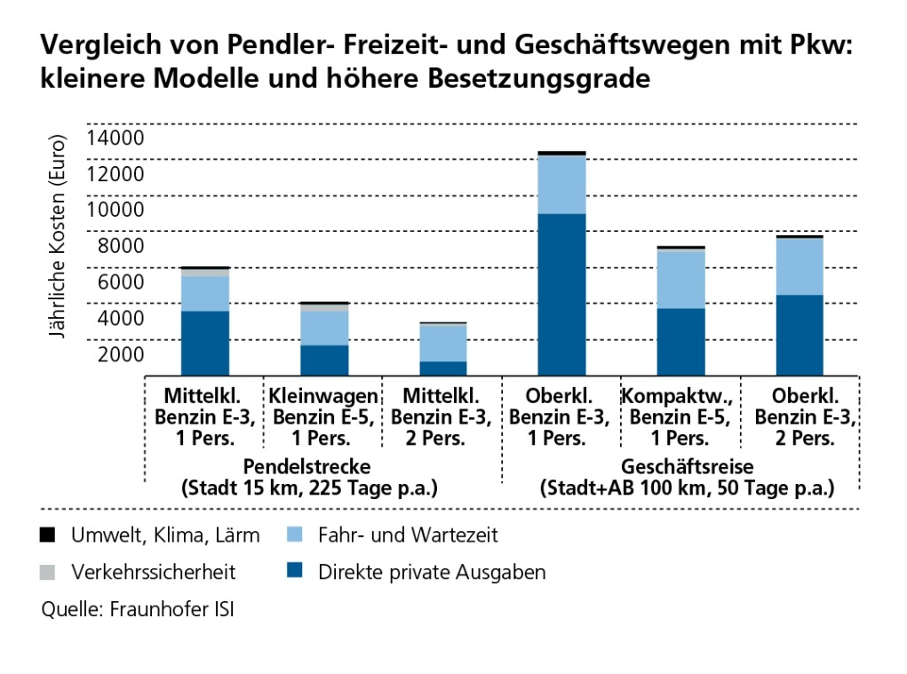
Personal benefit of more efficient car use
Example:
Commute (15 km, 250 days/a) by car with 2 instead of 1 person. Direct and indirect savings per year:
Car owning and use +1800 €
Safety + 200 €
External impacts + 100 €
Health impacts 0 €
Travel and wait time 0 €
Total + 2100 €
Comparing commute, leisure and business trips in cities with car of different size and occupancy
Annual costs (euros)
Mid class Small Mid class
petrol E3 petrol E5 petrol E3
1 person 1 person 2 persons
Commuting 15 km
Upper cl. Compact Upper cl.
diesel E3 diesel E5 diesel E3
1 person 1 person 2 persons
Business trip 100 km
Environment *
Safety
Travel & wait time
Direct private costs
* Including climate and noise
Source: PExMO-Tool (Fraunhofer)
Einflussgrößen:
Pkw-Größe, Umweltstandard und Anzahl der Insassen
Zeitaufwand zur Erhöhung des Besetzungsgrades

Slide 14
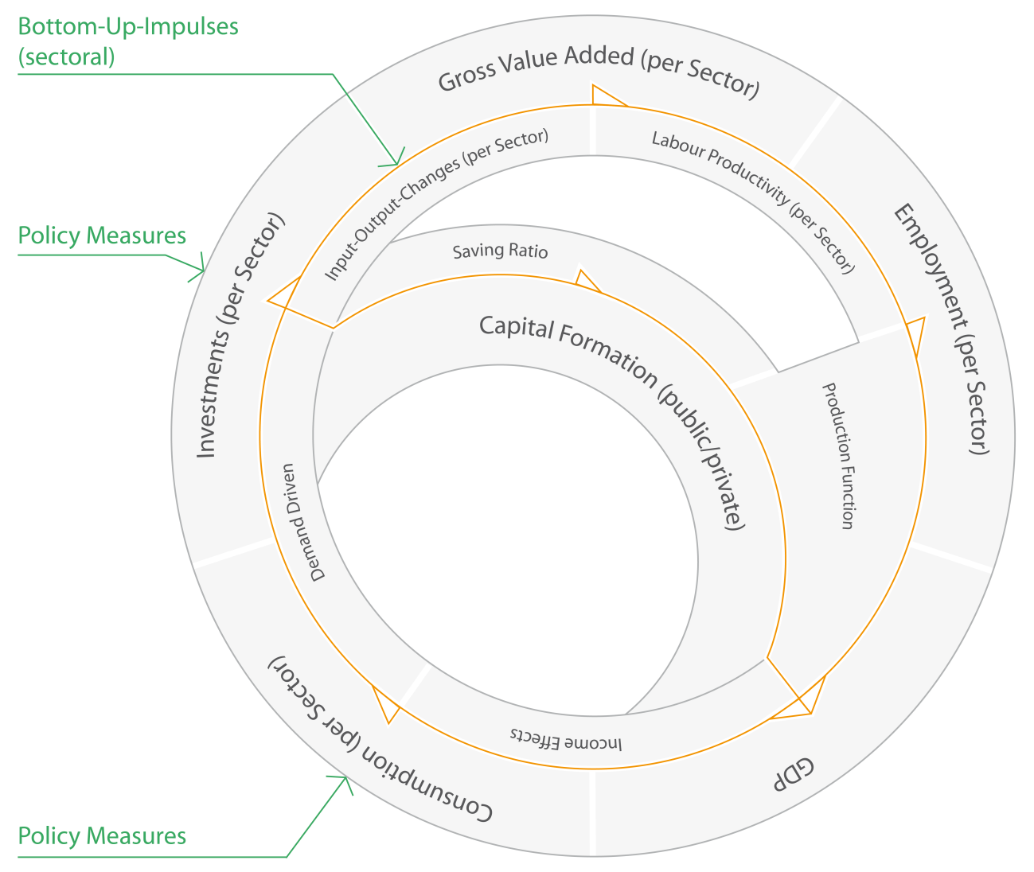
Macro-economic modelling approach with ASTRA
System dynamics model ASTRA-D:
Developed since 1998 for EC and German institutions
Closed macro-economic feedback model
Integrated consideration of transport and economic sectors
Time sequence of policy measures possible
Modeling of second round effects
Detailed computation of emissions by mode and time

Slide 15
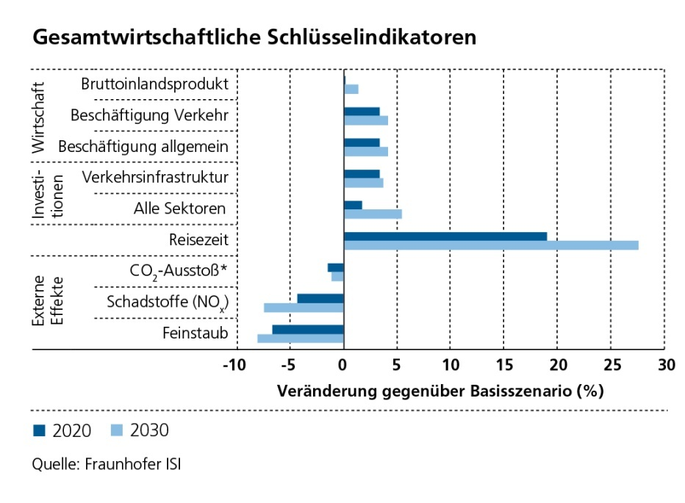
Macto-economic benefits of more active mobility
Instruments:
Parking fees, congestion charges
Investment in cycle lanes
Advertisement and campaigns
More cycling helps public transport. Doing so we provide a real alternative to the private car.
The environmental alliance creates investments and jobs (+4%), which more than balance less production in the automotive industry.
Travel time increases also in remaining car travel due to de-acceleration measures. Well received in times of increasing stress and burn out.
Emissions: air pollutants (-8%) decline more intensively than CO2-Emissionsn (-2%) due to energy use of public transport.
Macro-economic key indicators
Macro-economic key indicators
Gross domestic product
Employment transport
Emplayment general
Infrastructure transport
Infrastructure general
Travel time
CO2 emissions
Pollutions (NOx)
Particles (PM)
Change to scenario without measures (%)

Slide 16





Selected macro-economic indicators: measures compared to base case
M1:
cycle &
walk
M2:
public
transport
M3:
shorter
paths
M4:
fuel
efficiency
M5:
rail
freight

Slide 17
Comparison of macro-economic costs and benefits – without travel time
Curr. value 2010
(bill. Euro)
Benefit- and cost categories | M1 Walking & cycling | M2 Public transport | M3 Shorter trips | M4 Fuel efficiency | M5 Rail freight
Health benefits | 11,53 | 18,67 | 12,60 | 17,40 | 0,00
Safety benefits | 0,64 | 0,40 | 6,93 | -0,01 | 0,11
Environment etc. benefits | 0,49 | 0,27 | 3,06 | -2,28 | 3,46
Total benefits | 12,66 | 19,34 | 22,59 | 15,11 | 3,57
Investments and operations | 1,29 | 2,41 | 11,02 | 0,20 | 1,73
Benefit-cost- ratio | +9,8 | +8.0 | +2,1 | +75,5 | +2,1
* Ohne Zeitkosten

Slide 18
Comparison of macro-economic costs and benefits – with travel time
Benefit and cost categories | Unit | Cycling& walking | Public transport | Shorter car trips | Efficient car use | Rail freight
Time benefits | Present value 2010 * Bill. euros | -63,26 | -51,35 | -55,25 | -28,99 | -1,34
Health benefits |  | 11,53 | 18,67 | 12,60 | 17,40 | 0,00
Safety benefits |  | 0,64 | 0,40 | 6,93 | -0,01 | 0,11
Environmental benefits |  | 0,49 | 0,27 | 3,06 | -2,28 | 3,46
Total benefits | Present value 2010 * bill. euros | -50,61 | -32,01 | -32,66 | -13,89 | 2,23
Benefits without time |  | 12,66 | 19,34 | 22,59 | 15,11 | 3,57
Investments |  | 1,29 | 2,41 | 11,02 | 0,20 | 1,73
Benefit-cost ratio (BCR) | Ratio | -39,2 | -13,3 | -3,0 | -69,4 | 1,3
BCR without time |  | 9,8 | 8,0 | 2,1 | 75,5 | 2,1
BCR for environment |  | 0,4 | 0,1 | 0,3 | -11,4 | 2,0
* Net present value with 2020 and 2030 values

Slide 19
Success factors to shift people away from the private car
Most important: classical hard facors of public transport supply:
Network density
Costs
Travel speeds
Soft factors relevant, but less expressed:
Safety (accidents + crime)
Staff (friendliness)
Source:
USEmobility project
EC 7th Framework Programme)

Slide 20
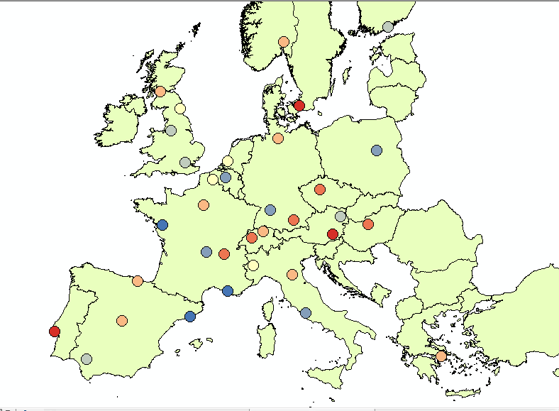
Linked success of public transport, walking and cycling policies
Survey on UIPT Urban Mobility Database: Main success factors for public transport use:
Quality of supply (vehicle kilometres)
Generalised costs in relation to cars
Number of bike parking places
Percentage of green areas in cities
Success of walking & cycling closely linked to PT
With good and complete alternatives people are ready to go without car

Slide 21
Recommendations
The case studies show, that transforming mobility systems to a more sustainable one is possible and pays off for the individual and the society
In addition to environment and climate protection transport users users save money. In addition they experience a considerable health benefit when cycling or walking more of up to 2000 €/year.
For shifting travel demand away from the private car, investments in cycling and walking infrastructure and in PT are required. This mostly balances out income declines in the automotive industry.
Transport systems may be successfully transformed by setting prices and fees, various regulatory measures, attractive and high capacity PT services as well as a modern region and city concepts (city of short paths). Most powerful are combinations of push and pull measures.

Slide 22
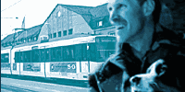
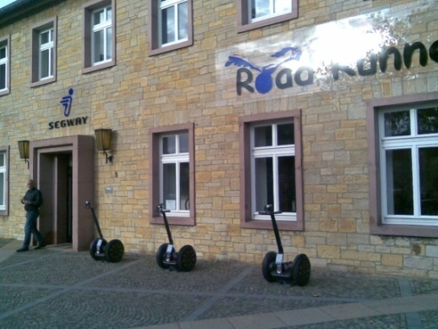
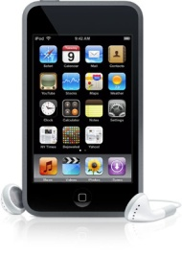
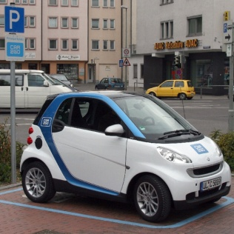
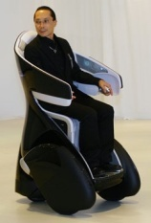

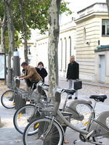
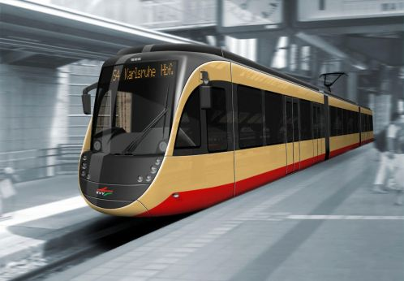
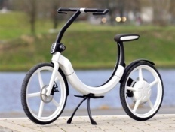
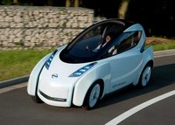
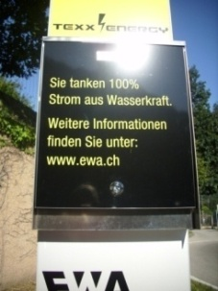
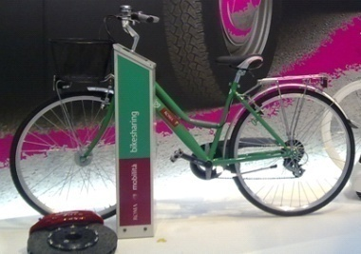
Positive Vision 2050: Seamless and sustainable mobility
New personal transporters (PT)
Reservation Using Information Billing
PTAs
Car-sharing
Mobility Card
PT / Bike-sharing
Modern public transport
Electric city cars

Slide 23
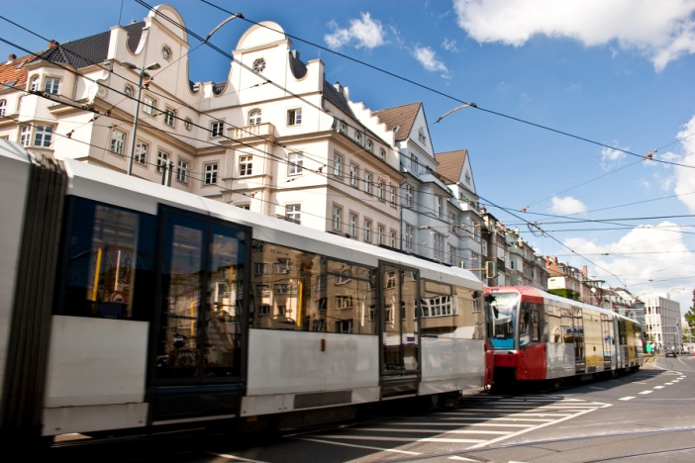
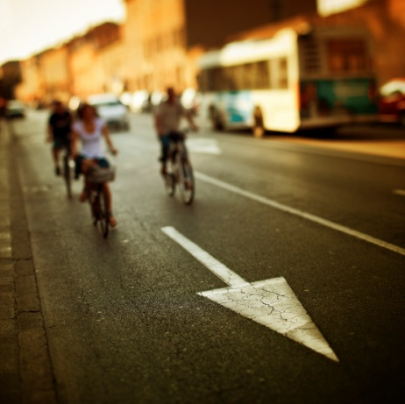
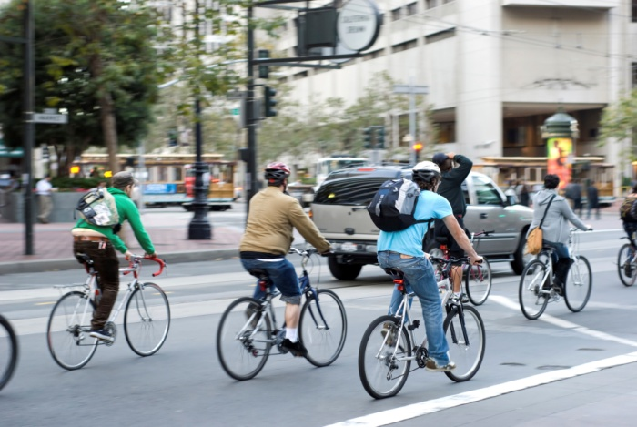
Implications for central Asia
Due to income levels, benefits and costs of policies for walking and cycling are considerably lower. But benefit to cost ratios may be similar
Mentality differences may exist. But successful examples from Europe indicate, that environmentally friendly travel can be implemented in very different cities.
New technoligies (e-bikes) and organisational forms (carsharing) may help that central asian countries manage mobility in quickly developing economies better than the west in the past 50 years

Slide 24
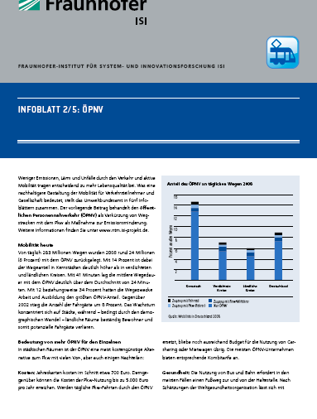
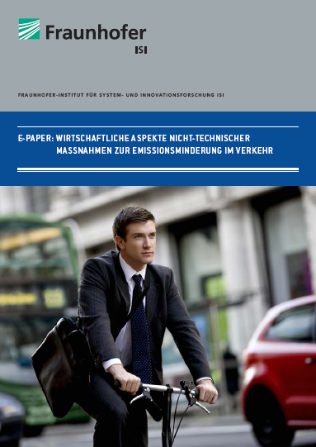

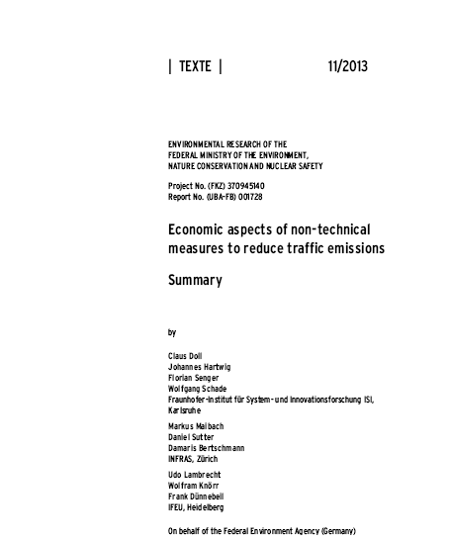
Available materials
At www.ntm.isi-projekt.de study reports and the PExMo tool are available (German only):
E-Paper for public communication (German)
Full report (German)
Summary (German and English)
PExMo Cost Calculator (German)
5 measure leaflets: (German)

