Slide 1
Situation and new challenges on pass-by noise for road transport vehicles
ECE R 51: noise for passenger cars, light commercial and heavy vehicles ( M& N)
ECE R 41: noise for motorcycles
ECE R 117: tyre noise
ECE R 28: horn systems
ECE R 59: replacement silencers for M& N category
ECE R 9: Noise of category L2, L4 and L5
ECE R 63: Noise of Mopeds L1
ECE R 92: replacement silencers for motorcycles
ECD R XX: new regulation on Quiet Road Transport Vehicle

Slide 2
Situation
Sound levels of tyres :
Regulation GSR CE/661/2009 and ECE117R02
Labelling - CE/1222/2011
Reduction from 2 to 4 dB before 2016
Sound levels of 4 wheels (and more) vehicles :
Regulation CE/540/2014 and ECE51R03
Reduction from 3 to 4 dB before 2026
Audibility of electrified vehicles :
Regulation CE/540/2014 and new ECE xxx
Minimum sound level before 2019
Sound levels of 2-wheels vehicles :
Regulation CE/168/2013 and ECE41R02
Time Schedule and reductions in progress

Slide 3
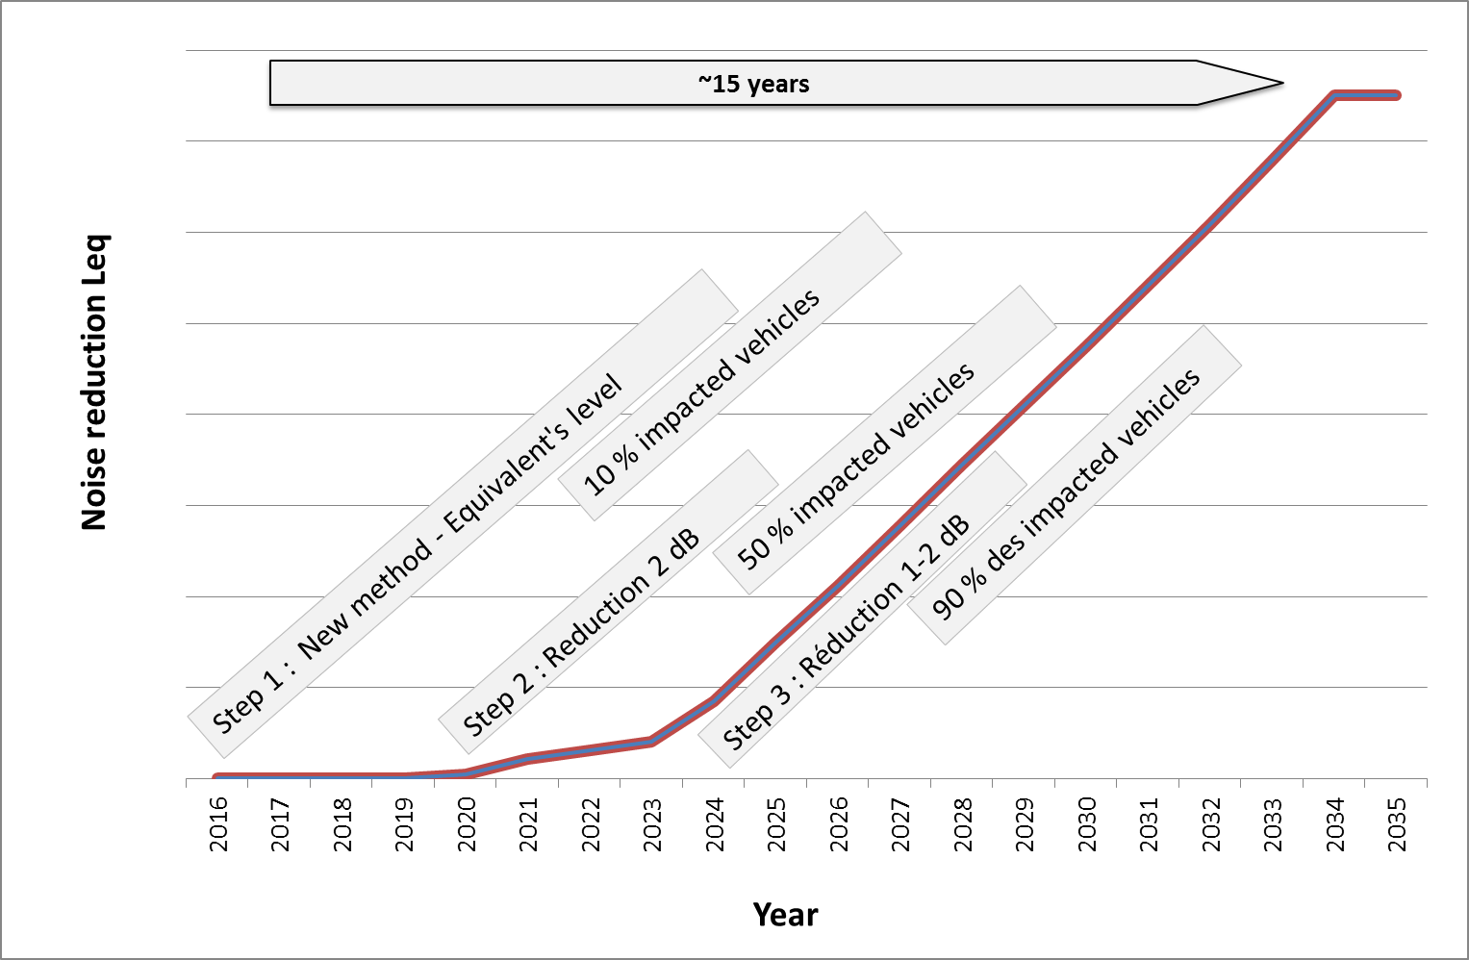
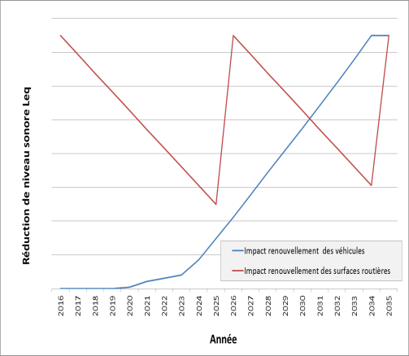
Benefit for environment
Comparison with road noise :
Local …. Global
Performance
Overall effect of vehicle / tyre : From 1,5 to 3 dB(A) over 15 years

