Slide 1
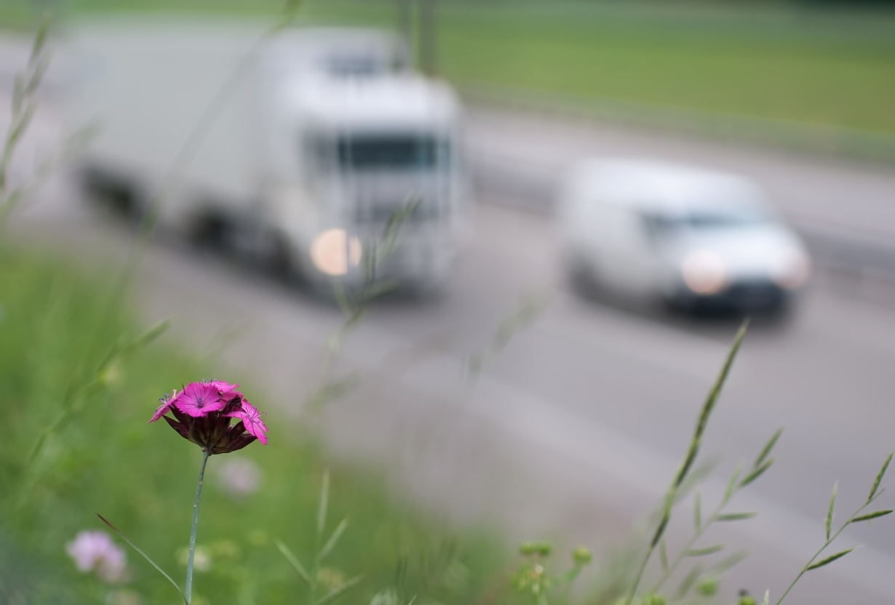
Transport-related Air Pollution in Germany
Nadja Richter
Umweltbundesamt (UBA)
Federal Environment Agency
Germany
Section I 3.1 Environment and Transport
THE PEP Workshop: Focus on Urban Central Asia – Almaty, Kazakhstan

Slide 2
FACT: air pollutants = health risk
Transport-related Air Pollution in Germany
→ improving health protection means reducing traffic related emissions
THE PEP Workshop: Focus on Urban Central Asia – Almaty, Kazakhstan

Slide 3
PM₁₀ Emissions in Germany 2010 Share of Transport
Transport-related Air Pollution in Germany
Source: National Trend Tables for the German Atmospheric Emission Reporting 1990-2010; TREMOD 5.25
THE PEP Workshop: Focus on Urban Central Asia – Almaty, Kazakhstan

Slide 4
NO_{x} Emissions in Germany 2010 Share of Transport
Transport-related Air Pollution in Germany
Source: National Trend Tables for the German Atmospheric Emission Reporting 1990-2010; TREMOD 5.25
THE PEP Workshop: Focus on Urban Central Asia – Almaty, Kazakhstan

Slide 5
PM₁₀ Emissions from Transport Germany 1960-2030
Transport-related Air Pollution in Germany
THE PEP Workshop: Focus on Urban Central Asia – Almaty, Kazakhstan

Slide 6
NO_{x} Emissions from Transport Germany 1960-2030
Transport-related Air Pollution in Germany
THE PEP Workshop: Focus on Urban Central Asia – Almaty, Kazakhstan

Slide 7
EU Air Quality Targets Limit Values for the protection of human health
Transport-related Air Pollution in Germany
Pollutant | Averaging period | Limit value* | Date by which value is to be met
NO₂ | 1-hour | 200 µg/m³ not to be exceeded > 18 times a calendar year | 1 January 2010
NO₂ | Calendar year | 40 µg/m³ (21 ppb) | 1 January 2010
PM₁₀ | 24-hour | 50 µg/m³, not to be exceeded > 35 times a calendar year | 1 January 2005
PM₁₀ | Calendar year | 40 µg/m³ | 1 January 2005
PM_{2.5} | Calendar year | 25 µg/m³ | 1 January 2015
* Limit Value is legally binding for member states.
THE PEP Workshop: Focus on Urban Central Asia – Almaty, Kazakhstan

Slide 8
Air quality in Germany
Transport-related Air Pollution in Germany
European air quality limit values for sulphur dioxide, carbon monoxide, benzene and lead no longer exceeded in Germany
2011: excessive levels of particulate matter (PM₁₀) and nitrogen dioxide (NO₂) pollution
→ daily averages for PM₁₀ above the allowable limit at 42 % of stations near urban roads
→ NO₂ levels above the allowable yearly average at 57 % of stations near urban roads
Many German cities record significant instances of exceeding the tolerated limit!
Source: http://www.umweltbundesamt.de/uba-info-presse-e/2012/pe12-006_how_good_is_air_quality_in_germany.htm
THE PEP Workshop: Focus on Urban Central Asia – Almaty, Kazakhstan

Slide 9
Air quality in Germany - PM₁₀
Transport-related Air Pollution in Germany
Percentage share of measuring stations with concentration values exceeding the
PM₁₀- daily mean values of 50 µg/m³, 2000 - 2011
THE PEP Workshop: Focus on Urban Central Asia – Almaty, Kazakhstan

Slide 10
What can cities and municipalities do?
Transport-related Air Pollution in Germany
→ set up clean air and action plans
mix of individual measures (e.g. in transport):
-- promotion of cycling, walking and public transport,
-- appropriate town planning to reduce need of travel,
-- speed limits of 30 km/h on urban roads,
-- parking space cost management,
-- ban on heavy duty vehicles,
-- designate low emission zones (LEZs)
→ 47 designated LEZs in Germany
THE PEP Workshop: Focus on Urban Central Asia – Almaty, Kazakhstan

Slide 11
What are Low Emission Zones?
Transport-related Air Pollution in Germany
restricted areas/roads
often the most effective measure
mainly fine particles, nitrogen dioxide and indirect ozone
http://www.lowemissionzones.eu
Countries in Europe designating LEZs:
Austria, Czech Republic, Denmark, Hungary, Germany, Italy, Netherlands, Norway, Portugal, Sweden, United Kingdom
THE PEP Workshop: Focus on Urban Central Asia – Almaty, Kazakhstan

Slide 12
Low Emission Zones in Germany
Transport-related Air Pollution in Germany
Emissions class | 1 | 2 | 3 | 4
badge | No badge
Requirement for diesel vehicles | Euro 1 or worse | Euro 2 or Euro 1 particulate filter | Euro 3 or Euro 2 particulate filter | Euro 4 or Euro 3 particulate filter
Requirement for petrol vehicles | Without a catalytic converter |  |  | Euro 1 with catalytic converter or better
(35. Federal Immission Control Ordinance – Marking Ordinance)
THE PEP Workshop: Focus on Urban Central Asia – Almaty, Kazakhstan

Slide 13
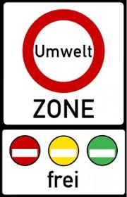
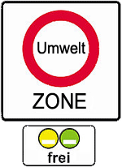
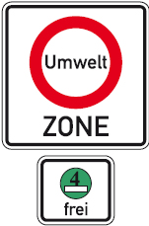
LEZ road sign according to national framework
Transport-related Air Pollution in Germany
DE Euro 2 LEZ DE Euro 3 LEZ DE Euro 4 LEZ
Source: http://www.lowemissionzones.eu/countries-mainmenu-147/germany-mainmenu-61
THE PEP Workshop: Focus on Urban Central Asia – Almaty, Kazakhstan

Slide 14
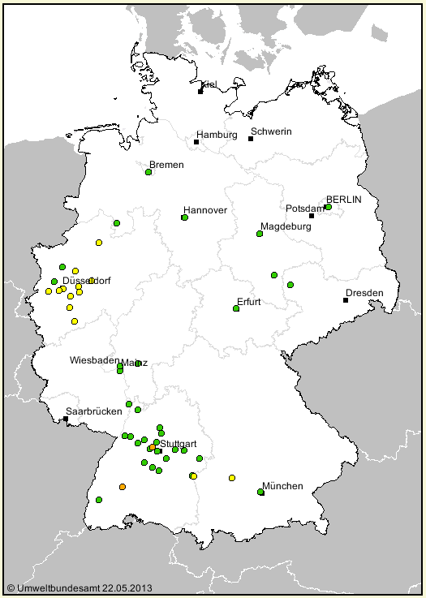
Low Emission Zones in Germany
Transport-related Air Pollution in Germany
LEZ scheduled
LEZ stage 1
ban on vehicles emission class 1
LEZ stage 2
ban on vehicles emission class 1+2
LEZ stage 3
ban on vehicles emission class 1+2+3
THE PEP Workshop: Focus on Urban Central Asia – Almaty, Kazakhstan

Slide 15
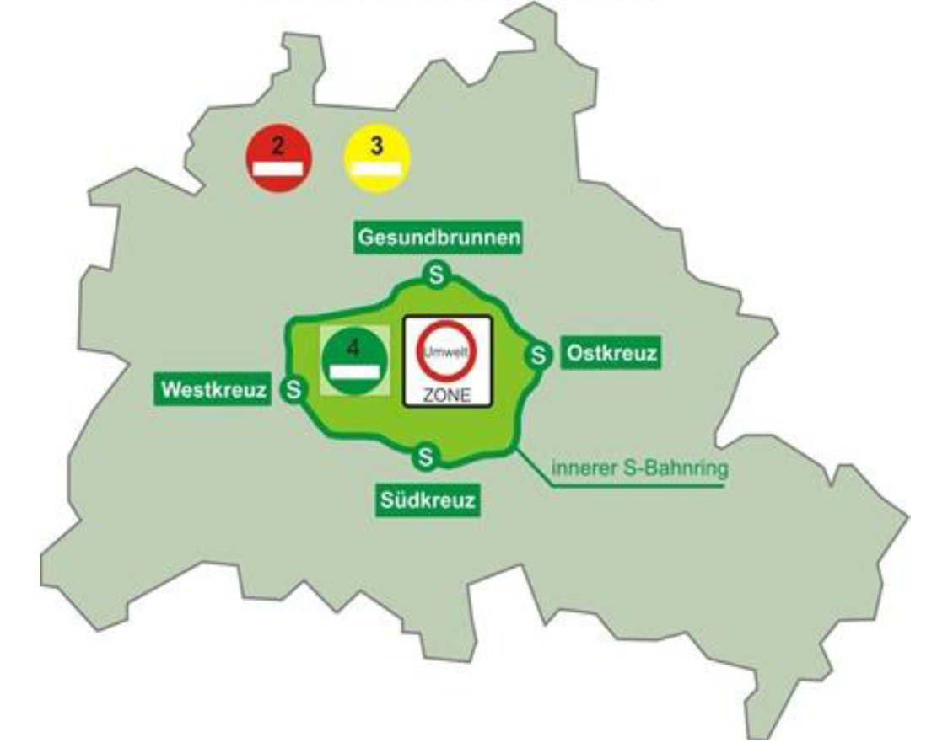
Low Emission Zone in Berlin
Transport-related Air Pollution in Germany
Abstract:
introduced in two stages (2008, 2010),
comprehending the central city area,
dimension: 88 km²,
more than 1,1 Mio. residents,
delimited by the local, railway loop
01.01.2008, first stage: all vehicles without badge are restricted from entering
01.01.2010, second stage: only vehicles with green badge are admitted
source: http://www.lowemissionzones.eu/countries-mainmenu-147/germany-mainmenu-61
THE PEP Workshop: Focus on Urban Central Asia – Almaty, Kazakhstan

Slide 16
Impact of LEZ in Berlin
Transport-related Air Pollution in Germany
Impact on vehicle fleet
accelerated modernisation of vehicle fleet
a high number of cars retrofitted with particulate filters
Impact on air pollution
-58 % or 173 t/yr Diesel particle emission reduction
-20 % or 1517 t/yr NO_{X} emission reduction
PM₁₀: annual mean -7 %, 10 excess days prevented
NO₂: annual mean -5 %
THE PEP Workshop: Focus on Urban Central Asia – Almaty, Kazakhstan

Slide 17
Problems?
Transport-related Air Pollution in Germany
Problems with measuring the effects of an LEZ
traffic is only one source of PM and NO_{X}
measured data is weather-dependent
additional dependence of the emissions on local traffic situation:
traffic increase/decrease + congestion
→ continued measurements are necessary
THE PEP Workshop: Focus on Urban Central Asia – Almaty, Kazakhstan

Slide 18
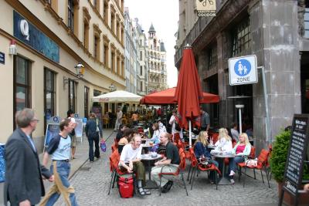
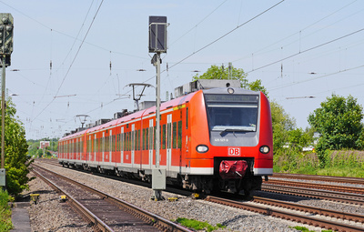
Combining measures!
Transport-related Air Pollution in Germany
THE PEP Workshop: Focus on Urban Central Asia – Almaty, Kazakhstan

Slide 19
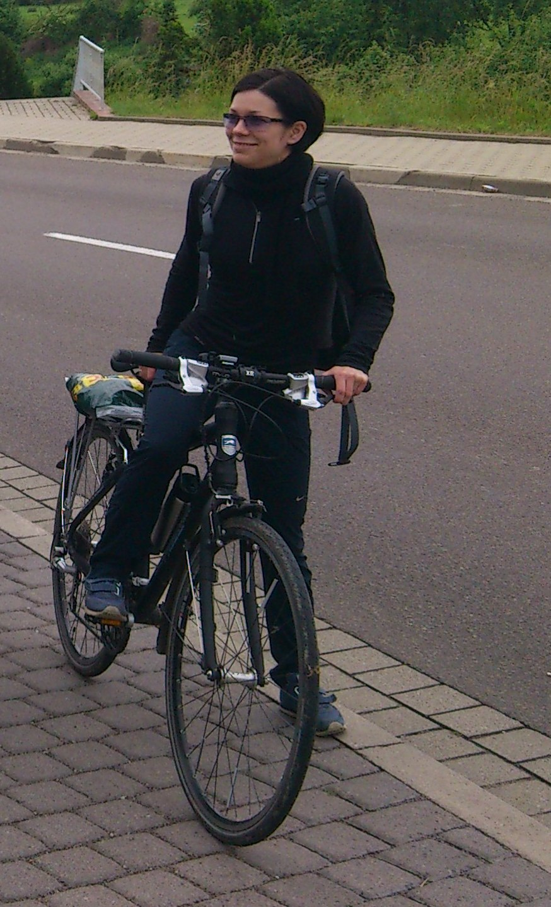
Transport-related Air Pollution in Germany
THANK YOU FOR
YOUR ATTENTION
Nadja Richter nadja.richter@uba.de www.umweltbundesamt.de
THE PEP Workshop: Focus on Urban Central Asia – Almaty, Kazakhstan

