Slide 1
IMPLEMENTATION OF DDI STANDARD IN THE STATISTICAL AGENCY UNDER PRESIDENT OF THE REPUBLIC OF TAJIKISTAN

Slide 2
The Statistical Agency under President of the Republic of Tajikistan in cooperation with the World Bank implemented the Accelerated Data Program (ADP) project.
The purpose of the project is – documentation of the surveys conducted by the Statistical Agency in the DDI format.

Slide 3
In December 2013 the World Bank experts carried out the Workshop on the Metadata Editor program for the Agency’s staff members. The seminar was organized by the World Bank and PARIS21 within the framework of the accelerated Program data (ADP). Training on the metadata editor Nesstar (Nesstar publisher) usage was provided to eight employees from the different TAJSTAT departments. In addition, was provided a training on the NADAStaff web cataloging application management.

Slide 4
Following a workshop all conducted surveys (TLSS, ODP, MICS, DHS, etc.) were documented by the Statistical Agency staff members in the Data Documentation Initiative (DDI) format
And external resources (reports, questionnaires and guidelines) in the Dublin Core Metadata Initiative (DCMI) format

Slide 5
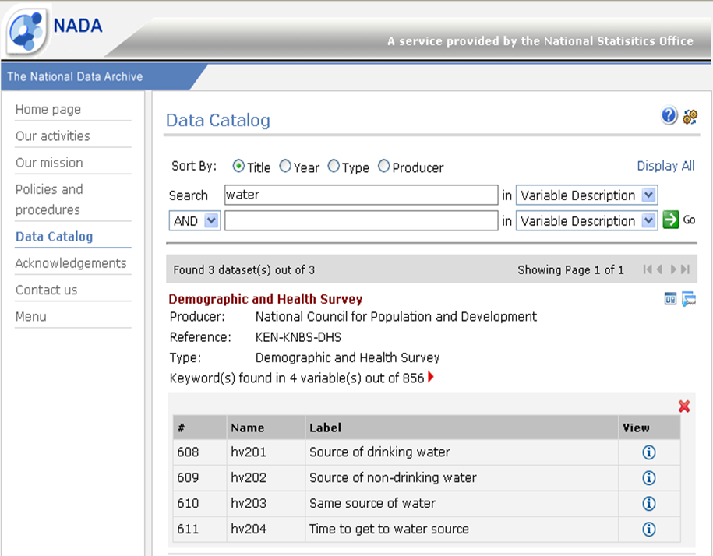
For the documented data dissemination on the Statistical Agency’s intranet the NADA (National Data Archive) has been launched and all the files has been uploaded

Slide 6
IMPLEMENTATION OF DDI STANDARD IN THE STATISTICAL AGENCY
For the further capacity development in the metadata management in TAJSTAT.
Finalization of the existing surveys documentation and archiving.
Creation of a national surveys catalog with the aim of the accessibility of the existing metadata and survey microdata for users.
Launch of an online surveys catalog in order to increase users awareness.

Slide 7
Thank you for your attention!

