Slide 1
The use of GSIM in Statistics Norway
Jenny Linnerud (jal@ssb.no)
Senior Adviser
Department of IT
Statistics Norway
10th June 2014, Nizhny Novgorod
Notes:
In this presentation I will talk about the use of the Generic Statistical Information Model in Statistics Norway.
My name is Jenny Linnerud and I am a senior adviser in the Department of IT in Statistics Norway.

Slide 2
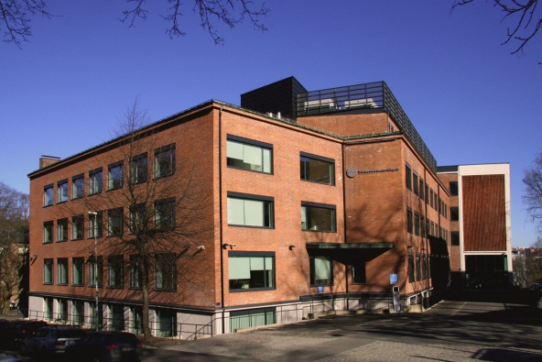
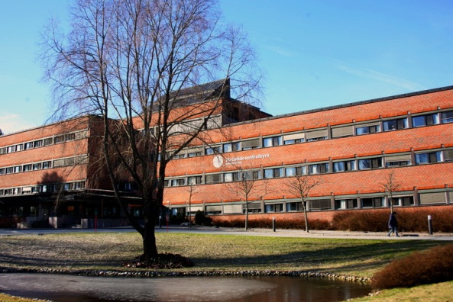
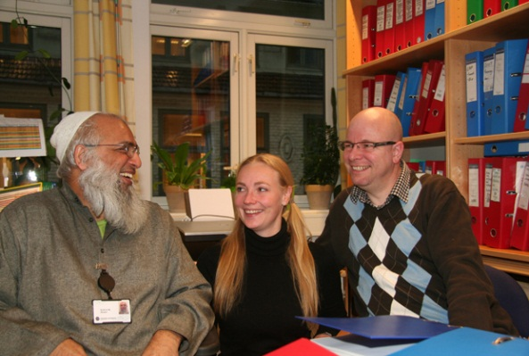
Statistics Norway – Key figures
910 employees (per 31.12.2013)
560 in Oslo, 350 in Kongsvinger
In addition, 175 interviewers
Around 420 different statistics
Around 1000 releases of new statistics on ssb.no in 2013
Notes:
First some words about Statistics Norway.
We have about 910 employees in two locations: 560 in Oslo and 350 in Kongsvinger.
In addition , we have 175 interviewers
We make about 420 different statistics
We had 1000 releases of statistics on our web site in 2013.

Slide 3
Statistics Norway’s participation in GSIM Development 2012
GSIM sprint in Slovenia, February
GSIM sprint in Republic of Korea, March
Integration workshop in the Netherlands, November
GSIM v1.0 December
Notes:
Statistics Norway was one of 17 organisations involved in the development of GSIM in 2012.
We participated in the two week sprints in Slovenia and the Republic of Korea.
We also participated in the one week integration workshop in the Netherlands.
The GSIM version 1.0 was released in December 2012.

Slide 4
Statistics Norway’s participation in GSIM Implementation 2013-2014
GSIM v1.0 Brochure and Communication document in Norwegian
Informal task force on metadata flows in the GSBPM - ca. 20 GSIM information objects were mapped to the phases in GSBPM v4
GSIM v1.0 discussion forum
GSIM Statistical Classification Model -> GSIM v1.1 December 2013
Contribute Statistical Classification services within the Implementing CSPA Project 2014
Try out GSIM v1.1 within the RAIRD project
Notes:
Our participation in GSIM did not stop in 2012.
In 2013 we translated the brochure and communication documents to Norwegian to help our organisation understand the importance of GSIM.
We also participated in an informal task force that looked at metadata flows in the GSBPM. About 20 information objects from GSIM were mapped to the inputs and outputs of the phases in GSBPM v4. This work was presented at METIS in 2013 – see WP 22 Metadata flows in the GSBPM.
We contributed with questions and comments to the GSIM v1.0 discussion forum throughout 2013.
We contributed substantially to the GSIM Statistical Classification Model that formed part of the next release of GSIM v1.1 in December 2013.
In 2014 we are contributing to the Implementing CSPA Project. We will be responsible for two Statistical Classification services.
We are also trying out GSIM v1.1 in a 5 year Norwegian project called RAIRD.

Slide 5
Remote Access Infrastructure for Register Data (RAIRD)
Statistics Norway and the Norwegian Social Science Data Services (NSD) aim to establish
a national research infrastructure
providing easy access to large amounts of register based statistical data
managing statistical confidentiality
protecting the integrity of the data subjects.
The work is funded by the Research Council of Norway through 2017. See: www.raird.no
Notes:
In the RAIRD project we are building a Remote Access Infrastructure for Register Data.
Statistics Norway (SSB) and the Norwegian Social Science Data Services (NSD) aim to
establish a national research infrastructure that will provide easy access to large amounts
of rich high-quality statistical data for scientific research while at the same time managing
statistical confidentiality and protecting the integrity of the data subjects.
The work is funded by the Research Council of Norway through 2017
5

Slide 6
RAIRD Information Model (RIM)
Based on GSIM v1.1
Design principles
Information objects (ca. 115)
- 27 new information objects for users (producers, administrators and researchers) and explicit statistical confidentiality
- Less information objects for details of official statistical production
Notes:
One of the first deliverables is the RAIRD Information Model (RIM).
This is based on GSIM v1.1. In particular, the GSIM design principles
and the ca. 115 GSIM information objects.
We have created 27 new information objects for different users
(producers, administrators and researchers).
We do not make use of GSIM information objects that are mainly
focussed on the details of official statistical production.

Slide 7
GSIM Glossary blue – not in RIM, yellow – in RIM
Notes:
Here we can see 4 information objects from the GSIM Glossary.
1, in blue, the Statistical Support Program in the Businesss group, is not expected to be used in RIM
3, in yelllow, the Subject Field and Unit from the Concepts group and the Unit Data Point from the Structures group, are used in RIM.

Slide 8
GSIM and GSBPM
GSIM describes the information objects and flows within the statistical business process.
Notes:
GSIM works together with the GSBPM.
GSIM describes the information objects and flows within the statistical business process.
RIM will work together with the researchers business process and the producers business process.

Slide 9
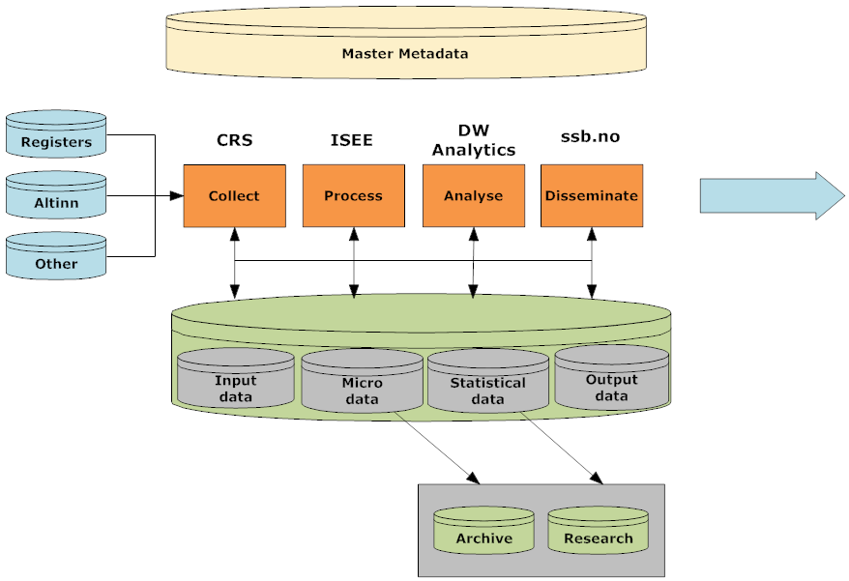
GSIM in Statistics Norway - Vision
META DATA
Notes:
Our vision in Statistics Norway is to use GSIM to describe the information objects throughout our business process.
We are focussing on four platforms: Collect, Process, Analyse and Disseminate and four steady states for data: input, micro, statistical and output
Collect and Disseminate (via our website ssb.no) are well established.
Process is in place for over 170 statistics.
We are just starting to build a data ware house solution, DW Analytics, for Analyse.
We collect register data from central and administrative registers and business data from the AltInn portal.
NOTES FOR READERS, BUT NOT FOR LISTENERS:
AltInn stands for ‘everything in’ in Norwegian.
CRS = Common Reception Server
ISEE = Integrated System for Editing and Estimation

Slide 10
GSIM in Statistics Norway - Vision
GSIM should lead to:
A foundation for standardised statistical metadata use throughout systems
A standardised framework for consistent and coherent design of statistical production
Increased sharing of system components
Notes:
Our vision for the GSIM in Statistics Norway is that it should lead to:
A foundation for standardised statistical metadata use throughout systems
A standardised framework for consistent and coherent design of statistical production
Increased sharing of system components

