Slide 1
Modernization in Statistics Norway
Jenny Linnerud (jal@ssb.no)
Senior Adviser
Department of IT
Statistics Norway
11th June 2014, Nizhny Novgorod
Notes:
This time I will talk about modernization in Statistics Norway.

Slide 2
The Statistics Act (1989)
Statistics Norway’s tasks
Identify and prioritise needs for official statistics
Coordinate Norwegian statistics compiled by government agencies
Develop statistical methods, conduct analysis and carry out research
Provide information for statistical use for research purposes and public planning.
Be responsible for international statistics cooperation
Notes:
Statistics Norways tasks as listed in the Statistic Act from 1989 are unchanged, but the pressure on finances and the user expectations are increasing.
We must still
Identify and prioritise needs for official statistics
Coordinate Norwegian statistics compiled by government agencies
Develop statistical methods, conduct analysis and carry out research
Provide information for statistical use for research purposes and public planning.
Be responsible for international statistics cooperation
In order to meet these challenges we need to modernize.

Slide 3
Plans 2014
European Peer Reviews
Escalation of Lean
Improve portfolio and project management
Development of standardized solutions to improve efficiency
Notes:
Amongst other plans for 2014,
we have
European Peer Reviews
Escalation of Lean
Improve portfolio and project management
Development of standardized solutions to improve efficiency

Slide 4
Lean
Case 1: Efficient maintenance of the business register
Case 2: Improving data collection specifications
Case 3: Tracking respondents in sample surveys
Case 4: Digital communication in data collection
Case 5: Respondent support service
Notes:
Lean thinking is
Culture and management for continuous improvement
Based on the same elements as other quality systems, like TQM, Six Sigma etc.
Adds customer value
Focuses on processes
Involves staff
Reduces waste – work smarter
In our department of data collection and methods we have tried lean thinking in five cases:
Case 1: Efficient maintenance of the business register
Case 2: Improving data collection specifications
Case 3: Tracking respondents in sample surveys
Case 4: Digital communication in data collection
Case 5: Respondent support service
More details are available in the paper: Continuous improvement and Lean thinking in Statistics Norway I
n the proceedings of the Quality 2014 conference http://www.q2014.at/

Slide 5
IT Cooperation
International
Statistical Network: New Zealand, Australia, Canada, Sweden, Norway, United Kingdom,
Modernisation Committee on Production and Methods
Modernisation Committee on Standards
Nordic cooperation

Slide 6
International Standards
GSBPM
GSIM
CSPA
SDMX & DDI
Notes:
The international standards that we view as most promising for modernization are
GSBPM
GSIM
CSPA
SDMX & DDI
We are actively following these standards.
NOTES FOR READERS, BUT NOT FOR LISTENERS:
GSBPM – Generic Statistical Business Process Model
GSIM – Generic Statistical Information Model
CSPA – Common Statistical Production Architecture
SDMX – Statistical Data and Metadata eXchange
DDI – Data Documentation Initiative

Slide 7
Why do we need a BPM?
To define and describe statistical processes in a coherent way
To compare and benchmark processes within our organisation
To make better decisions on development of production systems
To optimize organisation and allocation of resources
Notes:
7

Slide 8
Statistics Norways business process model
Modernisation and standardisation of statistical production
Notes:
In Statistics Norway we will use our business process model for the modernisation and standardisation of our statistical production.
The 7 phases of our model are the same as in the GSBPM.
We have two additional overarching phases that we focus on: Quality management – evaluate and feedback, Support and infrastructure.

Slide 9
Statistics Norways business process model
Specify needs
1
Develop and design
2
Build
3
Collect
4
Process
5
Analyse
6
Disseminate
7
Determine need for information
1.1
Outputs
2.1
Build and enhance process components
3.1
Establish frame and registers, select sample
4.1
Classify and code
5.1
Acquire domain intelligence
6.1
Prepare data for dissemination database
7.1
Consult and confirm need
1.2
Frame, register and sample methodology
2.2
Integrate production system with other systems
3.2
Set up collection
4.2
Micro-edit
5.2
Produce statistics
6.2
Produce product
7.2
Establish output objectives
1.3
Data collection methodology
2.3
Test production system
3.3
Run collection
4.3
Macro-control
5.3
Quality assure statistics
6.3
Release and promote product
7.3
Check data availability
1.4
Process and analysis methodology
2.4
Finalise production system
3.4
Finalise collection
4.4
Impute for partial non-response
5.4
Interpret and explain statistics
6.4
Manage customer queries
7.4
Prepare business case
1.5
Production system
2.5
Calculate weights and derive new variables
5.5
Prepare statistics for dissemination
6.5
Finalise content
6.6
Notes:
Statistics Norways business process model is slightly different from the GSBPM on a detailed level within Build
Some processes within Process and Analyse, on a detailed level, are placed differently from the GSBPM

Slide 10
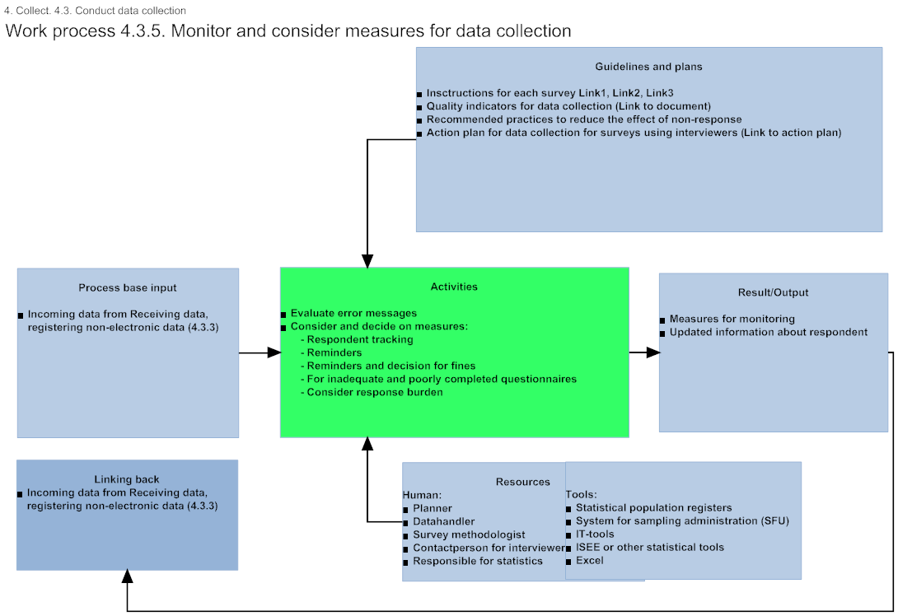
Complete documentation on our Intranet
Notes:
In addition to the previous two levels we have a more detailed level.
The complete documentation of this level is on our intranet in Norwegian.
For each process we show
Input: Any data/metadata/documents needed to start the process. They might be changed during the processing
Activities: Activities runs until quality is satisfactory according to guidelines or until it is decided to go back to an earlier process
Output: Any data/metadata/documents produced in the process. They arise, change and/or are approved during the processing.
Guidelines: Any data/metadata/documents which describe what, when, and how the process should be performed. These are not changed during the process.
Resources: people/roles & tools involved in the process
Any links back to earlier processes

Slide 11
We need consistent information
Modernisation of statistics requires:
reuse and sharing of methods, components, processes and data repositories
definition of a shared “plug-and-play” modular component architecture
The Generic Statistical Business Process Model (GSBPM) will help us determine which components are required.
GSIM will help us to specify the interfaces.

Slide 12
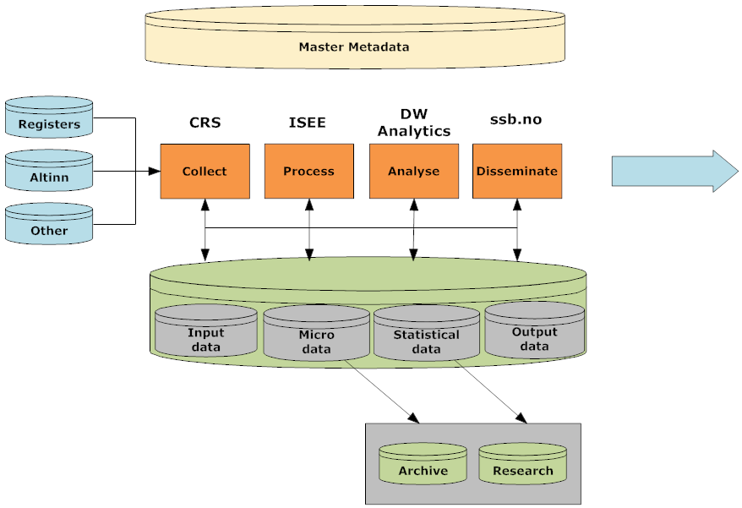
GSBPM in Statistics Norway Streamlining Statistics Production
Notes:
As I mentioned yesterday our vision in Statistics Norway is to focus on four platforms: Collect, Process, Analyse and Disseminate, one for each of the four production phases in the business process model in order to streamline our production of statistics.

Slide 13
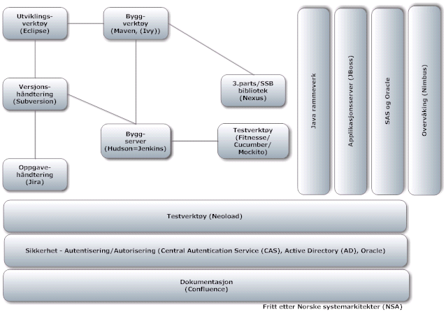
Categorising systems
SFU
FDM
Norsamu
(Trekkbas)
Telefinn
SMIE
SERES
Presys
ssb.no
statistic register
Google analytics
Stat. Bank
SIV/SIL
Blaise
Altinn
(Idun,
Kostra)
Java
SAS
Oracle
Fame
ISEE
ISEE Driller
Verify
SELEKT
X12-Arima
Tau-Argus
Mu-Argus
SAS Insight
Service Manager
(Helpdesk, OTRS)
LDA-app
Stat. population registers:
- National register
- The Central Coordinating Register for Legal Entities
- GAB – Landed property, Address, Dwelling (map)
“Projectplanning”: - Jira Document centers: Confluence (Trac, Wiki) Windows-server
Produktregister Metadataportals: - Vardok - Datadok - Stabas - ssb.no (About statistics)
MS Office SmartDraw ArcGIS Websak SPSS Adobe
Notes:
We use the seven phases of our business process model to categorise our systems and to identify overlapping functionality.
Our aim is to reduce our portfolio of systems.

Slide 14
Summary
The international standards and cooperation help us to
plan new statistics
prioritize new projects (portfolio management)
improve existing work processes in statistical production
reduce our portfolio of IT-systems
reduce risk
make a more complete business architecture
train and integrate new & existing staff.

