Slide 1

Standards-based Modernization of
Official Statistics
Steven Vale
UNECE
steven.vale@unece.org

Slide 2
Contents
Context – Why modernize?
  The “data deluge”
  Competition
  Efficiency
The HLG-BAS: Modernizing official statistics
Important Standards
  GSBPM
  GSIM

Slide 3
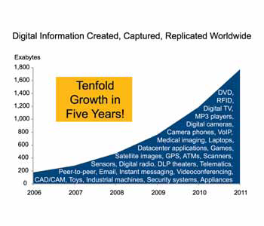
What is the Data Deluge?

Slide 4

Prediction for 2020

Slide 5
In the last 2 years more information was created than in the whole of the rest of human history!

Slide 6
Competition?
Private sector understands the value of data
Google:
  Real-time price indices
  Public Data Explorer
Facebook, store cards, credit agencies, ...
  What if they link their data?
Will they provide an alternative to population censuses?

Slide 7
Efficiency
“Do more with less”
Increasing demands
Shrinking budgets

Slide 8
Official Statistics Response
HLG-BAS
  High-Level Group for Strategic Developments in Business Architecture in Statistics
Created by the Conference of European Statisticians in 2010
10 heads of national and international statistical organisations

Slide 9
HLG-BAS Strategic Vision
Endorsed by the Conference of European Statisticians in June 2011
We have to re-invent our products and processes and adapt to a changed world

Slide 10
The challenges are too big for statistical organisations to tackle on their own.
We need to work together

Slide 11
Modernize statistical production
Statistical
Concepts
Information
Concepts
conceptual
GSBPM
GSIM
Common generic
statistics production
Methods
Technology
practical
Statistical
HowTo
Production
HowTo

Slide 12
A strategy for modernization
Transform vision to reality
New products
Rationalised processes
  “Plug and play” architecture – based on the GSBPM and GSIM
Managing organizational change to support change and collaboration

Slide 13
A strategy for modernization
Transform vision to reality
New products
Rationalised processes
  “Plug and play” architecture – based on the GSBPM and GSIM
Managing organizational change to support change and collaboration
Conference of European Statisticians, June 2012
Endorsed

Slide 14
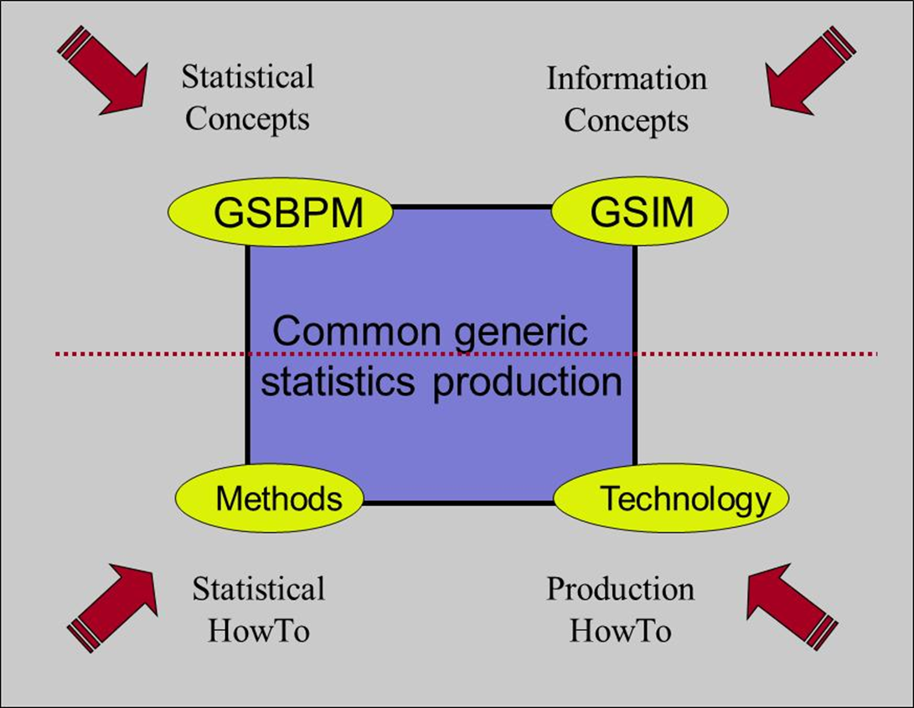
Introducing the GSBPM
You are here

Slide 15
Why do we need the GSBPM?
To define and describe statistical processes in a coherent way
To standardize process terminology
To compare and benchmark processes within and between organisations
To modernize and standardize processes
To make better decisions on production systems and organisation of resources
Notes:
15

Slide 16
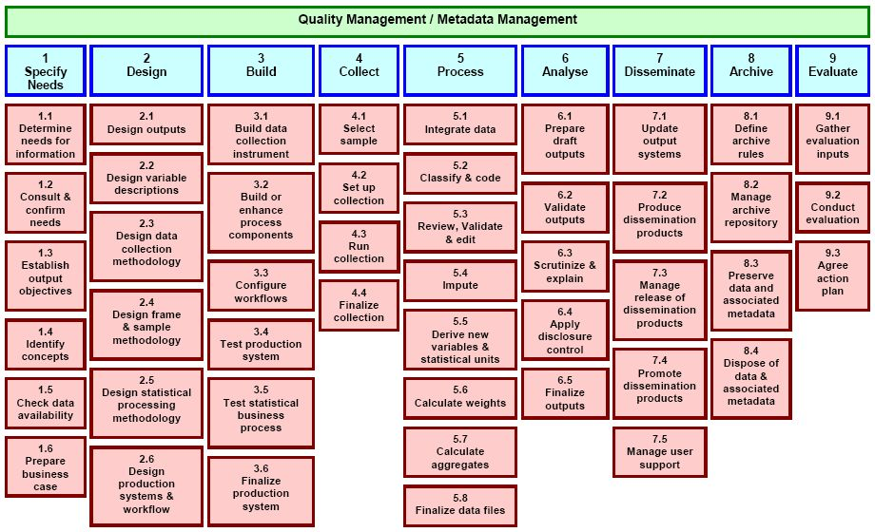
The GSBPM

Slide 17
Key features
Not a linear model
Sub-processes do not have to be followed in a strict order
It is a matrix, through which there are many possible paths
Some iterations of a regular process may skip certain sub-processes

Slide 19
The GSBPM is used by more than
50 statistical organizations
worldwide to manage and
document statistical production

Slide 21
Introducing the GSIM
You are here

Slide 22
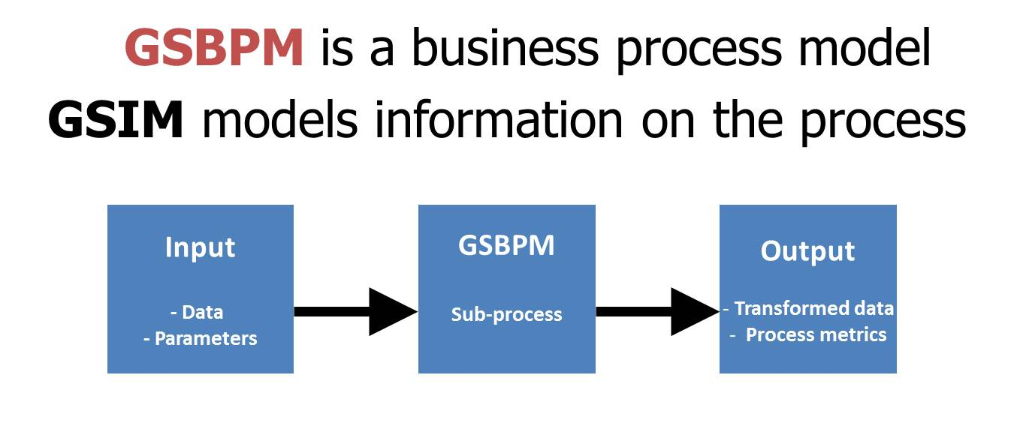
GSIM: A complementary initiative
Another model is needed to describe information objects and flows within the statistical business process

Slide 23
GSIM: The “sprint’ approach
The HLG-BAS decided to accelerate the development of the GSIM
“Sprints” – 2 week workshops for 10-12 experts (IT, methodology, statistics, ...)
Sprint 1 – Slovenia, February 2012
Sprint 2 – Republic of Korea, April 2012
Integration Workshop, Netherlands, September 2012

Slide 24
Provision Agreement
Provision for formalisation of arrangements for data acquisition and dissemination
Process Step Definition
Provider
Methodology applies to processes in all areas
Methodology
Balanced support for all data acquisition channels
Information Request
Process Method
Acquisition Program
Dissemination Program
Process management for all areas of activity
Activity
Statistical Project
Production
Process Step Design
Separation of Statistical, Acquisition, and Dissemination programs, with central role for Methodology
Balanced support for multiple dissemination channels
Statistical Program
Process Control
Process Step Execution
Statistical projects access shared data
Mapping of processes to support managed operations
Rule
Shared Data Resource, maintained corporately, for use by all statistical programs
Data Resource
Data Set
Statistical Products
Information
Conceptual
Variable
Population Units
Concept
Data Structure
Cube Structure
Unit Data Structure
Basic infrastructure for critical base elements
Value Domain
Record Structures
All structures and relationships described in metadata to support automated processes
Classification

Slide 25
The big picture
You are here

Slide 26
Standards-based Modernization

Slide 27
“Grand Unification”
Generalized Statistical Production System
Conceptual
GSBPM
GSIM
Common Generic
Industrialized Statistics
Practical
Methods
Technology
Grand Unification is a new approach that brings together the GSBPM and GSIM to make statistics
To be developed ...

Slide 28
Key points
1. Official statistics organizations have to modernize to survive
2. Modernization is not an IT issue!
It is strategic: Defining the future of official statistics
3. GSBPM and GSIM are not software tools – they are new ways of thinking

Slide 29
More information
GSBPM
  http://www1.unece.org/stat/platform/display/metis/The+Generic+Statistical+Business+Process+Model
GSIM
  http://www1.unece.org/stat/platform/display/metis/Generic+Statistical+Information+Model+(GSIM)
HLG-BAS
  http://www1.unece.org/stat/platform/display/hlgbas

Slide 30
Questions? steven.vale@unece.org

