Slide 1
MEETING ON
THE MANAGEMENT OF STATISTICAL INFORMATION SYSTEMS
14-16 APRIL 2014
MANILA
THE IMPLEMENTATION OF E-SURVEY IN
THE DEPARTMENT OF STATISTICS MALAYSIA
by
Habsah Salleh
Department of Statistics Malaysia (DOSM)

Slide 2
What is e-survey
An electronic web-based survey instrument where the questionnaire is in the server network and connected to other organisation via internet .
This medium of data collection is a safe and secured e-service platform that allows user to submit business survey via the internet. It provides a safe and convenient way to submit the survey returns and check for submission status.

Slide 3
Background
As part of the modernization program, the DOSM has started using this electronic medium for data collection
Computer-assisted personal interview (CAPI) - monthly prices
Computer-assisted telephone interview (CATI) - labour force survey
E-mail and e-survey for economic surveys
E-survey in DOSM was first introduced in 2008 for the International Trade-In Services Survey. The application of the method was then extended to the Monthly Manufacturing Survey in 2009 and Quarterly Services Survey (2012).

Slide 4
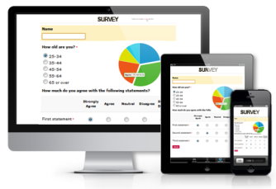
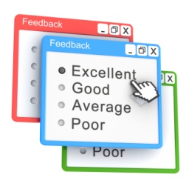
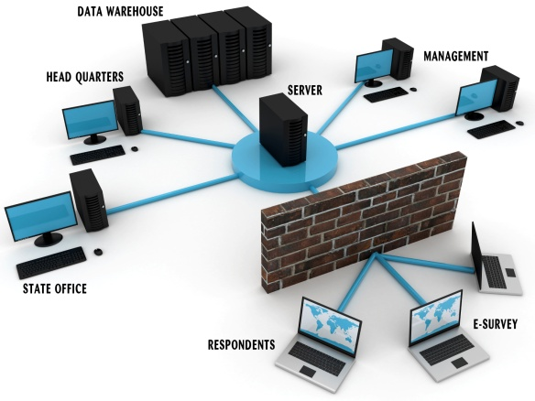
Efficient
Cost effective
Expectation
Time reduction

Slide 5
Workflow

Slide 6
Implementation
Criteria:
- Short questionnaire
- Frequency of data collection is more often
Preparation :
Contacts -> make a visit –> introduce e-survey –> guide the usage of e-survey
Attempts :
- Made from time to time to increase participation
- Keep good relationship
- Engagement program organised on regular basis

Slide 7
Implementation
Training guide to respondents:
Training guide to respondents on the usage of e-survey system is normally held at their premises but some are also invited to the office where DOSM organise training session. Identification number will be provided to the respondents.

Slide 8
LABOUR: LOW-SKILLED WITH LOW PRODUCTIVITY
Results
International Trade-in Services Survey
International Trade in Services Survey (ITS)
launched in April 2008
subsector: Transportation
sample size about 240 establishments
30 percent responded via e-survey
data compilation shortened from 10 to 7 weeks

Slide 9
LABOUR: LOW-SKILLED WITH LOW PRODUCTIVITY
Results
Monthly Manufacturing Survey
launched in 2009
sample size: about 4500 establishments
2009-2011 : very low response (less than 5 percent)
achieved 33 percent response rate in 2013
data processing time reduced from 7 to 6 weeks

Slide 10
LABOUR: LOW-SKILLED WITH LOW PRODUCTIVITY
Implications/Benefits
Speed up data preparation
processes - no data entry and verification
Correspondence via electronic means
Accelerate
Cost
Human Resource
Data Quality
Security
Saving in transportation,
courier and printing cost
Numbers of labour
reduced
Exposure to new
data collection method
Accustom technology
in working culture
Systematic work culture
Work load reduced

Slide 11
LABOUR: LOW-SKILLED WITH LOW PRODUCTIVITY
Implications/Benefits
Confidentiality of data
ensured
Flexibility of feedback
Authorization to access
Accelerate
Cost
Human Resource
Data Quality
Security
Reduce non-sampling error
Fixed-term accurate feedback
Eliminate data entry
Ensure data integrity &
reliability

Slide 12
LABOUR: LOW-SKILLED WITH LOW PRODUCTIVITY
Limitation
Depend on the targeted population and the goal of the research project
time-consuming development
limited access to potential users (only those with internet access)
potential technological problems
possibility of poor security threatening the validity of the study
Both parties, DOSM and respondents, must be ready to be equipped with e-survey infrastructures; and the willingness to participate in the survey.

Slide 13
LABOUR: LOW-SKILLED WITH LOW PRODUCTIVITY
Way Forward
The department is promoting the usage of web-based method in data collection.
Various strategies have been introduced to increase participation such as:
Organising session with respondents to inform them on the usage of e-survey and hands-on.
Sending pamphlets and brochures on e-survey to establishments with e-mail address.
Determine target responds (KPI)
Assist respondents in registration as portal user
Sharing of findings on industries related to respondents.

Slide 14
LABOUR: LOW-SKILLED WITH LOW PRODUCTIVITY
Way Forward
DOSM is continuously finding ways to increase the usage of e-survey to replace the conventional method. Apart from increasing the number response in the establishment surveys, plans are being made to apply e-survey in the household surveys.
DOSM needs to develop a group of technical expertise in the design of questionnaires which are user friendly in term of the sequencing of questions, system features and stable network.

Slide 15
THANK YOU

