Slide 1


Joint UNECE/Eurostat/OECD
Meeting on the Management of Statistical Information Systems
The ICT Change Management
at Italian National Institute of Statistics
Silvia Losco
Operation Unit Manager – ICT Strategic Planning and IT asset management
ISTAT – Italian National Institute of Statistics
MSIS 2014, Dublin and Manila14-16 April 2014

Slide 2
My area
Strategic planning, ICT procurement and purchasing, IT assets
Within the activities of the Central Directorate for Information and Communication Technologies, I am responsible for the management of ICT strategic planning, the ICT procurement and the management of ICT assets of the Institute.
Core activities of the unit:
Strategic IT planning and the ICT change management project
Main Products
  ICT 3-year strategic plan and operative plans for Institute computerization following the requirements for the Digital Agenda
  Design of the ICT organization within a governance scope

Slide 3

Istat ICT organization
Istat’s IT structure has undergone a profund change in the last ten year.
A gradual transition from a highly centralized structure to a distributed organization has started.
Istat currently has a complex Information System both in terms of technology and organization.

Slide 4
Istat ICT organization
As for the technological architecture the current configuration is as follows:
  Servers located at the headquarters and at branch offices(about 200)
  Workstations and printers located both at the headquarters and branch offices (about 3000 workstation and desktop);
  Telco network using TCP/IP services to connect the peripherals to the center
The software assets include ad hoc applications developed both with traditional techniques and with object oriented or prototype techniques.
Also IT human resources are distributed in the statistical department performing application development to support statistical mission.
This architecture and organization became more and more difficult to manage and raised problems of efficiency, quality of IT services and governance in general.

Slide 5
Issues for ICT in Istat
This ICT architecture and organization
became more and more difficult to manage
raised problems of efficiency
raised problems of quality of IT services
raised problems of governance in general.
ICT is becoming
a strategic resource for an organization
the key to the collection analysis production and distribution of information
the real key of success for the achievement of the objectives of the organization
The rapid and continuous evolution of information technology is constantly changing the way we produce statistics

Slide 6
ICT changes organizational approach
It is essential that a statistical organization changes his culture.
the ICT function has to maintain a continues focus on flexible technical and organizational solutions.
the statistical sector must keep a continuous focus on the sharing of methodological, technical and organizational solutions, in order to turn complexity into opportunity and efficiency
Adoption of EA and BA is required to reformulate statistical process
Industrialization
Standardization of the process
I

Slide 7
ICT changes organizational approach
It is essential that a statistical organization changes his culture.
the ICT function has to maintain a continues focus on flexible technical and organizational solutions.
the statistical sector must keep a continuous focus on the sharing of methodological, technical and organizational solutions, in order to turn complexity into opportunity and efficiency
Adoption of EA and BA is required to reformulate statistical process
Industrialization
Standardization of the process
STAT2015 Istat Programme

Slide 8
Project Background
The information audit process
According with this new vision, in 2010 Istat started a process of Information Audit aiming to:
identify the organization's technological infrastructure and software assets;
assess the quality, efficiency and effectiveness of the processes for the provision of ICT products and services;
make proposals to overcome problems and to ensure the development of the ICT function in line with the strategy of the Institute.
Audit identifies some important points of attention
the pervasiveness of dependence on information and services and infrastructure that deliver the information;
the increasing scale and cost of technology and related IT services;
the potential for technologies to enable the transformation of statistical process and practices
As a result of emerging evidences and resulted recommendations by the Audit, ISTAT decided to start the "ICT Change Management “ project

Slide 9
ICT organization evolution within a governance scope
  The ICT Change Management project
  The recommendations resulting from the Information Audit highlighted the need for a deep re-arrangement of Istat’s processes with focus on those regarding the ICT area.
  The Change Management project started in 2012
  Main objectives
  designing and defining a new way to conduct IT function at Istat with a new approach services oriented according with the statistical model based on the Generic Statistical Business Process Model (GSBPM)
  achieving adequate governance, management and control of IT environment
  It is the ICT line of the Stat2015 programme.

Slide 10
  The ICT Change Management project
  Project goals
  The object of the project is to design and implement a more efficient IT organizational structure by clearly defined processes, roles and responsibilities, to improve the governance and execution of IT function within the Institute.
  The model will be built on the basis of ITIL best practices (representing an international reference for the organization of complex IT functions).
  The new model will be oriented to processes (standard activities), performances (KPIs), results (expected outputs) and compliance (adherence to international standards and regulations).

Slide 11
ICT organization evolution within a governance scope
  The ICT Change Management project
  The ICT Change Management, ongoing project, enables the transition from the actual status (As Is) to the planned future status (To Be) through a structured approach.
  The approach used analyzes the current ICT organization to design the new ICT model focusing on a process based organization.
  In this way we can overcome the tendency to work stand alone as a silos allowing the ICT organization to work more integrated (by process).

Slide 12
ICT organization evolution within a governance scope
  Benefits of the project
better alignment of business and IT, basing the approach on statistical focus
shared understanding amongst all statistical and technician stakeholders, creating a common language
an understandable view of what IT does for business management and statistical processes
clear ownership and responsibilities, based on process orientation
fulfillment of the risk management requirements for IT control environment

Slide 13
  The main pahases of the project
The project is articulated in three main phases:

Slide 14
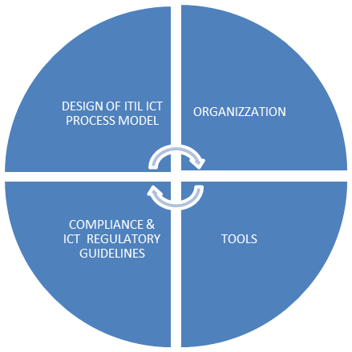
The phase 1 of the project: scope and activities
The Phase 1 of ICT Change Management Project is structured in four main lines of activities.
Design of ITIL Process Model : Reengineering of key process to operate as ICT Service provider
Organization: Definition of rules and responsibilities in line with ITIL Process Model
Tools: Set up of supporting tools.
Compliance and Regulatory guidelines: compliance check on ICT security policies and regulatory guidelines.

Slide 15
The phase 1 of the project : the teams
The line of activities are led by teams that involve human resources spanning across various Istat IT organization units and focusing on specific and different IT areas of competence :
software development division
IT infrastructure division
EA unit
IT unit of statistical department.
The governance of the project is provided by the IT Steering Committee and a Working Group, that are in charge of its coordination, design, monitoring and assessment.

Slide 16
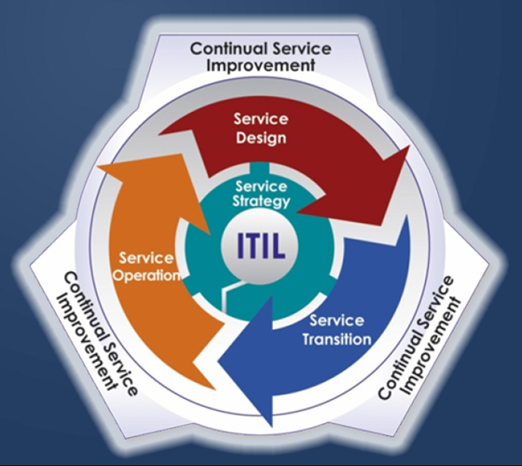
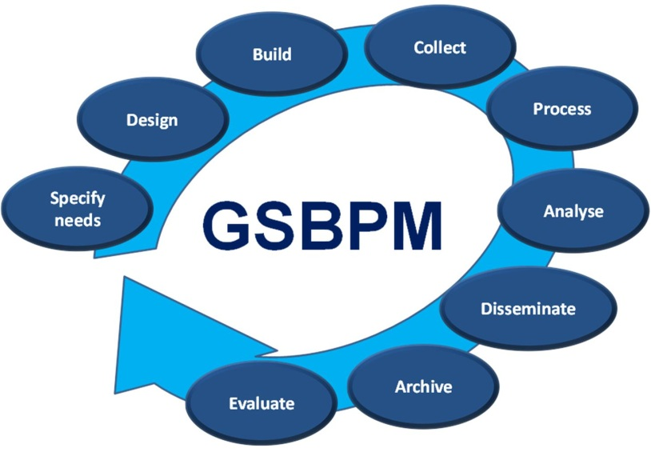
Principles and frameworks
  ITIL for the IT service management linked to GSBPM
IT Infrastructure Library
Generic Statistical Business Model

Slide 17
Principles and framework
  ITIL for the IT service management linked to GSBPM
Istat has adopted the ITIL (IT Infrastructure Library) framework, considered the most widely accepted approach to implement IT Service Management.
The primary objective of IT Service Management is to ensure that the IT services are aligned to the business needs and actively support them.
It is imperative that the IT services underpin the business processes and statistical process but it is also increasingly important that IT acts as an agent for change to facilitate business and statistical transformation and evolution.

Slide 18
Principles and framework
  ITIL for the IT service management linked to GSBPM
The GSBPM provide a basis for statistical organizations to agree on standard terminology to aid their discussions on developing statistical metadata systems and processes.
Therefore , the GSBPM should be seen as a flexible tool to describe and define the set of business processes needed to produce official statistics.
Istat linked the IT Service Management to the GSBPM. The use of this model can also be envisaged in other separate, but often related contexts such as harmonizing statistical computing infrastructures, facilitating the sharing of software components.

Slide 19
Why ITIL
From a statistical perspective, the adoption of ITIL to design the IT process model ensure many benefits.
All the IT services are aligned better with the statistical priorities and objectives;
IT service under an ITIL organization are more reliable and work better for statistical users so this IT organizations helps the increased statistical productivity, efficiency and effectiveness.
ITIL helps a more effective change management, enabling the statistical environment to keep peace with change.

Slide 20
Why ITIL
The ITIL Framework is divided into 4 main Sections
Service Strategy
Service Design
Service Transition
Service Operation

Slide 21
Why ITIL
Service Strategy: The achievement of strategic goals or objectives requires the use of strategic assets. Strategy processes show how to transform service management into a strategic asset.
Service Design: process of designing IT services, along with the governing IT practices, processes and policies, to realize the strategy and facilitate the introduction of services into the live environment ensuring quality service delivery, customer satisfaction and cost-effective service provision.
Service Transition: process of developing capabilities for transitioning new and changed services into operations, ensuring the requirements of Service Strategy, encoded in Service Design, are effectively realized in Service Operations while controlling the risks of failure and disruption.
Service Operation: process focused on achieving effectiveness and efficiency in the delivery and support of services to ensure value for the customer and the service provider. Strategic objectives are ultimately realized through Service Operations.

Slide 22
Methodological approach
To approach the Process model design phase, Istat leads the following methodological approach:
A Gap Analysis focused on gathering information: about current operating practices /routines compared with ITIL Best practices;
a wide range of interviews involving all Institute’s organizational functions (more than 60 interviews including Departments of statistical data production);
a formal document collection on related topics.
Several shared meetings to collect feedbacks from main stakeholders involved in Change Management process.
The issues coming from the gap analysis were addressed to be overcome in a process design phase following the ITIL guideline.
In addition Istat performed a benchmark survey involving the Statistical Network

Slide 23
Benchmark Survey
In order to gain a better understanding on how the National Statistical Institutes deal with ICT rapid evolution, ISTAT designed an IT Benchmark Survey to collect information regarding IT organization and the maturity level of IT processes.
In particular, scope of the survey is to investigate on two main topics: the Enterprise Architecture and some selected IT processes of the ITIL framework (Demand Management and Service Portfolio Management).
The benchmark defined five dimensions of observation:
strategy governance and control
roles and responsibilities
integration and communication
processes
standard and tools.

Slide 24
Benchmark Survey - Invited Institutes
Questionnaire was sent to members of Statistical Network on April 2013.
Specifically, the following institutes were invited to participate in:
Statistics Sweden
Statistics New Zealand
Statistics Canada
Office for National Statistics - UK
Statistics Norway
Australian Bureau of Statistics
Invited Institutes
Invited and participants Institutes

Slide 25
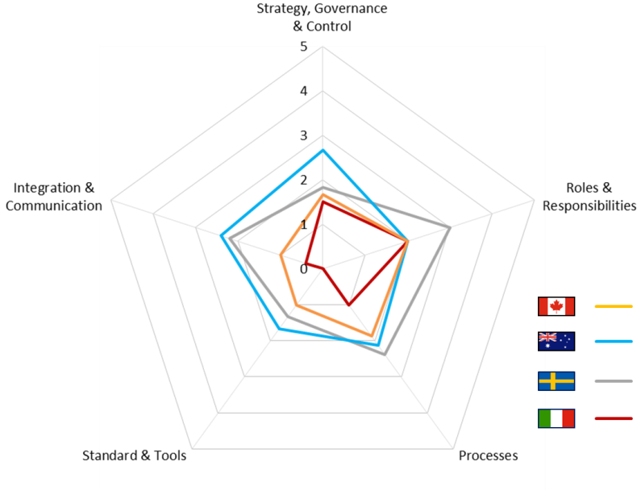
The general result of the ICT benchmark
  Capability Maturity Model
The Process Maturity Framework (PMF) has been used to analyze the results of ICT Benchmark study conducted across the members of Statistical Network.
In particular, the method has been used to “measure” the maturity of Strategy Processes on a scale from 0 to five :
zero= not existent;
1= initial;
2= repeatable; 3=defined;
4=managed;
5=optimized

Slide 26
ITIL Process Model in Istat
Analysis and design are based on the ITIL framework and are focused on 10 specific processes, divided into the 4 service areas (Strategy, Operation, Transition and Design)
Service Strategy
Determination Market Space IT policies
Demand Management
Service Portfolio Management
Service Design
SLA Management
Service Transition
Change Management
Asset & Configuration Management
Release & Deployment
Service Operation
IT Service Desk
Incident Management
Problem Management

Slide 27
Services Strategy
The Service Strategy process helps Istat to determine the ICT Strategic Plan to figure out ICT guidelines and policies to manage IT systems. The process is aimed at guarantee the
alignment of IT strategies to statistical requirements and Institute’s strategic goals and at
minimize risk related to provide IT services.
Service Strategy is also aimed at collect and evaluate the overall Institute’s ICT requirements to finalize the ICT Strategic Operation
Issue :
Need to clearly define IT policies and standards for ICT environment (ICT Architecture)
Need to create a service and portfolio catalogue to support statistical environment.
Need to consolidate the planning phases with the Statistical Department defining priorities, activities, allocation of financial and human resources
Service Strategy
Determination Market Space IT policies
Demand Management
Service Portfolio Management

Slide 28
Services Operation
The Service Operation function helps Istat to design IT services, along with the governance of IT practices, processes and policies. It provides the primary window for users to contact the IT Organization to be supported on a day-by-day basis. The Service Desk is responsible for collect and manage trouble tickets and IT standard services (IMAC requests). It is also responsible of manage any events which is not part of the standard operation of a service which cause an interruption to, or a reduction in, the quality of the services. Its objective is to restore normal operations as quickly as possible with the least possible impact on the business/users. Incident management and control activities include identification, logging, categorization, prioritization, initial diagnosis, escalation, resolution and closure. Problem management is responsible for managing the lifecycle of all problems. Scope of the process is to identify an issue before it places system performance at risk.
Issue :
Need to introduce a trouble ticketing systems
and standardize the supporting operation of statistical processing;
Ensure the continuity of business operation throughout ICT monitored infrastructure (fast incident detection/resolution);
Need to consolidate development platforms and statistical analysis.
Service Operation
IT Service Desk
Incident Management
Problem Management

Slide 29
Services Transition
The Service Transition process helps Istat to design IT services, statistical processes, and other aspects of the service management effort.
Service Transition addresses how a planned service solution interacts with the larger statistical business and technical environments, service management systems required to support the service, processes which interact with the service, technology, and architecture required to support the service, and the supply chain required to support the planned service.
Issue :
Need of managing Request for Change in ICT Infrastructure/application centrally
Assure the governance of ICT configuration items throughout a Configuration Management Data Base (CMDB)
Standardize the release of ICT Application and ensure the performance of testing & quality control procedures
Service Transition
Change Management
Asset & Configuration Management
Release & Deployment

Slide 30
Services Design
The Service Design process helps Istat in designing IT services, statistical processes, and other aspects of the service management effort.
Therefore the SLA management is responsible of defining, negotiate and monitoring the level of services between IT Organization and its stakeholders. It assure that all operational level agreement (OLA) and outsourcing contracts of IT Services are suitable to guarantee the agreed level of services.
Issue :
Monitoring the level of service performance of ICT suppliers
Set Key Performance Indicators (KPI’s) and metrics to measure the ICT Services
Service Design
SLA Management

Slide 31
ITIL Process Model in Istat

Slide 32
Responsibility Assignment
Istat adopted a responsibility assignment matrix, known as RACI Matrix to clearly define roles and responsibilities within the IT Organization.
The key responsibilities role are defined as follow:
Responsible: Those who do the work to achieve the task.
Accountable (also approver or final approving authority): The one ultimately answerable for the correct and thorough completion of the deliverable or task.
Consulted (sometimes counsel): Those whose opinions are sought, typically subject matter experts
Informed: Those who are kept up-to-date on progress, often only on completion of the task or deliverable
Every process of the model is linked to a RACI matrix that assigns a clear role to the different Unit of the IT organization, both in the IT Central Department and in the IT Unit located in the statistical departments

Slide 33
Responsibility Assignment
The process to define the IT Strategic Plan has been innovated by introducing a more participative approach by involving other Institute’s committees like:
Information Technology Committee (CI) attended by IT Central Department Director, top Managers and ICT delegates from statistical departments. It represents the main roundtable to negotiate IT Services to be provided to business;
Enterprise Architecture Committee composed by EA experts consulted for strategic decision on ICT architecture to ensure the alignment with statistical business architecture;
Change Advisory Board (CAB) attended by IT Central Department Director and Top Managers responsible to evaluate ad approve main Request for Change (RFC) submitted by Operations.

Slide 34
Remarks and next steps
The “to be” model offers an integrated view of the IT process, that can facilitate the realization of Istat industrialization and modernization.
Next step
Service strategy
Service operation
introduce a trouble ticketing system and standardize the supporting operation of statistical processing;
Service transition
align all players to ICT Standards and guidelines (ICT Architecture).
create a service and portfolio catalogue to support statistical environment;
consolidate the planning phases with the Statistical Department defining priorities, activities, allocation of financial and human resources
ensure the continuity of business operation throughout ICT monitored infrastructure (fast incident detection/resolution);
assure the governance of ICT configuration items throughout a Configuration Management Data Base (CMDB);
standardize the release of ICT Application and ensure the performance of testing & quality control procedures.

Slide 35

Remarks and next steps
Finally a changing process relies on people.
A good people training is one of the most relevant factor to put in place.
The new IT model can be real effective only if people change their approach and their way to work helping the institute to turn complexity in opportunity.

Slide 36
Thanks for your kind attention
For further clarifications:
silvia.losco@istat.it

