Slide 1
ICT: CONTRIBUTING TO CULTURAL CHANGE AT THE ABS
Patrick Hadley Chief Information Officer Australian Bureau of Statistics
MSIS - Dublin April 2014

Slide 2
INTRODUCTION
ICT – Integral & Fundamental to NSOs
NSOs & Technology:
innovative; adept;
opportunities & challenges
NSOs and Change ?
a new paradigm
Many forces shape and change organisation culture
The impact of ICT on organisation culture is profound

Slide 3
CONTEXT & BACKGROUND
Business Transformation
The Challenges
ABS 2017 Transformation Program

Slide 4
The Challenges
Financial Constraints
New Information:
Sources/ potential
Reduce costs of business
More complex measurement
Increased expectations:
new statistical products
Improved data quality
Faster
Improved/flexible access

Slide 5
ABS Transformation Program
Survive Reduce the cost and time of doing business
Thrive Grow the business through new statistical products and services
Provide Deliver the first digital Census (2016) on time, budget, and quality ...while delivering on Business As Usual.
Notes:
To meet the challenges the ABS has embarked on a significant Transformation Program which aims to facilitate a changed role for the ABS.
Survive & Thrive aims to transform the business.
What we are trying to do
Change the way we do business
Focus on the value add activities

Slide 6
CONTEXT & BACKGROUND
Business Transformation
Capabilities to Deliver Transformation
Whole of Government Strategies
new Australian federal government September 2013
ICT policy: e-government & the digital economy
Commission of Audit

Slide 7
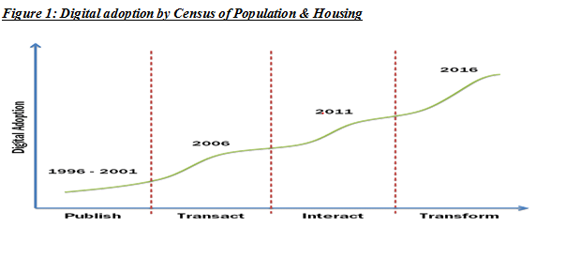
2016 AUSTRALIAN CENSUS OF POPULATION & HOUSING
The first truly digital Census

Slide 8
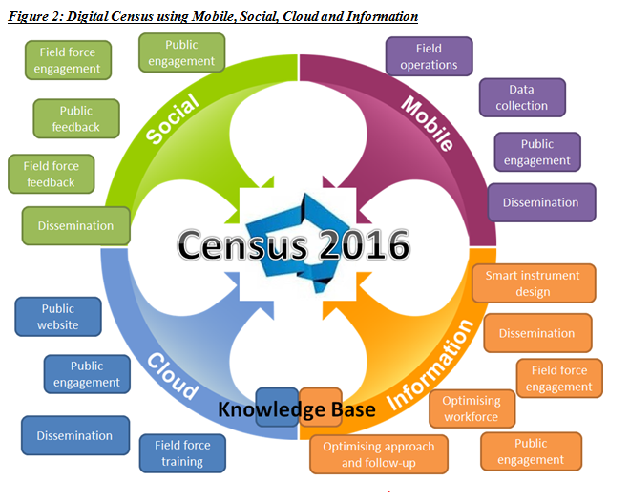
2016 DIGITAL CENSUS
The nexus of forces

Slide 9
2016 DIGITAL CENSUS
Aims:
Optimise field workforce deployment based on real-time data
Shift population to willing on-line respondents
A richer data set – targeted respondent prompts
Dissemination: analytics driven; personalised; visualisation
A broader agenda: Leadership & Capabilities

Slide 10
ICT CONTRIBUTION TO CULTURAL CHANGE
Core characteristics (themes):
agility & flexibility
dynamic, real–time decision making
external focus
responsibilities
leadership
technology management

Slide 11
AGILITY & FLEXIBILITY
ICT enables us to take a “citizen centric” view in how we can engage
Census now has a number of engagement channels
Change in organisational culture away from “one-size-fits-most

Slide 12
DYNAMIC, REAL TIME DECISION MAKING
Ability to access, collect, stream and integrate more data and information
The new approach to Census 2016 relies upon real-time decision making
Culture shift from defined, inflexible processes to immediacy and responsiveness

Slide 13
EXTERNAL FOCUS
Change drivers / game changers
Transformation : COTS / GOTS
Transformation capacity and capability
Whole of Government Strategies
Census
Strategic partnerships
Open source
Cloud
Culture shift: more open, responsive, participatory stakeholder engagement; collaborative partnerships

Slide 14
RESPONSIBILITIES
The lines are blurring between where business stops and ICT starts
Project teams must wear an “enterprise hat”
New structures, capability ownership, centralisation
Increased complexity: stakeholders; teamwork; communication; project management

Slide 15
LEADERSHIP
Business leaders technology literate
ICT Leaders business savvy
Census an exemplar of ICT/business partnerships, governance, engagement
ICT grows and exports business leaders
Now a strategic dimension

Slide 16
TECHNOLOGY MANAGEMENT
ICT investment, governance, project management and business value are no longer owned solely by the CIO/CFO
ICT
Not just operational/financial efficiencies
Business transformation
Business growth/wealth creation
Change in culture: managing ICT as a valued business resource

