Slide 1
Information Infrastructure: Foundations for ABS Transformation
Stuart Girvan,
Australian Bureau of Statistics
MSIS Paris, April 2013

Slide 2
Outline
ABS 2017 Transformation Vision and Information Infrastructure
Metadata Registry and Repository (MRR) & Statistical Workflow Management system (SWM)
Achievements so far
What’s next?
The journey
Notes:
Vision for ABS 2017 Transformation and the role of Information Infrastructure
The Metadata Registry and Repository (MRR) & the Statistical Workflow Management system (SWM)

Slide 3
Vision for ABS 2017 Transformation & the role of Information infrastructure

Slide 4
Enablers
Business Change
Benefits
Strategic Goals
Enterprise Architecture
Re-engineered, Improved Business Processes
Managed, consolidated & consistent business processes
Re-use processes
Processes captured as Services, Workflow – SOA
Grow business via new statistical products/services
Statistical Workflow Management System (SWM)
Survive and Thrive
Existing/new applications integrate with SWM/SOA
Managed, consolidated & consistent applications & components
Metadata driven processes
(Better) Tools and applications integrated with MRR
Process Assembly and
Automation
Existing/new applications integrate with MRR/EDW
Reduce time and cost of business operations
Metadata Registry and Repository (MRR)
Managed, consolidated & consistent metadata
Re-use metadata
EDW
Information Governance, Architecture & Management
Migrate corporate/foundation metadata to MRR
Notes:
The vision for the ABS 2017 Transformation program from a slightly tech point of view
Key outcomes of the 2017 program
Get to key outcomes by changing business – step change re-use of process, re-use of metadata and process automation
Get to re-use of processes and metadata by managing, consolidating and making consistent. Making available and changing culture.
The left hand most column shows the key elements of ABS2017 program, particularly those relating to Information Infrastructure, Enterprise Architecture and Business Process Reengineering
The end game:
For new collections statistical business managers assembling a significant amount of the statistical processes (from a catalogue)
For both new and existing collections, end to end statistical processes will be largely automated, driven by configured metadata
On the way we will develop (and derive significant benefits from)
Process re-use (business and supporting software services)
Metadata re-use
Metadata driven processes

Slide 5
Enterprise
Business
Re-use of common business processes
Process assembly, configuration and automation
Information
Re-use metadata
Application
Re-use application components
Component/service assembly
Business Transformation
Notes:
Business transformation
-Change across these layers often happened incidentally, e.g changing applications often inadvertently changes information requirements and business process
transformation must take a holistic approach if we are to achieve sustainable major changes in the way the agency works
And in order get the most out of business re-engineering statistical, information and technical staff need to work together and iterate through the potential opportunities provided by standardised processes, statistical information and automated workflow.

Slide 6
The role of MRR and SWM
MRR and SWM provide foundations for processes and metadata to be:
Managed
Consistent
Discoverable
Governed
Executable
Ultimately, re-usable, easily assembled, and in the case of processes, automatable

Slide 7
MRR AND SWM

Slide 8
What is MRR?
The Metadata Registry and Repository consists of two parts:
Repository – the centralised store for standards based metadata
Registry – the catalogue that tells you what’s in the repository
Notes:
Includes: statistical metadata, paradata/process metadata

Slide 9
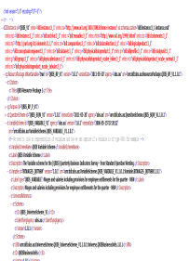
MRR – Registering & Retrieving Metadata
E.g. Register metadata
Repository
Complete metadata package resides in Repository
Registry
Register key elements of metadata package
Notes:
What gets registered vs what ends up in repository
What people/applications are likely to search on
Analogy – you can (advanced) search for books on amazon by keywords, author, title, ISBN etc, but not customer reviews, ratings, chapter titles, whether its available for pre-order etc.
We don’t yet know exactly what that constitutes but we will aim to keep it to the minimum number required to meet business needs (and therefore sustainable), the model is evolving (but very much based on GSIM) and the MRR is flexible and designed to support that evolution
Why not just put everything in the registry?
Don’t want to have to build and maintain our own standards
Why not just put everything in the repository?
Using different standards would make it difficult to search between them
Also unlikely a google-like search would be useful
Also as it grows potential performance implications

Slide 10
MRR – Registering & Retrieving Metadata
E.g. Metadata search
Repository
Search for metadata here
Registry
?
Pointer to Metadata in Repository
Returns list of relevant metadata held in the repository

Slide 11
MRR – Registering & Retrieving Metadata
E.g. Retrieve metadata from here
based on search results
Repository
Registry

Slide 12
MRR & standards
Repository
Registry
Mapping between the registration and the standard
Model of what we keep in a registration (ATMM- GSIM)
E.g.
DDI,
SDMX,
And ?
This will be the metadata content in the most appropriate standard (DDI, SDMX, etc)
Notes:
One of the key aspects of the MRR is the mapping b/w the registry and the repository.
The registry in effect has its own data model – called the ATMM. As mentioned it is designed to hold the key information about the metadata held in the repository. That data model, in effect, is close to an implementation of a subset of GSIM – the “Transitional” in the title refers to the fact that in future we would like that model to be wholly GSIM compliant.
We map between our registry model and the standards we accept (DDI and SDMX to start with)
As mentioned previously we will try to keep the number of standards we will deal with to the minimum number required to meet business needs for sustainability purposes. For flexible standards (DDI) we will have to have profiles so that developers know what they have to build against (issues, but not insurmountable)
Note: we would rarely expect users to interact directly with MRR – vast majority will be via other applications
Other MRR Design Considerations
Must talk to a range of applications
Web services interface
Must handle
Collection specific and corporate metadata (and links between them)
Versioning
Process metadata (paradata)
Metadata being registered in the MRR must meet specific standards if we are to achieve re-use and automation - this is not a registry built just to find metadata, it’s a registry built to enable active use of metadata

Slide 13
What is SWM?
Statistical Workflow Management System
ActiveVos (BPMS)
+ governance (e.g. Alignment of new processes to business architecture, Duplication of existing processes?)
+ processes for building workflow and orchestration
+ role and responsibilities

Slide 14
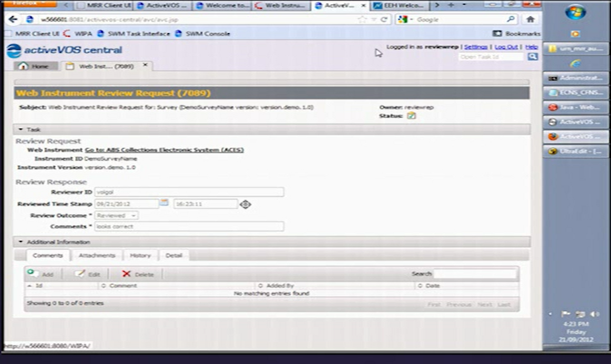
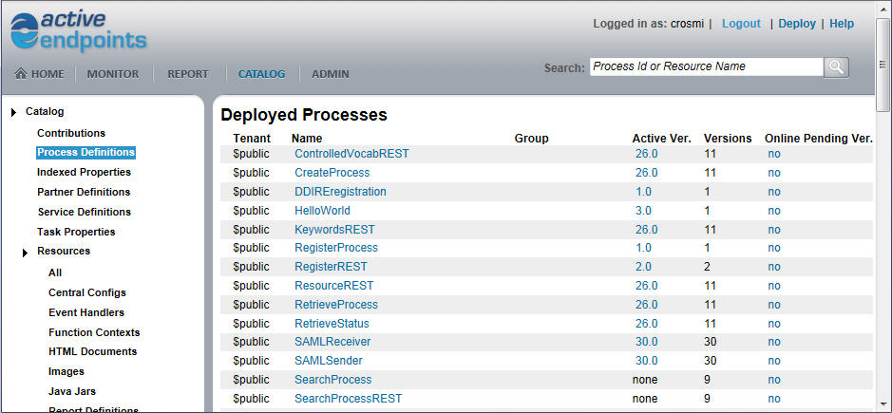
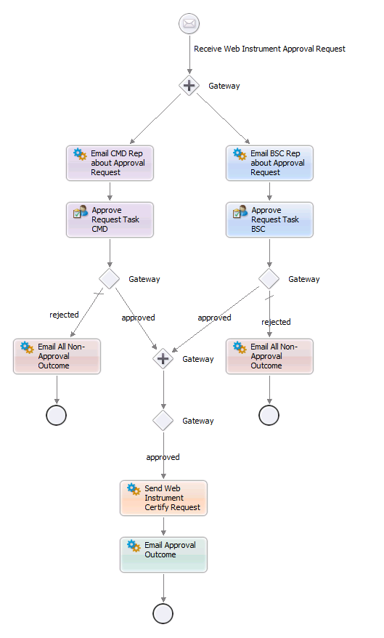
Notes:
ActiveVos
Process artefacts catalogue
Standards-based workflow modelling -> BPMN 2.0 &
Some inbuilt workflow interfaces (modify this interface or create our own) for standard process fragments
e.g. email, identity, approvals etc. and
Other features:
Web services based
Subscription/notification services
Integrates with a process design repository (Subversion)

Slide 15
WHAT WE have DONE so far and what’s next

Slide 16
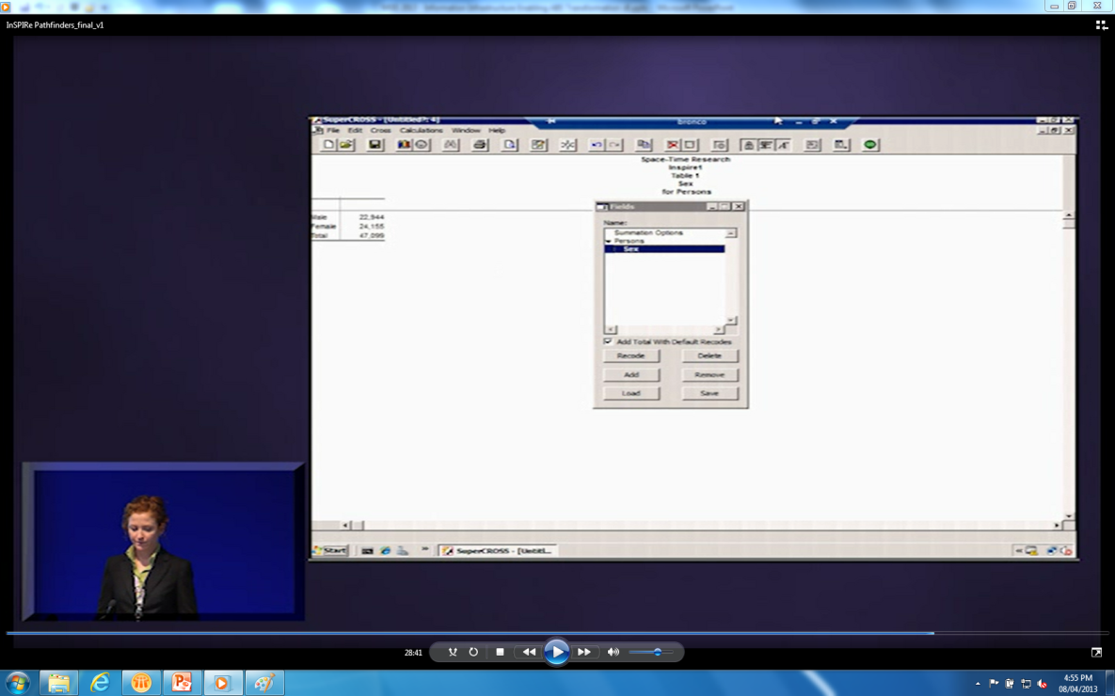
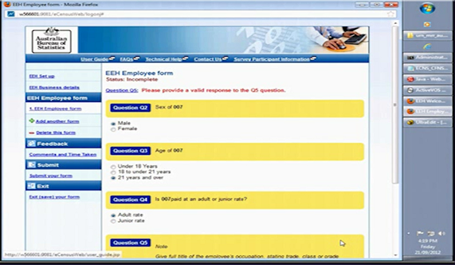
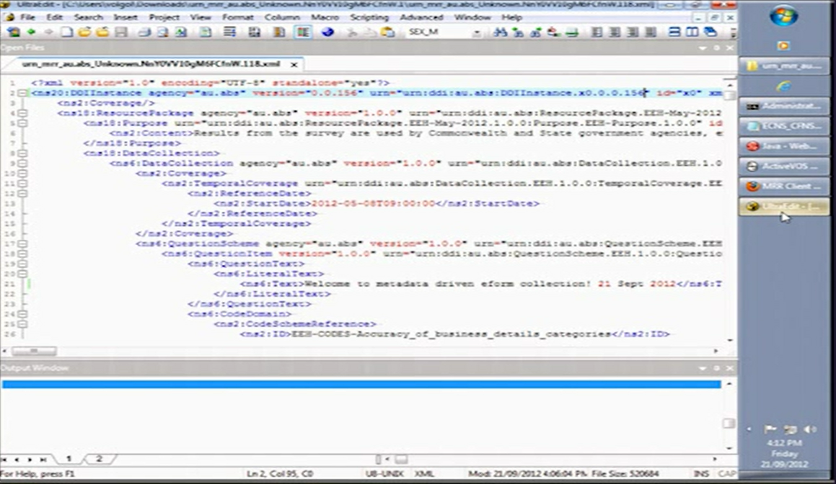
Notes:
What we’ve done so far
Proof of concept MRR in June 2011 and demonstration of use of DDI & SDMX
All vapourware, largely showed that we could handle and usefully use DDI & SDMX
Prototype “pathfinder” integration with real ABS systems- July 2012
Built MRR and deployed SWM in “test” environments
Demonstrates DDI in MRR being used to
Generate e-forms
Table creation from data warehouse in analysis tool
Register existence of new tables in MRR
Demonstrates SWM
Handling workflow for e-form approval
Handling a-synchronous events for long processes
Have videos available of demonstrators for people to copy if interested.

Slide 17
What have we learnt?
MRR works
DDI/SDMX successfully used
E-forms generation
Table production for analysis
Metadata queries for end user data sets
Notes:
MRR works – can handle the registration, search for and retrieval of metadata in different standards
DDI/SDMX can be successfully used in the contexts we have so far tested (e-forms generation, table production for analysis, metadata query for end-users)

Slide 18
What have we learnt?
SWM good for
doing things quickly
joining things up
coordinating and re-using processes
handling long, asynchronous events
Exposes and documents business process
Notes:
doing things quickly that we would otherwise have to code
joining things up – what you’d expect from high level workflow
coordinating and re-using processes - so far we’ve only re-used process at a fairly low level
Exposes and documents business process in a more transparent way (than code) or indeed business processes that are currently undocumented.

Slide 19
What’s next?

Slide 20
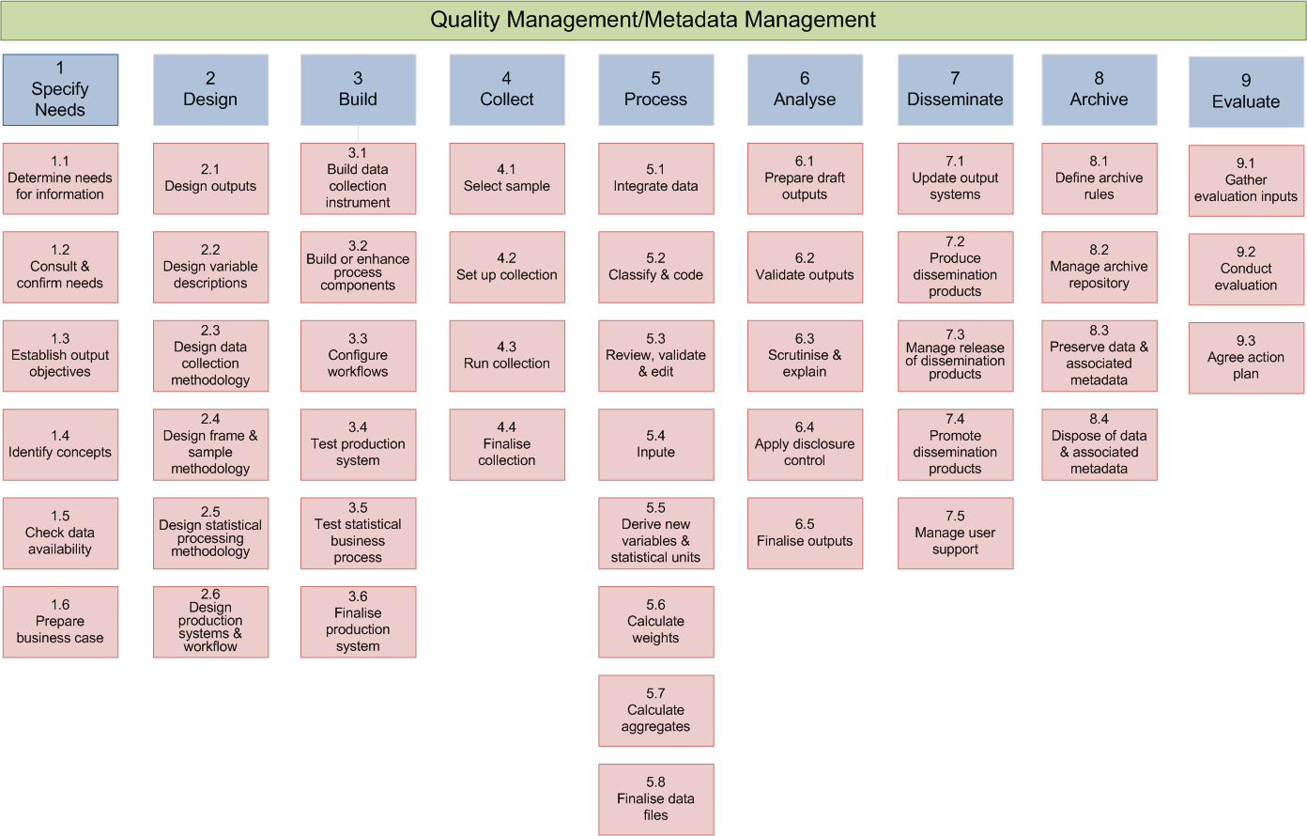
Collection
/Data Definition Tools
Instrument Definition
Tools
Instrument Generation
Tools
Run Survey/ Data Collection Tools
Input Data Warehouse and Tools
Processing,
Editing, Analysis Data Warehouse
and Tools
Output Data Warehouse and Tools
Disseminate
Tools
Corporate
Metadata Tools
Classification Management
Standard Question, Data Element (variable) Definition
Glossary Management
Topics Management
Corporate Metadata Registry
and Repository
Corporate Business Process
Tool and Repository
MRR
SWM
Notes:
Putting our suite of applications in the GSBPM context
We have a number of applications that support business processes at specific points in the collection cycle (“collection” metadata)
We also have a number of applications that support business and other applications across the cycle (“corporate” metadata)
We are currently building the MRR and SWM will support and integrate with both of these types of applications and the metadata they utilise
Production release of MRR V1.0 December 2013
Production release of SWM November 2013
Where do we start integrating with SWM/MRR? Working with specific collections to be our early adopters. Focusing on systems that support the front end of GSBPM and the systems they are dependent on , i.e. the systems that support corporate metadata such as classifications. Taking this approach as we need the solid metadata foundations before it can “flow” through the system
Refactoring and wrapping existing metadata authoring tools, (Collection, Classification, Question and Instrument metadata)
Describing and automatically ingesting admin data into our Enterprise Data Warehouse using metatata
E-form integration with MRR (auto generating e-forms, as much as possible, from metadata in MRR) – rebuilding of systems that support elements of the design, build and collect phases of GSBPM

Slide 21
Reaching the vision
Notes:
Now I want to talk a little bit more about what it is we’re trying to achieve and benefits we’d expect to gain along the way

Slide 22
Vision for Re-use: Existing Applications/Tools decomposed into re-usable bits
Any given application consists of
User Interface
Business Rules and Processes
Common, stable, reusable,
modular services
Services
Code that takes metadata and data, and does something with it (e.g. imputation)
Common (largely), stable, reusable, automatable workflow
Workflow & process orchestration
SWM
Data and Metadata
Common Statistical Metadata
MRR
Information about Statistical Data
Common Statistical Data
EDW
Statistical Data
Notes:
When we integrate existing applications with the information infrastructure , we have to decompose each application into the re-usable bits
Then centralise those common bits into our new infrastructure:
Centralise common data in EDW (our Enterprise Data Warehouse)
Centralise common metadata in MRR
Centralise common workflow into SWM
Centralise common services into a common services repository
You have to have repositories for common elements before you can assemble them into new tools and applications, or integrate them with existing tools

Slide 23
Vision for Re-use for New Applications/Tools
New Application
User Interface
Common, stable, reusable,
modular services
Services
Business Rules and Processes
Common (largely), stable, reusable, automatable workflow
SWM
Application Specific Code
MRR
Common Statistical Metadata
Data and Metadata
Common Statistical Data
EDW
Notes:
Once you have common repositories you can begin to use them to assemble new tools and applications

Slide 24
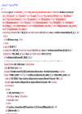
Vision for re-use and automation (& assembly)
SWM
User Interface
User Interface
User Interface
User Interface
User Interface
User Interface
Information Infrastructure Backbone
Services
SWM
MRR
EDW
Notes:
Vision for automation
As previously noted – data metadata largely held in MRR and EDW, services and workflow held in SOA/SWM
Driving cycles through configurable metadata - drives high level workflow
User still required to deal with specific standalone applications, but output from applications used to drive process forward as input to other apps as apps all speak the same language (using standardised metadata)
Users still required to perform quality checking, analysis, value add at certain points in process
Note that most applications would store data and metadata in the MRR and EDW, but will need capacity to deal with data locally from performance point of view, but authoritative versions of metadata and data held in information infrastructure.
Note that some applications effectively become simply a collection on services and/or orchestration of services at a low level via SWM, less need for interaction with low level applications
Vision for assembling process for new collections and capabilities from existing workflow, apps and metadata base, out of information infrastructure backbone

Slide 25
The journey, and wins on the way
User Interface
Configure and assemble processes from components
Business process greatly automated
Code small number of things, re-using a lot others
Business Rules and Processes
Information
Infrastructure Backbone
Data and Metadata
Services
User Interface
Some re-use of metadata and process via integrated tools
Some coding, some re-use of code
Tools begin to integrate
Business Rules and Processes
SWM
Data and Metadata
MRR
User Interface
Code most new applications
Different tools don’t play well together
Business Rules and Processes
EDW
Data and Metadata
Notes:
1 - IT people code the majority of new applications from scratch
Different tools don’t play well together
2 - IT people coding some things and re-using others, business people re-using metadata and process via some tools
Tools begin to play well with each other
This is really important – we will begin to see benefits along the way as systems begin to integrate with infrastructure backbone and each other – we are not waiting for the big bang where everything suddenly works together
3 - Some tools and components play so well together business users can now configure and assemble processes from components, Significant increase in automation, significant decrease in fixing data to fit applications and in trying to understand data’s genesis, IT people code small number of things, re-using a lot others

Slide 26
Enablers
Business Change
Benefits
Strategic Goals
Enterprise Architecture
Re-engineered, Improved Business Processes
Managed, consolidated & consistent business processes
Re-use processes
Processes captured as Services, Workflow – SOA
Grow business via new statistical products/services
Statistical Workflow Management System (SWM)
Survive and Thrive
Existing/new applications integrate with SWM/SOA
Managed, consolidated & consistent applications & components
Metadata driven processes
Metadata Registry and Repository (MRR)
Process Assembly and
Automation
Existing/new applications integrate with MRR/EDW
Reduce time and cost of business operations
(Better) Tools and applications integrated with MRR
Managed, consolidated & consistent metadata
Re-use metadata
EDW
Information Governance, Architecture & Management
Migrate corporate/foundation metadata to MRR
Notes:
Returning to the vision, information infrastructure, and MRR and SWM in particular, are critical to the business changes required to achieve the ABS 2017 transformation goals off reduceing the cost and time of business operations and allowing the agency to grow its business as efficiently as possible.

Slide 27
QUESTIONS?
Contributors: Chris Conran, Simon Wall, Gillian Nicoll

