Slide 1
Streamlining statistical production process in Eurostat
Artur Queiroz
Mihaela Vacarasu

Slide 2
A statistical vision for the next decade
change the ESS business architecture by replacing the traditional stovepipe model with an integrated model
COM(2009) 404 final, Brussels, 10.8.2009

Slide 3
Two projects in the ESS
Re-engineering the Agriculture and Fisheries Statistical Production Processes
Harmonising and Consolidating the National Accounts Production Systems - NAPS2

Slide 4
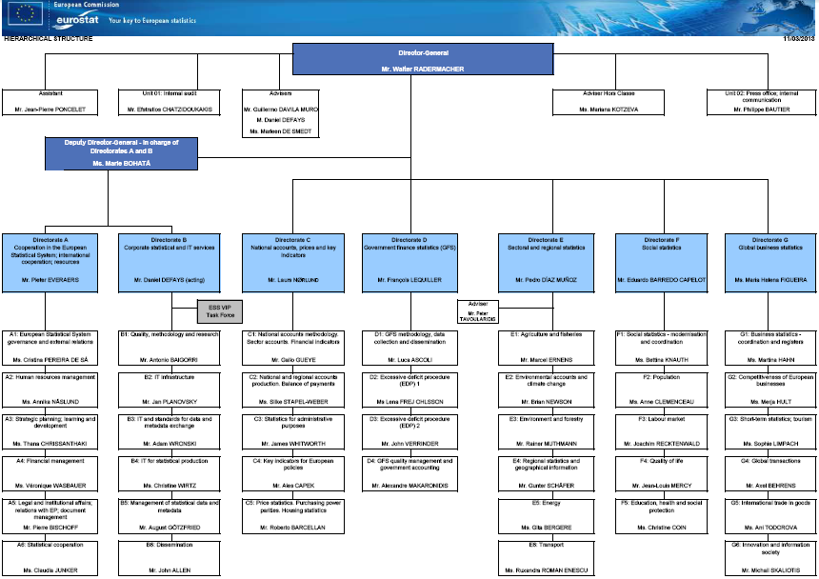


Agriculture & Fisheries - Context
Agriculture and Fisheries
50 years of history
30 people
6 statistical areas
Dozens of domains
Agriculture and Fisheries
too many different systems
local optimisation
no standard business process
high staff turnover

Slide 5
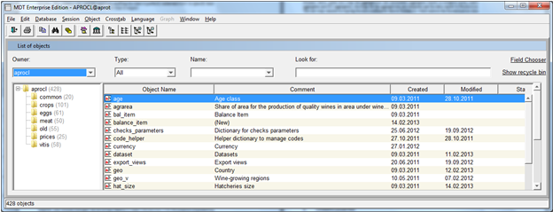
Agriculture & Fisheries - Project Goal
Create a corporate statistical system
  Migrate and reengineer to the central tool - MDT
  Discontinue the superfluous tools
Create a standardized statistical business process
  Reimplement the business logic where necessary
  Agree similar architectural elements for the domains

Slide 6
Project timeline
Pre-analysis
1st Wave
2009
2010
2011
2012
2013
2014
assess current state / create test databases
consolidation of test databases
implement 2 new domains – Crop Production Statistics, Absolute Prices
work done by an external contractor

Slide 7
Project timeline
!
Pre-analysis
1st Wave
2nd Wave
2009
2010
2011
2012
2013
2014
contractor based abroad → coordination issues
project moved in-house → better communication
easier project management
Client
IT unit
Contractor

Slide 8
Project Main Output
Definition of a to-be state for the statistical process
Apply the process in every upcoming domain
Many technical challenges had to be tackled…
Notes:
Challenges:
Flag mappings
Disclosure control
Revisions of code lists

Slide 9
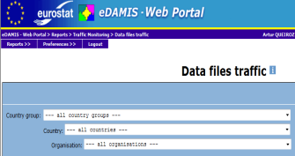
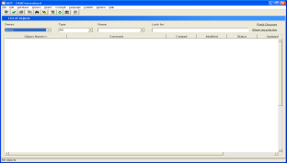
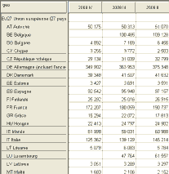


Collect
Process & Analyse
Disseminate
Input
Reference
DB
Primary
Production
Reference
Automatic Loader

Slide 10
National Accounts - Context
3 directorates
8 production units
21 production processes
4 applications
Fragmented processes
Difficult NA inter-domain exchanges

Slide 11
National Accounts - Objectives
documentation and IT analysis of the NA production process;
harmonisation of the NA domains and their IT environment;
consolidation of the NA domains.

Slide 12

National Accounts - Objectives
documentation and IT analysis of the NA production process
  Workflows – Production process;
  Business cases – Production process;
  IT harmonisation procedures – IT process;
  User and technical guides – IT process.

Slide 13

National Accounts - Objectives
2. harmonisation of the NA domains and their IT environment
Harmonise
Domain level
Process of standardizing :
  the IT standards
  the regulations and methodologies

Slide 14

National Accounts - Objectives
3. consolidation of the NA domains
Consolidate
System level
  Improved generic NA business model
  Better data exchange via common repository
  SOA

Slide 15
National Accounts – Timetable
Jan 2012
Pilot domain
Dec 2014
March 2012
May 2013
Name: NAMA - National Accounts Main Aggregates
IS used: FAME
        Align with IT standards:
        Align with applicable NA methodology

Slide 16
Lessons learned
Documentation is the key
Don't lose the big picture
The "Big Brother" effect
Stovepipe vs. integrated models: what do I gain?

Slide 17
Next steps
Capitalize on established structures
Flags in Eurostat
SDMX-ML – standard format for data exchanges

Slide 18
Questions?
Artur Queiroz
Mihaela Vacarasu

