Slide 1

Evolving our Business Model for Statistical Production
MSIS Conference, May 2012
Ann McPhail, IMF Statistics Department
Notes:
My presentation focuses on the work in the Statistics department to evolve our business model to meet increasing demands—potentially a tidal wave of new data coming our way.
My aim in giving this presentation to MSIS, is to contribute to an exchange of views and ideas around how our respective organizations are planning for the future of statistical production: how we envisage changing our business processes (eg data collection, validation, dissemination), any shifts in the kinds of products we offer, and the direction of our IT systems. If any of what I present resonates with you, please seek me out over the next three days and tell me how your organizations are coping, and let’s learn from each other.

Slide 2

Drivers of Change
Respond to Data Gaps Initiative by providing data to support analysis of spillover s and interconnectedness :
  Users want “more, better, faster” data
  Our budget is flat
More countries posting data, not reporting to STA (Gov 2.0, Open data initiative)
Competition by commercial sources (using data posted on web)
NSOs are “industrializing” their processes, & changing their product sets
Consumer needs and expectations
Notes:
Like many of you, we’ve been asking ourselves, what will statistical data processing look like in 5 years, what external factors will impact our work, are we prepared? Our our resources aligned with the right priorities?
The Data Gaps initiative, which was in response to the financial crisis, is a key driver of change for us. Specifically, there are 20 recommendations to fill data gaps that have been adopted by the G20 Finance Ministers and Central Bank Governors in November 2009. The DGI has brought increased visibility to the role of official statistics in evidence-based decision making; it provides a golden opportunity for producers of official statistics to increase important “market share” among policy makers and others who rely on high quality data for high quality decision making.
This opportunity comes with equal if not greater challenges, to produce “more, better, faster” data—within a flat budget.
The world is changing, people’s behaviors and expectations for consuming information are changing. The methods for collecting and sharing information are changing. Change seems to be the norm. Unless we evolve our processes and products, we will fall behind in meeting the demands of our organization and our users.

Slide 3
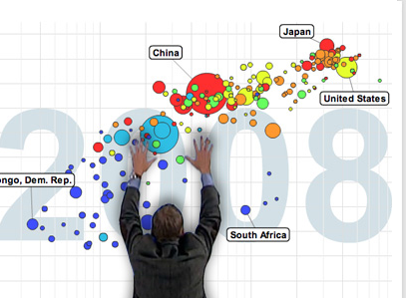
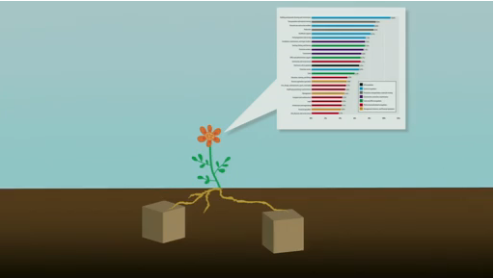
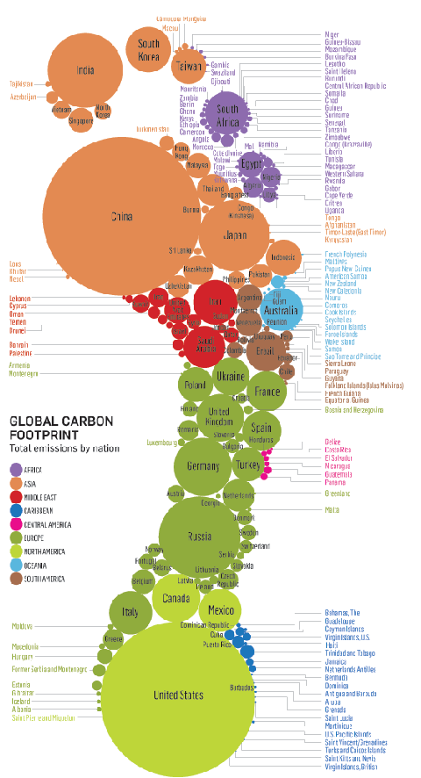
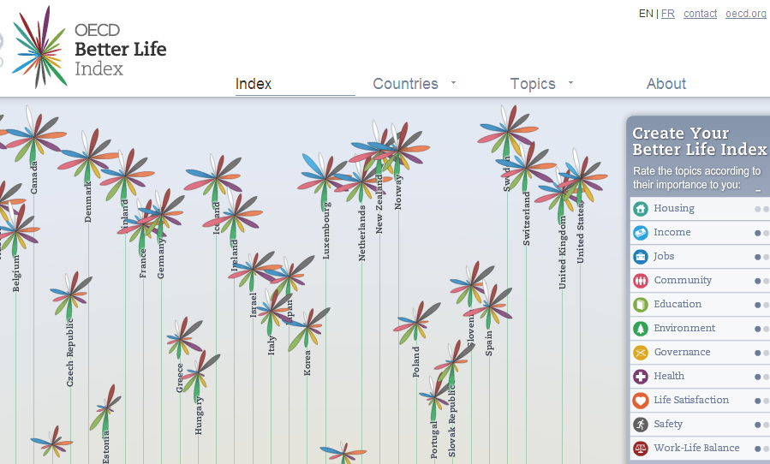
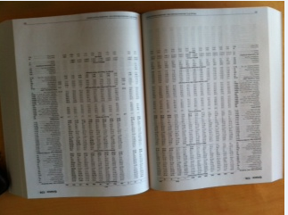
Our position in the value chain?
Source: conceptlink.com
Source: Hans Rosling
Our print publications
(people still want data tables, but...)
Source: oecd.org
Source: scienceblogs.com
Notes:
Changes in data dissemination have been among the most exciting to me and are driving user behaviors and expectations. We owe a debt to Hans Rosling for pointing out the need for more story telling to bring statistics to life. He said that statistics were underground, brown, boxy, boring; but when you combined them to tell a story, you could change people’s understanding of the world.
Our main statistical publications include metadata and data tables—our research tells us that our users still want the data tables, it helps them navigate our large cross-country databases. But data tables alone will not suffice. How will users discover our data, and make sense of it? We have taken small steps towards “Story telling”, such as the Data Spotlight feature in the Fund’s Finance and Development periodical. And our electronic publications have undergone substantial change as you will see tomorrow in the demonstration of the Fund’s eLibrary and eLibrary Data products.
Looking down the road, we are paying more attention to cross-sector data consistency (or inconsistency, as is often the case), and see this as a “high value added” area for STA.
Yes, we would like to do more “story telling” or otherwise help users make the best use of our data, but finding the time to craft these stories and finding easy to use tools is still a major challenge, particularly in times of flat budgets.

Slide 4
Product growth over the past 10 years
10 yrs ago | 5 yrs ago | Today
External Sector: BOP/IIP | BOP/IIP | BOP/IIP (analytical IIP)
 | CPIS | CPIS (sector, semiannual)
 | Reserves template | Reserves template
 | Quota | Quota
 |  | CDIS
 |  | JEDH/QEDS
Monetary & Financial: MFS for IFS | MFS for IFS/SRF/IMD | MFS for IFS/SRF/IMD (Other financial corps)
COFER/INFER | COFER/INFER/SEFER | COFER/INFER/SEFER
 |  | FSI
 |  | FAS
Real/Cross sector: IFS DOTS Quota | IFS | IFS
 | DOTS | DOTS
 | Quota | Quota
Fiscal Sector: GFSY | GFSY | GFSY
 |  | GFS-HF
... | ... | Cross Sector: PGI
All: SDDS metadata(51) | SDDS metadata (64) | SDDS metadata (70)
GDDS metadata (52) | GDDS metadata (90) | GDDS metadata (103)
Notes:
Our key concern at this stage in to manage the volume increases in data that we collect, validate and process. Here is a snapshot of the past ten years.
The first row of this table covers our data products in the External sector. Ten years ago, we had essentially one product, today we have expanded that product and added 6 new products, two of which, the CPIS and CDIS have proven very relevant in the financial crisis, by providing some insights into countries’ exposure to other countries’ debt, for example.
The second row covers our financial sector products. We are expanding our MFS data to cover OFCs, another key need arising from financial crisis. We have also added Financial Soundness Indicators and the Financial Access Survey.
While Real sector, in the 3rd row, hasn’t changed materially in the last ten years, the Data Gaps Initiative calls for Sectoral accounts data which will be a significant increase in data.
Two factors have enabled us to absorb this growth:
--In 2007 we completed a transition in our organization structure to a centralized statistical production model, this delivered a number of efficiency gains.
-- IT automation has been a great help in delivering efficiencies through automation, although we need to more in this area. We reduced processing times for running our data aggregation programs, we put more tools in the hands of data managers and eliminated the need to submit a large number of work requests to IT. To cite a few examples.
On the other hand, as a result of IT efficiency gains, we had to return a dividend to our budget office a few years back, and lost a few staff.
Then the downsizing came in 2009. We have since make liberal use of temporary/contractual resources and had a very modest increase in our staffing budget.
What keeps me up at night is wondering how we will manage the “tidal wave” of data that we see potentially coming our way, with a flat budget.

Slide 5

Directional Impact over next 5 years
Volume
(more countries, more observations, more datasets)
Source: arthursclipart.org
Year 5 baseline
Today’s baseline
Today
Year2
Year5
Time
Notes:
This is the tidal wave that I mentioned.
We analyzed the demands of the DGI and well as internal Fund initiatives (TSR, SDDS+), which are illustrated on this slide. On top of our baseline of existing products, which will continue to expand, as we add more countries and encourage higher frequency reporting (QNA, Semi-annual CPIS), we have accounted for the planned expansion of existing data sets and the addition of new data sets. We classified the demands according to impact and likelihood (the dotted line indicates a high degree of uncertainty.) The blue arrow from today’s baseline to Year 5 we feel
In addition to looking at how we can scale up our processes, we are also examining all of our products to determine what can be scaled back or possibly eliminated.
Even if the tidal wave does not come, this is the right time for us to plan as if it were, so that we are better able (agile) to handle the forces that will come out way, if not from DGI, then from Big Data or the next economic crisis.

Slide 6
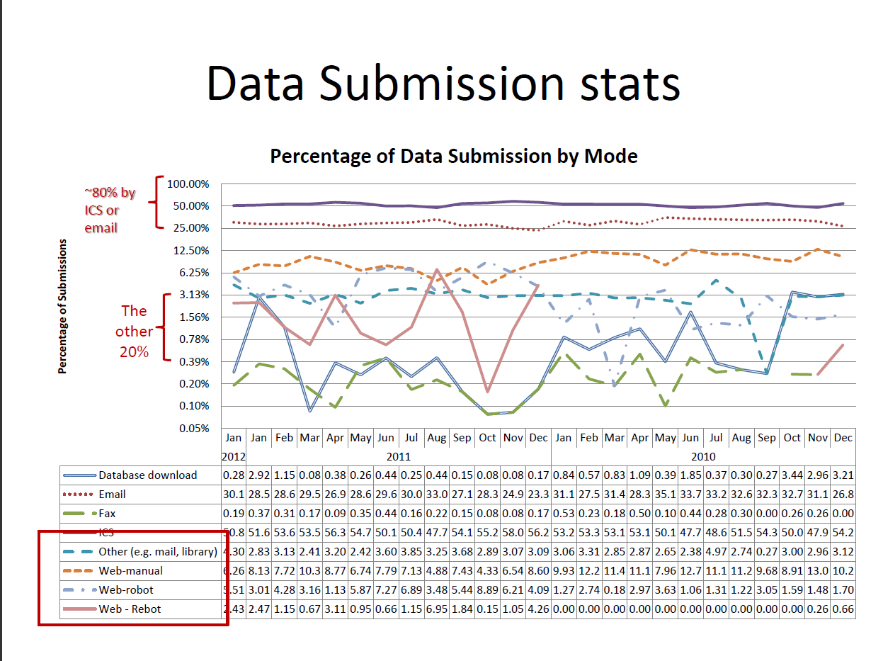
How the data arrive @STA
Notes:
Evolving our business model is the main thrust of our plans: moving towards more standardization, streamlining operations across topical domains and automating as much as possible.
I’ll share some examples of the challenges that we will be dealing. Let’s start with data acquisition. This slide is about the transmission mode of data to STA.
Around 80% of the data are reported to us in electronic format of one form or another (using our ICS system or email—this could be Excel or SDMX files, for example).
We pull around another 20% from web site, books, wherever we can find the data. We have invested in web scraping tools, which is fine for key indicators like CPI but does not work for large data sets, like BOP or GFS.
We’ve invested a lot in our ICS system, but we have been slow to gain additional users. The ICS allows a country to retrieve a report form, specify a date range, extract as much of their country data as they wish from our database and then update and return the form. ICS provides automation, e.g., for tracking reports, comparing new and old data, and automates the initial stages of data processing. The system was created more than 8 years ago, and well before Gov 2.0 and Open Data. The benefits have been sizable in terms of helping us manage volume, but the reliance on Excel presents many challenges. It handles SDMX files and we hope to get more of our data in SDMX format in the future. At the same time, we know NSOs are changing their systems and methods of data collection. We’d like to get ahead of the curve as methods and technologies change, for example, by promoting SDMX formats for Open Data platforms and Gov 2.0 initiatives.
We are also partnering more with regional and international agencies on data sharing and leveraging SDMX web services to extract data from their data warehouses. We see this as an important channel of data acquisition going forward.
Our conclusion is that the proliferation of methods for data collection, many of which are suboptimal, will hold us back unless we can find ways to improve country reporting, efficiently “harvest” bigger data sets, promote development of open government in a way that leverages SDMX so we can automate data harvesting.
We have some more ideas that we are investigating, as part of our change initiative. And we’d love to hear what others are planning in this area.

Slide 7
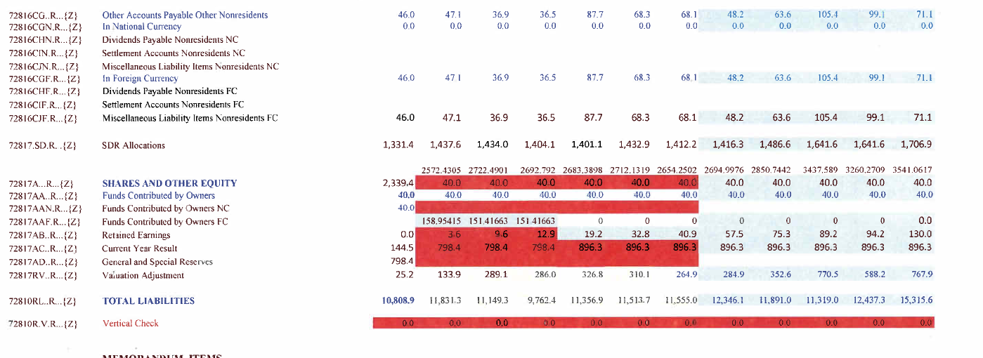
What it takes to get the data today...
Example for our statistical publications (IFS, BOPSY, DOTSY, GFSY)
1,200 report forms per month that can be processed
  Avg of 4 receipts processed per day per person
  Avg 8% submissions can’t be processes
  40% of staff are contractual, retraining at least every 4 years...
This form can be processed but only after:
adding zeros
realigning rows
adding non-reported xrate (not shown)
Notes:
Our processes for data collection vary by topical domain. We are still in the process of creating the “fact base” to fully describe our operations, the extent of--and need for, variations across topical domains. We also need to catalog the business rules that are embedded in different topical report forms so that we can begin to develop standards.
Here is an example from our core data sets, this is a structured report form that we manage; the country downloaded it usin the ICS, and this is what was returned: business rules for aggregation in this sector require that we add zeros to all blank cells. In this case, the country was able to unlock the file and move around rows, unfortunately, they misaligned data with the times series code on the left. In brief, my colleagues have to do a lot of clean up on this one form before it can be loaded to our processing environment.
We also have a legacy of report forms and business rules from the days when statistical production was decentralized to each topical domain. Variation across domains adds a lot of complications: MFS: add zeros, BOP: remove zeros, FAS: add three dots for ‘na’
From a staffing perspective, we are at capacity, with a heavy reliance on contractual staff which means a heavy training burden.
Conclusion: we could become much more efficient if we had standard methods and processes for report forms and processing across all domains. SDMX as a format would help enormously, but we also need to do more to standardize our internal operations.

Slide 8
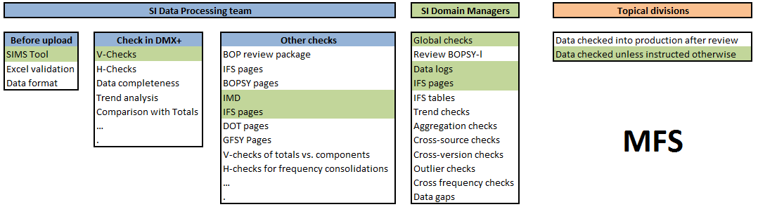
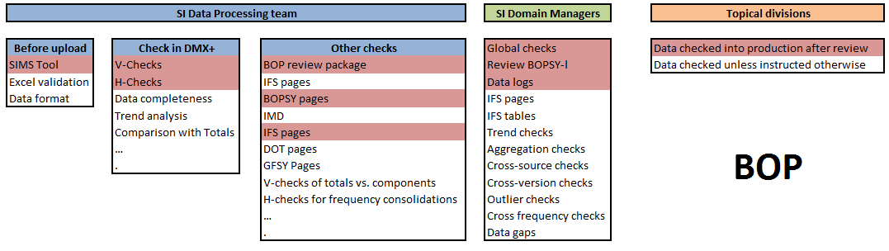
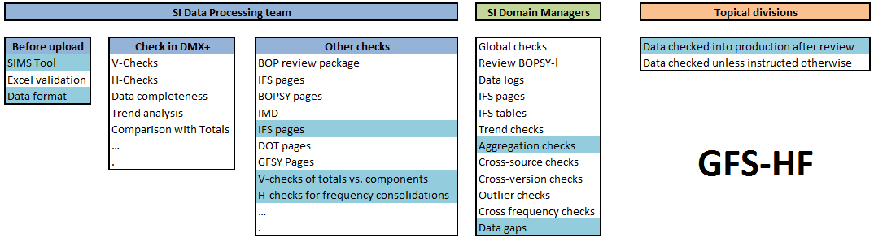
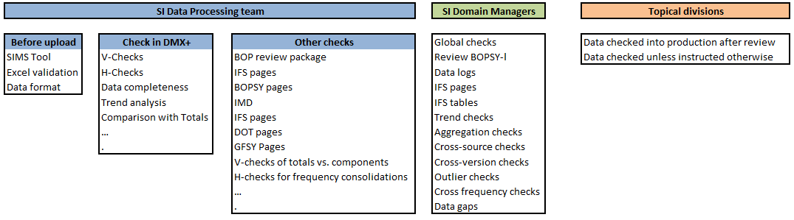
Types of Data Validation
Notes:
We spend a lot of time validating data. We have inventoried our various techniques into this simple presentation, but let’s look at the variation across topical domains.
Again, we have legacy processes that vary by data set and domain. New data sets have often been developed like a “cottage industry”, again, because we did not have standards in place, there was much reinventing of the wheel based on preferences rather than standards.
For validation, our conclusion is that we need to standardize or die trying to keep pace with volume growth. In addition, we would like to move away from a model where every number that enters our building is validated.
We would like to take a tiered approach to data validation, e.g., identify the priority data (master data, or core data) for which data quality must be assured. But we first need agreement on the levels of data quality (referencing our DQAF as relevant) and then agreement on the level of validation that each data set requires. If, or maybe when, the tidal wave of data hits us, we can pass through data that does not require validation for real time dissemination (at least within the Fund), perhaps with a stamp that identifies it as “unvalidated”. We have another working group looking at options for evolving our validation practices, so we are still deliberating on the next steps.

Slide 9
Organizational Considerations
STA Topical Domains
External Sector BOP/IIP, CPIS, Reserves...
Monetary Sector MFS/IFS, COFER/INFER
Real Sector NA, Prices, Trade, Employment
Fiscal Sector GFSY
Dissemination Standards SDDS, GDDS, DQAF
Pre-2007 Decentralized Data Operations
1-2 divisions
1-3 divisions
1 division
1 division
1 -2 divisions
2007 Centralized Data Operations
1 division | New SI division (data)
1 division
1 division
1 division
1 division
Notes:
STA has undergone organizational changes over time. In my early days in STA, there were 4 topical domains (this was before the establishment of the SDDS and the DSBB). There were always 2 Monetary and Financial sector divisions (divided by countries/languages), this expanded temporarily into 3 when with the split up of the FSU.
Centralizing our statistical production activities was a huge step for the Department towards a more standardized and streamlined data operations. Efficiencies were realized -- STA was able to pay our budget office the dividend it required from IT investments. We achieved a lot of standardization across countries within a given domain, but are still struggling to standardize across all divisions: BOP economists (in the BP division) had one way of tracking data reporters, reviewing data, and their own ideas about publication. Ditto for the MFG division and the GO division.
SI has a unique “end-to-end” view of our data and metadata operations but the decision making remained largely with the topical divisions. SI negotiates and influences, but with one division at a time and not always successfully. We still have plenty of legacy processes, and divisional variations that don’t appear to be necessary. We need a more centralized decision making model.

Slide 10
Recent Developments
2012 Centralized Data Operations & Governance
BOP - Balance of Payments | SI - Statistical Information Management
MFS - Monetary and Financial Statistics
RE - Real Sector
GO - Government Finance
DR - Dissemination and Review
Governance Committee for Data Initiatives
Governance Committee for Print/Electronic Publications
What we collect, data priorities
What and how we publish
Notes:
The department recently formalizef two new governance structures. We now have a cross-division Task Force, headed by a B4/Deputy Director, that is accountable for decisions about data initiatives--what to collect, where to apply priorities, eg in terms of timeliness and accuracy, and a sense of high value add versus low-value add in our products. And we have a high level steering group, also headed by a B4/Deputy Director to oversee our print and electronic publications strategy.

Slide 11

Governance – a missing link
Reach agreement on priorities, e.g., for tiered validation
Adopt and promote standards across data sets
More clarity on shifts in user base
Coherence in publications strategy
Image source: http://www.bazaarvoice.com/blog/2011/01/27/cmos-think-they%E2%80%99ll-find-the-%E2%80%9Cmissing-link%E2%80%9D-in-2011/
Notes:
Yes, governance was a key missing link in our ability to evolve our business model. With these governance bodies in place, we can move forward on several fronts: to reach agreement on priorites, to implement standards, to ensure coherence in our publications strategy.

Slide 12
Opportunities
Leverage our advantages:
Brand name
Country relationships: through TA, training
Organizational partnerships: e.g., Inter Agency Group
Technical and process standards: SDMX, GSBPM, GSIM
Focus on products that are relevant, meet users’ needs
Streamline, Standardize, Automate
“Start Small, Plan Big”
Source: HLG-BAS
Notes:
We are now well positioned to carry forward our change initiative, using all the levers at our disposal: brand name, country relationships, organizational partnerships, standards such as SDMX, GSBPM, and GSIM. Our strategy will be to streamline, standardize and automate, and talking a lesson learned from some HLG-BAS literature that I came across, we will ‘start small, but plan big”.
Thank you for your attention.

