Slide 1
Development of Inter-Ministry Information System for Official Statistics (IMISOS) under the efforts for The Optimization Plan of Operations and Systems for Statistical Work
Experiences of Architecture in Japan
Meeting on the Management of Statistical Information Systems (MSIS 2012)
Washington, DC, 21-23 May 2012
Shunsuke Kimura and Ken Hoshino
Ministry of Internal Affairs and Communications of Japan
Statistics Bureau,
Ministry of Internal Affairs
and Communications

Slide 2
Contents
Framework of Architecture
Effective Information Management
Dissemination
Collection
Other functions
Conclusion and Challenges
Statistics Bureau,
Ministry of Internal Affairs
and Communications

Slide 3
Framework of Architecture
Statistics Bureau,
Ministry of Internal Affairs
and Communications

Slide 4
1. Framework of Architecture
The Optimization Plan of Operations and
Systems
In 2006, Japanese government made a government-wide
strategic plan in order to promote “e-government” as a
part of administrative reform
Statistical system of Japan
the decentralized one
prone to the redundant operations and systems
It is desirable to overcome the disadvantage
Statistics Bureau,
Ministry of Internal Affairs
and Communications

Slide 5
1. Framework of Architecture
“The Optimization Plan of Operations and
Systems for Statistical Work” was adopted in 2006
improve public statistical services
improve convenience and security of responses by survey
respondents
reduce public statistical work load
save public statistical expenditure
centralize the statistical information systems
the statistical information systems of different ministries were
integrated into the
“Inter-Ministry Information System for Official Statistics (IMISOS)”
Statistics Bureau,
Ministry of Internal Affairs
and Communications

Slide 6
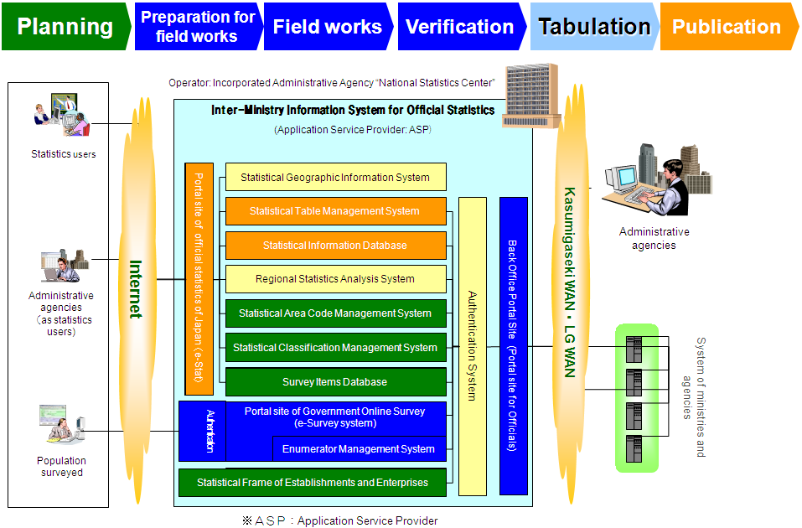
1. Framework of Architecture
Concept of the IMISOS
based on the “architecture” that integrates system components
contributes to “streamlining” of public statistical work
Statistics Bureau,
Ministry of Internal Affairs
and Communications

Slide 7
2. Effective Information Management
Statistics Bureau,
Ministry of Internal Affairs
and Communications

Slide 8
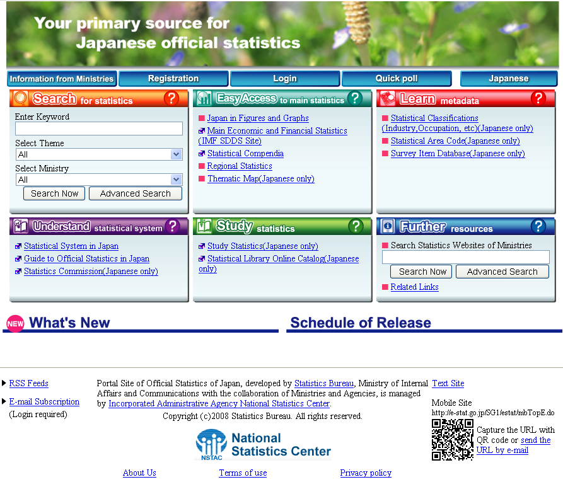
2. Effective Information Management (Dissemination)
The “e-Stat” site provides “One-Stop-Service”
collects and integrates statistical information from the websites
of all ministries
provides various statistical services via Internet
http://www.e-stat.go.jp/SG1/estat/eStatTopPortalE.do
Statistics Bureau,
Ministry of Internal Affairs
and Communications

Slide 9
2. Effective Information Management (Dissemination)
Search for Statistics
e-Stat saves Excel, CSV or PDF files of statistical tables
Users can search by keyword, theme, and ministries
Users can browse, download, and draw out tables and graphs
Easy Access to main statistics
Users can grasp the latest statistical indicators by numbers and
graphs
Statistics Bureau,
Ministry of Internal Affairs
and Communications

Slide 10
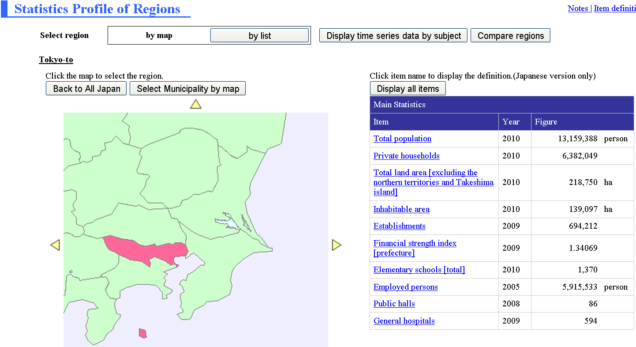
2. Effective Information Management (Dissemination)
Regional Statistics Analysis System
Users can browse principal data such as population and the total
land area of each prefecture and municipality in detail
Statistics Bureau,
Ministry of Internal Affairs
and Communications

Slide 11
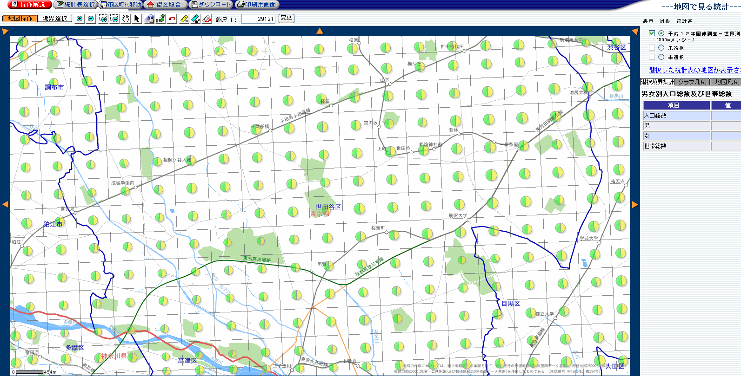
2. Effective Information Management (Dissemination)
Statistical Geographical Information System
Users can download statistical data together with geographic
information
concerning prefectures, municipalities, and more small areas
such as “500m×500m Mesh Statistics”
Statistics Bureau,
Ministry of Internal Affairs
and Communications

Slide 12
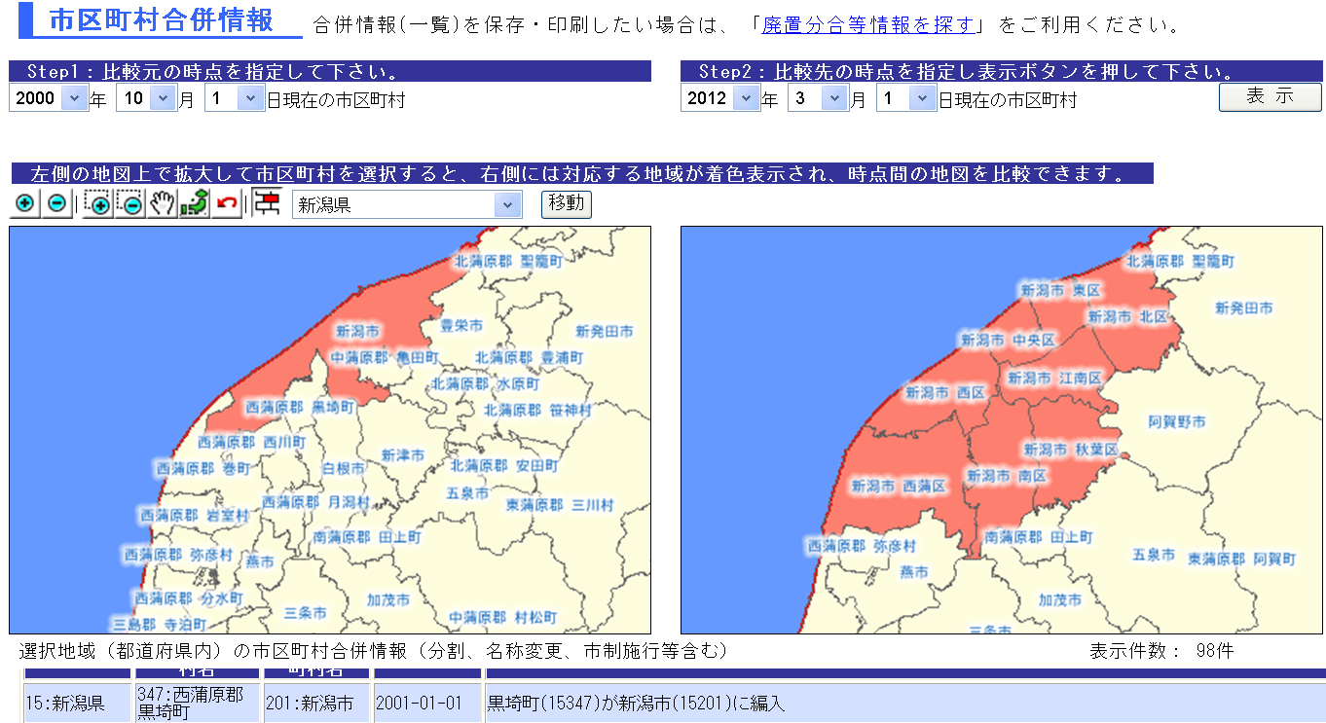
2. Effective Information Management (Dissemination)
Statistical Geographical Information System
Users can easily grasp the situation concerning the merger of
municipalities
Statistics Bureau,
Ministry of Internal Affairs
and Communications

Slide 13
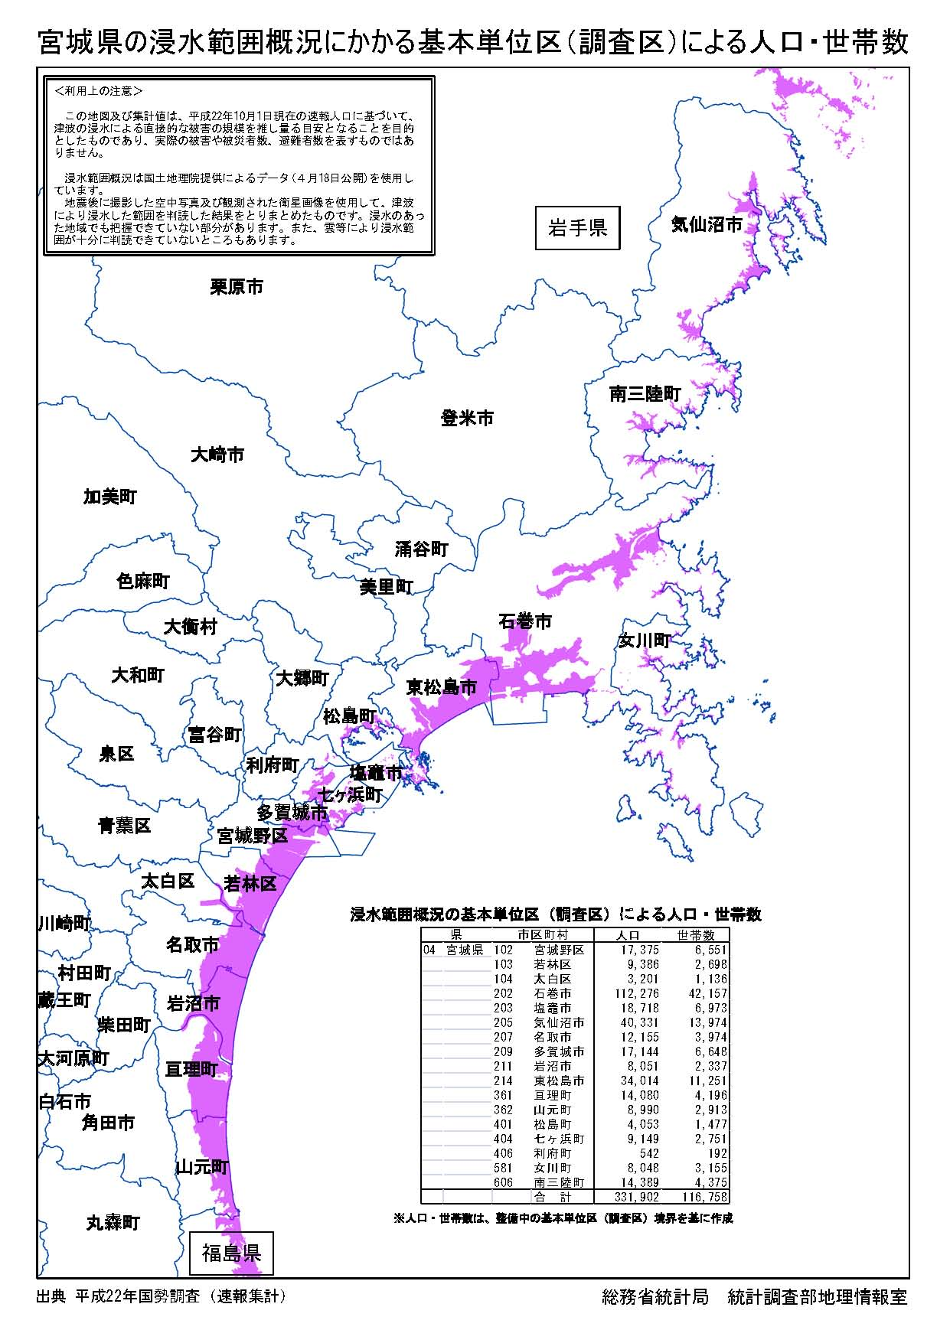
2. Effective Information Management (Dissemination)
Emergency measures
The e-Stat contributed to providing information about
“The Great East Japan Earthquake”
For example, we had posted the map of the flooded area, and number of population and households there
Statistics Bureau,
Ministry of Internal Affairs
and Communications

Slide 14
2. Effective Information Management (Collection)
Survey respondents have been complicated to
respond to surveys
respect for privacy, diversification of their lifestyle and such
The “e-Survey” system
makes it possible for people and enterprises to conveniently
respond from their homes or offices via the Internet
operates under a rigorous security measure
provides automatic data editing
The ministries need only to make an electronic questionnaire (Excel,
PDF or HTML) to use e-Survey system
Statistics Bureau,
Ministry of Internal Affairs
and Communications

Slide 15
2. Effective Information Management (Collection)
Enumerator Management System (“EMS”)
The e-Survey system contributes to the statistical operation of
“Field works” by coordinating with EMS
The EMS enables to relate the enumerators to the enumeration
districts
Each enumerator can check the online survey responses in each
enumeration district
Each enumerator takes charge of the collection by using
together with paper questionnaire
Statistics Bureau,
Ministry of Internal Affairs
and Communications

Slide 16
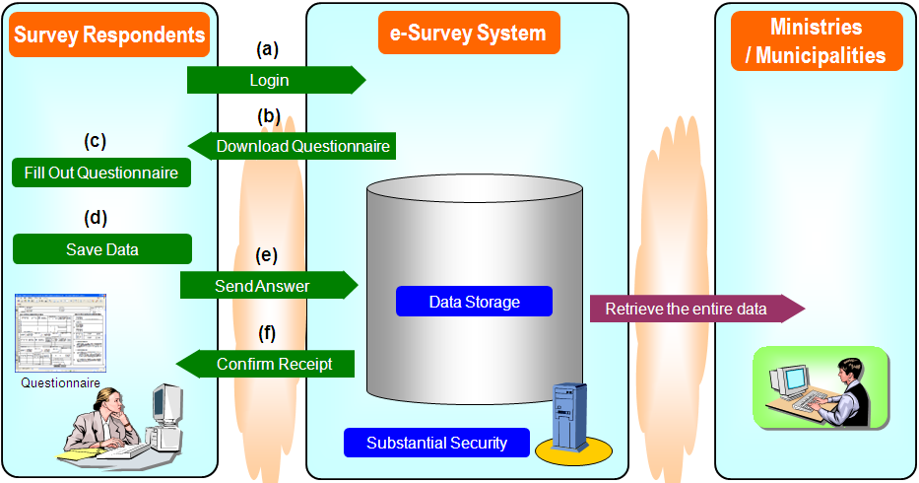
2. Effective Information Management (Collection)
The process of accessing the e-Survey system
Login by entering the ID and password
Download the electronic questionnaire from e-Survey system
Complete the questionnaire responses
Save the responses in electronic form (can be saved with password)
Send the responses to e-Survey system
Receive confirmation of the acceptance of the data of the questionnaire
Statistics Bureau,
Ministry of Internal Affairs
and Communications

Slide 17
2. Effective Information Management (Other functions)
Statistical Frame of Establishments and
Enterprises
a business survey frame (database system)
has population information concerning establishments and
enterprises
assists in collecting samples and avoiding repetition of survey
respondents
manages the historical answer-record of surveyed objects
Survey Items Database
records items and questionnaires used in Statistical Surveys
Users can search metadata such as definitions of items
Statistics Bureau,
Ministry of Internal Affairs
and Communications

Slide 18
2. Effective Information Management (Other functions)
Statistical Classification Management System
Japan Standard Industrial Classification
Japan Standard Occupational Classification
Japan Standard Commodity Classification
Classification of Diseases, Injuries and Causes of Death
Statistical Area Code Management System
manages information concerning changes regarding
municipalities such as mergers, name or boundary changes, and
a Statistical Area Code
possible to grasp these transitions via a timeline
Statistics Bureau,
Ministry of Internal Affairs
and Communications

Slide 19
3. Conclusion and Challenges
Statistics Bureau,
Ministry of Internal Affairs
and Communications

Slide 20
3. Conclusion and Challenges
IMISOS proved to be successful
Users can obtain their desired statistical information
Users can obtain various useful functions which make good use
of dissemination technology
Survey respondents can conveniently and securely respond from
their homes or offices vie the Internet
Statistical systems expenditure and statistical work load can be
saved
Good cooperation of all ministries is built
Statistics Bureau,
Ministry of Internal Affairs
and Communications

Slide 21
3. Conclusion and Challenges
Statistical survey results in IMISOS
The e-Stat system delivers the data of about 450 surveys
and 870 thousand of statistical tables
Almost all of the main statistics in Japan have been stored in
IMISOS
The number of accesses from users to e-Stat
The number of accesses has increased each year
The number in FY 2010 was more than 78 million
Statistics Bureau,
Ministry of Internal Affairs
and Communications

Slide 22
3. Conclusion and Challenges
Japan’s Architecture
Integration
Communication & Consensus among Ministries
Project team
The CIO Council
Statistical Officers and Information System Officers
of all the Ministries
Chief Information Officers
of all the Ministries
Reports the progress of the Optimization Plan each year
Statistics Bureau,
Ministry of Internal Affairs
and Communications

Slide 23
3. Conclusion and Challenges
Japan’s Architecture
Effectiveness
Save the expenditure (finally)
The systems expenditure by 480 million yen
(about 6 million dollars) each year
Reduce the work load (finally)
The work load of 3,000person-days each year
Statistics Bureau,
Ministry of Internal Affairs
and Communications

Slide 24
3. Conclusion and Challenges
Japan’s Architecture
Enrichment
New Services for Power Users
API (Application Programming Interface) for
Statistical Information Database
Enhanced publicities for Potential Users
Statistics Bureau,
Ministry of Internal Affairs
and Communications

Slide 25
3. Conclusion and Challenges
Japan’s Architecture
Present Architecture
Current IMISOS (Integration)
15 systems have already been transferred into IMISOS
11 systems will be done
Online Survey Method
Effectiveness
Enrichment of Service
【Key to success】
◆ Setting goals and visions
◆ Leadership of the MIC
◆ Cooperation (Communication and Consensus)
of all Ministries
Future Architecture
Complete IMISOS
Statistics Bureau,
Ministry of Internal Affairs
and Communications

Slide 26
Thank you very much
Statistics Bureau,
Ministry of Internal Affairs
and Communications

