Slide 1
Safe Centre Network Need for Safe Centre to enrich European Research
Maurice Brandt (Destatis) and David Schiller (IAB)
Work session on statistical data confidentiality, Ottawa (2013)

Slide 2
Outline
Important European Projects dealing with the Safe Centre approach
What is a Safe Centre
Pros and Cons of a Safe Centre
Need for Cooperation
A Safe Centre Network
Summary and Outlook

Slide 3
ESSnet DARA
“Decentralised And Remote Access to confidential data in the ESS” (DARA)
European Project from October 2011- November 2013, with 6 Partners in 5 Member States, funded by the European Commission (70%)
Task: Implementation of a pilot of a Remote Access connection from NSI Safe Centres to the EU statistics at Eurostat
Main Output:
Accreditation Guidelines for Access Facilities
Successfully tested Pilot for an European Remote Access System
Handbook for ESS staff and researchers

Slide 4
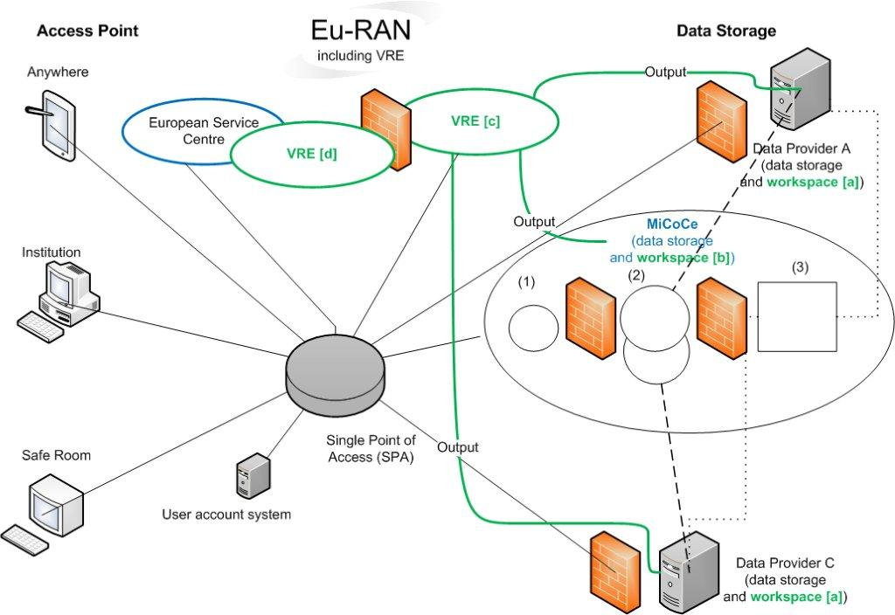
DwB WP4
EC FP7 funded project with 29 partners from 11 European countries
Deals with topics like: legal issues, resource discovery, data documentation, disclosure control, forcing communication etc.
WP4: “Improving Access to OS microdata”
Main output: Proposal for a European Remote Access Network (Eu-RAN) – see other talk

Slide 5
Safe Centre
Access point with two structuring levels:
Safe room
Physical room with access control
Equipped only for access the regarding microdata
Monitored by trained local staff
Organizational structure
Fixed agreements and contracts
Security requirements, responsibilities etc.
Resulting in trust between Safe Centre and data owner

Slide 6
Pros and Cons
Pros:
Less traveling to reach confidential microdata
More data access and endpoint under control
Some data will only be available in this setting
institutionalization of international microdata access
Cons:
Less traveling but still traveling
Costs for setting up and running a Safe Centre
Trained and trusted staff is needed

Slide 7
Need for Cooperation
Safe Centres need…
…accreditation criteria
agreed and harmonized standards and
partners willing and experienced to run such an infrastructure.
Coordination is needed on three levels:
Organizational
Technical
Legal

Slide 8
A Safe Centre Network
Safe Centre could be set up all over Europe
Researchers would have to travel not more than, e.g. 300km
A sophisticated technical solutions is needed to access data in an secure way
A board has to coordinate the network
Agreements and trust are needed

Slide 9
Summary and Outlook
Possibility to institutionalize microdata access
Accredited Safe Centres create trust
Might be the only way of access for some data
Can be seen as a starting point for international microdata access
Future work on standards and harmonized procedures

Slide 10
Thanks for listening
maurice.brandt@destatis.de
david.schiller@iab.de

