Slide 1
Statistical Methodology for the Automatic Confidentialisation of Remote Servers at the ABS
Session 1 UNECE Work Session on Statistical Data Confidentiality 28-30 October 2013
Daniel Elazar
daniel.elazar@abs.gov.au

Slide 2
Confidentiality Risks for Remote Server Outputs
Known Types of Attack from the literature
Tabular attacks
Averaging
Differencing
Scope coverage
Sparsity
Regression attacks
Tabular attacks as above, plus
Leverage
High R2 – saturated or ideal model fit
Influence
Solving model equations
Notes:
Most analyses will be fine BUT we need to protect against the risky situations
Not possible to identify all unknown risks

Slide 3
TableBuilder Functionality
 | Weighted | RSEs
Counts | R | R
Estimates | R | R
Means | R | R
Quantiles | R | R

Slide 4
TableBuilder Protections
Protection | Description
Perturbation | Statistical noise added to values
Custom Ranges | min, max, min interval width
Field Exclusion Rules | Certain combinations of variable that increase identification risk are prohibited
Additivity | Restores additivity of inner cells to margins
Sparsity checks | Tables with too high a proportion of cells with a small number of contributors are not released
RSEs | Further adjusted; quality cutoff

Slide 5
DataAnalyser Functionality
Exploratory
Data Analysis
Transformations
/ Derivations
Analysis
Procedures
/Specifications
Output
Formats
Outputs
Logical derivations
Categorical/ Dummy variables
Category collapsing
Expression Editor for categ. vars
Drop variables / records
Action List
Robust Linear Regression
Binomial logistic
Probit
Multinomial
Poisson
Diagnostics
Weighted Analysis
R-squared
Pseudo R-squared
Coefficients
Standard errors
Other Diagnostics
CSV
Storage of intermediate datasets
Summary statistics
(sums, counts)
Summary Tables
Graphics
(side-by-side box plots)
Summary statistics
(count)
Graphics
Written in R
Full User Authentication
Audit System
Workflow Control
Data Repository Interface
Metadata Handler

Slide 6
DataAnalyser Protections (additional to TB)
Perturbation | Statistical noise added to regression score function
Linear Robust | Huber Mallows robustness incorporating perturbation for outliers and leverage points
Hex Bin Plots | Replaces scatter plots
Coverage and scope based Perturbation | Perturbation controlled by the specific units included in scope and the definition of scope
Drop k units | One record is dropped for each category of each explanatory categorical variable
Explanatory Only Variables | Demographic variables not allowed in the response variable field
Sparsity | Regressions based on to few units are not released
Leverage | Regressions on data containing units with excessive leverage are not released

Slide 7
So where’s the Risk in Regressions?
x₁,x₂,…,x_{n}
x₁
x₁,x₂,…,x_{k}
Saturated Model
Sparse Model
The Perfect Model
y
$$e^{\left(\frac{x}{x−c}\right)}$$
c
x
Leverage Attack

Slide 8
Scope-Coverage (Differencing) Attack
Case 1
Case 2
15
Age
95
96
15
Age
95
96
A
B
A
B
Other Characteristics
Other Characteristics
Confidentialised outputs from requests A and B differ slightly
→ unit(s) (in red) exists in set B excluding A and are likely to be rare/unique
Confidentialised outputs from requests A and B are exactly the same
→ There are no units in set B excluding A
Notes:
Assume
Coverage based perturbation only is used in remote server
Attacker knows this
Scope-Coverage Attack is launched as follows:
Attacker makes a request defined by scope A
Attacker makes another request defined by scope B (which is only very slightly different to that of scope A)
If outputs from request are different then attacker knows there is a 96 yo with ‘other characteristics’ in the data

Slide 9
Perturbation of Unweighted Counts
Unweighted Count (UWC)
$$CKey=mod\left(\sum{{RKey}_{i}},bigN\right)$$
p_{col_index}
. | . | . | . | . | .
. | -3 | +1 | 0 | -3 | .
. | 0 | +6 | +1 | +3 | .
. | +4 | -2 | +5 | -4 | .
. | -2 | -5 | -1 | -2 | .
. | . | . | . | . | .
p_{row_index}
pUWC = UWC + p
p = pTable[ p_{row_index,} p_{col_index} ]
Perturbation Table

Slide 10
Perturbation of Unweighted Counts
p = pTable[ p_{row_index,} p_{col_index} ]
$$\underbrace{ CKey } ≝ \underbrace{ A } \underbrace{ B } \underbrace{ C } \underbrace{ D }$$
32 bits 8 bits 8 bits 8 bits 8 bits
$p_{row_index}=A ⨁{B}⨁$ C $⨁$ D $⨁$ is the bitwise XOR operator. ${\left(A⨁{B}\right)}_{i}=$ $A_{i}$ + $B_{i}$ (mod 2), for $i$’th bit
$p_{col_index}=\left\{\begin{aligned}n if n≤pTableSize−smallN \\ \\ pTableSize −smallN+ \\ n\left(mod smallN\right)+1 otherwise \end{aligned}\right.$

Slide 11
The Perturbation Algorithm:
Protects against differencing
Ensures that the same cell value receives the same perturbation (prevents averaging)
Does not perturb zero cells
Will not produce negative values for counts
Applies relatively more noise to smaller values
Does not add bias

Slide 12
Perturbation of Weighted Continuous Values
$$pWY=\sum_{i=1}^{n}{w_{i}y_{i}}+\sum_{i=1}^{topK}{d_{i}m_{i}s_{i} w_{i}y_{i}}$$
where
$d_{i}=\left\{\begin{aligned}+1 if 9^{th} bit of {\left(RKey\right)}_{i}=1 \\ −1 if 9^{th} bit of {\left(RKey\right)}_{i}=0\end{aligned}\right.$
direction
$m_{i}=$ mTable[i]
magnitude
$$s_{i}=sTable[s_{row_index}\left(i\right),s_{col_index}]$$
noise
$$s_{row_index}\left(i\right)=1^{st} 8 bits of {\left(RKey\right)}_{i}$$
$s_{row_index} =\left\{\begin{aligned}n+32 if n ≤smallC \\ \left(1^{st} 5 bits of CKey\right)+1 if n >smallC\end{aligned}\right.$

Slide 13
Perturbation of Regression Estimates
For generalised linear models, perturbation is applied to the score function $Ξ\left(β\right)=\sum_{i=1}^{n}{t_{i}=}0$using the following algorithm:
Begin with an initial value $β^{\left(0\right)}$
Solve $Ξ\left(β\right)=0 using IRLS$to obtain an unperturbed MLE $\hat{β}$
Calculate the perturbed score function evaluated at $\hat{β}$ applying the continuous perturbation to each summand${ t}_{i}$ in $Ξ\left(β\right)$. This results in a vector of perturbation values, $ε.$
Solve $Ξ\left(β\right)=ε$ using IRLS with initial value $\hat{β}$ to obtain the perturbed estimate ${\hat{β}}_{pert}$.

Slide 14
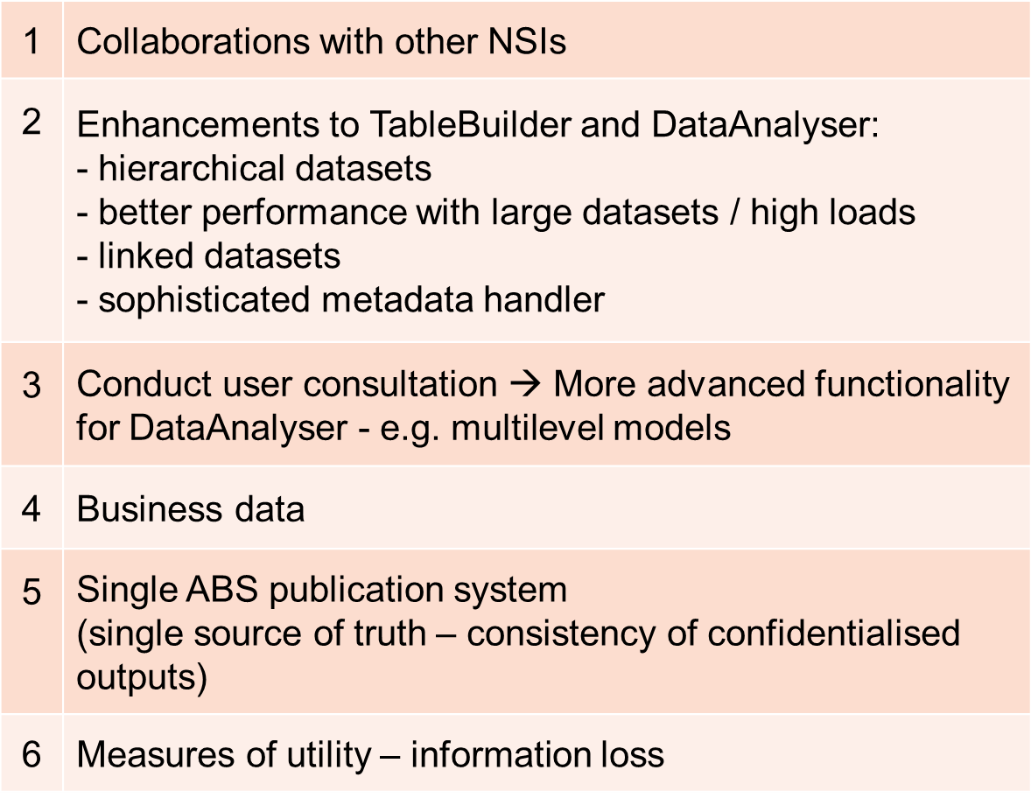
Future Directions

