Slide 1
Disclosure risk when responding to queries with deterministic guarantees
Krish Muralidhar
University of Kentucky
Rathindra Sarathy
Oklahoma State University

Slide 2
Query/Response Systems
Renewed interest in query/response systems due to easy communication facilities
Fits nicely in a remote access environment

Slide 3
Input versus Output Perturbation
Input perturbation
The original data is modified. All responses to queries are based on the modified data
Output perturbation
The response is computed using the original data and modified prior to release
Advantages of output perturbation
Easier to implement
Data updates are easy
Fits nicely in a remote access environment

Slide 4
Analytical Validity
One key component of providing responses to queries is to assure the intruder that the response is meaningful
For ad hoc queries, it may be difficult to provide a priori assurances regarding analytical validity
Solution: Interval Responses

Slide 5
Interval Response
As the name implies, the response to every query is provided in the form of an interval instead of a single value
Allows the users to directly assess the analytical accuracy of the response
For a given query, response (1000 – 2000) is much less accurate than the response (1250 - 1275)
The true value is guaranteed to be in the response interval

Slide 6
Deterministic Methods
Determinism is often visualized only in terms of the masking method employed
Perturbed value = a + (b × True value)
a and b are constants
Knowledge of two true values is adequate to compromise the entire database
Providing the guarantee that the interval response will contain the true value is also deterministic

Slide 7
Determinism versus Disclosure
It is well known that data masking techniques that are purely deterministic are subject to complete, exact disclosure of the confidential values
But what if the determinism occurs in terms of the response?
Are methods which provide deterministic guarantees regarding the response subject to the same type of complete, exact disclosure?

Slide 8
Confidentiality via Camouflage (CVC)
A procedure for providing interval responses to queries
Can be implemented for both binary and numerical data
Intervals computed using this procedure guaranteed to contain the true response

Slide 9
CVC for Binary Data
Procedure
a represents a column of binary values (of length n) representing the confidential attribute
Specify k (≥ 3)
Let V (= V¹, V², …, V^{k}) represent k column vectors also of length n
Set V^{i} = a
For each row in V
Randomly set v^{j} = (1 – a) (j ≠ i)
Set all other values randomly as (0, 1)
For any query, select the appropriate rows in V, compute the values for each of these vectors; Response = Minimum and maximum of the computed values
Since V^{i} = a , the true response is guaranteed to be in interval

Slide 10
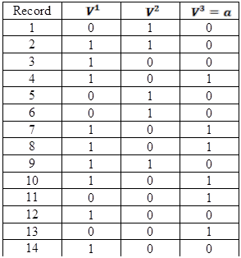
Example
Every row consists of at least one “0” and one “1”
Every confidential value is “represented” by the interval (0, 1)
A simple example is shown on the right
n = 14
k = 3
V³ = a
Data is the same as that used by Garfinkel et al (2002) in their paper

Slide 11
Is CVC Deterministic?
At first glance, CVC is not deterministic
Garfinkel, Gopal, Goes (2002, page 755)
There is clearly a deterministic component since V³ = a
This deterministic component is necessary in order to satisfy the guarantee that every interval response will contain the true value

Slide 12
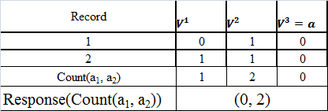
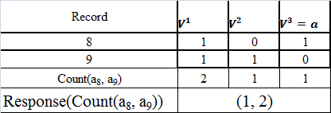
Responding to Queries

Slide 13
Query Based Attack
Reconstructing V using brute force search
Select a small subset of the data of size m such that is within exponential computational capability.
Issue every possible query involving the records and store the corresponding responses. This results in a total of (2^{m} – 1) queries and responses.
Evaluate all possible (2^{m}) combinations of values for a and identify candidate solutions for a that satisfy all responses from the previous step
For the given data set, m = 14 is within computational capability. Perform search.

Slide 14
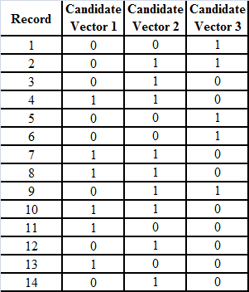
Search Result
The search reproduces V (Candidate vector 1 = V³ = a, Candidate vector 2 = V¹, and Candidate vector 3 = V²)

Slide 15
But is it disclosure?
Every record still has a (0, 1); so is it disclosure?
Suppose intruder knows a₂ = 0, the true value vector is immediately identified as candidate vector 1
Knowledge of one (or utmost two) records results in complete, exact disclosure

Slide 16
What if …
We increase k?
Small increases in k have no impact on the reconstruction of V
In order to prevent reconstruction of V, it is necessary that k is close to 2^{m}
Increasing k also reduces the analytical validity since the interval is larger
Increasing k also increases storage and computational requirements

Slide 17
Computational Complexity
Note that the search procedure is computationally feasible even if n is very large
Since compromising m records is possible, we would then incrementally compromise the records in subsets of m
Once subset m is revealed, the intruder can also compromise the remaining data using simple queries

Slide 18
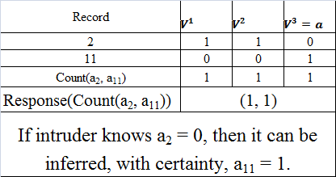
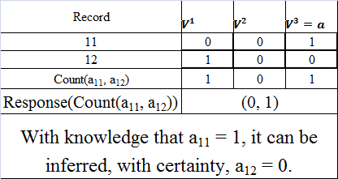
Disclosure via Simple Queries
All records can be progressively compromised
Any response which is not of the form (0, cardinality) results in disclosure. But the response (0, cardinality) is useless for analytical purposes!

Slide 19
Insider Threat Protection
CVC suggests an insider threat protection scheme which involves subtracting 1 (2) from the lower limit and adding 2 (1) to the upper limit
But this insider threat protection is easily defeated by the intruder by
Either adjusting the responses
Or by using a base set and issuing queries incrementally using this base set to eliminate the “noise”

Slide 20
Summary
In order to ensure that the true value is always contained in the response interval, it is necessary that V^{j} = a
Using simple search, it is possible to reconstruct V
Unless k is very large which creates other problems
Even if the search procedure fails, it is possible to compromise using responses to simple queries
Hence, if the CVC method is implemented to protected binary data, the true confidential value vector a is subject to complete, exact disclosure

Slide 21
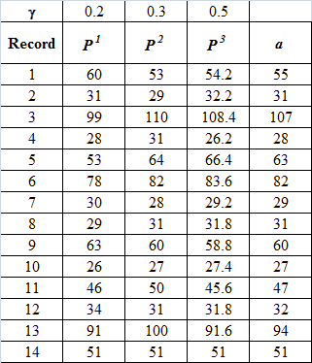
CVC for Numerical Data
The confidential value vector a is now hidden among k vectors in P
P does not contain the true value vector a
For any given record:
Σ(ϒ^{j} × P^{j}_{i}) = a_{i}
(0.2 × 60) + (0.3 × 53) + (0.5 × 54.2) = 55
0 ≤ ϒ^{j} ≤ 1
Σϒ^{j} = 1
Data is the same as that used by Gopal et al (2002) in their paper

Slide 22
Responses to Queries
For simple sum and difference queries, the response is computed exactly as with the binary CVC method
For more complex queries, it is necessary to solve a system of equations (linear or non-linear depending on the query) to compute the interval response
For more details see Gopal, Garfinkel, and Goes (2002)
We limit our discussion to sum and difference queries

Slide 23
Deterministic Component
For numerical CVC, the true confidential value vector a is not a part of P
However, the deterministic component of numerical CVC lies in the fact that Σ(ϒ^{j} × P^{j}_{i}) = a_{i}
Does this deterministic component lead to disclosure?

Slide 24
Computational Complexity
We assume that the intruder knows that the true confidential value is integer
Ignore last record since it is not protected
Intruder issues queries relating to individual records and receives responses
These responses provide the respective upper and lower bounds for individual records
53 ≤ a₁ ≤ 60; 29 ≤ a₂ ≤ 32; …….; 91 ≤ a₁₃ ≤ 100
A total of 2,903,040,000 potential candidate solutions

Slide 25
Modified Search Procedure
Select subset of the data (m = 5)
Identify candidate solutions
One of these candidate solutions must be true solution
Incrementally add one more observation
The number of candidate solutions to be evaluated equals the (number of candidate solutions from previous step × number of possible integer values for the current observation)
Repeat for all observations and identify candidate solutions

Slide 26
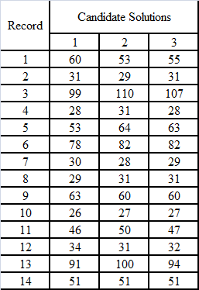
Result of Search Procedure
Only three candidate solutions
One of these candidate solutions must be the true solution
Assume intruder knows true value of a₁ = 55
The true value vector is immediately identified as Candidate solution 3 resulting in complete, exact disclosure

Slide 27
Compromise for Large Data Sets
As with binary data, we can avoid the computational complexity by selecting small subsets
However, for numerical CVC, knowledge of (k – 1) true values is adequate to compromise the entire data set since we can now solve a system of k equations and k unknowns resulting in knowledge of ϒ. With ϒ known, it is simple arithmetic to compute a

Slide 28
Assume that a₁ and a₂ are known
Reconstruct P using the above responses

Slide 29
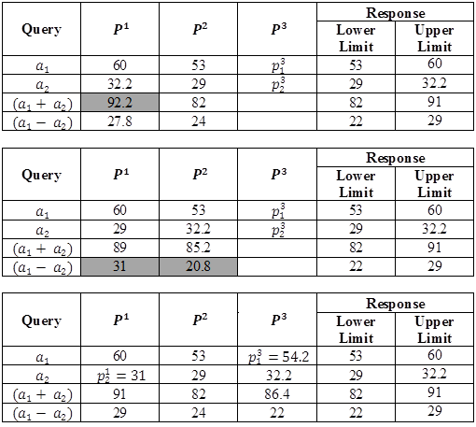
INFEASIBLE
INFEASIBLE

Slide 30
Once P has been reconstructed, it is a simple matter of solving a set of equations to solve for ϒ. With this information, the remaining values can be compromised by issuing simple queries.

Slide 31
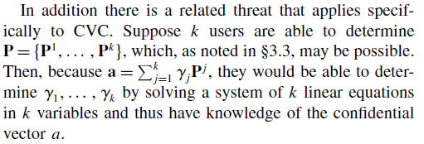

Slide 32
Conclusions
Based on “traditional definition” of deterministic, CVC would not be classified as a deterministic procedure
Deterministic guarantees always require that the masking approach have a deterministic component
Any masking approach with a deterministic component is susceptible to complete, exact disclosure with knowledge of just a few true confidential values
Remote access centers that contemplate the use of output perturbation approaches for answering ad hoc queries should consider the disclosure issue very carefully

Slide 33
Takeaway
The definition of “deterministic procedures” should be expanded to include any procedure that attempts to provide deterministic guarantees regarding responses to ad hoc queries
Just as procedures traditionally classified as deterministic are subject to complete exact disclosure with knowledge of a few values, procedures that offer deterministic guarantees are also subject to the same disclosure.

