Slide 1
Application for presenting census results in the context of statistical data confidentiality in Poland
Amelia Wardzińska-Sharif
Central Statistical Office of Poland
Tarragona, Spain, 26-28 October 2011

Slide 2
Mixed Model for Population and Housing Census
Mixed model - a combination of data from administrative sources with data acquired from statistical surveys

Slide 3
Driving Forces for Polish Statistics
Expected better product - more coherence, more detail (small areas, population groups) and more flexibility in the statistical output
IT developments: more registers, better quality
Expected high nonresponse rates in social surveys
Cut down processing costs - available budget is constantly reduced
Lower response burden – EU policy
  less questions - achieving lower irritation factor

Slide 4
Where we are?
2007
Start of preparation
IX-X.2009
Spis Próbny
PSR 2010
IV-V.2010
Trial census
NSP 2011
IX-X.2010
PSR 2010
IV-VI.2011
NSP 2011
2013
End of project
National Population and Housing Census 2011
Agriculture Census 2010
We are here!
4

Slide 5
Policy implications
From primary to secondary data collection
  Wherever possible use data available in existing registers and other administrative sources
  Primary data collection only if no data available from registers
From traditional to electronic data collection
Standardisation of statistical processes;
  multi-data-source statistics;
  efficient sampling

Slide 6

Registers - data acquisition
Data Owners:
Ministry of Finance,
Ministry of Interior and Administration,
Ministry of Justice,
Agricultural Social Insurance Fund,
National Health Fund,
Agency for Restructuring and Modernisation of Agriculture,
Agricultural and Food Quality Inspection,
Agency for Geodesy and Cartography,
State Fund for Rehabilitation of Disabled Persons,
County Offices,
Commune Offices,
Regional Offices,
Telcoms,
Energy Suppliers,
Office For Foreigners,
Social Insurance Institution,
Housing Managers,

Slide 7
The use of administrative sources in censuses
7
The usage of administrative sources during the census:
  direct source of research data ,
  source of information to create a list of entities covered by the census frame (address-housing survey) ,
  in addition, a source of information for :
    imputation,
    data estimation,
    comparison the quality of the data.

Slide 8
Data collection channels
Administrative sources – including spatial data reference registers
ON_LINE:
Self-enumeration by Internet
  ( CAII – Computer Assisted Internet Interview)
Telephone Interview
  ( CATI - Computer Assisted Telephone Interview)
Sample surveys (using hand-held terminals with GPS and GIS service – HTC Touch HD with GPS)
  ( CAPI - Computer Assisted Personal Interview)

Slide 9
Supervisor
Questionnaire completeness analysis
Enumerator monitoring
  Census Progress
  Localization and trail
Census completeness monitoring
Emergency situation management
  Providing help for enumerators
Providing necessary information to enumerators

Slide 10
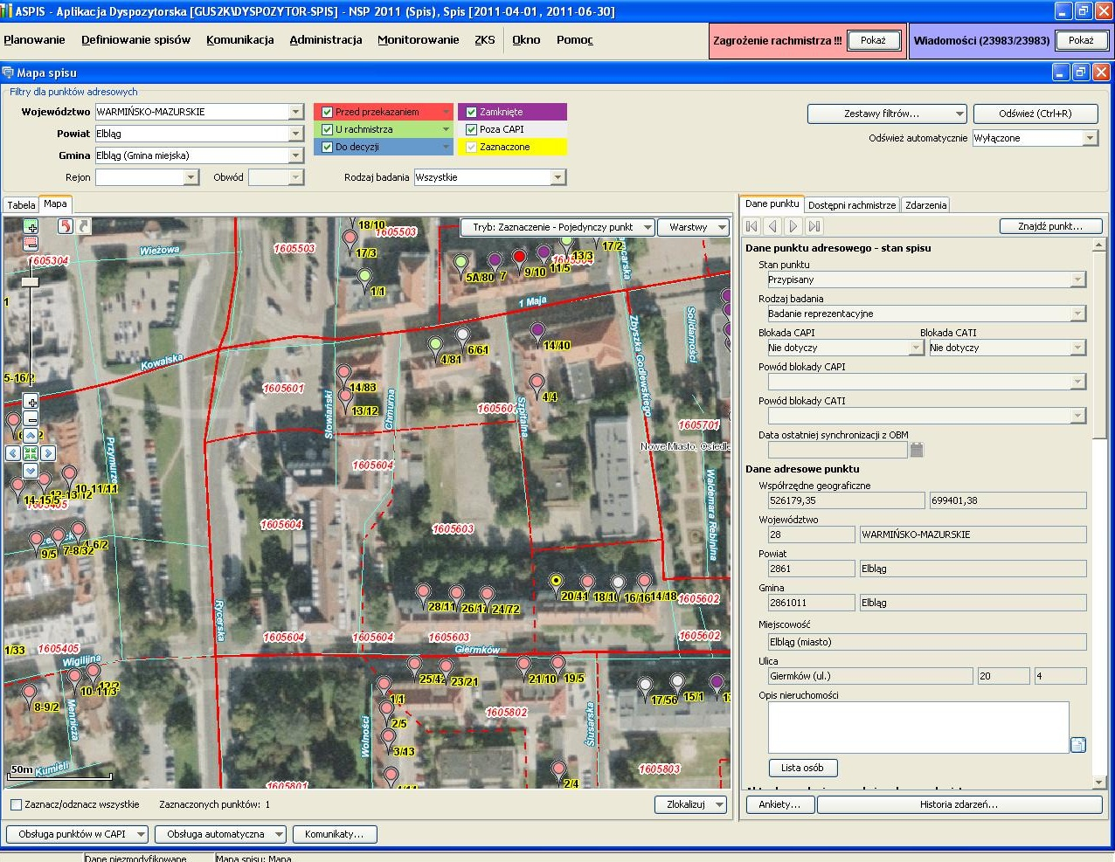

Slide 11
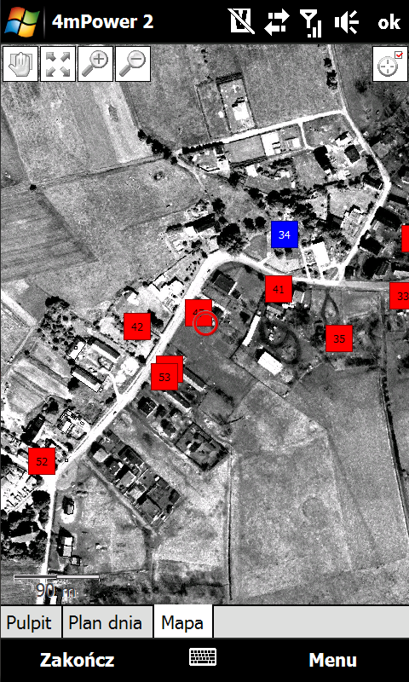
Enumerator
Map module - GIS
  Ortophotomap
  Cadastral Data
  Assigned Tasks
  Started Tasks
  Completed Tasks

Slide 12
Census quality aspects

Slide 13
Quality requirements for modern
Statistics
Main aspects of product quality (Eurostat Code of Practice):
Relevance
Accuracy
Timeliness and punctuality
Comparability
Accessibility and clarity

Slide 14
Census Quality
Key elements of census process in terms of census quality
Census planning - scope of census,
Data sources,
Data collecting,
Data storing,
Data processing,
Development of census results,
Dissemination of census results,
Census Metadata System.

Slide 15
x,y GEOCODING
Territorial identification registry (System TERYT) provides location data of all statistical units as the address-point of a related building
Location of buildings is specified using geographical x,y coordinates, giving the exact location of each building and make possibility to linking microdata from several registers.

Slide 16
x,y GEOCODING
This will eliminate the necessity to recalculate data when administrative borders are changing. Furthermore, the point assignment will allow easy processing of statistical data in any chosen area - even for the GRID - GEOSTAT
x,y geocoding is crucial in all three stages of the census:
  the preparatory works,
  management of enumerators
  and after the census for multidimensional spatial analysis.

Slide 17
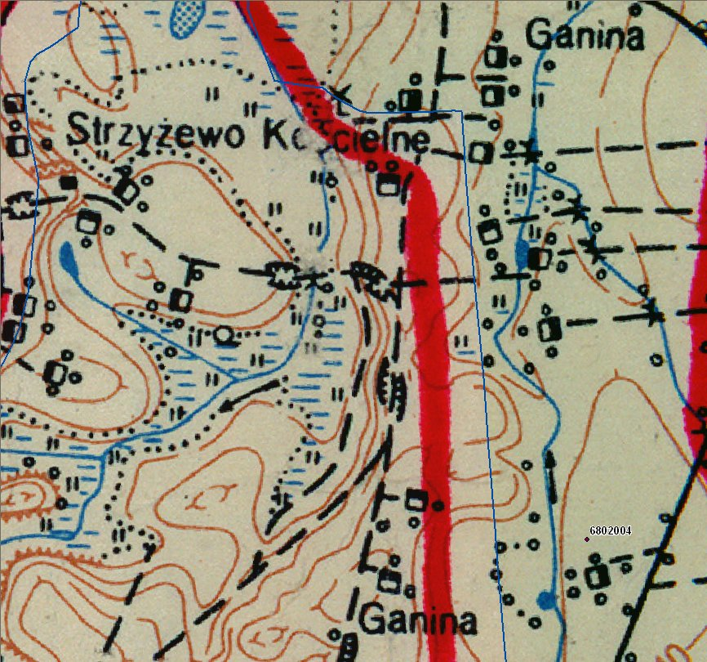
220 lat Statystyki PL
Dyrektor Projektu: J. Dygaszewicz
17

Slide 18
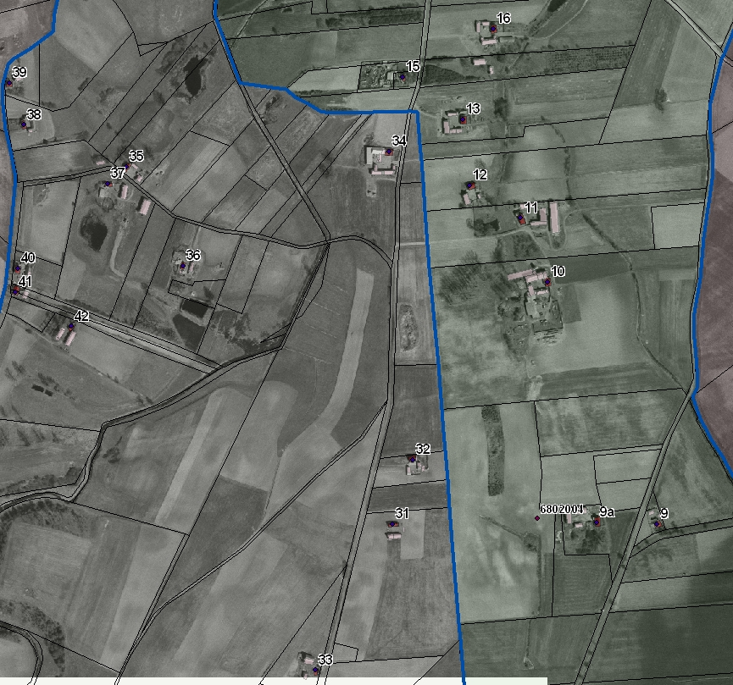
220 lat Statystyki PL
Dyrektor Projektu: J. Dygaszewicz
18

Slide 19
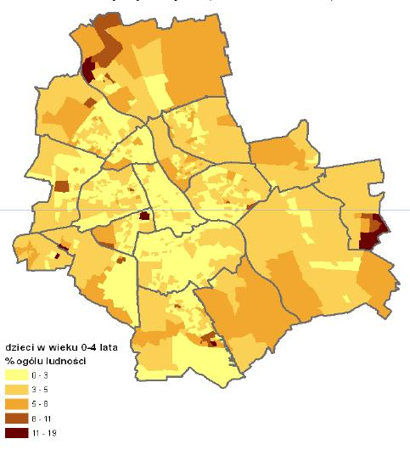
Area assignment vs point assignment
(area assignment)
19

Slide 20
New possibilities

Slide 21
Homeless survey – first results
About 9 700 „roof-less” have been enumerated
All data have been positioned by x,y coordinates

Slide 22
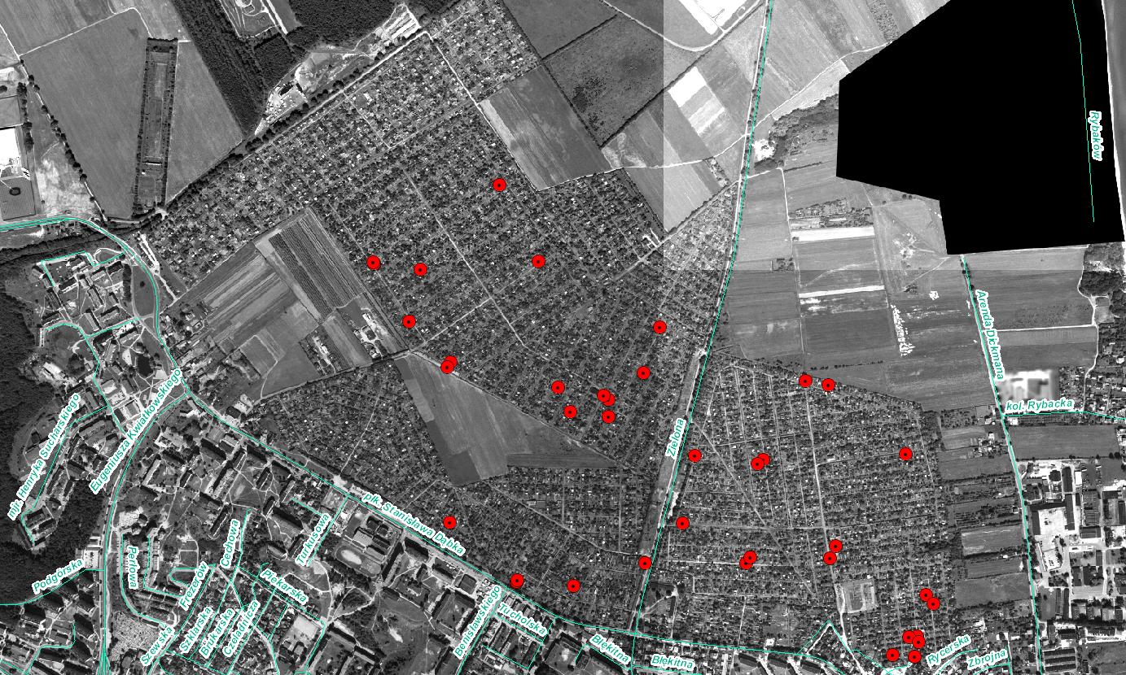

Slide 23
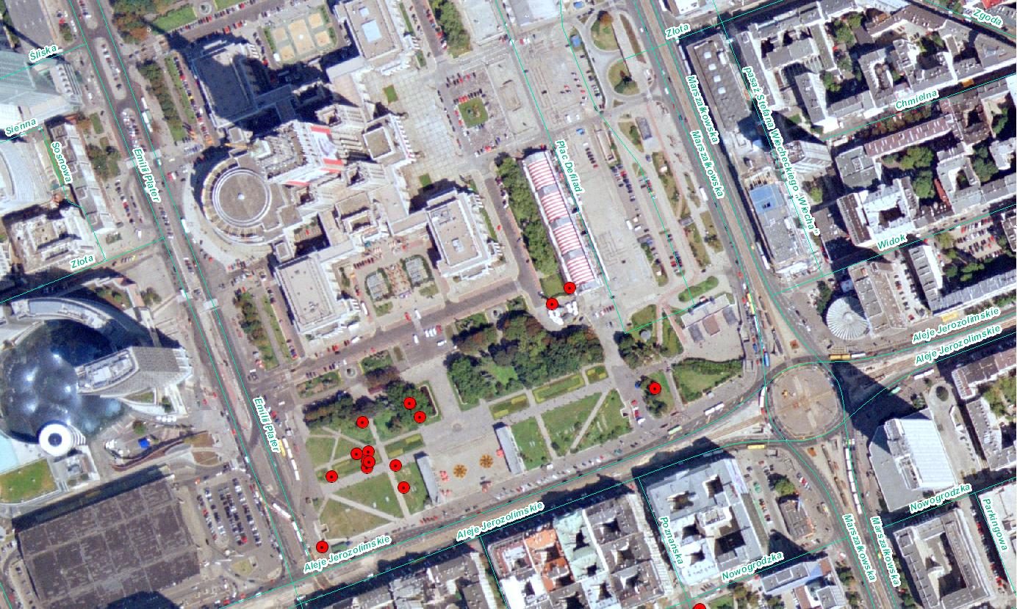

Slide 24
Presentation of the results of censuses
CSO decided to create the “Geostatistic Portal” which will serve two functions:
make aggregated data available in the form of a variety of spatial analysis (pre prepared and individual orders, preserving statistical confidentiality),
allow address points updates in municipality offices.

Slide 25
The task of the Portal will be spatial presentation of the data collected, analysis of microdata and fulfillment of tasks associated with implementation of the INSPIRE Directive guidelines for subjects 1 and 10 from Annex III of the Directive, including support for metadata profiles and metadata catalogues

Slide 26
the individual user will be allowed to order his own thematic maps in the form of a cartogram, based on any of the characteristics of thematic data model

Slide 27
Support for individual orders
Support of requirements
Individual users involved in decision-making:
Main:
− Needs Manager
− Product Manager
− End User
Support:
− MS SQL Administrator

Slide 28
2. Support of orders
Individual users involved in the ordering-support process:
Main:
− Product Manager
Support:
− Report Analyst
− Quality Manager
− MS SQL Administrator

Slide 29
Central Statistical Office - Poland
Thank you for your attention
Amelia Wardzińska-Sharif
Central Statistical Office of Poland
Tarragona, Spain, 26-28 October 2011

