Slide 1
Data Shuffling for Protecting Confidential Data
A Software Demonstration
Rathindra Sarathy* and Krish Muralidhar**
* Oklahoma State University, Stillwater, OK 74078 USA (rathin.sarathy@okstate.edu)
** University of Kentucky, Lexington, KY 40506, USA
(krishm@uky.edu)

Slide 2
Data Shuffling
Method that:
Combines the strengths of data perturbation and data swapping
Shuffled data uses only original confidential values – no added noise or “unreasonable” values
Preserves marginals exactly and all monotonic relationships among variables (preserves pairwise rank order correlation closely)
Non-parametric method
Maximum protection against identity and value disclosure

Slide 3
Technical Basis
X represents M confidential variables
S represents L non-confidential variables.
X is assumed numerical; S can be categorical or numerical variables.
Y represents the masked values of X.
Let R is rank order correlation matrix of {X, S}.
Define variables as follows: X* and S* as:

Slide 4
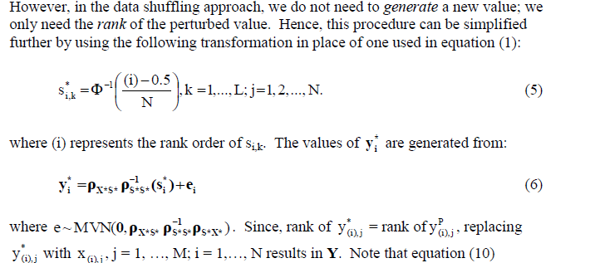
Technical Basis - continued

Slide 5
Example Dataset – Shuffled data

Slide 6
Example Dataset – Rank Order Correlations

Slide 7
Example Dataset - Relationships

Slide 8
Software Demo
Two versions are available – both in early Beta (Java and Windows)
Example shown earlier was run on Java version of software
We will demonstrate the software later

