Slide 1
Increasing Statistical Literacy among Students through the Census at School: Food Preference Survey
Presented by Suzanne King, Public Affairs Office Director
U.S. Department of Agriculture,
National Agricultural Statistics Service
for the
UNECE Work Session on the Communication of Statistics
Geneva, Switzerland, 18-20 June 2014
Session i: Statistical Literacy

Slide 2
Census at School
Census at School is an international classroom program for grades 4-12 that engages students in statistical problem solving.
Anonymous questionnaire/survey – Using questions that are directly related to the students is fun and encourages interest and engagement
Database of responses allows for student inquiry and analysis
Notes:
Just a quick bit of background. Many may already be familiar with the Census at School program as it is international.

Slide 3
Census at School - Background
Since its development in 2000 in the U.K., it is active in New Zealand, Australia, Canada, South Africa, Korea, Ireland, and Japan.
American Statistical Association, the Population Association of America, Census Bureau and a other partners launched the program in Washington, DC in 2010.
Notes:
Started in the U.K . Expanding

Slide 4
Census at School - Goals
To increase statistical interest and literacy among students to develop the next generation of statisticians.
Raise awareness of the use and importance of statistics and responding to surveys.
Increase survey and census response rates.

Slide 5
Census at School - Background
By 2010, the U.S. project included a questionnaire that tied to the international Census at School, teacher training, a successful program test pilot, a repository for data at the ASA, and statistical expertise.
A website at ASA housed the survey, response data, and resources.
Have – Infrastructure, statistical expertise
Need – Partner with network of teachers, schools; curriculum expertise; and project manager.
Notes:
The U.S. project

Slide 6
Partners
The National Agriculture in the Classroom organization had an established network of classroom teachers in all states and an interested national leadership.
The USDA National Institute for Food and Agriculture provided a collaboration point to bring ASA, NASS, and NAITC together.

Slide 7
Partner Goals
USDA NASS Goals
- Increase use of the Census at School Program;
- Increase awareness of NASS and use of survey and census data;
- Increase response to its data collection among the farm and rural population; and
- Develop a next generation of statisticians.
Ag in the Classroom Goal – Agricultural Literacy

Slide 8
Tie to the U.S. Education System
Each U.S. state has its own education standards, creating complexity and diversity.
New state-led standards known as the common core are unifying and bringing commonality to the U.S. school systems.
Most states have adopted these high-quality academic standards in Math, English, and Language Arts/Literacy.

Slide 9
Developing the Lessons
Use existing questionnaire to enhance program’s use and quality of existing and future data.
Extend learning opportunities.
Hire curriculum development specialist to work with statisticians.
Lesson plan addresses common core standards for grades 5-8 in Math, Language Arts, Nutrition, Social Studies, and National Family and Consumer Sciences.
Notes:
Key decisions:
Tie with Ag in Classroom infrastructure and needs (food/ag, grade levels); common rural ag audience for NASS; volunteer/no project manager – hire; tie with USDA my plate – timely food, ag and nutrition conversation.

Slide 10
Food Preference Survey
Timely, topical
Food and agriculture
Use Census at School survey
Lesson plan, activities and extensions

Slide 11
The Lessons
Students complete a brief online survey, analyze their class census results, and compare their class with random samples from students in the U.S and other participating countries.
Important issues addressed in the introduction include security of Internet and personal identifying information.

Slide 12
40 questions
13 are the same across the international program
27 are unique to the U.S.
Countries can add questions of unique importance or interest

Slide 13
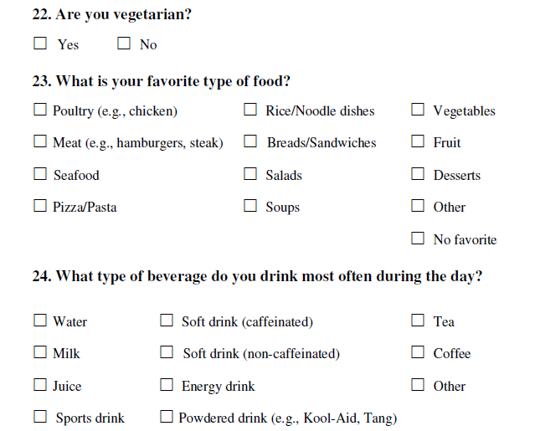
The food preference lessons use 3 questions.
favorite foods, beverages for a class;
variables for the class;
numerical summaries for those variables;
type of graph to best show the data;
Discussion topics.

Slide 14
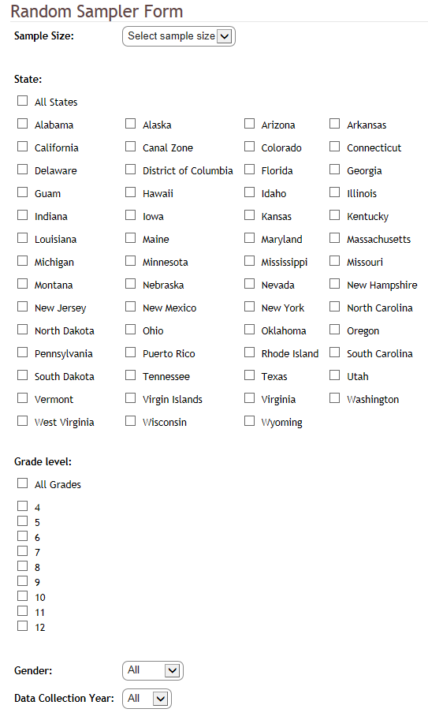
Random Sampler

Slide 15
Sampler Results - Beverage
Random Sample of 500 U.S. responses on favorite drink.
Class favorites?
Response rates?
Difference between males and females in preferred beverage?
Compare class results with this random sample.
Notes:
Note: 440 responses. 220 male and 220 female. Is there a relationship between favorite beverage and gender?

Slide 16
Sampler Results - Beverage
Notes:
Graph by response.

Slide 17
Sampler Results - Beverage
Notes:
Response by percentage.

Slide 18
Sampler Results - Beverage
Notes:
A look at beverage favorite by percentage male and female.

Slide 19
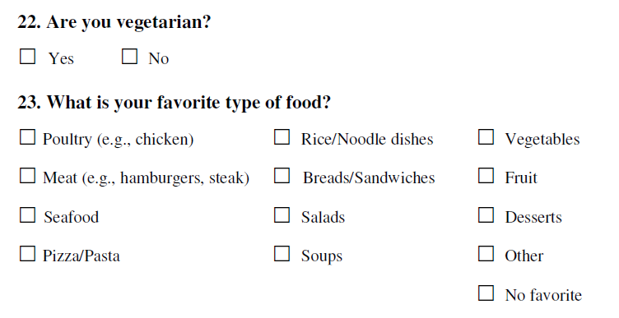
Sampler Results - Food
The activity asks if there is a potential association between favorite food and whether someone is a vegetarian.

Slide 20
Sampler Results - Food
Notes:
frequency of responses. – data quality?

Slide 21
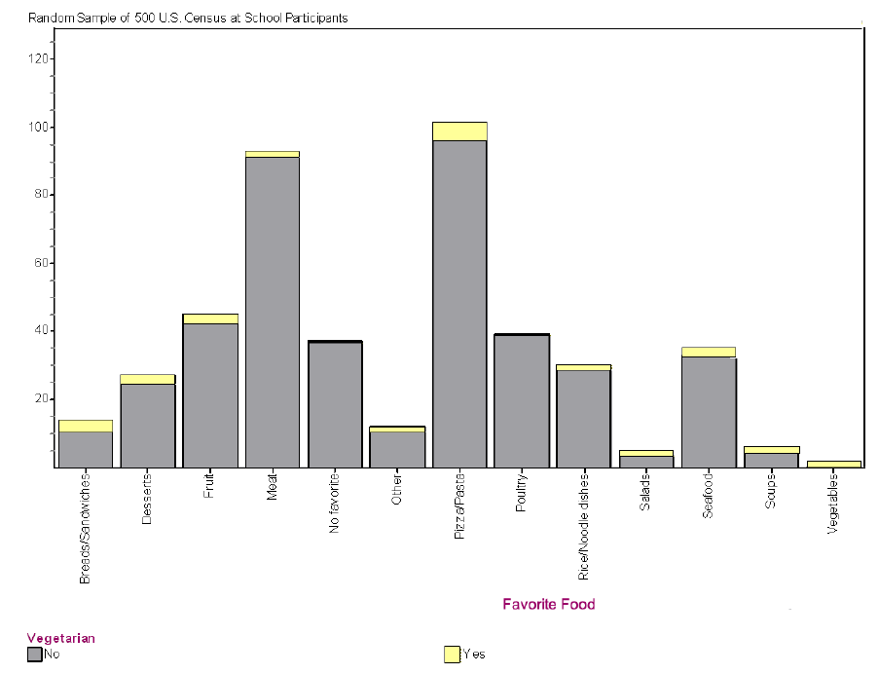
Sampler Results - Food
Notes:
Pizza/pasta favorite among vegetarians and non. Meat was second favorite food.

Slide 22
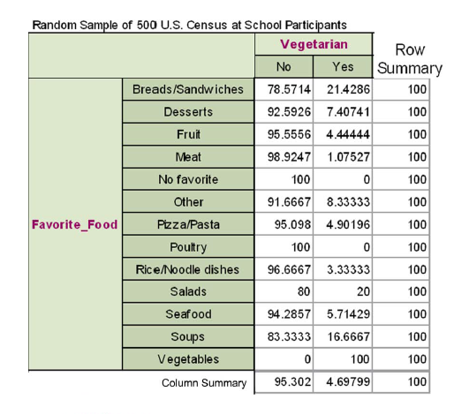
Sampler Results - Food
Notes:
Percentages. Favorite food

Slide 23
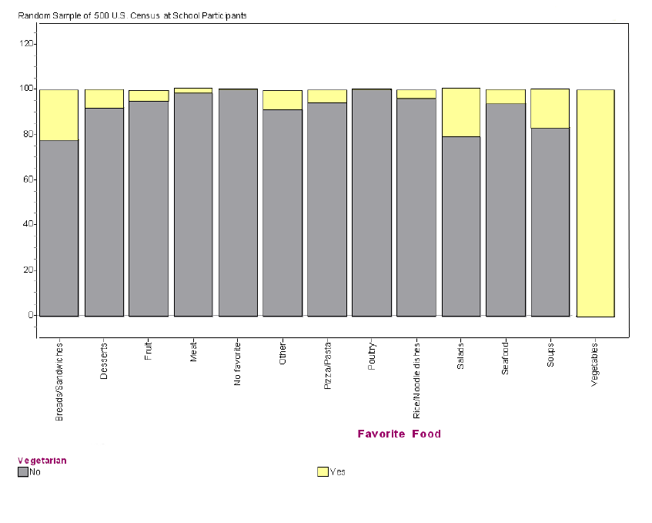
Sampler Results - Food
Notes:
Favorite food vegetables correlates to being a vegetarian. More useful to look at percentages than frequency to make correlation

Slide 24
Lesson Additions
Some Discussion Points:
Did the results surprise you?
Who might want to have this information for your class and the whole school and why?
How and where do the favorite food preferences fit in the MyPlate food categories and on the MyPlate graphic?
If the favorite foods represented a meal, what would the plate look like? Would it be balanced? Would it represent the food groups?
Examples of Additional Activities:
Conduct another random sample to see if results are different
Select a single food and beverage and research components; who grows or produced those components in the U.S. or internationally; Identify the 5 states or countries and estimate food miles, etc.
Plan a party. Use the data to determine menu, donations, fewest food miles.
Notes:
USDA federal nutritional guidelines called “MyPlate.”

Slide 25
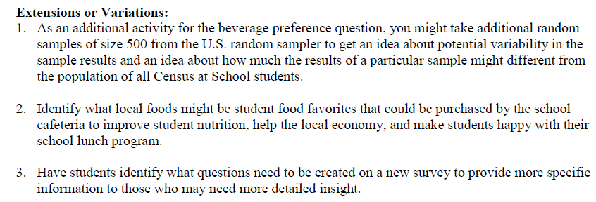
Extensions

Slide 26
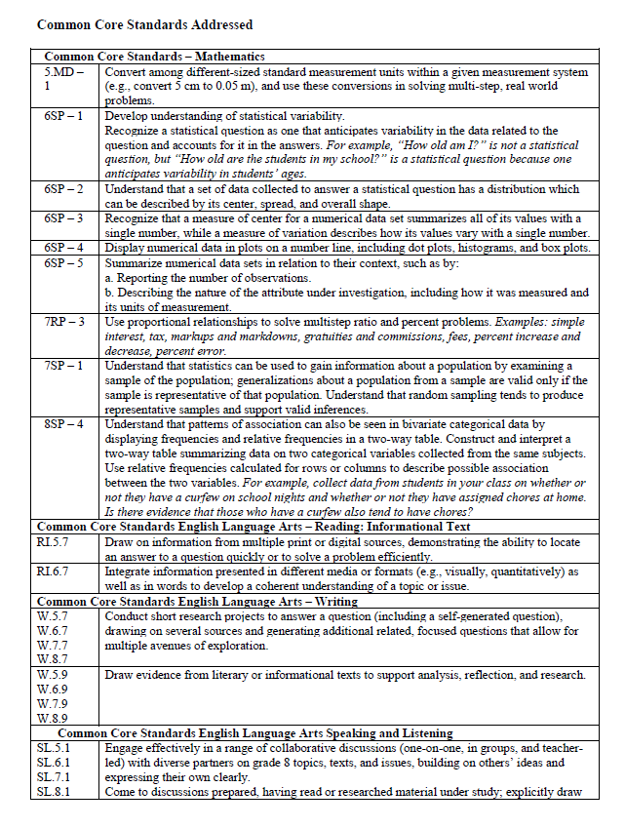
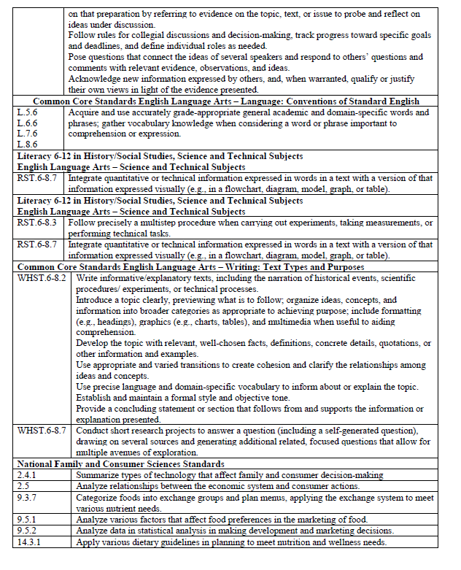
Common Core Standards

Slide 27
Launching the Program
NASS and a partnering teacher conducted an instructional session to a receptive audience at the annual National Agriculture in the Classroom Conference in June 2013.
Other modes of promotion:
NAITC publication articles
Cross links and features on all members’ websites
USDA blog
Twitter
Article for ASA website

Slide 28
Measuring Progress
As of April 2014, there were more than 20,000 students from 46 states plus Washington, DC and Guam who had participated, and 931 registered teachers with 433 who have associated student data.

Slide 29
Next Steps
Project evaluation and expansion
Continue promotion and encourage use
-Both Census at School and Food Preference
Project manager
Continue to encourage future statisticians, learn from other countries, and build statistical literacy worldwide.

Slide 30
Resources
U.S. Census at School - www.amstat.org/censusatschool
Food Preference Survey www.nass.usda.gov/Education_and_Outreach/
International Census at School www.censusatschool.org.uk/international-projects
U.S. Census of Agriculture, USDA National Agricultural Statistics Service - www.agcensus.usda.gov
U.S. Agricultural Production, USDA National Agricultural Statistics Service www.nass.usda.gov
USDA My Plate - www.choosemyplate.gov
World Production Reports, USDA Foreign Agricultural Service www.fas.usda.gov/report.asp

Slide 31
Thank You
Suzanne King
Public Affairs Office Director
USDA’s National Agricultural Statistics Service
1400 Independence Avenue, SW, Room 5029
Washington, DC 20250
Sue.king@nass.usda.gov
202-690-8122
www.nass.usda.gov
www.agcensus.usda.gov

