Slide 2
Interactive Graphics at the US Bureau of Labor Statistics
Michael Levi
UNECE Work Session on the Communication of Statistics
June 20, 2014

Slide 3
Why Interactivity?
Present more information
Add another dimension to the data
Time, in particular
Let users decide what they want to see
Custom views of data

Slide 4
Simple Interactivity
Map
Mouse-over to display detail
Links
Line chart
Show/ hide series
Mouse-over to display detail
Bar/Line mix and match
Multiple charts, “stacked”

Slide 5
Moderate Interactivity
Map with linked bars
Stacked bar with highlights

Slide 6
High Interactivity
Animation
Zoom

Slide 7
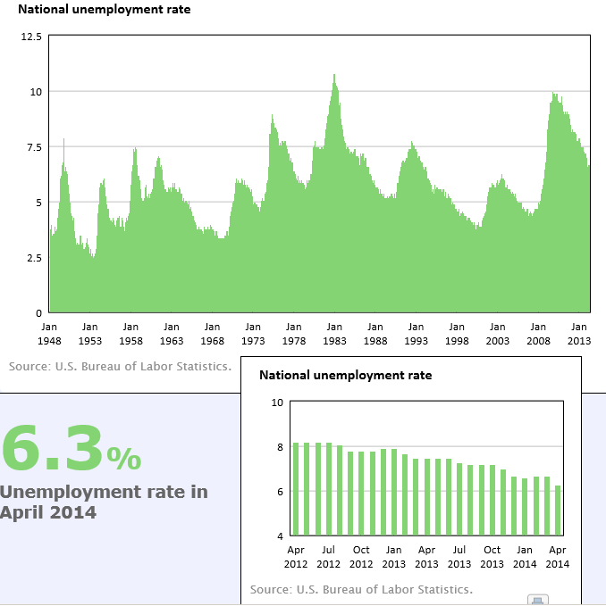
Alternative to Zoom

Slide 8
Behind the Scenes
Highcharts (www.highcharts.com)
JavaScript library
Download code and install on server
Each chart has a unique code set that makes calls to the Highcharts library
Generated by hand (or, at BLS, with Jay’s Chart Maker tool)

Slide 9
Learning curve
Simple charts
Line, bar, bubble, etc.
Including mouse-over and legend toggle
No programming required
Select options/parameters
Good instructions

Slide 10
Learning Curve (cont.)
Advanced charts
Animation, styles not already in library
Programming is required
Need good JavaScript skills and coding experience

Slide 11
Output
Client-side execution
Browser dependent
Older browsers may not execute well
Sometimes requires tweaking existing code when new browsers are released

Slide 12
Michael D. Levi Associate Commissioner for Publications and Special Studies U.S. Bureau of Labor Statistics 202-691-5100 levi.michael@bls.gov

