Slide 1
Statistics in Schools: Using Real Life Data to Increase Statistical Literacy Among Students
Kendall B. Johnson, U.S. Census Bureau
United States of America

Slide 2
Introduction
Emphasize value of statistics through educational projects
Reach, educate, and mobilize educators, students, and families
Significant growth over 60 years
Increase statistical literacy and propensity to work in statistical-related fields
Increase brand recognition and public’s familiarity with the work of the organization.
Notes:
- Bureau has long understood the importance of increasing awareness of our work by emphasizing the value of statistics through educational projects, specifically targeting elementary and secondary students.
Throughout the program’s iterations, the common belief was children would openly share information that they believed no one else had heard about, especially a parent or guardian. Sharing would result in increased participation and response rates.
Understand the relevance and importance of the Census in their daily lives
Improving statistical literacy of students and demonstrating the applicability and utility of statistics and statistical concepts in educational activities.
Statistics in Schools – expand statistical literacy by providing free dynamic standards-based content in subjects including math and history; using real-life census data that are relevant and useful for teaching in the classroom.
Activities that align with the Common Core State Standards
An initiative in the US that details what K-12 students should know in English language arts and ma at the end of each grade.
~ 20% of the Common Core curriculum for math in Grades 6-12 aligns directly to statistics, providing a unique opportunity for the Census Bureau to leverage its vast collection of statistical data.

Slide 3
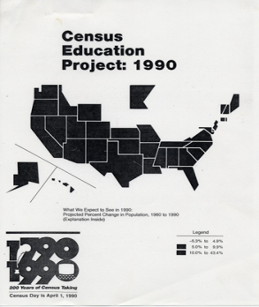
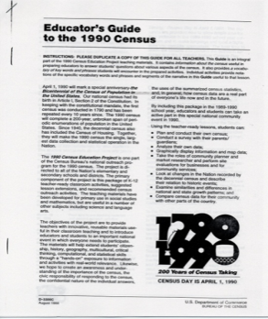
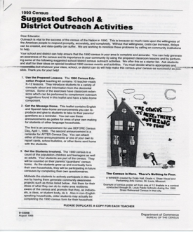
History (1950-1990)
1950 – “We Count in 1950”
1960 – Formal agreements with publishers
1970 – Educational materials and limited distribution of promotional items
1980 – Multi-faceted effort to reach educators
1990 – Bicentennial – Elementary → College
Notes:
1950 – We Count in 1950 – this booklet was disseminated to teachers so that they could familiarize students with the census process and stress the importance of the census.
1960 – Scholastic Magazine, Inc., the American Education Publications, the Civic Education Service, the National Education Association: These publishers included a series of articles about the 1960 Census in the products they had circulating within the schools.
1970 – Publication “Census Data for Community Action” demonstrated the use of house and population data in the development of community action projects.
-A prototype mini-lesson used in selected school systems
-Distributed 5 million flyers and several hundred thousand lapel buttons to school children
-1st time special attention given to AA and Hispanic audiences
1980 – College Curriculum Support Project
-3 issues annually of 35-page newsletter “Updates”
-special features sections w/curriculum resources on topics of interest
-Booklet, “Continuing the Fact Finder Tradition”
– focused on use of 1980 Census data (undergraduate programs)
-Product Primers – series of booklets
-introduced Census Bureau data products for use in classroom projects
-Newsletter – communication highlighted new Census products with info useful to educators.
1990 – 10 instructional activities (K-12) – social studies, math, science, language arts
-224,000 kits distributed
-8-page kit supplement with teacher notes and extension activities
-ten

Slide 4
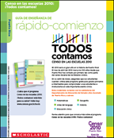
History (2000-2010)
2000 – Grade specific kits (K-5, 5-8, 9-12)
Adult Literacy, Adult English as a Second Language, Head Start
45 million Take-Home activities
2010 – Top-down outreach and marketing strategy
Take-Home activities in 27 languages
Notes:
2000 - Census in Schools – provided educators with the tools to bring the census to life for students and to explain the importance and benefits of the census.
Contracted with Scholastic
Grade-specific teaching kits for US Teachers K-4, 5-8, 9-12
Cultural and language-specific teaching kits for Island Areas
Kits for each principal in U.S., and Island Areas
Two Newsletters for U.S. educators
Teaching kits for instructors of Adult Literacy and Adult ESL
Everybody Counts – large, colorful read-aloud book for younger children, coloring books, teacher guide, and audiotape
Take home materials for all K-8 students in US & Puerto Rico, and for ALL students in the Island Areas.
45 million take-home materials distributed
Partnerships w/ 23 national educational assoc. and gov’t agencies.
- Paid advertising helped to amplify the Census and thus, more focus on CIS
- top down outreach and marketing strategy
– materials sent to principals: they would disseminate to most appropriate educators, promote usage, advocate participation in the census across entire school community.
Printed materials to for all K-8, 9-12 students in 50 states, Washington, DC, and Puerto Rico (Spanish); as well as K-8 in the Island Areas
Print outreach to K-8 English Language Learners (ELL), English as a Second Language (ESL), Pre-K, 5-8 via the Diversity Program and any kids at promo events.
Maps for K-8 and 9-12 classroom use.

Slide 5
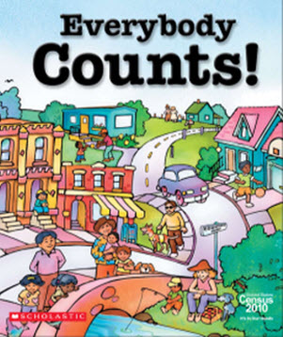
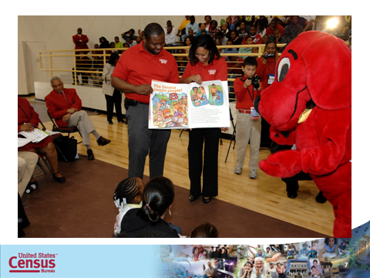
2010 Census

Slide 6
Statistics in Schools
Notes:
-Evergreen program – more focused on improving statistical literacy – thus the name change to Statistics in Schools.
-1. Educate the public by improving statistical literacy of students.
-2. Demonstrate the applicability and utility of statistics and statistical concepts in educational activities
-3. Increase the Census Bureau’s brand recognition
-4. Improve the public’s familiarity with the work of the Census Bureau; and
-5. Encourage public cooperation in Census Bureau surveys and censuses.
-Alleviate costs associated with “ramping up” each decennial period.
-Capitalize on “lost opportunities” – ongoing outreach and support
-Realize benefits of Census Bureau’s presence in K-12 schools across the nation
Scalable program to accommodate growth during decennial period.
Incremental spending, over a ten-year period, is more palatable than huge outlay each decade.
Provides a channel for continual marketing, outreach and support of current and future Census Bureau products and services. – A permanent dedicated vehicle for promoting and communicating statistical data to users and stakeholders.
Provides a tool for educators to stimulate and revive a lagging interest in math and the sciences by making statistics interactive and engaging, allowing students to explore the relationships between census data and the world in which they live.

Slide 8
Math Activity

Slide 9
History Activity

Slide 10
Conclusion
Long-term relationship with students
Produces younger data users
Greater appreciation
Statistics, Geography, Math, Survey Methodology, Computer Modeling, Economics
Success metrics
Usage of activities
Website metrics
Active partnerships
Ongoing feedback
Notes:
-Establishing a long time relationship with students that makes both the use of surveys and data routine, increasing the likelihood of adult participation in surveys and censuses.

Slide 11
Contact Information
Kendall B. Johnson
Chief, Customer Liaison and Marketing Office
U.S. Census Bureau
301-763-4238
Kendall.b.johnson@census.gov

