Slide 1
Statistics Explained: 5 years after opening, where are we?
UNECE Work Session on the Communication of Statistics, Geneva
18-20 June 2014
Fabienne Montaigne

Slide 2
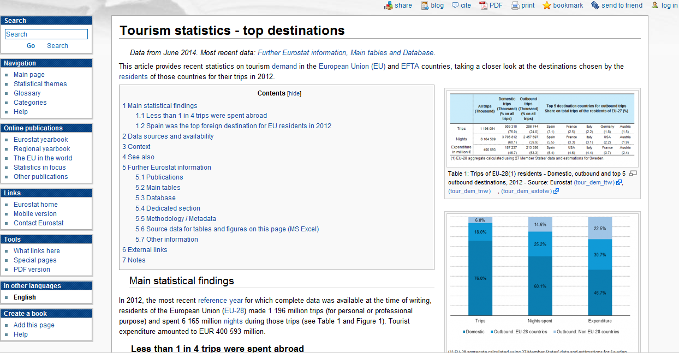
Statistics Explained

Slide 3
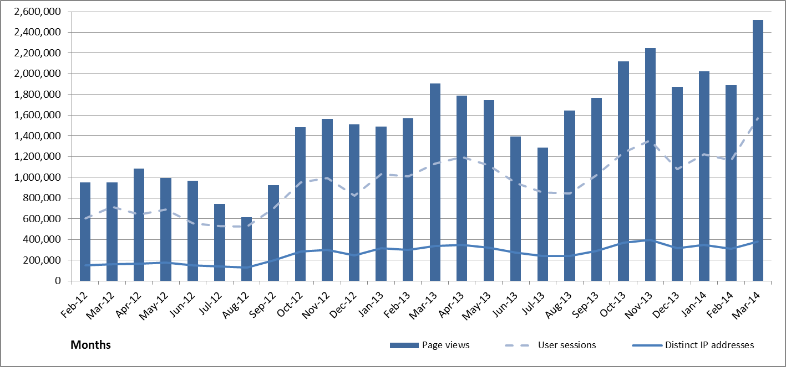
Users' visits: some figures (1/2)

Slide 4
Users' visits : some figures (1/2)
10 most accessed pages in 1st trimester 2014
Page | Accesses
Unemployment statistics | 118 429
Main page | 73 436
Eurostat yearbook | 40 106
Migration and migrant population statistics | 37 504
Electricity and natural gas price statistics | 32 940
Statistical themes | 30 913
Wages and labour costs | 25 888
Energy price statistics | 24 156
Marriage and divorce statistics | 23 704
Energy production and imports | 22 791

Slide 5
Growing structure
May 2009: 160 stat.articles + 900 glossary items May 2014: 800 articles + 1800 glossary items
(stat., background, theme introduction)
Coherence, integration, harmonisation
Articles structured, grouped through:
Category pages
Online publications
Rules for names and titles
SE articles = source for creating new publications

Slide 6
Several languages
Multilingual Mediawiki plugin
Page by page connected language versions
Since May 2010: French & German (now about 100 articles) and 20 articles in 20 languages, updated yearly
Additional articles in Spanish and Russian
Quality guaranteed through DGT & model pages
Technical constraint: English page should exist
Glossary expanding in several EU languages

Slide 7
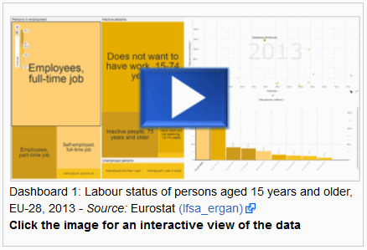
Flexible dashboard (1/3)
http://epp.eurostat.ec.europa.eu/statistics_explained/index.php/Labour_market_and_Labour_force_survey_%28LFS%29_statistics

Slide 8
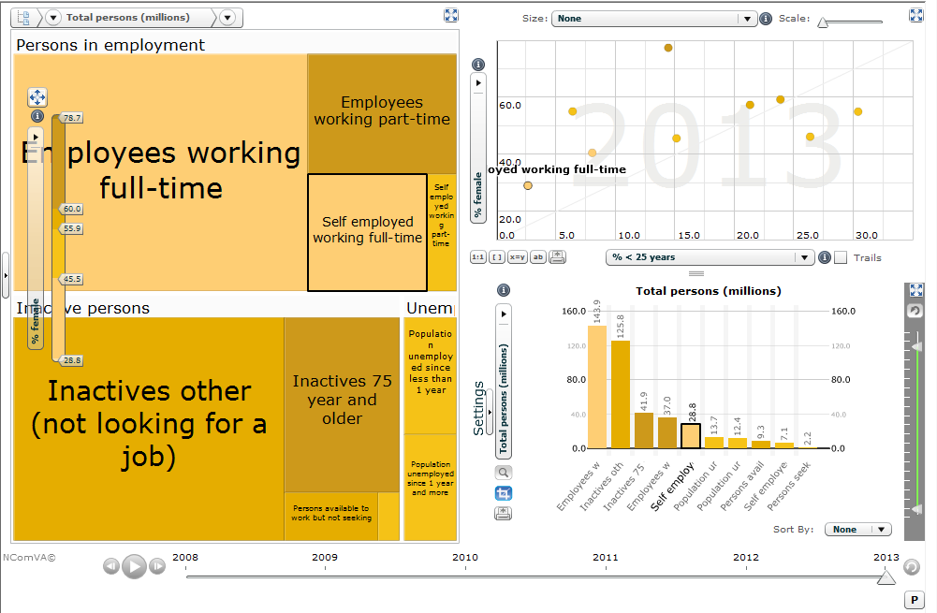
Flexible dashboard (2/3)

Slide 9
Flexible dashboard (2/3)

Slide 10
What's next?
New Eurostat website
Statistics Explained main page
Articles written by EU NSIs staff

