Slide 1
Experiences in Soliciting and Incorporating Feedback from Diverse Data Users and Providers
Presented by Suzanne King
U.S. Department of Agriculture, National Agricultural Statistics Service
for the
UNECE Work Session on the Communication of Statistics
Berlin, Germany, 28 May 2013
Session iii: Understanding and responding to user needs

Slide 2
Gathering User Feedback for Communications and Dissemination
Communications plan
2012 Census of Agriculture
General/ongoing program input and evaluation
Purpose – To learn how people want/need our data and communications tools and how to best deliver those products to them so that data are visible, useful, and valuable.
Goal – Improved perception of the value of NASS and data and ultimately higher response rates.
Key Finding – “One Size Does Not Fit All” –or-
We need to customize communications and data products for different audiences who want or need our products in different ways.

Slide 3
Key Lessons
Understanding the audience and soliciting feedback is necessary and invaluable;
Government rules make gathering feedback difficult;
Integrating feedback into realistic initiatives is necessary;
Follow through and evaluation is difficult;
Public and stakeholder engagement reaps rewards- powerful relationships.

Slide 4
Methods We Use to Gather User Feedback
Traditional focus groups, research reviews;
Annual data user meeting and other meetings;
Social Media- only Twitter and Blogs;
Web form to solicit census “stories”;
Third parties through the news media;
Engaging a self-selected group of data users who volunteered to provide feedback;
Agency newsletter and internal evaluations;
Website analytics tools.

Slide 5
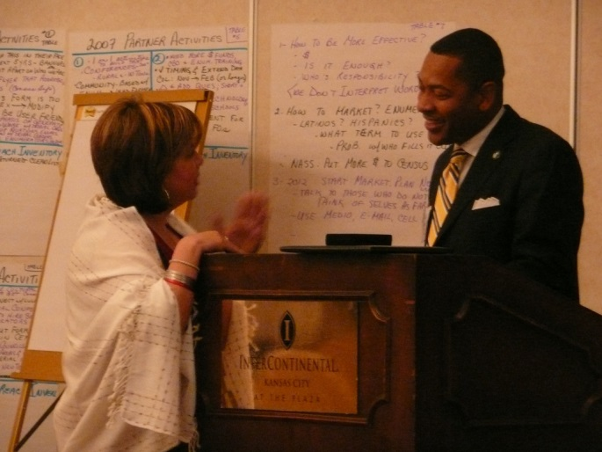
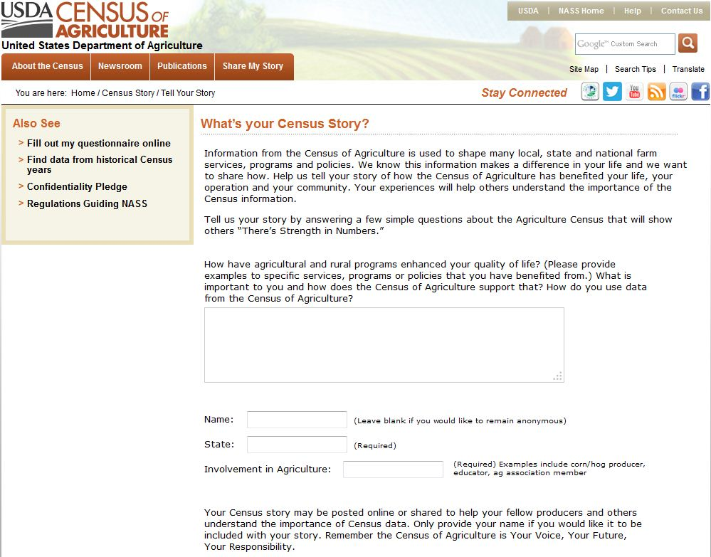
Obtaining Feedback
Twitter example.
Nextgov.com article:
Who’s Using Our Data? Ag Agencies Ask (22 March 2013)
Hats off to two Agriculture Department divisions
for seeking feedback Thursday and Friday about how and whether
their open data are being used by researchers and other data
consumers….USDA’s National Agricultural Statistics Service
tweeted…“Have you used our Ag Census #data to build an app, tool
or site? Let us know with a tweet!
Response from the University of Kentucky’s
Agriculture College. @usda_nass We built
#county #data profiles for all 120 #Kentucky
counties. Our users love them!...

Slide 6
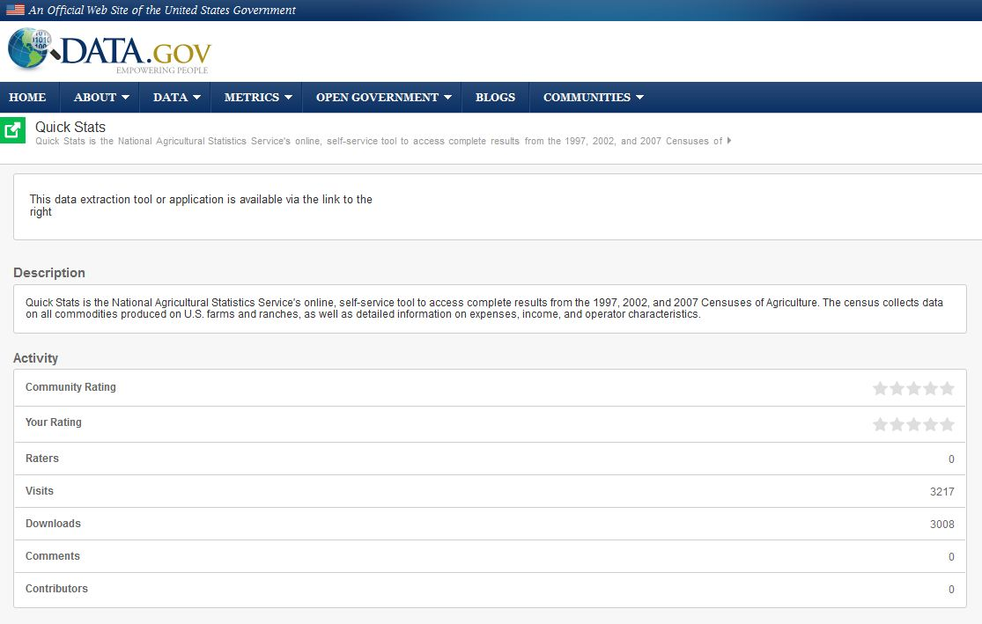
Obtaining Feedback
Formal surveys, feedback tools and evaluations.

Slide 7
Obtaining Feedback

Slide 8
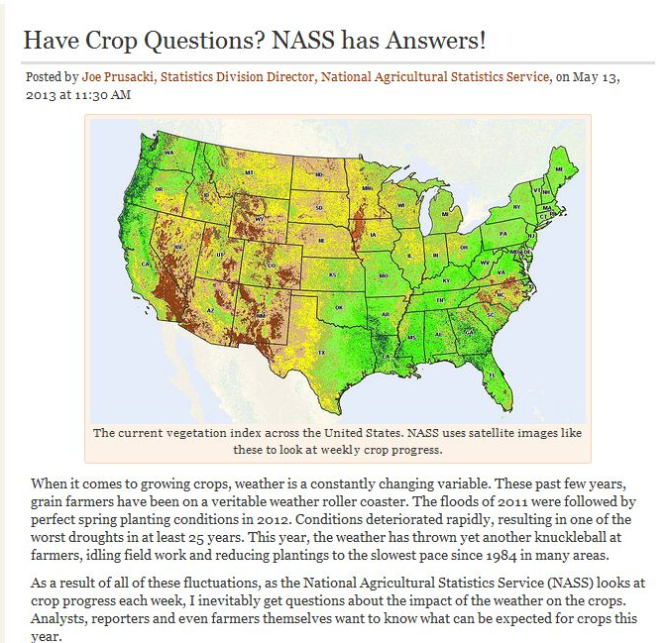
Feedback Implementation

Slide 9
Feedback Implementation
Census materials images – widget, v-psa broadcast pieces, language, sample materials;
Promotional materials on iPads;
Website redesign;
New product development.

Slide 10
Opportunities
62% of U.S. farms had Internet access in 2011, up from 59% in 2009.
iPad data collection.
Technology/Internet advances.
On-line publication of statistics vs. print.
Consumer expectations.
Diverse audiences and diverse ways to reach them.

Slide 11
Challenges
38% of U.S. farms did not have Internet access in 2011, down from 41% in 2009.
iPad data collection.
Technology/Internet advances.
On-line publication of statistics vs. print.
Consumer expectations.
Limited Resources.
Gap between consumer expectations and agency resources to meet expectations.
Diverse audiences and diverse ways to reach them.

Slide 12
Wish List
Fast and timely feedback mechanism.
More ability to engage in social media.
Improved on-line census and survey response tool.
Improved Quick Stats online data service.
Mobile friendly website.

Slide 13
Discussion Ideas
What’s been successful for you?
What did you try that didn’t work?
Successful evaluation criteria and matrix?
Social media evaluation – How to prove engagement is translating to improved perception and survey response rates?
Any successful partnerships to help bridge government resource gap?

Slide 14
Thank you
Suzanne King
Public Affairs Section Head
USDA’s National Agricultural Statistics Service
1400 Independence Avenue, SW, Room 5029
Washington, DC 20250
Sue.king@nass.usda.gov
202-690-8122
www.nass.usda.gov
www.agcensus.usda.gov

