Slide 1
Web TV – A new way of engaging audiences
Considerations and lessons learned
Marianne Mackie & Helle Harbo
June 2012

Slide 2
Why introduce web TV?
Meet the users where they are
Visualize heavy subjects
Add faces to abstract figures
Not replace but offer a supplement

Slide 3
Organizational worries in advance
The reputation of Statistics Denmark
– will we lose credibility?
Entering YouTube
– how do we handle criticism?
Ressources?

Slide 4
Choosing form and content
Aim at 4 different kinds:
1: Journalistic video complementing
article
2: Explaining complex concepts
3: Branding Statistics Denmark
4: Presenting statistical subject & figures

Slide 5
Audience ratings as a guide?
A choice somewhere inbetween:
Bestsellers that sell themselves
and
Highlighting subjects of less
Immediate interest
Visits on website May 2012
Front page of website:
137.000 visits
Front page of name statistics:
52.000 visits
Front page of regional accounting statistics:
51 visits

Slide 6
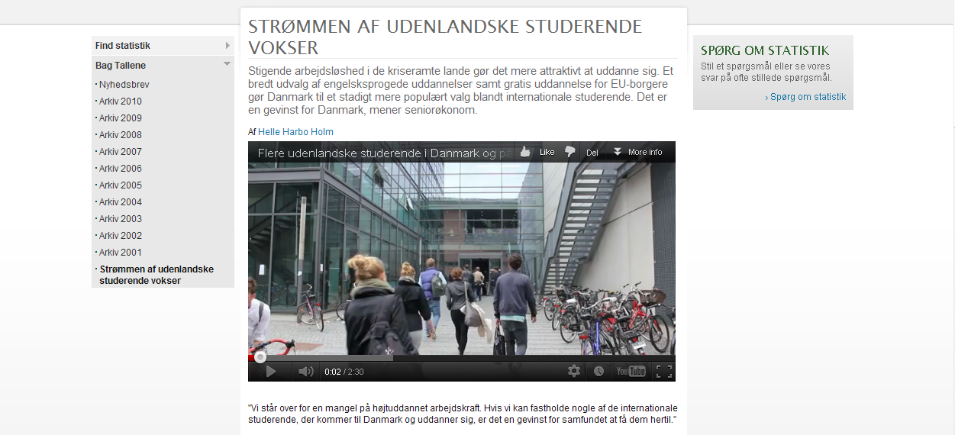
Experiences so far
News item presenting the whole story

Slide 7
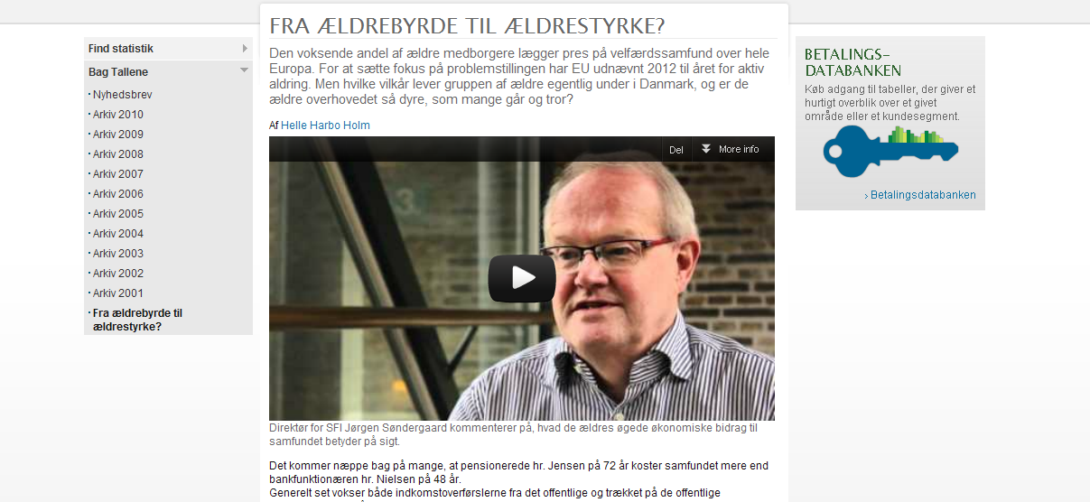
Experiences so far
Perspective on a story

Slide 8
Experiences so far
Branding purpose:

Slide 9
Experiences so far
Internal communication:

Slide 10
Experiences so far
Transverse yearbook project:

Slide 11
Lessons learned
Prepare story and interview
Experts: not only academic skills, but visual variation, ability to make punch lines…
Focused interviews - sum up the points
Technical pitfalls: lamps, shadows…
Organization: taking turns in editing

Slide 12
Challenges in phase two
Time, time and time
Make video part of the website’s joint expression
Structural uniformity?
Ambitions – talking heads or news items?
Advice and input from you?

