Slide 1
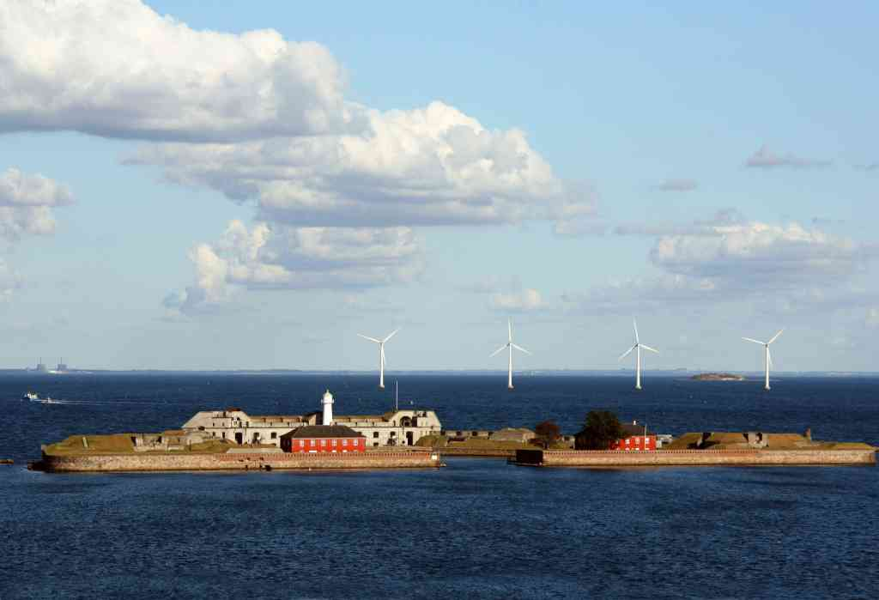
Usage of Proces Data in Data Editing at Statistics Denmark
Work Session on Statistical Data Editing, 24th-26th April 2017
Regin Reinert (reg@dst.dk) and Olav Grøndal (ogd@dst.dk), Statistics Denmark

Slide 2
Agenda
Proces data
Modernized data editing
Data Archive (at Statistics Denmark)
Examples

Slide 3
Proces Data
Proces data are data collected during the editing proces.
Proces data can contain information on:
Time of collection
Source of collection
Violated edit rules
Time of editing
Source of editing

Slide 4
Modernized data editing
Statistics Denmark has initiated a proces called Modernized Data Editing.
The purpose of the modernized data editing proces is to standardize editing processes across statistics at Statistics Denmark.
Proces data are important in order to monitor progress.

Slide 5
Data Archive
Statistics Denmark has constructed a Data Archive (DA), to store data in during the entire editing proces.
The methodoligical department has emphasized the importance of proces data during the construction of the Data Archive.
Changes on records can be tracked on any time.
All data are stored on a normalized level. I.e. Changes can be tracked to exactly which field has been changed at any time.

Slide 6
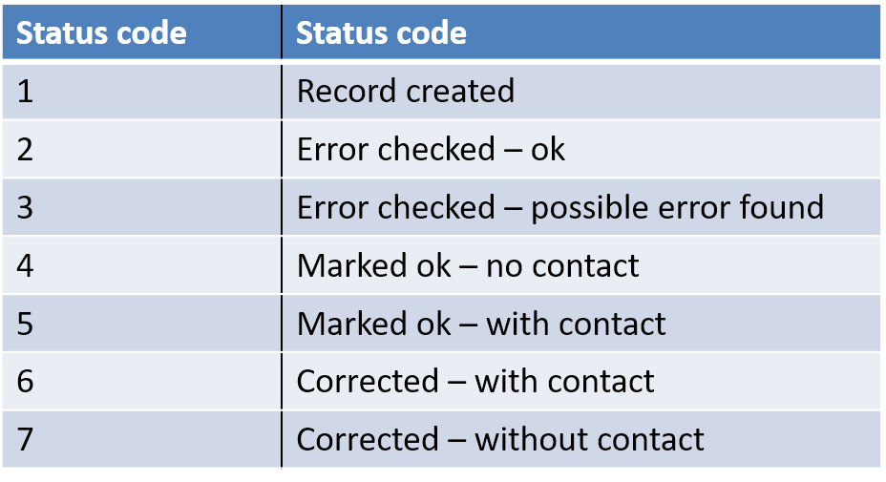
Status Codes for Records
For each record in the data archive the status code secures the possibility of creating proces indicators.

Slide 7
Extraction of Proces Data from the Data Archive
It is easy to extract indicators on proces data from the data archive.
The normalized construction of the data archive makes is possible to extract process data on all levels.
Proces data can be extracted on record level.
Proces data can be extracted on field level.
Proces data can be extracted on editing rule level.

Slide 8
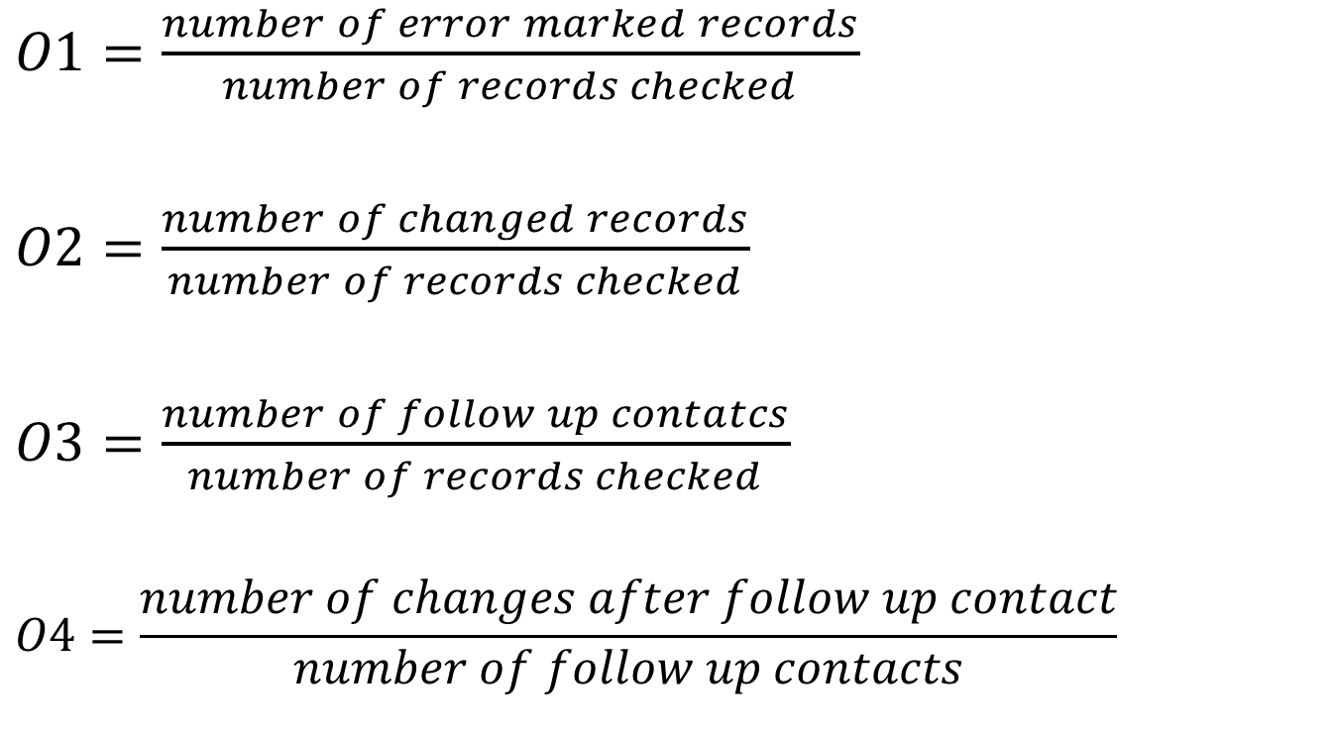
Proces indicators - Records Introduced by Granquist – ”Guide til Granskning”
$O1=\frac{number of error marked records}{number of records checked}$
$O2=\frac{number of changed records}{number of records checked}$
$O3=\frac{number of follow up contatcs}{number of records checked}$
$$O4=\frac{number of changes after follow up contact}{number of follow up contacts}$$

Slide 9
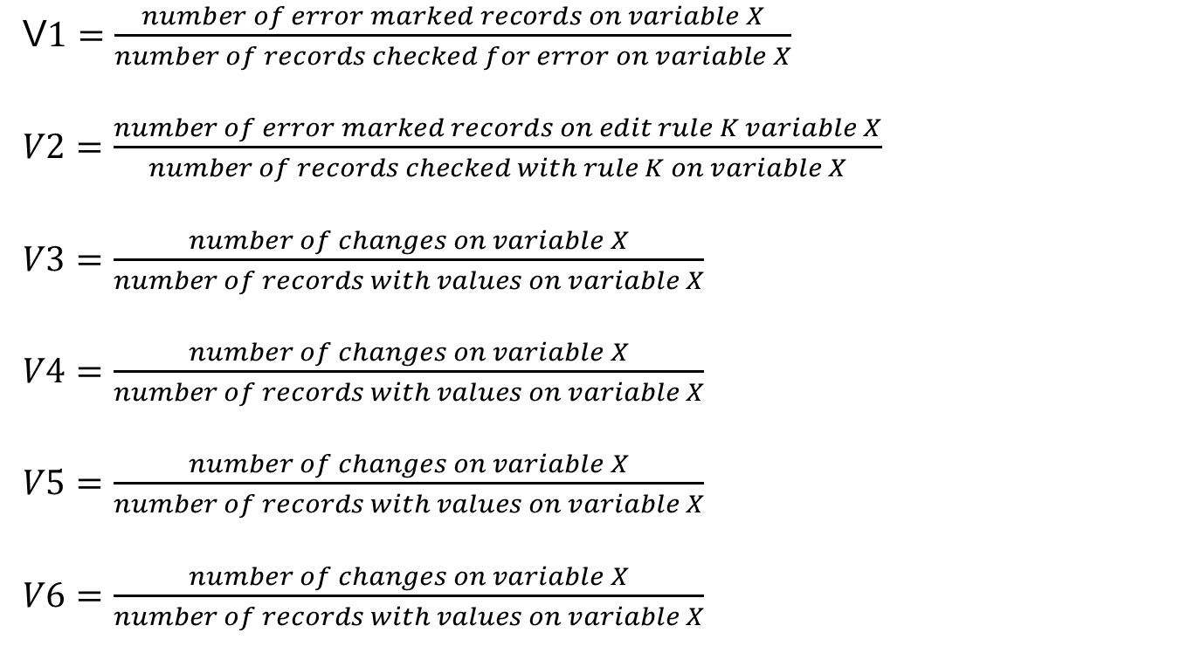
Proces indicators - Fields Introduced by Granquist – ”Guide til Granskning”
V$1=\frac{number of error marked records on variable X}{number of records checked for error on variable X}$
$V2=\frac{number of error marked records on edit rule K variable X}{number of records checked with rule K on variable X}$
$V3=\frac{number of changes on variable X}{number of records with values on variable X}$
$V4=\frac{number of changes on variable X}{number of records with values on variable X}$
$V5=\frac{number of changes on variable X}{number of records with values on variable X}$
$V6=\frac{number of changes on variable X}{number of records with values on variable X}$

Slide 10
Example – $O1$ PIGS-Survey
Proces indicators are easy to construct in the data archive.
In the example above an update in SAS 4th quarter 2015 caused the editing program to mark far too many errors.
Errors are marked by a score function which is quite sensitive in comparisons of numbers from quarter to quarter.
There are many rules, so many records are marked as possibly erroneous. But the majority of them have low scores – and are not manually checked.

Slide 11
Example: External Vendor
During 2014 and 2015 it became obvious that records collected through an external vendor were much more prone to errors.
Storage of proces data made it possible to document this assumption

Slide 12
Example – $O3$: Rate of follow up contacts
The number of follow up contacts has decreased significantly since all data have been collected inhouse

Slide 13
Example – $O4$: Correction rates of follow up contacts
Correction rates are high but do not seem to be affected by the more than 50% reduction in rate of follow up contacts.

Slide 14
Example : Corrections by field (variable)
It is easy to extract editing data by variable and count number of corrections by variable

Slide 15
Summary
It is easy to extract proces data from the Data Archive.
It can be useful to have access to proces data.
Regular reporting of proces indicators still remains to be implemented.

Slide 16
Thanks for your attention
Questions?
Regin Reinert (reg@dst.dk), Statistics Denmark

