Slide 1
Implementation and Evaluation of Automatic Editing
Jeroen Pannekoek, Mark van der Loo and Bart van den Broek

Slide 2
Introduction
Automatic data editing can involve many different kinds of actions that each perform a specific task in the editing process.
Current work at SN is targeted at supporting the implementation of these editing tasks with standardised re-usable methods and software tools.
But the effectiveness of such implementations depends very much on the parameterisation of methods and especially specification of edit-rules and other rules that drive the automatic editing functions.
This means monitoring the effects on the data but also feedback on the sets of (edit)rules used by the different tasks.
Notes:
All kind of processes, that is a sequence of process steps and we want indicvators that follow the changes to the data made by ech processstep.
I this short talk I’ll give an impression of our work in this direction.

Slide 3
This presentation
The types of rules that are input to the automatic editing
The automatic editing task or process steps
Main point:
Ways of generating feetback from the automatic editing process that can help in the improvement of the configuration of the different process steps.
Notes:
All kind of processes, that is a sequence of process steps and we want indicvators that follow the changes to the data made by ech processstep.
I this short talk I’ll give an impression of our work in this direction.

Slide 4
Input Rule Sets:
Verification and Modification
Verification of data values (Cheking- or edit-rules)
Profit = Revenues – Costs
Employees in FTE < Employees
Modification of data values (Direct “if-then” type of rules)
Correction: value -> value
If Wages > 10 000 * Employees Then Wages <- Wages /1000
Error localisation: value -> missing
If (Employees > 0 & Wages = 0) Then Wages <- NA
Imputation: missing -> value
If (Employees = 0 & Wages = NA) Then Wages <- 0

Slide 5
Editing process steps
Raw data
Correction of thousand errors
Correction of rounding errors
Deductieve imputation
Regression (NN) imputation
Adjustment of imputed values
Corrections with other rules
Correction of typos
Error localisation Fellegi- Holt
Error localisation with rules
Direct
modification rules
Edit rules
Corrected data
Log file

Slide 6
Effects of editing: data related and edit related views
Across process steps:
Data related views
Status of data cells (observed, missing, imputed etc.)
Values of data (e.g. estimates of means, totals, variances
Edit related views
Status of edits (violated, satisfied, not verifiable)
Values of edits (tolerances, scores)
Notes:
Ac
dross process steps
Different affects or cganges thereof.

Slide 7
Status of data cells
At each step we have available and missing data values
These can be subdivided according to the way they are changed with respect to a previous step or the raw data.
All cells
Available |  |  | Missing
unaltered | modified | made available (imputed) | unaltered (still missing) | made missing (cancelled)

Slide 8
Data cell status
Left: Childcare institutions
Right: SBS Wholesale

Slide 9
Data values
Means and estimated CI
by process step
Childcare Institutions:
Turnover,
Revenues

Slide 10
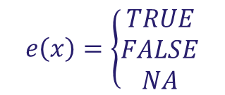
Edit verification status
Notes:
The edit status is simple we have three possibilities: satisfied violated and not verifiable.
Percentages of each of these statuses are displayed in this figure, for both data sets,
In the left panel there are no missings and all edits are verifiable, to start with.
there is a sam

Slide 11
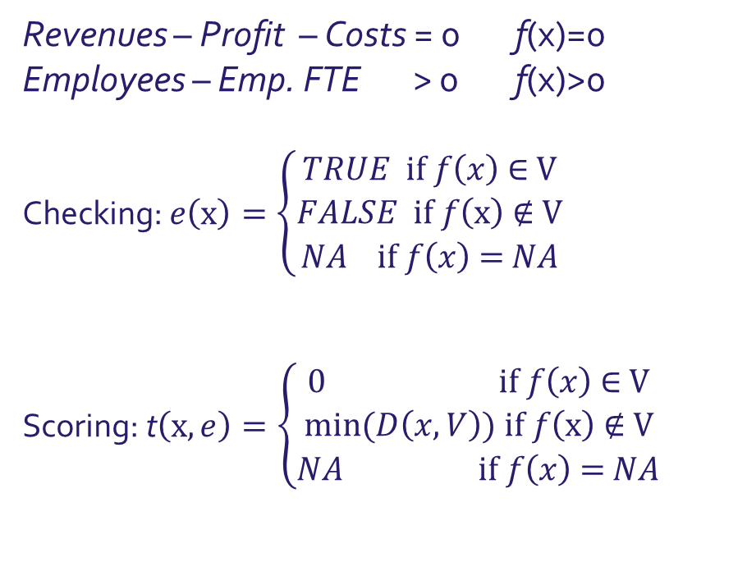
Edit tolerance or score
By how much is an edit violated?
(an edit-related score function)
Notes:
If an edit is violated, it is informative to look at the amount by which it is violated.
This can be seen as a measure of the implausibility of the data:
Dan Hedlin proposed such a measure as a score function to be used in selective editing.
He called it the edit related score function as opposed to the estimate related score function

Slide 12
Edit tolerances for Wholesale
Plots of tolerances
Height of box
proportional to
sqrt(# positive tolerances)
Left side: numbers of not evaluated tolerances.
Notes:
Bad results for negative values and th. Errors.
Other correction rules does quite wel
Typos and rounding are based on algorithms thatb take the edit-rules as input and cannot result inmore edit violations
FH error localisation failed to fiind a solution for a few records, because an older FH-algorithm was used. Our current R-modules made by Mark really perform very well are flwless inn this wouldn’t happen.

Slide 13
HB scores for Childcare
Hidiroglou-Berthelot
scores for two ratio’s
Left:
Wages/Employees
Right:
Revenues/Costs
Hard edit-rule:
0.5×Costs
< Revenues <
2×Costs

Slide 14
Concluding remarks
Step-by-step evaluation of indicators can lead to :
    improvements in edit-rules (1000-errors, minus signs, relaxation of bounds)
    improvements in configuration of methods (imputation)
    efficient selective editing (review specific corrections)
Other benefits of indicators by process step:
it makes automatic editing more transparent,
and more easily accepted by editing staff.

Slide 15
Concluding remarks
Thank you for your attention!

