Slide 1
A generalised Fellegi-Holt paradigm for automatic editing
Sander Scholtus

Slide 2
Introduction
Automatic editing as a partial alternative to manual editing: advantages in
efficiency
timeliness
reproducibility of results
Methods:
deductive editing for systematic errors (if-then rules)
error localisation for random errors

Slide 3
Introduction
Error localisation for random errors
Specify edit rules
Adjust data so that they satisfy the edit rules
Paradigm of Fellegi and Holt (1976):
Imputation as a separate step after error localisation
Extension: assign confidence weights to variables
Find the smallest subset of variables that can be imputed so that the imputed record satisfies the edit rules.

Slide 4
Introduction
The Fellegi-Holt paradigm sometimes leads to systematic differences between automatic and manual editing
Example 1: interchanging values of costs and revenues
Example 2: transferring amounts between variables
e.g., turnover wholesale ↔ turnover retail trade
 | revenues | costs | balance
raw data | 70 | 130 | 60
data after manual editing | 130 | 70 | 60
data after automatic editing (1) | 190 | 130 | 60
data after automatic editing (2) | 70 | 10 | 60
data after automatic editing (3) | 70 | 130 | –60

Slide 5






Edit operations
Data editing tries to reverse the effects of errors
true data
$$\left(\begin{matrix}142 \\ 38 \\ 180 \\ ⋮ \\ 5\end{matrix}\right)$$
$$\left(\begin{matrix}142 \\ 83 \\ 180 \\ ⋮ \\ 5\end{matrix}\right)$$
observed
$$\left(\begin{matrix}142000 \\ 83000 \\ 180000 \\ ⋮ \\ −5000\end{matrix}\right)$$
error 1
error 2
error t
…
corrected
$$\left(\begin{matrix}142 \\ 38 \\ 180 \\ ⋮ \\ 5\end{matrix}\right)$$
$$\left(\begin{matrix}142 \\ 83 \\ 180 \\ ⋮ \\ 5\end{matrix}\right)$$
observed
$$\left(\begin{matrix}142000 \\ 83000 \\ 180000 \\ ⋮ \\ −5000\end{matrix}\right)$$
edit op. t
edit op. t–1
edit op. 1
…

Slide 6


Edit operations
Consider numerical variables, linear edit rules
Fellegi-Holt paradigm: one type of edit operation
Call this a “Fellegi-Holt operation”
$$\left(\begin{matrix}x_{1} \\ ⋮ \\ x_{j−1} \\ x_{j} \\ x_{j+1} \\ ⋮ \\ x_{p}\end{matrix}\right)$$
$$\left(\begin{matrix}x_{1} \\ ⋮ \\ x_{j−1} \\ α \\ x_{j+1} \\ ⋮ \\ x_{p}\end{matrix}\right)$$
imputed value: free parameter

Slide 7


Edit operations
General linear edit operation
Special case: Fellegi-Holt operation
$$x=\left(\begin{matrix}x_{1} \\ ⋮ \\ x_{j} \\ ⋮ \\ x_{p}\end{matrix}\right)$$
$$g\left(x\right)=T\left(\begin{matrix}x_{1} \\ ⋮ \\ x_{j} \\ ⋮ \\ x_{p}\end{matrix}\right)+\left(\begin{matrix}h_{1} \\ ⋮ \\ h_{j} \\ ⋮ \\ h_{p}\end{matrix}\right)$$
constant
or free
parameter
coefficient matrix

Slide 8
Edit operations
Some examples of edit operations:
Change the sign of a variable
$$\left(\begin{matrix}x_{1} \\ x_{2} \\ x_{3}\end{matrix}\right)→\left(\begin{matrix}−x_{1} \\ x_{2} \\ x_{3}\end{matrix}\right)=\left(\begin{matrix}−1 & 0 & 0 \\ 0 & 1 & 0 \\ 0 & 0 & 1\end{matrix}\right)∙\left(\begin{matrix}x_{1} \\ x_{2} \\ x_{3}\end{matrix}\right)+\left(\begin{matrix}0 \\ 0 \\ 0\end{matrix}\right)$$
Interchange two adjacent values
$$\left(\begin{matrix}x_{1} \\ x_{2} \\ x_{3}\end{matrix}\right)→\left(\begin{matrix}x_{2} \\ x_{1} \\ x_{3}\end{matrix}\right)=\left(\begin{matrix}0 & 1 & 0 \\ 1 & 0 & 0 \\ 0 & 0 & 1\end{matrix}\right)∙\left(\begin{matrix}x_{1} \\ x_{2} \\ x_{3}\end{matrix}\right)+\left(\begin{matrix}0 \\ 0 \\ 0\end{matrix}\right)$$
Transfer an amount between two variables
$$\left(\begin{matrix}x_{1} \\ x_{2} \\ x_{3}\end{matrix}\right)→\left(\begin{matrix}x_{1}+α \\ x_{2} \\ x_{3}−α\end{matrix}\right)=\left(\begin{matrix}1 & 0 & 0 \\ 0 & 1 & 0 \\ 0 & 0 & 1\end{matrix}\right)∙\left(\begin{matrix}x_{1} \\ x_{2} \\ x_{3}\end{matrix}\right)+\left(\begin{matrix}α \\ 0 \\ −α\end{matrix}\right)$$

Slide 9
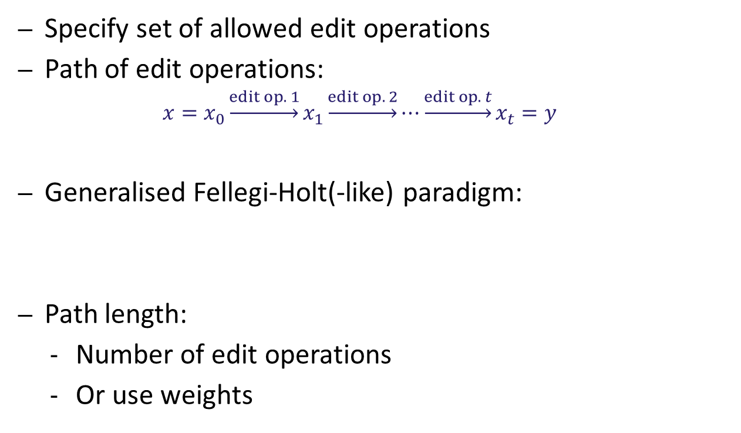
Edit operations
Specify set of allowed edit operations
Path of edit operations:
$$x=x_{0}\underset{→}{edit op. 1}x_{1}\underset{→}{edit op. 2}⋯\underset{→}{edit op. t}x_{t}=y$$
Generalised Fellegi-Holt(-like) paradigm:
Path length:
Number of edit operations
Or use weights
Find the shortest path of allowed edit operations that can be used to reach a record that satisfies the edit rules.

Slide 10
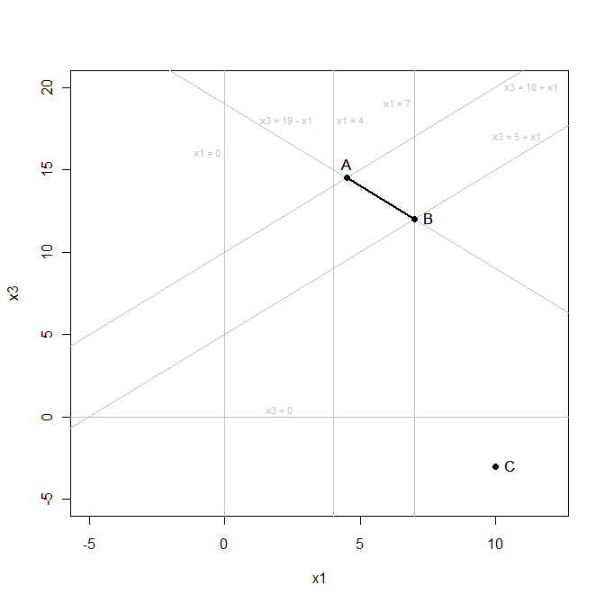
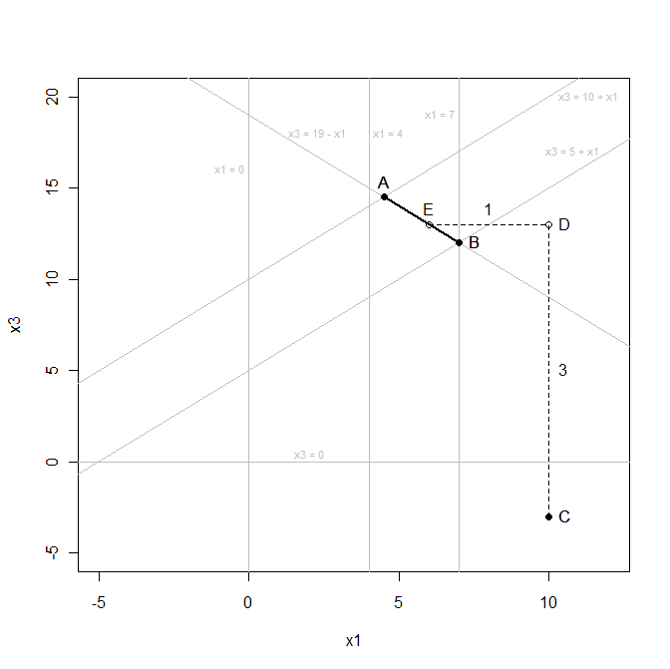
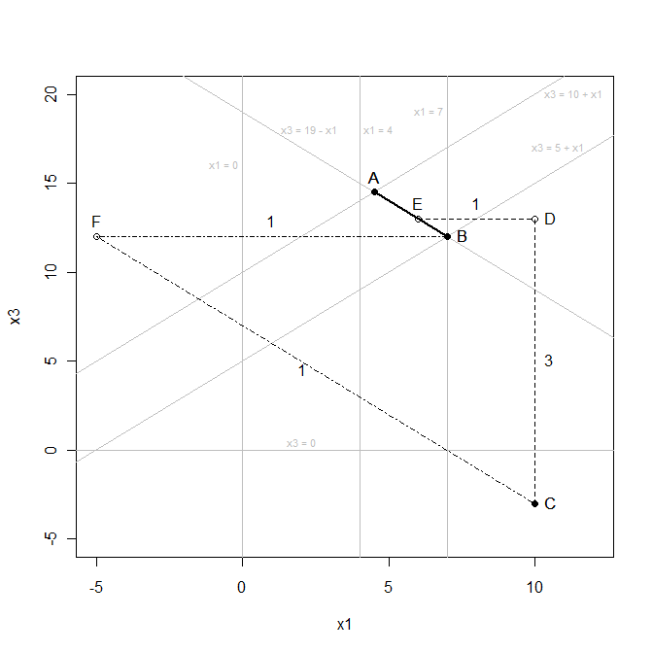


Example
Edit rules:
Raw data: $\left(x_{1},x_{3}\right)=\left(10,−3\right)$
Edit operations:
Impute $x_{1}$ (weight: 1)
Impute $x_{3}$ (weight: 3)
Transfer ≤ 15 units between $x_{1}$ and $x_{3}$ (weight: 1)
$$x_{1}+x_{3}≥19$$
$$x_{3}−x_{1}≥5$$
$$x_{3}−x_{1}≤10$$
$$x_{1}≥4$$
$$x_{1}≤7$$
$$x_{3}≥0$$

Slide 11
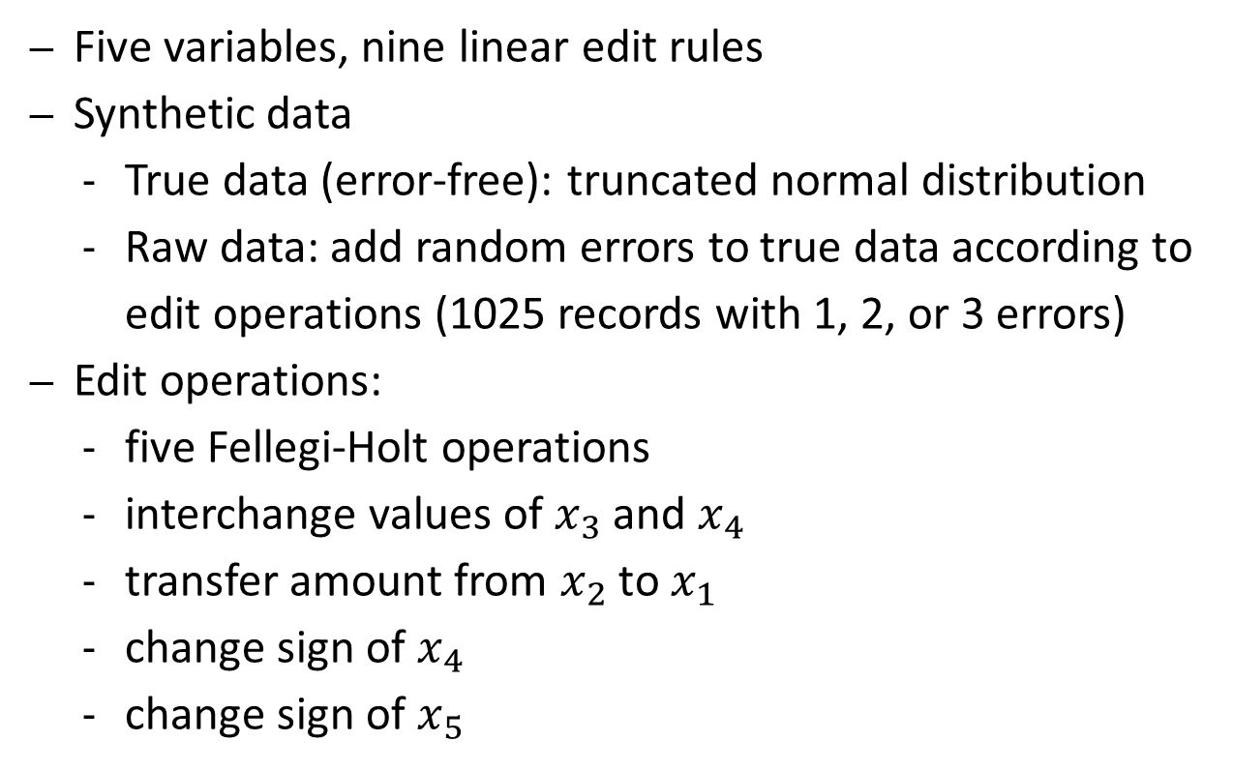
Simulation study
Five variables, nine linear edit rules
Synthetic data
True data (error-free): truncated normal distribution
Raw data: add random errors to true data according to edit operations (1025 records with 1, 2, or 3 errors)
Edit operations:
five Fellegi-Holt operations
interchange values of $x_{3}$ and $x_{4}$
transfer amount from $x_{2}$ to $x_{1}$
change sign of $x_{4}$
change sign of $x_{5}$

Slide 12
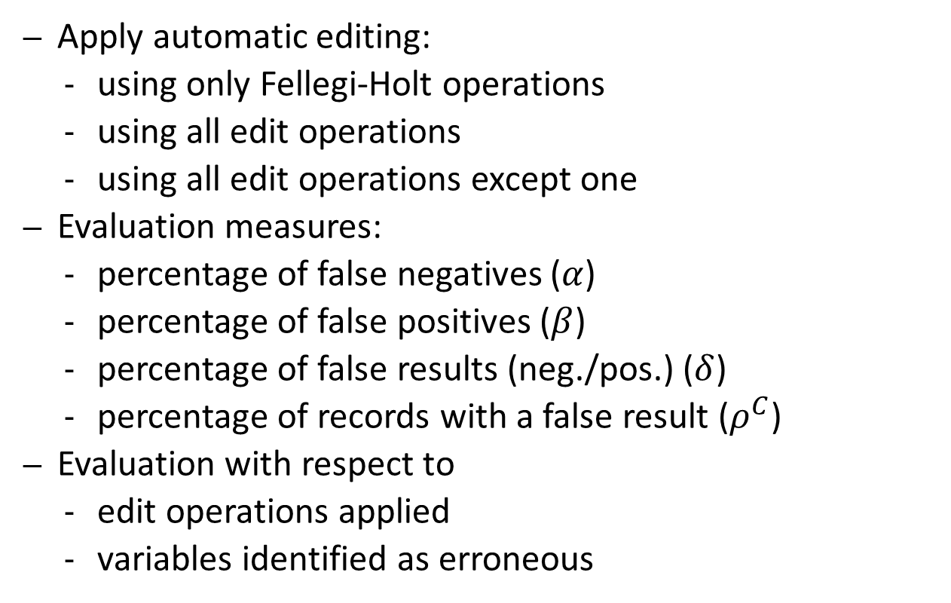
Simulation study
Apply automatic editing:
using only Fellegi-Holt operations
using all edit operations
using all edit operations except one
Evaluation measures:
percentage of false negatives ($α$)
percentage of false positives ($β$)
percentage of false results (neg./pos.) ($δ$)
percentage of records with a false result ($ρ^{C}$)
Evaluation with respect to
edit operations applied
variables identified as erroneous

Slide 13
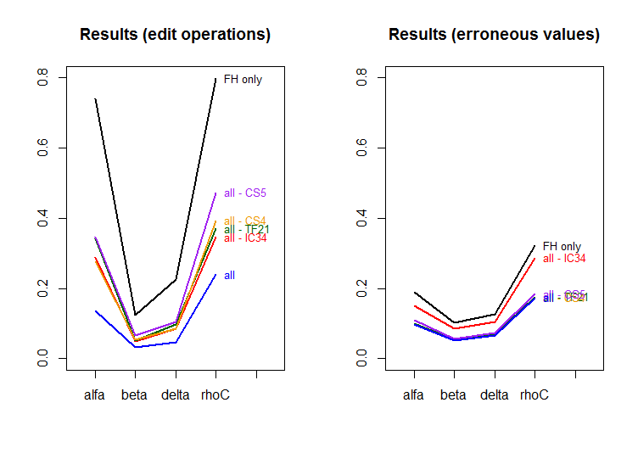
Simulation study: results

Slide 14
Concluding remarks
New paradigm for automatic editing
Fellegi-Holt paradigm: special case
Use edit operations: analogy to “edit distances” in approximate matching of text strings
Reduce gap between automatic and manual editing?
Results on synthetic data: promising
More research needed:
Efficient algorithm
Finding relevant edit operations
Extensions to categorical and mixed data

Slide 15
Concluding remarks
Thank you for your attention!

