Slide 1
Assessing the Impact of a New Imputation Methodology for the
Agricultural Resource Management Survey
Wendy Barboza, Darcy Miller, Nathan Cruze
United States Department of Agriculture
National Agricultural Statistical Service

Slide 2
The Agency and Mission
The National Agricultural Statistics Service (NASS) is a statistical agency located under the U.S. Department of Agriculture (USDA).
Mission: To provide timely, accurate, and useful statistics in service to U.S. agriculture.
NASS conducts hundreds of surveys every year and publishes numerous reports covering virtually every aspect of U.S. agriculture.

Slide 3
Agricultural Resource Management Survey (ARMS)
Provides an annual snapshot of the financial health of the farm sector and farm household finances.
Only source of information available for objective evaluation of many critical policy issues related to agriculture and the rural economy.
USDA and other federal administrative, congressional, and private-sector decision makers use this data when considering alternative policies/programs or business strategies for the farm sector or farm families.

Slide 4
Adjusting for Item-level Nonresponse
The ARMS survey questionnaire is long and complex: 51 pages and > 800 data items.
The survey questions cover the characteristics, management, income, and expenses of both the farm operation and the farm household.
Obtaining a response for every item is challenging; imputation is performed for missing items.

Slide 5
Current Imputation Methodology
Uses conditional mean imputation.
Groups formed by locality, farm type, economic sales class (outliers excluded).
Specified collapsing order when not enough records in a group.
Underestimates the variance and distorts relationships between variables.

Slide 6
New Imputation Methodology
Uses multiple variables in imputation.
Data are transformed and a regression-based technique is used.
Various criteria are used to select the covariates.
Parameter estimates for the sequence of linear models and imputations are obtained using Markov chain Monte Carlo.
Referred to as Iterative Sequential Regression (ISR).

Slide 7
18 Key Variables
- Agricultural Chemicals Expenditures
- Farm Improvements and Construction
- Farm Services*
- Farm Supplies and Repairs
- Feed Expenditures
- Fertilizer, Lime and Soil Conditioner Expenditures
- Fuels Expenditures
- Interest
- Labor Expenditures
- Livestock, Poultry, and Related Expenses
- Miscellaneous Capital Expenses
- Other Farm Machinery Expenditures
- Rent
- Seeds and Plants
- Taxes*
- Total Expenditures*
- Tractor and Self-Propelled Farm Machinery Expenditures
- Trucks and Autos Expenditures
* Variable contains imputed values

Slide 8
Analysis of 2011/2012 Data
Examined the 18 key variables.
Percent change = 100*[(ISR-mean)/mean].
Positive (negative) value indicates that the estimate using ISR is greater (less) than the estimate using conditional mean imputation.

Slide 9
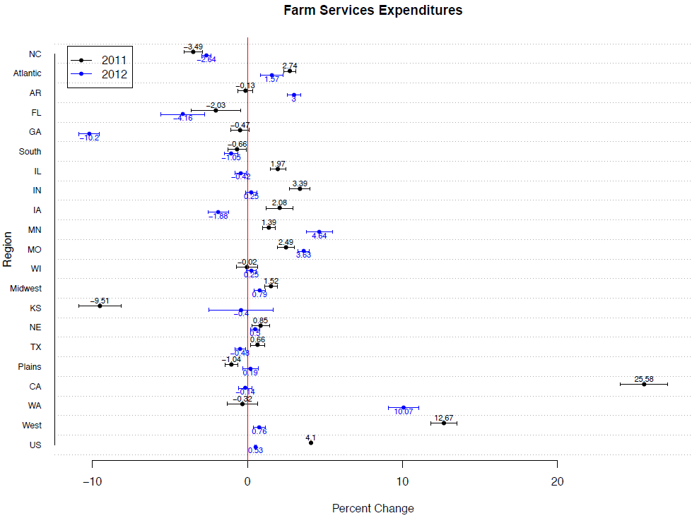

Slide 10
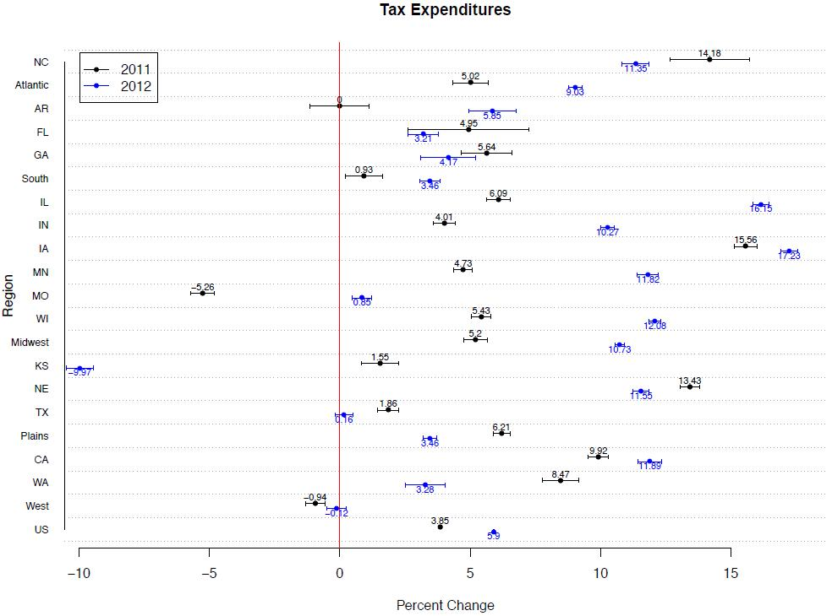

Slide 11
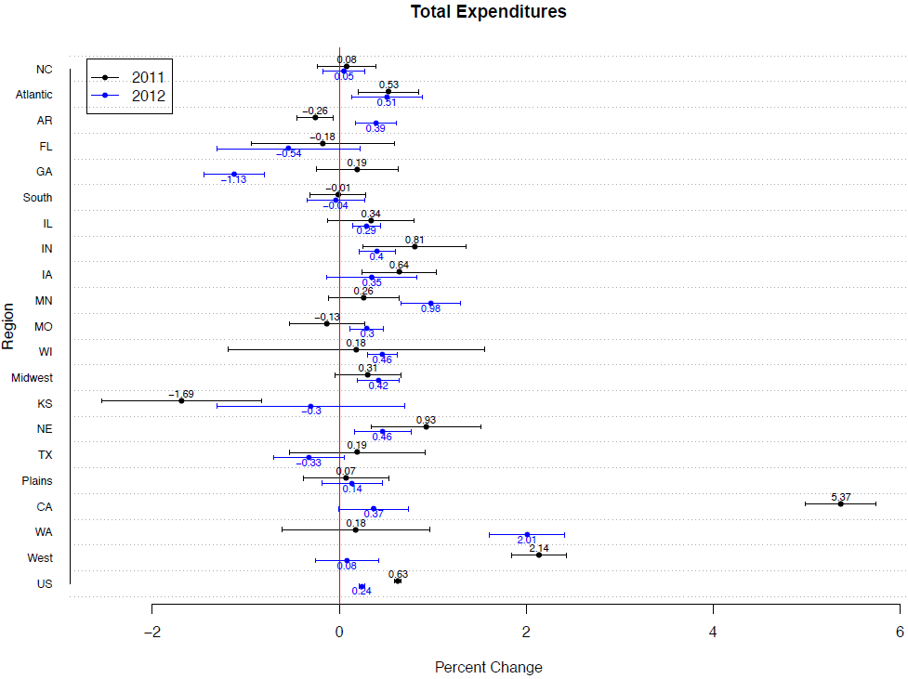
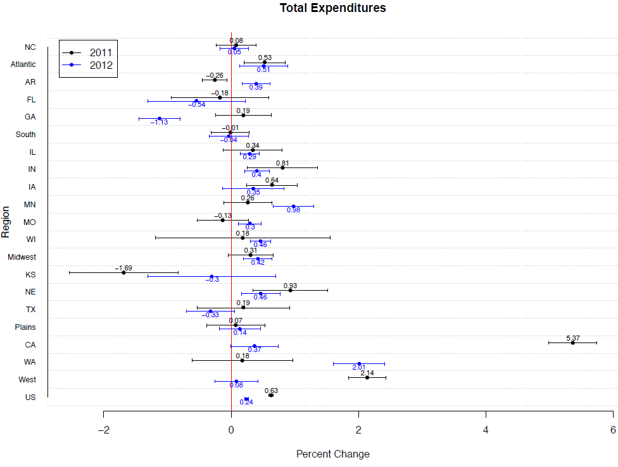

Slide 12
Conclusion
There are major disadvantages with using the conditional mean imputation methodology.
ISR will preserve important relationships, the distribution of the respondents’ data, and provide a better estimate of uncertainty.
Preliminary analysis has shown that there is a significant difference between the two methodologies for some estimates.
However, the results are promising and additional analysis is currently being conducted.

Slide 13
Thank you!
Wendy Barboza
wendy.barboza@nass.usda.gov
United States Department of Agriculture
National Agricultural Statistics Service

