Slide 1
Revolutionizing Censuses and Demographic & Social Statistics with
Administrative Sources
Lars Thygesen, lth@dst.dk
Notes:
Danish statistics reform
registers, new and unforeseen needs

Slide 2
The setting
Law on Statistics Denmark 1966:
  Use admin sources
  Maybe even for Census
Administrative registers from 1970
  Unique identifiers
  ”Huge Data” challenge

Slide 3
To link
or not to link
- that’s the
question!
The case of Denmark

Slide 4
Milestones
Notes:
last Census
Act: Access to adm + influence on them

Slide 5
The notion of a Statistical Information System
CPR
Educa-
tion
Employ-
ment
Person
id:
Person Number
Tax
Inter-
view
Question-
naire
Social
Health
etc
Dwelling
id:
Address
Enterprise
id:
CBR-No
Cadastre
BDR
CBR

Slide 6

A treasure!
High data quality
Coverage
Coherence
Combining & linking
Longitudinal studies
World’s first Census without questions
www.dst.dk/declarations

Slide 7

The filing or archive structure
SumDatabase
-
Notes:
Nordbotten stated that the total database should be seen as a data box with 3 dimensions: Statistical unit, variable and time. During the last 10 years, Statistics Denmark has made a real movement in that direction

Slide 8
Consequences of archive method
Data collection not linked to use
Key purposes are foreseen
Almost anything can be made on demand
The statistical program | Paid services
Decided by the Board | Customers
Free on Internet/ StatBank.dk | Full (average) cost recovery
Examples: Municipality level Detailed statistics | Examples: Small area statistics Even greater detail Research on micro data

Slide 9
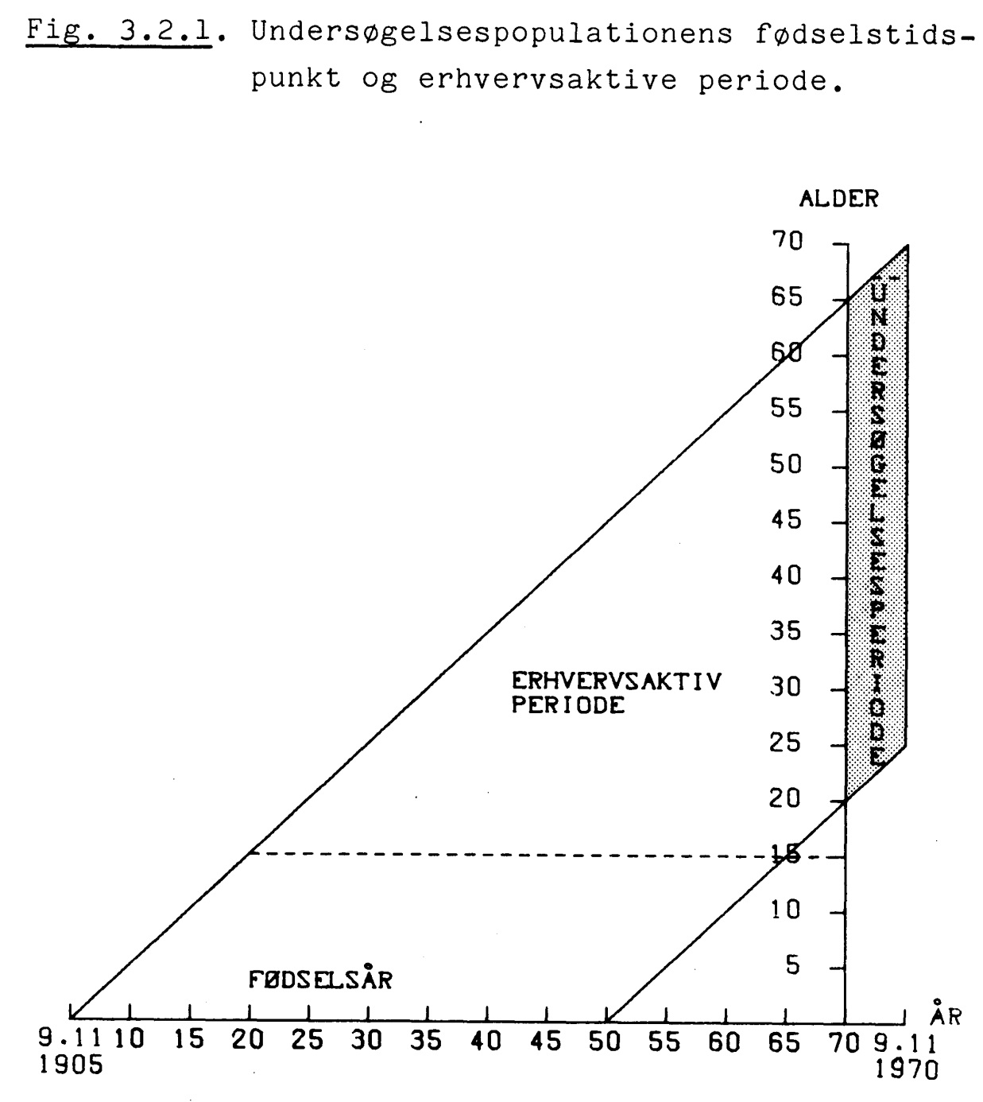
Micro data and longitudinal analysis
Age
Elsebeth Lynge:
Occupational mortality 1970-75
Researchers’ remote access:
300 institutes
3,000 researchers
400 active projects
2 M€
Econoically active ages
Year of birth

Slide 10
Confidentiality and data protection
Challenge: Keep public trust
data security regulations
  strict organisational and technical measures
  limiting internal and external access to data
need to know principle
1978 Register Law

Slide 11
Difficulties in practical implementation
Convincing ourselves
  Champions of traditional statistics
  University textbooks
  Strong management commitment
Convincing the rest of the world
  Suspicion
  Bad experience history, especially WW2
  Survey is the truth ?
  International meetings, Eurostat book (1995):
  Statistics on Persons in Denmark – A Register-Based Statistical System. Eurostat, Luxembourg 1995

Slide 12
Difficulties #2
Confidentiality and access to data
  The threat of a “Big Brother” society
  Lawsuit against Statistics Denmark in 1978-81 by five municipalities
Data breaks
  changes in the legislation
  difficult to assess long-term trend
  identify events

Slide 13
Organisation
Administrative registers kept for administrations
  but complying with certain standards
  combined across when real need
Statistics is a ”by-product”
No access to individual data in statistics

Slide 14
Consequences
We don’t talk of censuses
  we have a census every day
No publications but Statbank.dk©
Many ad hoc data needs can be met
  supplementary survey collection
A gold mine for researchers

Slide 15
Nordbotten 1960:
“In 1970, there will probably not be any need to collect a census in the traditional way”

Slide 16


The End!

