Slide 1
KAUSL Alexander
Statistics Austria
Registers, Classifications
and Methods Division
24nd – 26rd September 2012
THE DATA IMPUTATION PROCESS OF THE AUSTRIAN REGISTER-BASED CENSUS
UNECE Work Session on Statistical Data Editing, Oslo

Slide 2
Evolution of the Austrian census
2001 Last traditional census High burden for respondents, considerable financial effort (72 million Euros)
2006 Register-based test census New strategies and methods, data procedures and use of registers were successfully tested
2009 Start of annual register-based labor market statistics Possibility for application and improvement of methods
2011 First complete register-based census No burden for respondents, costs reduced to 10 million Euros – Data from 8 base and 7 comparison registers (35 data holders)

Slide 3
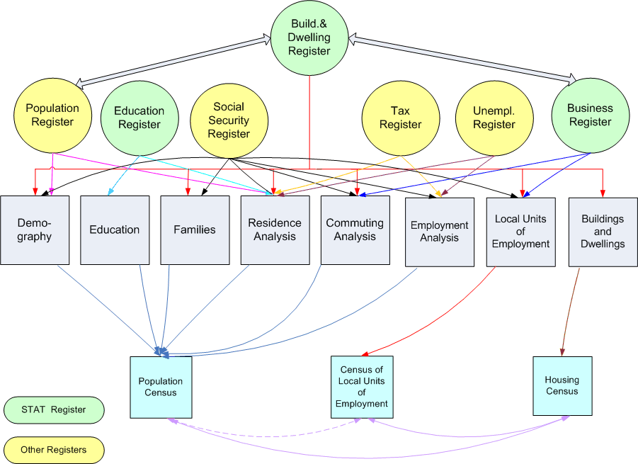
Registers
Base registers
Central Population Register
Housing Register of Buildings and Dwellings*
Business Register of Enterprises and their Local Units*
Central Social Security Register
Tax Register
Unemployment Register
Register of Educational Attainment*
Register of Enrolled Pupils & Students*
Comparison registers
Child Allowance Register
Registers of public servants of the federation and the federal states (NUTS2 level)
Central Foreigner Register
Register of Social Welfare Recipients
Register of Alternative Civilian Service
Conscription Register
Register of car owners
* registers are maintained by Statistics Austria

Slide 4
General data process (1)
Raw data
Single registers provided by the data holders
Every register authority delivers the bPIN_OS¹
Census Database
Combined information from the registers
-> unique, multiple and derived attributes
The key for data merging is the bPIN_OS²
Final Data Pool
The final data after imputations by the NSI
Data base for all applications
¹ “branch-specific personal identification number official statistics“ (encrypted key)
² “branch-specific personal identification number official statistics” (decrypted key)
RAW
CDB
FDP

Slide 5
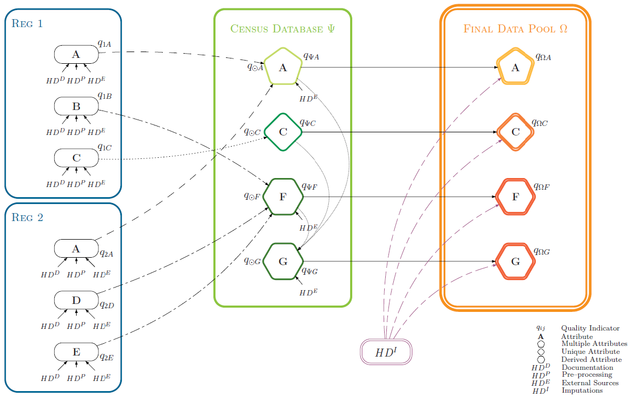
General data process (2)

Slide 6
Imputation process (1)
The first imputation processes were developed at the TRBC in 2006.
To guarantee a structured imputation procedure, different aspects had to be considered:
A variety of registers are used in the census process to ensure sufficient quality for all variables. Because of different data delivery times and census dissemination dates, it was necessary to check at which time each attribute can be edited.
Missing data analysis.
The choice of predictors used for imputation should mainly be based on the strength of their association with the variables to be imputed. Therefore it was important, to analyse the highest correlations between the variables to develop optimal estimation models for each imputation step.

Slide 7
Imputation process (2)
The structured imputation procedure should also provide the possibility to assess the quality of each imputation step, as a part of the quality framework.
The imputation process includes
Deterministic editing
Correlation
Clustering
Imputation methods
Hot-Deck technique
Logistic Regression

Slide 8
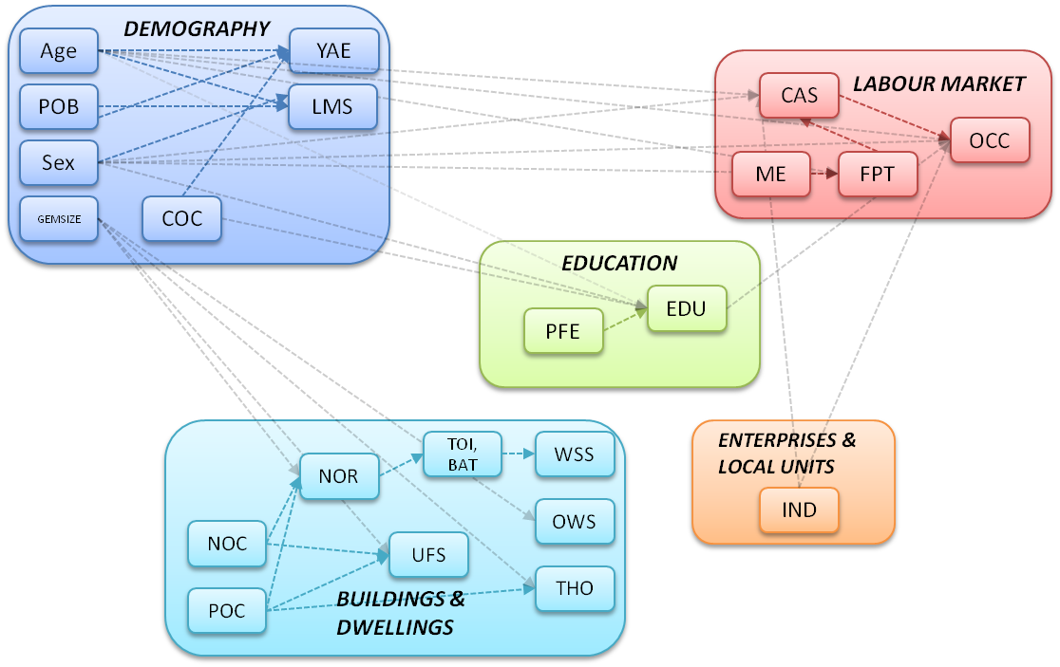
Imputation process (3) Dependences within and across census subjects
(POB … place of birth, GEMSIZE … size of locality, COC … country of citizenship, YAE …year of arrival in the country since 1980, LMS … legal marital status, CAS … current activity status, ME … marginal employment, FPT … full-part-time employment, OCC … occupation, PFE … participation in formal education, EDU … educational attainment (highest completed level), NOC … number of occupants, POC ... period of construction, NOR … number of rooms, TOI/BAT … toilet/bath facilities, WSS ... water supply system, UFS ... useful floor space, OWS ... type of ownership, THO ... type of heating, IND … industry (branch of economic activity))

Slide 9
Missing rates

Slide 10
Deterministic editing
Before statistical methods are used, we primarily look for alternative deterministic rules.
Because of the possibility of using a variety of register data we are often able to derive missing values from auxiliary data:
Legal Martial Status (e.g. Information from the Central Social Security Register about a widow’s/widower’s pension or relationships between family members)
Place of Birth (the information from COC can be used for people with foreign citizenships)
For people under 15 years various attributes can easily be derived (LMS, EDU, CAS, ...)
Family Workers (e.g. relationships between family members, main residence, branch of economic activity)
Water Supply System (existence of toilet or bath)

Slide 11
Correlation and Clustering
To obtain optimal predictors for imputation models, it is necessary to check correlations between variables to select attributes, which have the greatest strength of association.
Different types of measures for different types of variables:
Pearson's χ²-test of independence (categorical)
-> Cramer’s V ... strength of association
Spearman's rank correlation coefficient (ordinal)
Pearson’s correlation coefficient (continuous)
Clustering of variables by
logical considerations
statistical methods
Average Linkage
Ward’s Minimum variance
EDU : | Sex | Age clustered | PFE | GEMSIZE clustered
Chi-square | 12.151 | 610.300 | 831.925 | 182.488
P-value | < .0001 | < .0001 | < .0001 | < .0001
Cramer’s V | 0.1467 | 0.46493 | 0.35034 | 0.15923
Conclusion | weak correlation | medium correlation | medium correlation | weak correlation

Slide 12
Hot-Deck technique (1)
Basic idea
People are aggregated to groups (“decks”) by attributes, which are strongly correlated to the response variable.
The distribution in these decks of the source data will be transferred to the corresponding group of the target data.
A uniformly distributed random variable [0,1] determines an imputation value for every missing observation.
Example: Legal Marital Status
Sex | Age | Federal state | Size of deck | P_{never married} | P_{married} | P_{divorced} | P_{widowed}
female | 30-40 | Tyrol | 50.000 | 37% | 55.6% | 7% | 0.4%
male | 50-60 | Vienna | 100.000 | 12% | 66% | 20% | 2%
… | … | … | … | … | … | … | …

Slide 13
Hot-Deck technique (2)
Size and Number of Decks
The selection of the predictors to form the decks is non-trivial.
Size of Decks must not be too small
No donors for many missing value
Incorrect distribution
e.g. size of deck = 1 -> all non-response values corresponding to this deck, would be deterministically imputed by the same response value of the one observation.
Number of Decks should not be too small
Correct distribution only on highest level, incorrect distribution on lower levels
e.g. Number of decks = 2 (female/male) -> distribution of source and target is the same for males and females. But: distribution for regions, age,… can be incorrect!

Slide 14
Logistic Regression
Logistic regression is a type of regression analysis used for predicting the outcome of a categorical variable based on one or more predictor variables.
For binary response variables the logistic model has the form
Receiving probabilities from the logistic regression, a uniformly distributed random variable between 0 and 1 is produced, to assign a value for the imputed variable.
A set of different measures can be analysed to assess the goodness of fit of the logistic method (pseudo R², Wald statistic, classification rate, residual diagnostic).
=

Slide 15
Quality Assessment
Independence of the quality framework
The framework is closely tied to the data flow, but independent from
the processing to evaluate the process without influencing it.
Calculation of quality indicators
Quality indicators are derived for each attribute in each register. Further
these measures are calculated for the raw data level, CDB and FDP.
Hyperdimensions
The quality indicators contain information from the hyperdimensions HD^{D} (Documentation), HD^{P} (pre-processing), HDE (external source) and HD^{I} (imputation).
HD^{D}: quality of data generation and documentation HD^{P}: detection of formal errors, missing primary keys and non-response HDE: comparison of census data with an external source
HD^{I}: goodness of fit of the imputation model, missing rates
Link

Slide 16
Links and Informations
Fiedler R., Schodl P. (2008), Data Imputation and estimation for the austrian register-based census. Unece Conference of European Statisticians, Vienna.
http://www.unece.org/fileadmin/DAM/stats/documents/2008/04/sde/wp.36.e.pdf
Ćetković P., Humer S., Lenk M., Moser M., Schnetzer M., Schwerer E. (2012), A quality monitoring system for statistics based on administrative data. Conference contribution on Quality in Official Statistics, Athen.
http://www.q2012.gr/articlefiles/sessions/21.2_Manuela%20Lenk%20_A%20quality%20monitoring%20system.pdf
Berka, C., Humer, S., Lenk, M., Moser, M., Rechta, H. & Schwerer, E. (2012), Combination of evidence from multiple administrative data sources: quality assessment of the austrian register-based census 2011. Statistica Neerlandica, Vol. 66, No. 1, 18--33.
http://www.statistik.at/web_de/static/journal_statistica_neerlandica_063398.pdf
Ćetković P., Humer S., Lenk M., Moser M., Rechta H., Schnetzer M. & Schwerer E. (2011), Quality Assessment of Register-Based Statistics - Preliminary Results for the Austrian Census 2011. Conference contribution at ESSnet on Data Integration, Madrid.
http://www.ine.es/e/essnetdi_ws2011/ppts/Lenk.pdf

Slide 17
Please address queries to:
Kausl Alexander
Register based census
Contact information:
Guglgasse 13, 1110 Vienna
phone: +43 (1) 71128-7921
alexander.kausl.@statistik.gv.at
THE DATA IMPUTATION PROCESS OF THE AUSTRIAN REGISTER-BASED CENSUS
UNECE Work Session on Statistical Data Editing, Oslo

