Slide 1
Strengthening the EuroGroups Register for better usage and usefulness
August Götzfried
Eurostat
30 September 2019

Slide 2
The MNE measurement – Seeing the
whole elephant!

Slide 3
Introduction
The European Statistical System allocated high priority to the better measuring of globalisation in business or macro-economic statistics; two issue papers:
Systematic and coordinated approach for more consistent measurement of MNEs
GNI pilots
In this strategic context: statistical business registers and the EuroGroups Register (EGR) have a very prominent role;
The EGR is part of the EU statistical infrastructure and has been built up to better capture globalisation effects as well as for improving the consistency of European statistics on multinational enterprise groups;
The EGR is based on European legislation.

Slide 4
The EuroGroups Register
The EGR covers Multinational Enterprise Groups (MNE groups) operating in Europe
The EGR provides annual population frames of MNE groups to the statistical authorities of the EU and EFTA countries
The EGR provides a harmonised and agreed structure of European MNE groups
For the frame 2017, the EGR covers more than 121 000 MNE groups active in the EU and in EFTA countries when at least one legal unit of a MNE group is registered in an EU or EFTA country

Slide 5
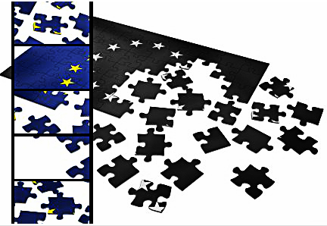
Scope of the EGR
The EGR provides harmonized information on:
enterprise groups, enterprises, legal units (identification, demographic and economic characteristics)
relationships and control
shareholdings of at least 10 per cent
The EGR also has the following purposes:
to produce a coordinated population of European MNEs
for use in the European Statistical System
to serve as authoritative source to European statistics related to globalization

Slide 6
Compilation of a MNE group in the EGR
DE ENT
DE ENT
AT ENT2
AT ENT2
AT ENT2
AT ENT1
AT ENT1
AT ENT1
AT ENT1
FI ENT
CH ENT
CH ENT
FI ENT
NSBRs
EGR

Slide 7
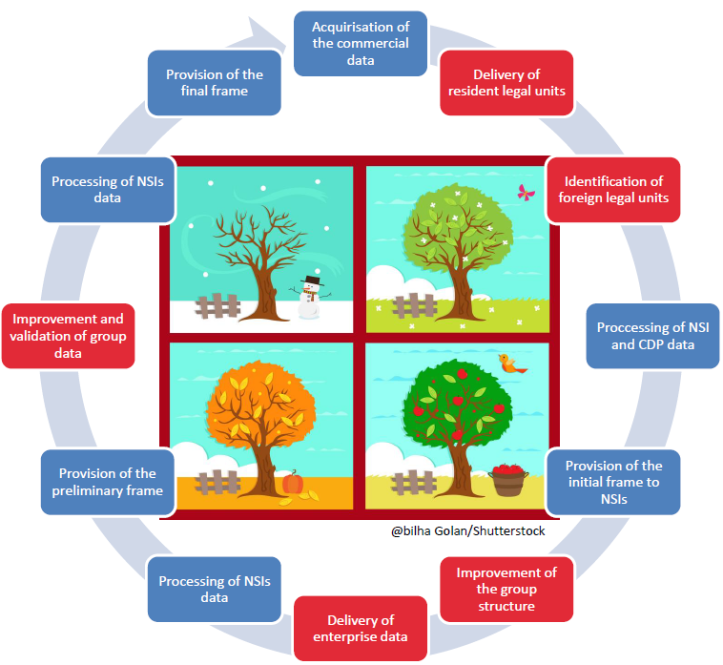
The EGR production process
After validation of data sent by NSIs or from other sources, Eurostat calculates the consolidated output of the MNE groups (on the legal units, their relationships and the enterprises)
Based on the final data on legal units and relationships, the EGR compiles the MNE group structure

Slide 8
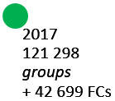
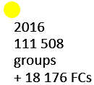
EGR coverage 2014-2017

Slide 9
EGR data users/producers
NA
GNI
FDI
FATS
BOP
SBS
BR
EGR

Slide 10
Data sharing and use of the EGR
The EGR is a statistical business register with restricted access (due to statistical confidentiality)
The EGR data of the MNE groups are only accessible for statisticians working as producer or users of European statistics in the EU and EFTA countries
We observe an increasing interest on the EGR micro data in the European Statistical System and also from National Central Banks
The EGR is used more and more for the production of FATS, FDI or other related statistics; national production processes for these statistics get redesigned and the quality of the statistical output seems to improve

Slide 11
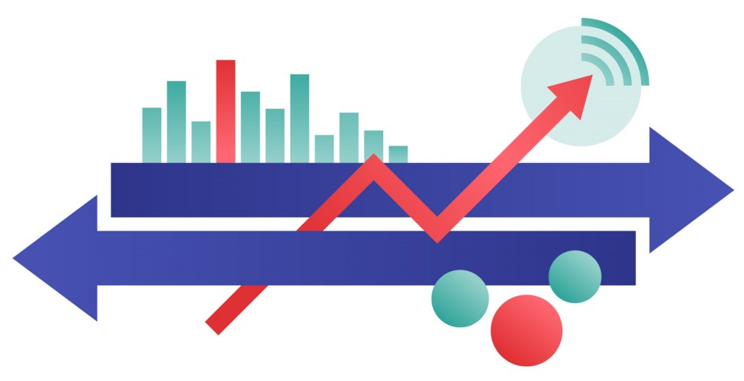
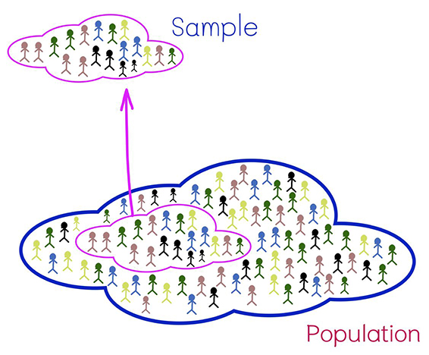
National
databases
EGR

Slide 12
What do the EGR user say?
The FDI statistics compilers said (survey results of Q4/2018):
The EGR data was judged as being useful and easy to access;
The EGR is useful for identifying missing relationships in the MNE group structures, for identifying extra-EU units and their turnover, NACE and employment;
The EGR data is useful for quality control of FDI statistics;
The production process of the EGR should be strengthened (better timeliness);
More characteristics/variables should be stored in the EGR (e.g. balance sheet data, minority relationships, SPEs, etc.).

Slide 13
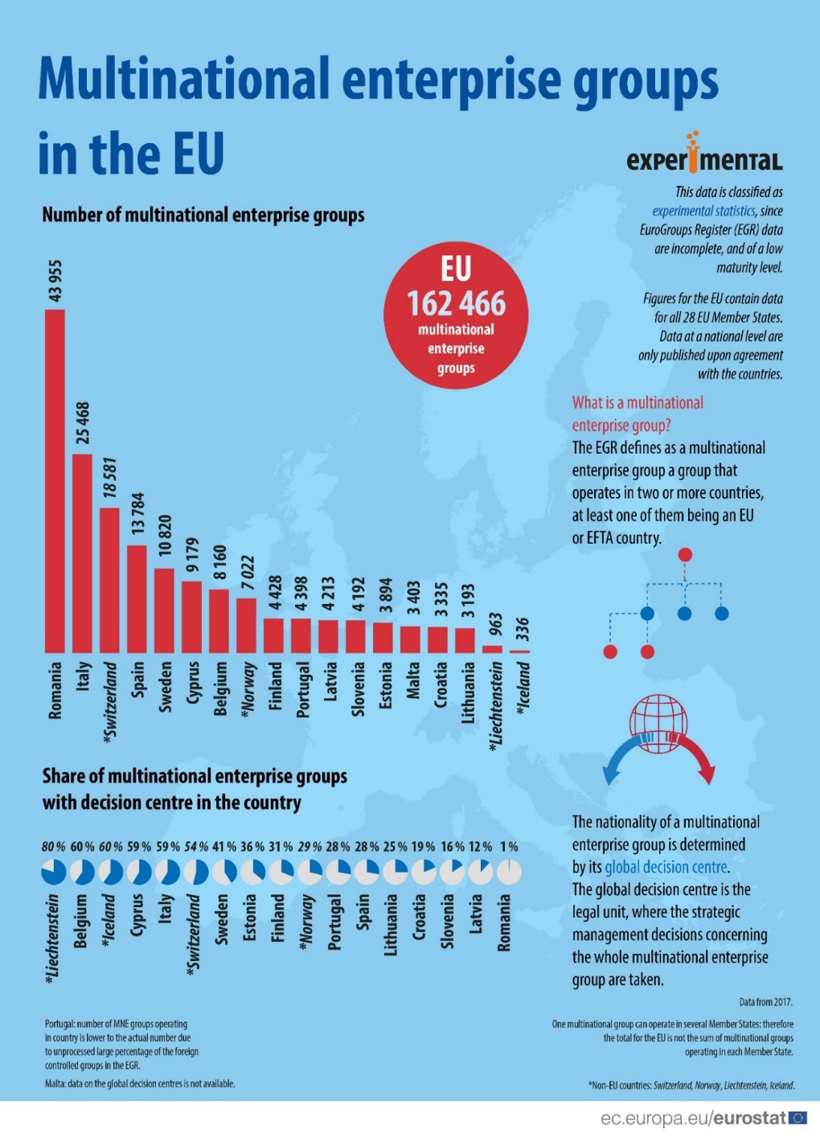
Aggregated statistics based on the EGR data
Eurostat publishes aggregated statistics using the EGR data (as experimental statistics)
These statistical output focuses on the population of the active MNE groups in EU and EFTA countries
Active MNE groups in the EU/EFTA countries cover groups with employment in two or more countries, at least one of them in the EU;

Slide 14
Outlook
Eurostat and the NSIs are continuously improving the quality of EGR:
Further improvements of the EGR processes, of its coverage, accuracy and timeliness are planned (based on stricter compliance monitoring)
Supplementary attributes will be introduced in the data exchange process (on SPEs, NPs)
Additional data sources will be investigated and – if possible – be used in the future (crowdsourcing platforms, web scraping, ADIMA, GLEIF, etc.)
The production and output of the largest MNEs might be strengthened further
The profiling results will be incorporated into the EGR
Pilot production of FATS data using the EGR micro-data

Slide 15
Further information on the EGR
Information on the EGR on Eurostat website:
https://ec.europa.eu/eurostat/web/structural-business-statistics/structural-business-statistics/eurogroups-register
Entry page to the EGR articles on Eurostat Statistics Explained website:
https://ec.europa.eu/eurostat/statistics-explained/index.php?title=EuroGroups_register
Experimental statistics from EGR on Eurostat website:
https://ec.europa.eu/eurostat/web/experimental-statistics/multinational-enterprise-groups

Slide 16
Thank you!
Questions
Contact:
estat-egr@ec.europa.eu

