Slide 1
Special session on CPRs 2018 Summary of the outcome of the Country Progress Reports 2018 Meeting of the Group of Experts on SBR, 30 September – 2 October, Geneva Claude Macchi, Swiss Federal Statistical Office FSO

Slide 2
Contents
Country progress reports received
Organization, Population and Usage of the Statistical Business Register
Progress and Developments in the Past Year
Future Plans
Main Challenges
Conclusions

Slide 3
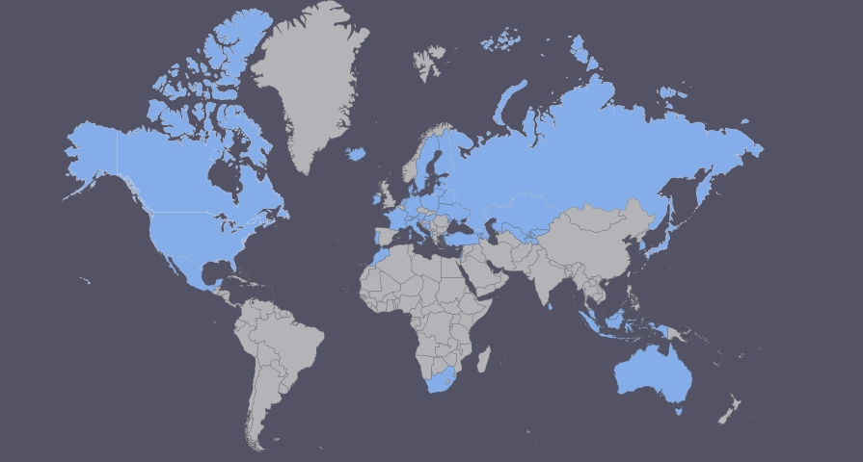
Country progress reports received
47 CPRs were sent (49 in 2017)

Slide 4
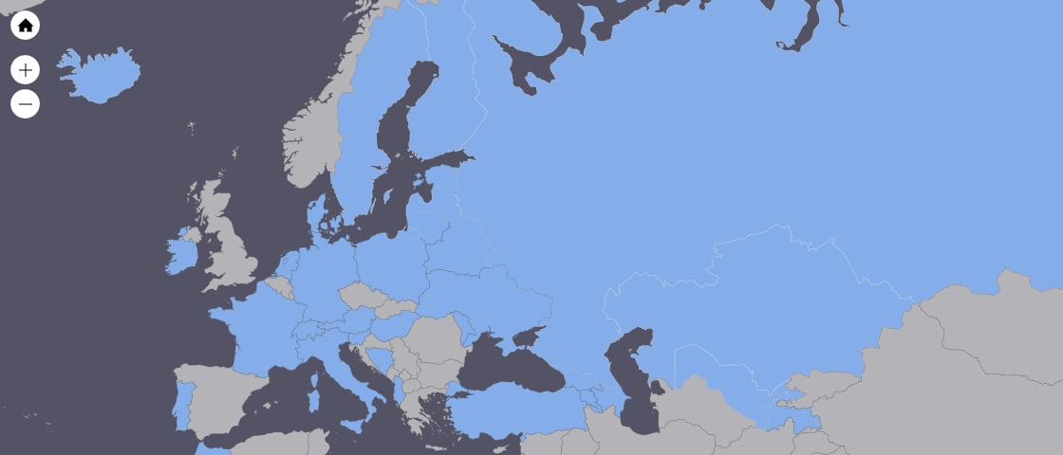
Country progress reports received

Slide 5
Organisation, Population and Usage of the SBR

Slide 6
Organisation, Population and Usage of the SBR

Slide 7
Organisation, Population and Usage of the SBR

Slide 8
Organisation, Population and Usage of the SBR

Slide 9
Progress and Developments in the Past Year (1/4)

Slide 10
Progress and Developments in the Past Year (2/4)
Units
2 subjects were mentioned most frequently: profiling and implementation of the Enterprise unit
Profiling of multinational enterprise groups
Profiling of statistical units Enterprise
Enterprise groups and profiling: Analyzed structure of national large and complex enterprises
New organization for profiling activity: The EGR-Profiling Team was set-up.
Statistical Enterprise and automated Profiling
The unit Enterprise Group was fully implemented in SBR.
Preparations for the implementation of Enterprise Groups
Profiling and creating Enterprises for 25 of the largest groups in the country

Slide 11
Progress and Developments in the Past Year (3/4)
Maintenance
As well as updating and maintaining the SBR, a lot of improvements and modernisations were mentioned in the PCRs:
Development of an e-form for profiling
Modernization initiatives
New platform for exchange of data
Introduction of a unique identification number

Slide 12
Progress and Developments in the Past Year (4/4)
Roles of the SBR
Establishment of Business Demography statistics
Improved data model so it is now possible to use several input sources for creating and maintenance of groups
Implementation of connection with the Register of Addresses
A profiling unit has been set up to profile large and complex enterprises that have a major influence on Business Statistics. The long term aim of this unit is to conduct profiling and take over the collection of surveys from all survey areas in relation to the top 250 enterprises.
The BR provides the initial directory for gathering the 2019 Economic Censuses and it identified specifically the establishments and firms that are part of the "Business Priority Group".
Local Units are considered as a part of the enterprise in the system of institutional business statistics and not as functional units with their own characteristics.
Work to reduce the response burden has been done.

Slide 13
Future Plans (1/3)

Slide 14
Future Plans (2/3)
Maintenance
The PCRs mentioned mostly the updating and maintaining the SBR. Here are some additional key words used in the descriptions:
Improve the quality of our web-based interface
Ensure full compliance with international standards and recommendations
Enlarged functionalities for the maintenance of enterprise groups
Improving statistical processes regarding the EGR

Slide 15
Future Plans (3/3)
Quality
Preparations for an update/revision of NACE and its national extension
ISIC revision
Continue Computer-assisted telephone interviewing (CATI) survey regular basis; works with owners of administrative data sources and use more and more alternative administrative sources for maintenance of business register
Conducting the Economic Census 2019
Profiling
Continuation of works on determining the institutional sector
Further improvements to EGR quality

Slide 16
Main Challenges (1/4)

Slide 17
Main Challenges (2/4)
Roles of the SBR
Introduction of geographical coordinates in the Statistical Register
Finding improved ways of integrating and using administrative and other non-survey data
Building data matching and integration tools that create a more standardized and efficient means of introducing new data
Integrating the BR program into a broader program of registers that also includes social registers
FATS
Understanding and implementing changes faced via FRIBS
Development of the national SBR and the EuroGroups Register under the scope of the European System of Interoperable Business Registers (ESBRs)
Lack of ressources
The Business Register (BR) serves many roles beyond being a sampling frame and administrative records repository. It is also the operational control system for the Economic Census (EC), the central repository of captured EC data, and the source of key data products

Slide 18
Main Challenges (3/4)
Units
Implementation of the Enterprise definition
Updated and maintained Enterprise Group Register
Profiling
FRIBS
Delineation of complex enterprises
Enterprise and local unit definition
Kind of Activity Units

Slide 19
Main Challenges (4/4)
IT Considerations
Using data model and interface of SBR by internal users and automatically update will create a live register
Software product development
Re-engineering of the SBR technical environment
Online system for statistical data collection
Re-engineering of the new business register
Implementation of new IT communication platform of the national company registration
Changing of the IT platform of production of the frame of foreign trade statistics

Slide 20
Conclusions (1/2)
Lots of countries did not send a CPR.
The number of SBR employees is often still quite low.
Re-engineering and modernisation of SBRs in several NSI
The use of geographical coordinates is increasing.
The treatment of multinational Enterprises in the SBRs is becoming one of the central activities.
Profiling is everywhere.

Slide 21
Conclusions (2/2)
Constant quality improvement efforts
Importance of communication and cooperation
Revision of the economic activities classifications (ISIC, NACE, national versions)
Implementation and research of new administrative data -> BEPS ??

