Slide 1
Guidelines
Chapter 2: Roles of the SBR
Geneva, 4 – 9 - 2013

Slide 2
Roles of the SBR
Purpose of chapter 2:
Questions answered by chapter 2:
What is meant when a SBR is fulfilling a role?
What are the roles a SBR could fulfil?
What is the mutual coherence between the roles?
Questions not answered by chapter 2:
Which roles should the SBR fulfil?
Establishment of the SBR?
Organisation of the SBR?

Slide 3
Roles of the SBR
Modelling a role:
- Data / information - Methods / rules - Legislation - Infrastructure / tooling - User needs - Staff
Inputs
- Use of features - Performance - Environment - Maintenance
Role
- Output - Destination - Users
Purpose

Slide 4
SBR Role: SBR Live Register
Other Data
Census Data
Administrative Data
SBR Live Register
SBR Backbone

Slide 5
SBR Role: SBR Backbone
SBR Live Register
SBR Backbone
Coordinated Populations of Statistical units (with links to sources)

Slide 6
SBR Role: SBR Information Source
SBR Live Register
Legislation
Infrastructure
SBR information source
Support of Investigations in Public and Private Domains

Slide 7
SBR Role: SBR Global Data Exchange
SBR Backbone
Cross-border relations
Regulatory framework
SBR Global Data Exchange
Coherence in Global Statistics

Slide 8
SBR Role: SBR Sample frame
SBR Backbone
Stratification
Historical frames
SBR Sample frame
Survey support

Slide 9
SBR Role: SBR Survey Support
SBR Sample frame
Survey design
Contact-information
SBR Survey Support
Survey

Slide 10
SBR Role: SBR Statistics
SBR Backbone
Linked Statistical Data
Methods/Rules
SBR Statistics
Indicators

Slide 11
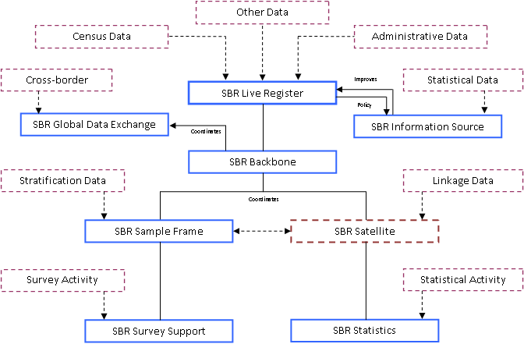
Roles of the SBR
Coherence:

Slide 12
Roles of the SBR
Feedback:
Do you recognize the roles of your SBR in this chapter?
Please send us your feedback to improve this chapter?

Slide 13
Questions ?

