Slide 1
Global Assessment of Business Registers
Ronald Jansen, United Nations Statistics Division, New York
Luis Gonzalez, United Nations Statistics Division, New York
Xioayan Liu, National Bureau of Statistics, China

Slide 2
Structure of Presentation
Overview of ongoing work
Why a Global Assessment ?
Survey
Results
Way forward

Slide 3
Overview of ongoing work
Implementation of SNA 2008, 2008 IRIS and ISIC, Rev.4
Linking Trade and Business Statistics
UNECE Task Force on BR Guidelines
ECLAC project on Business Registers
AfDB Guidelines on Business Registers

Slide 4
Overview of ongoing work
Implementation of SNA 2008, 2008 IRIS and ISIC, Rev.4
Linking Trade and Business Statistics
UNECE Task Force on BR Guidelines
ECLAC project on Business Registers
AfDB Guidelines on Business Registers

Slide 5
Coverage issues
Legal units : enterprise, establishment, local unit, other
Private sector, Public sector, Self-employed
Thresholds – Minimum Income level per year (Tax), minimum number of employees

Slide 7
Overview of ongoing work
Implementation of SNA 2008, 2008 IRIS and ISIC, Rev.4
Linking Trade and Business Statistics
UNECE Task Force on BR Guidelines
ECLAC project on Business Registers
AfDB Guidelines on Business Registers

Slide 8
Why a Global Assessment ?
How many countries have a Business Register ?
What are the main problem areas ?
What are the problems in developing countries ?
Are there regional differences ?

Slide 9
Survey
Letter signed by Assistant Secretary General
Online and in PDF
English, French, Spanish
30 Questions
Logical branching function built in

Slide 10
Intended coverage of Survey
The assessment aims to collect information on the status of the business register in all countries.
This questionnaire is not only applicable to national offices that operate a comprehensive single business register, but also covers countries that use a combined list or frame of businesses covering multiple industrial sectors. The data source could be survey or administrative data.

Slide 11
Actual coverage of Survey
Request was sent to 208 economies, of which 116 economies completed the questionnaire
116 economies
  32 OECD and 84 non-OECD
  37 developed and
  77 developing or transition economies
    23 Africa
    18 Latin America and Caribbean
    18 Asia and Pacific
    18 Southern and Eastern Europe

Slide 12
Actual coverage of Survey
Request was sent to 208 economies, of which 116 economies completed the questionnaire
116 economies
  32 OECD and 84 non-OECD
  37 developed and
  77 developing or transition economies
    23 Africa
    18 Latin America and Caribbean
    18 Asia and Pacific
    18 Southern and Eastern Europe

Slide 13
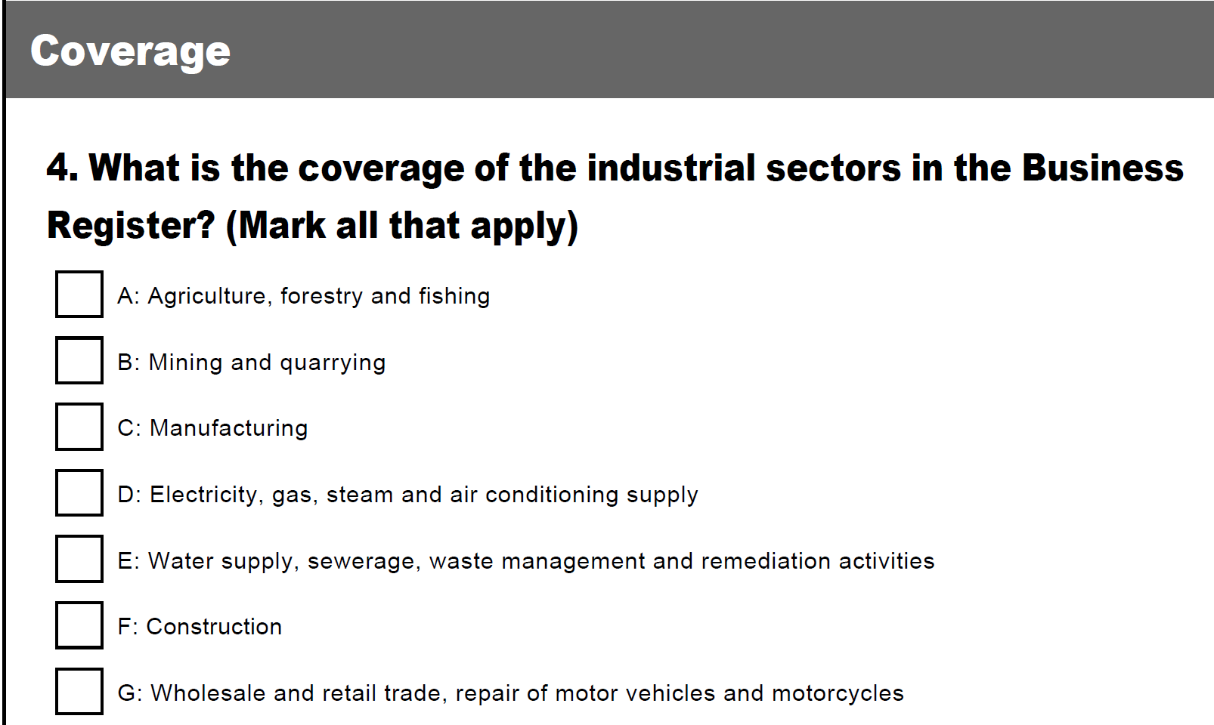

Slide 14
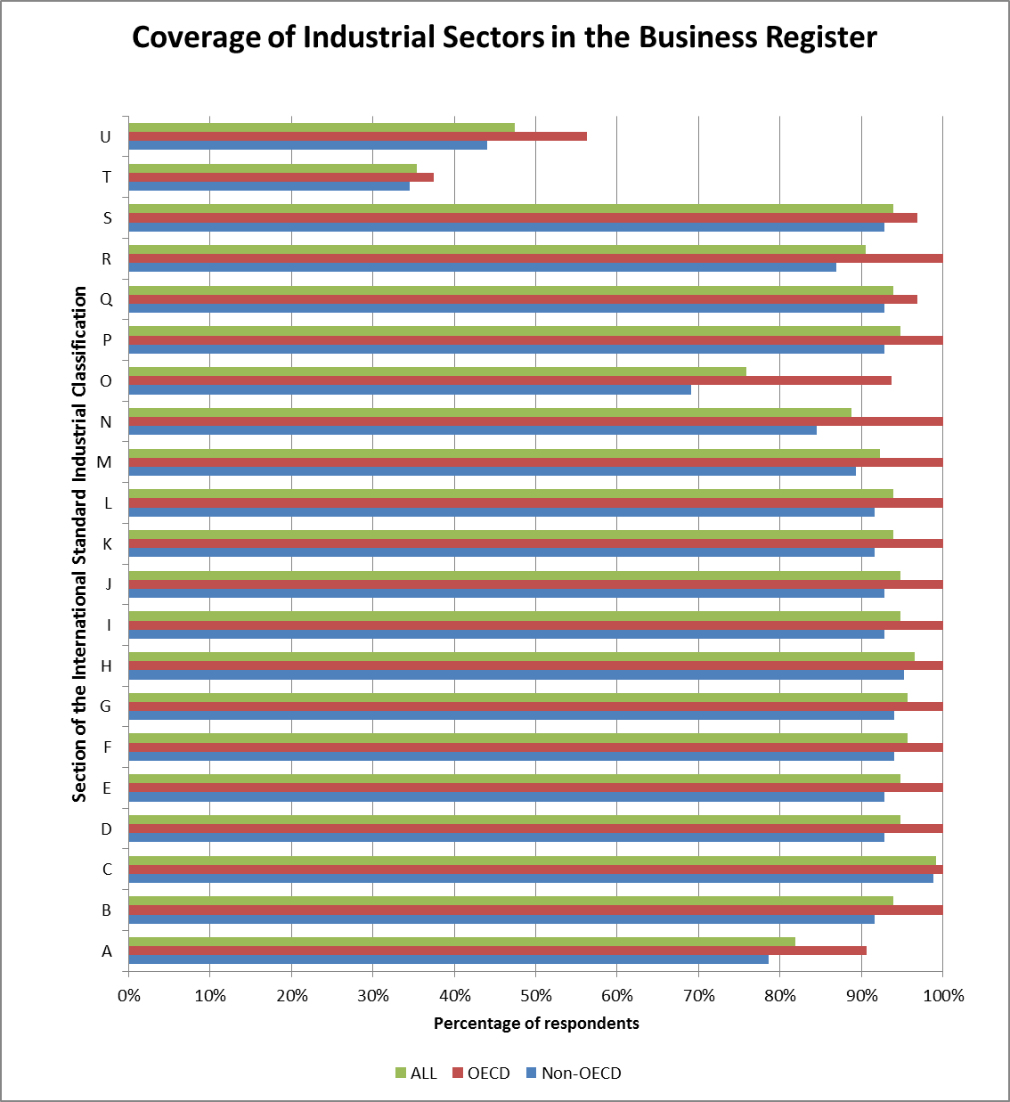

Slide 15
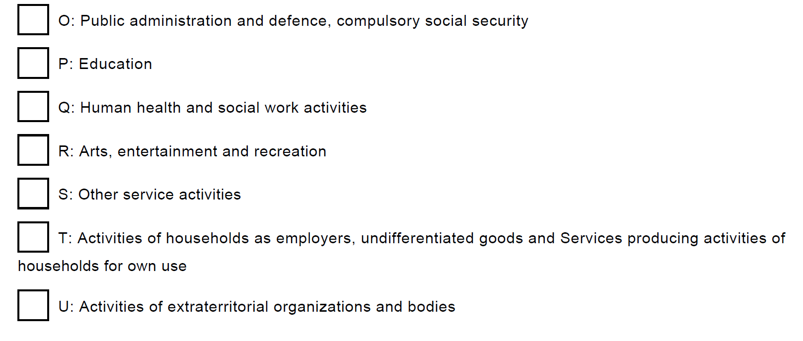

Slide 16
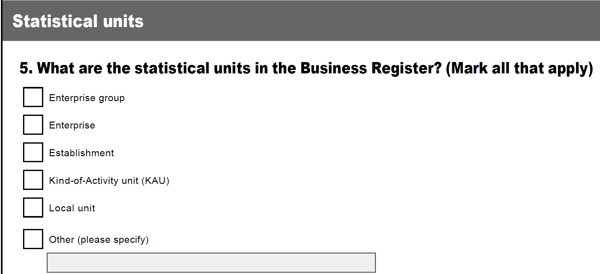

Slide 17
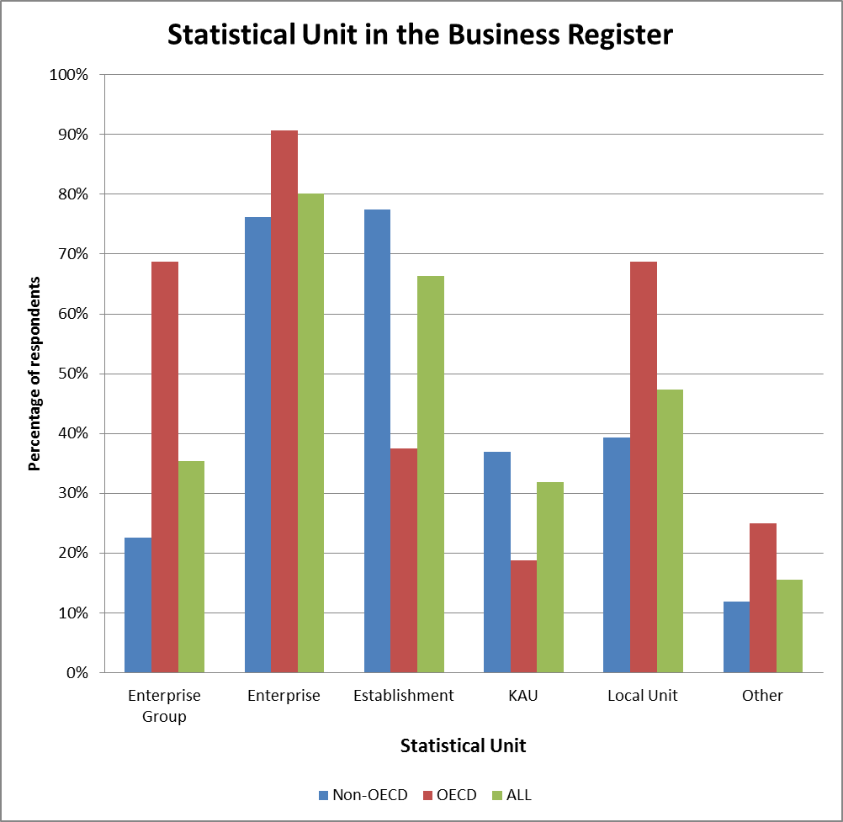

Slide 19
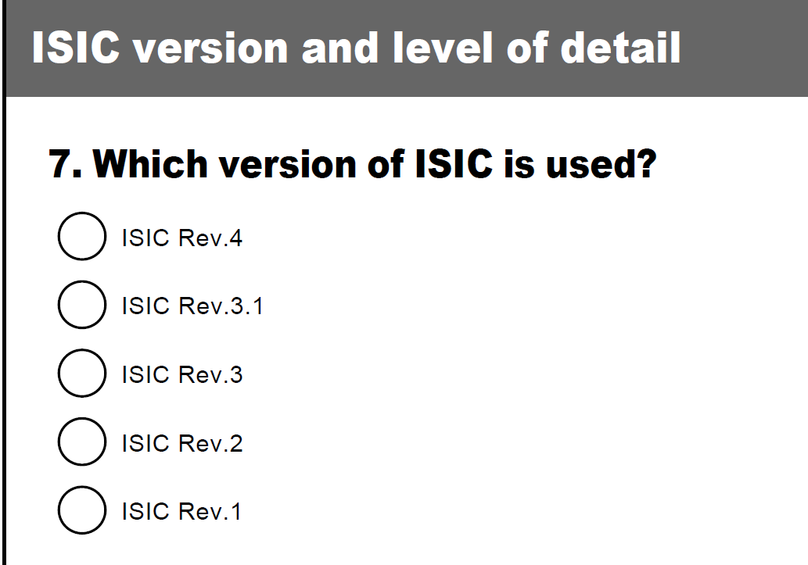

Slide 23
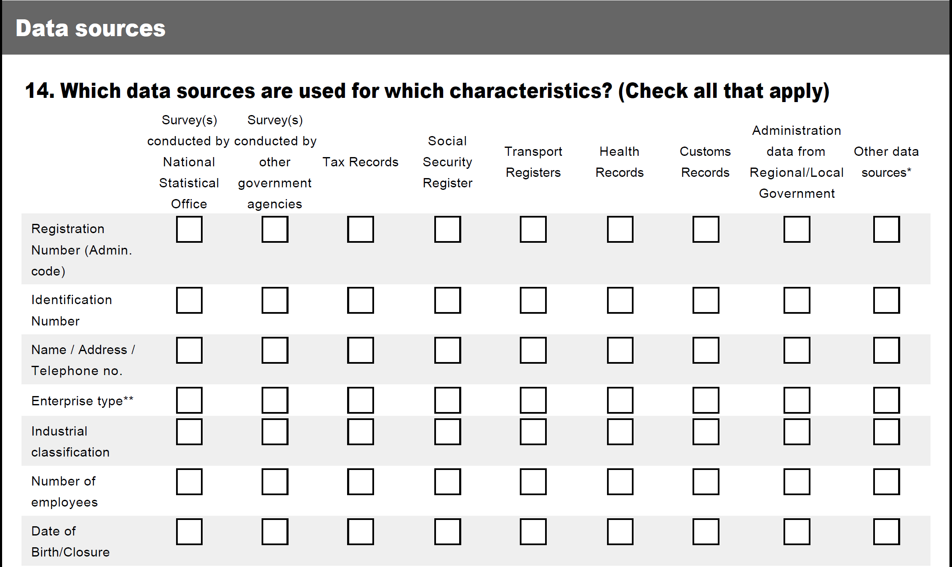

Slide 24
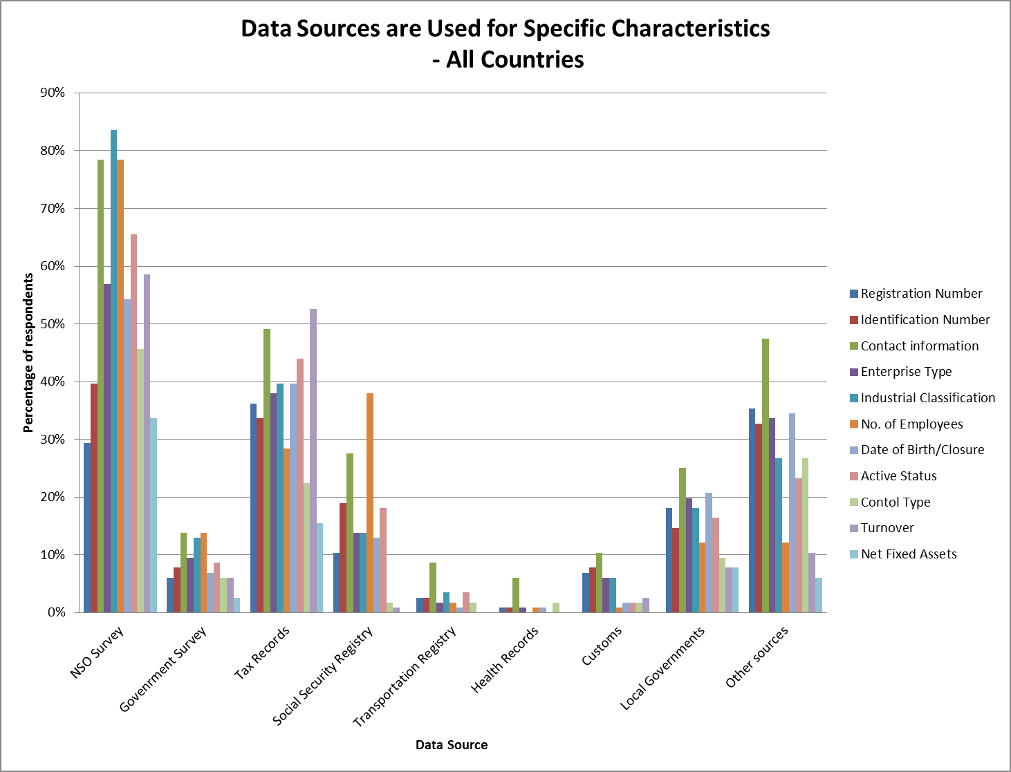

Slide 25
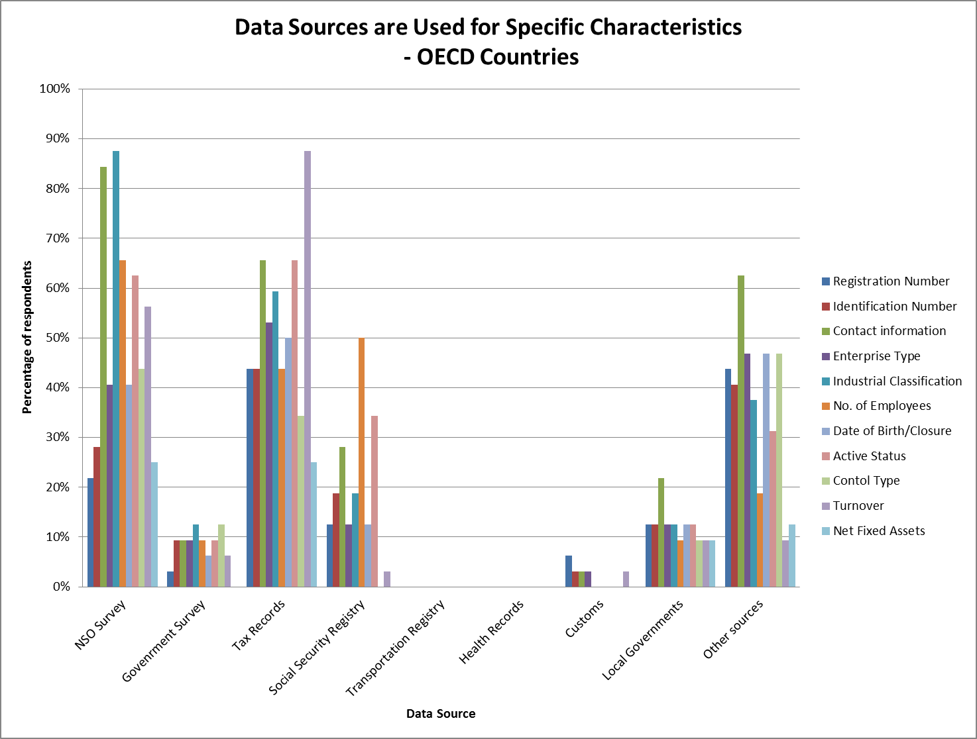

Slide 26
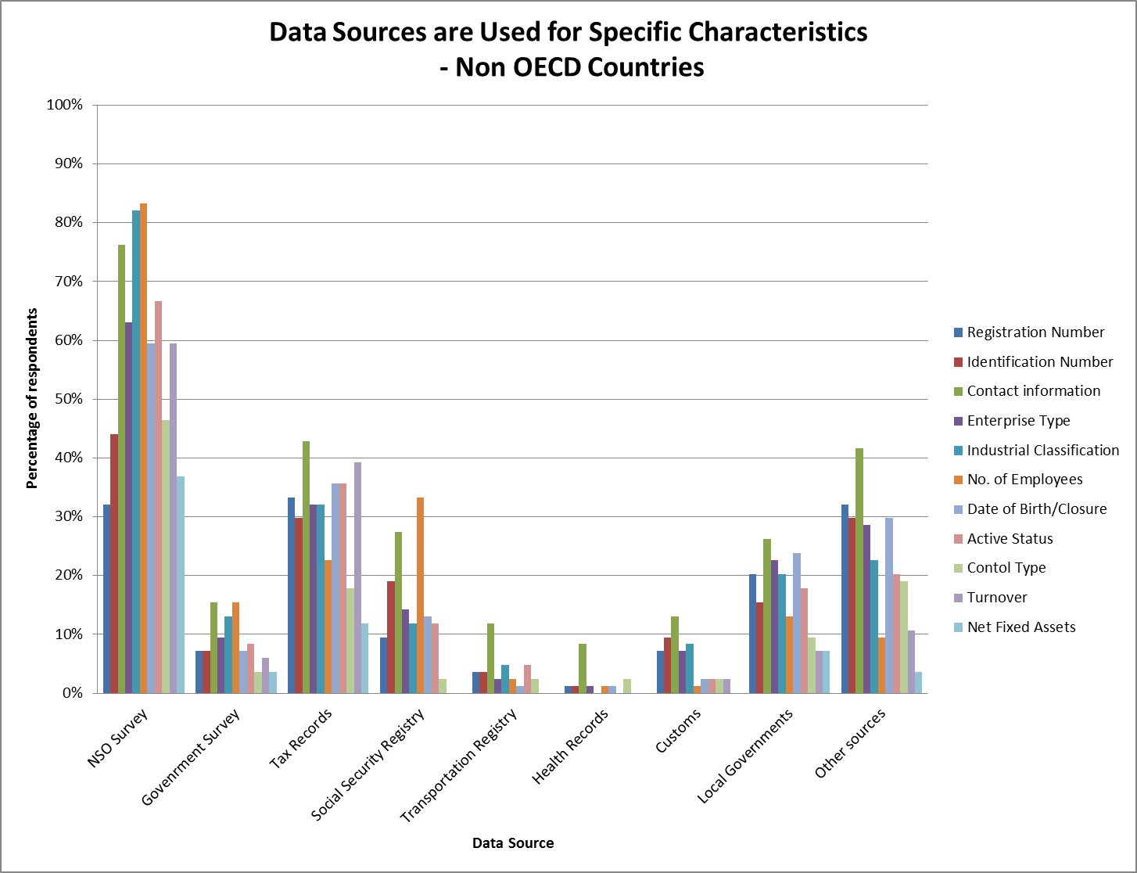

Slide 27
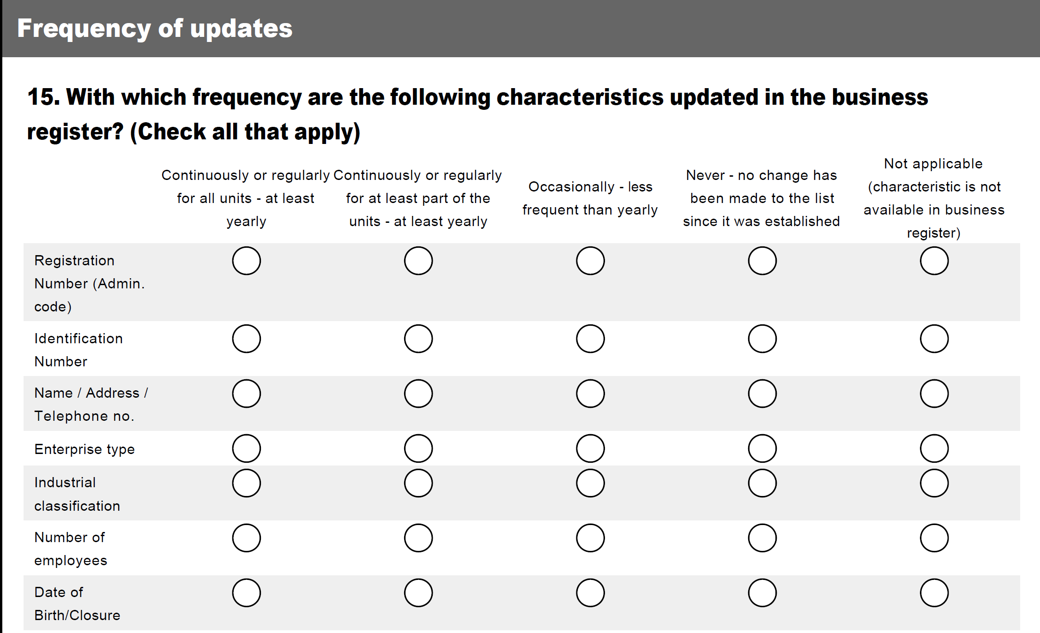

Slide 28
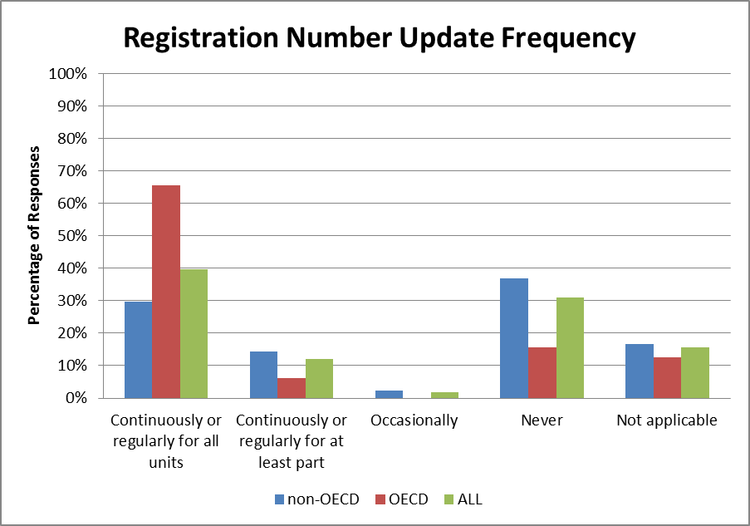

Slide 29
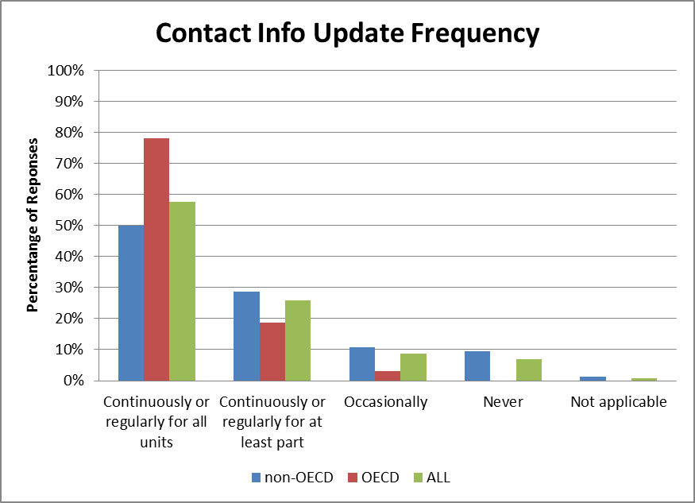

Slide 30
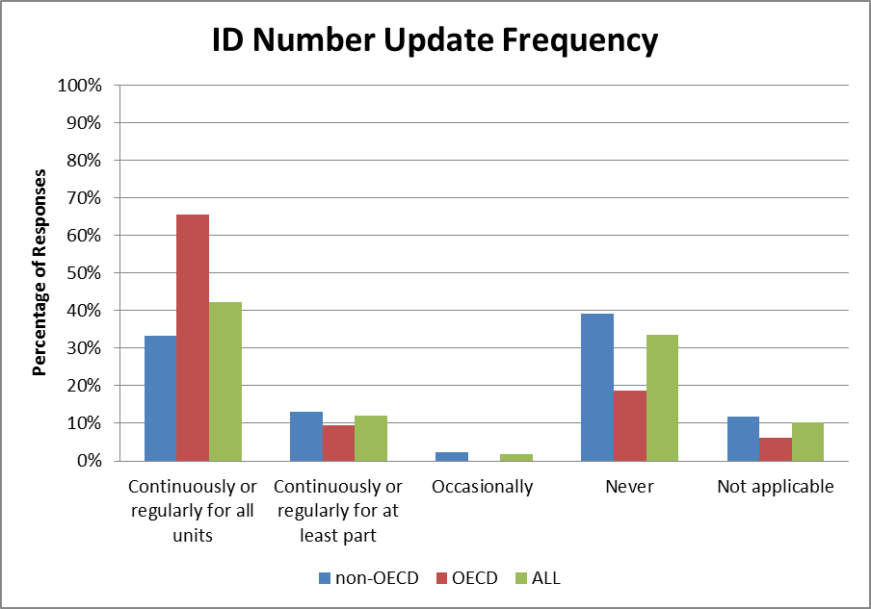

Slide 31
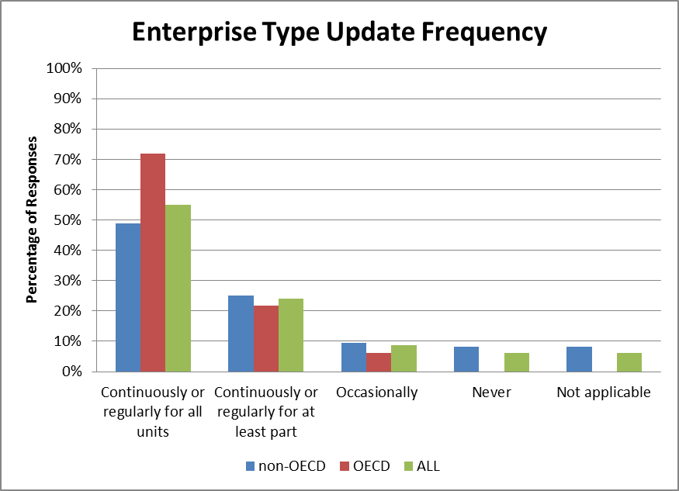

Slide 32
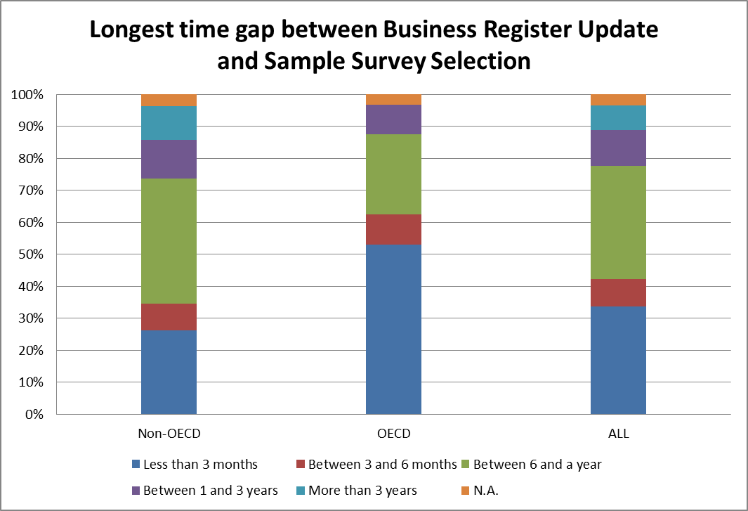

Slide 33
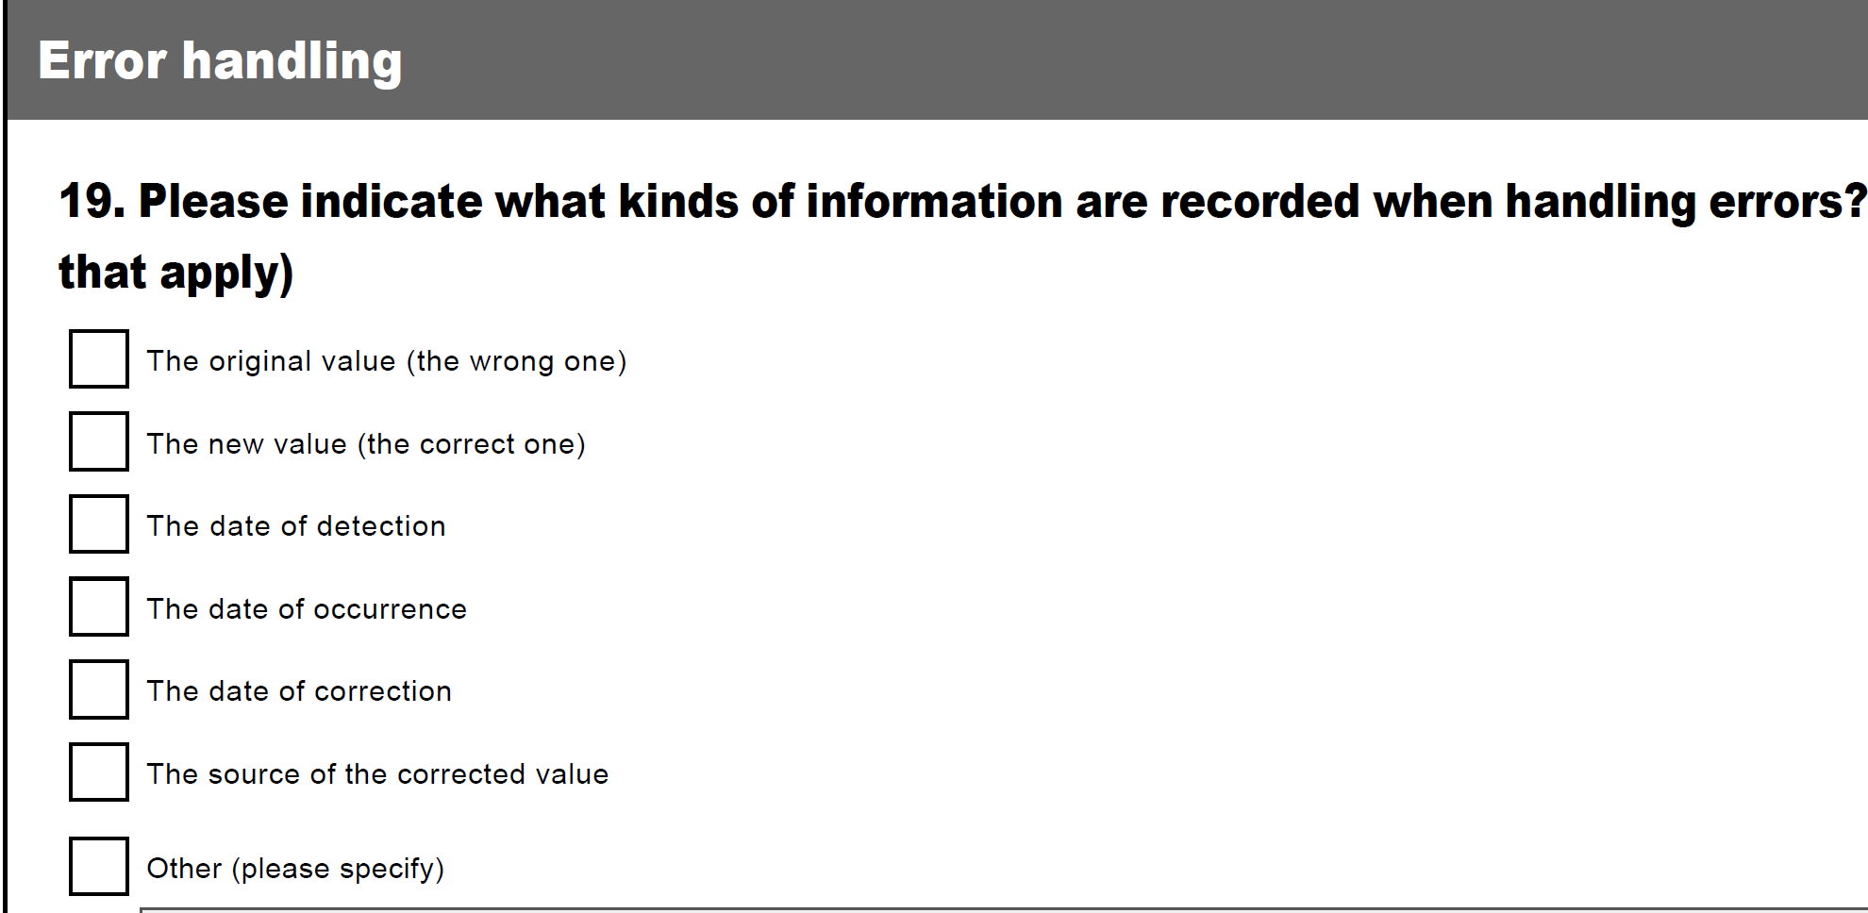

Slide 34
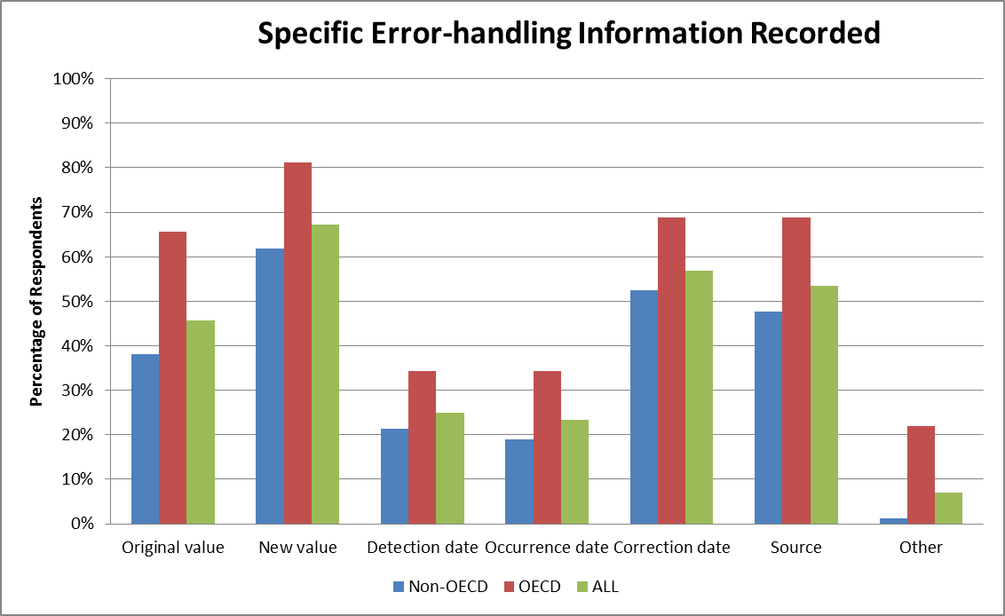

Slide 35
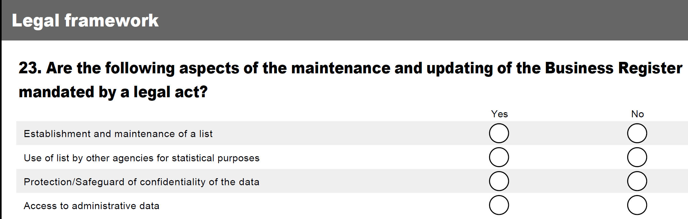

Slide 36
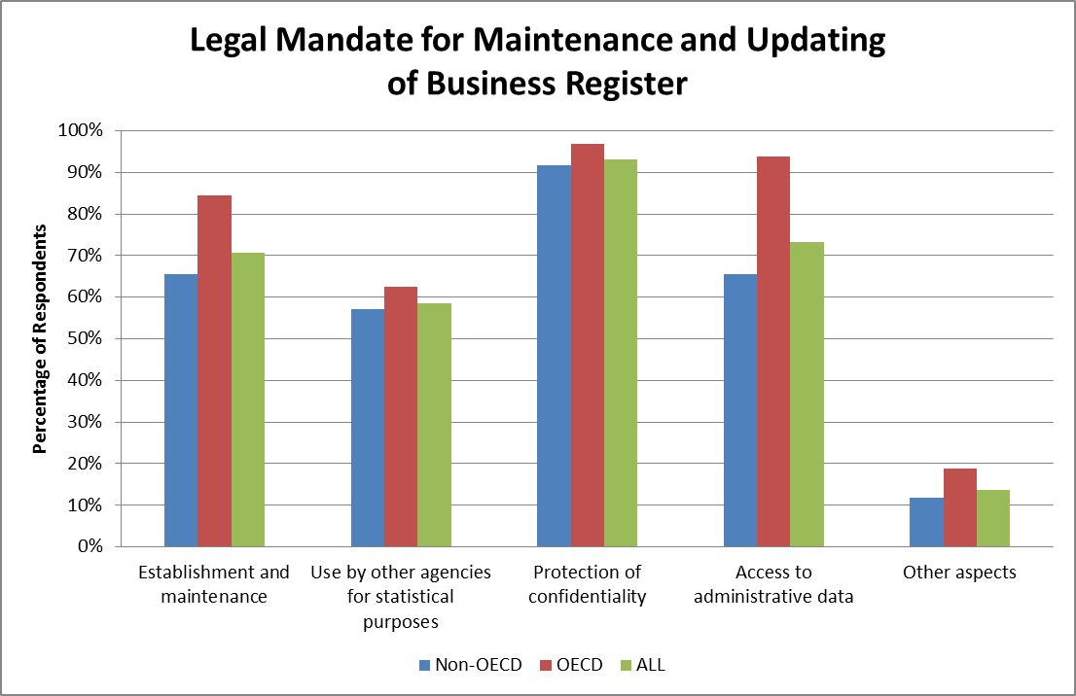

Slide 37
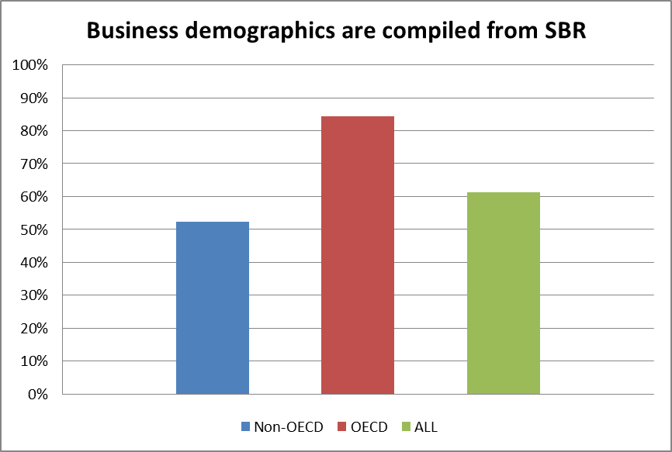

Slide 38
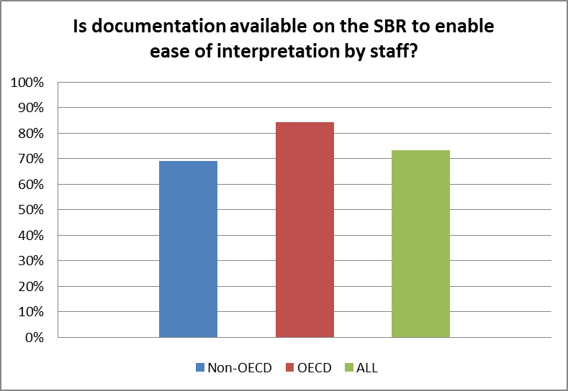

Slide 39
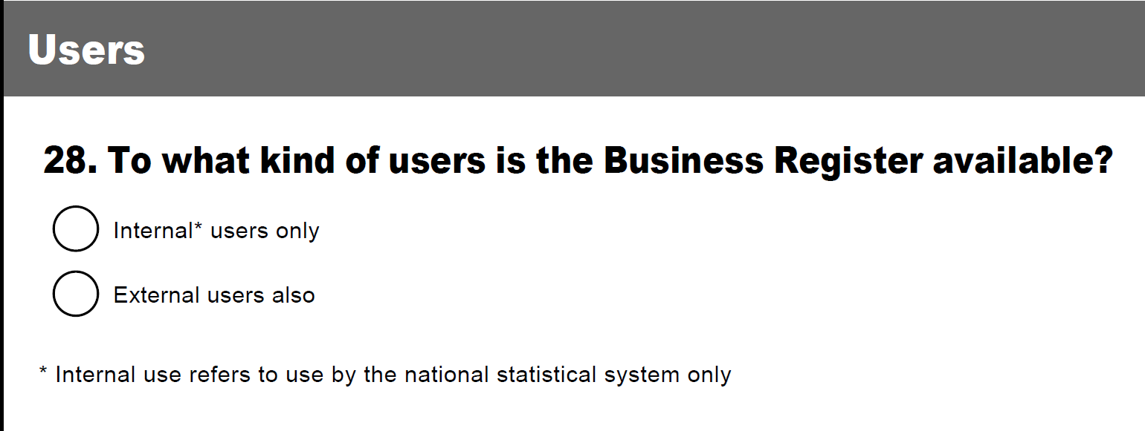
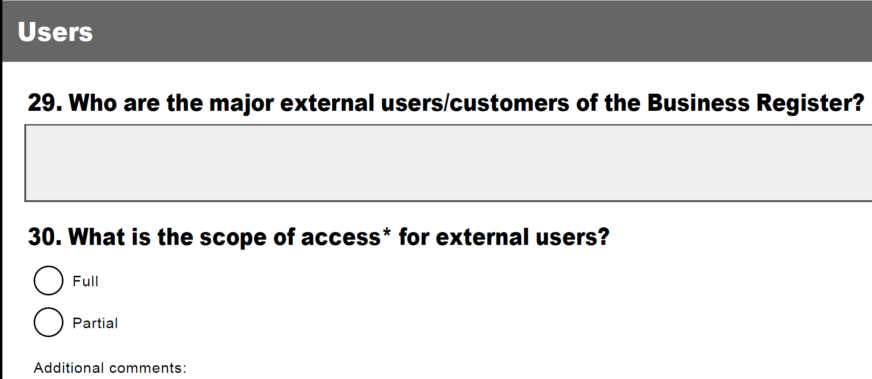

Slide 40
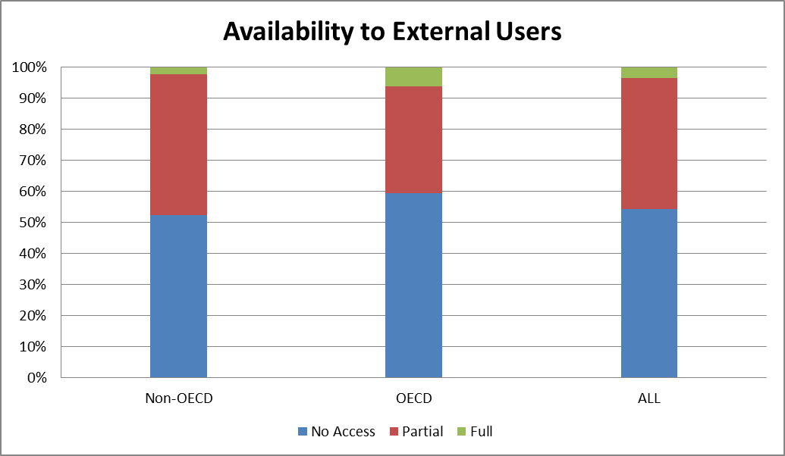

Slide 41
Structure of Presentation
Overview of ongoing work
Why a Global Assessment ?
Survey
Results
Way forward

Slide 42
Way Forward
Follow-up on answers received
Further exploration of open answers
  Other specific unit type and thresholds in SBR
  Other data sources are used for SBR
  Relationships between units
  Time gap between register updates and sample selection comments
  How to link the data from different sources?
  Legal framework additional comments
  Documentation with weblink
  External user and the access to external user
Use of results for Guidelines

Slide 43
Thank you
jansen1@un.org

