Slide 1
Evaluating the potential for moving away from a traditional census Becky Tinsley Office for National Statistics (ONS), UK

Slide 2
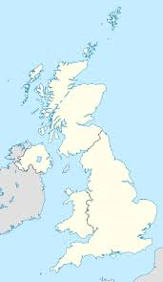
UK Context
Three Census taking authorities in UK:
ONS (England and Wales)
National Registers for Scotland
Northern Ireland Statistics and Research Agency
All work closely together
Presentation focuses on England and Wales
2

Slide 3
ONS Beyond 2011 Programme 2011-2014/15
Programme to identify the best way to provide small area population and socio-demographic statistics in the future (England and Wales)
ONS consulted on two options in autumn 2013:
Census once a decade
Census based on administrative data and large annual surveys
Made a recommendation in March 2014

Slide 4
National Statistician’s recommendation (March 2014)
An online census of all households and communal establishments in 2021 - with support for those who are unable to complete the census online.
AND
Increased use of administrative data and surveys in order to enhance the statistics from the 2021 census and improve annual statistics between censuses.
Make the best use of all available data to provide the population statistics required.
AND
Offer a springboard to the greater use of administrative data and annual surveys in the future

Slide 5
Way forward agreed with Government
“The Government welcomes the recommendation for a predominantly online census in 2021 supplemented by further use of administrative and survey data.
Government recognises the value of the census and its history as a bedrock of statistical infrastructure. The census provides information on the population that is of fundamental importance to society....
Our ambition is that censuses after 2021 will be conducted using other sources of data and providing more timely statistical information .... dependent on the dual running sufficiently validating the perceived feasibility of that approach.”
Minister for the Cabinet Office, July 2014

Slide 6
What do we mean by an Admin Data Census?
Aiming to replicate as many census outputs as possible using admin data (and surveys) by 2021 to compare with 2021 Census
Recommendation in 2023
Three key types of Census outputs:
Size of population
Number and structure of households
Characteristics of housing and the population
Lot of potential with admin data alone but it will not provide the complete solution.
Need access to range of admin data and combine with surveys. Likely to need two new surveys:
Annual 1% coverage survey to help measure size of population and households
Annual characteristics survey – size tbc

Slide 7
Framework for population characteristics – where we were and where we going
Where were we?
Where are we going?
All
characteristics
Some
Eg. Hours of unpaid care
provided
Survey
Most
Eg. Qualifications? Income?
Ethnicity?
Integrated
sources
Some
Eg. Number of rooms
Admin
However……it may be necessary to work with data suppliers to
collect unavailable data through administrative data

Slide 8
What needs to be in place for an Admin Data Census?
Data standards
2. Ability to
link data
efficiently
and accurately
Matching system/architecture
Linked data
1. Easy access
to data
Linked data
and to be
consulted about
changes to
admin data
Population and
socio-demographic
information needs
3. Methods to produce
statistical outputs of
sufficient quality to meet
priority information needs
USERS
surveys
Methods
Privacy and security safeguards
(Public, suppliers, Parliament)
Outputs
£
4. Acceptable to
stakeholders
USERS
5. Value
for money

Slide 9
How will we know if we’re ready to move?
Annual cycle
Research outputs every Autumn (first: 22 October 2015)
expanding the accuracy and/or breadth and/or detail each year
Assessment every Spring (first: 16 May 2016)
Using five high level criteria
where we are now
where we expect to be by 2023

Slide 10
First assessment of ONS’ ability to move to Admin Data Census post-2021
 | Access to data | Ability to link | Methods to meet information needs |  |  |  | Acceptability to stakeholders | Value for money
 |  |  | Population estimates | Households and families | Housing character-istics | Population character-istics
Where are we now?
Where do we expect to be by 2023?
Red/
Amber
Red/
Amber
Red/
Amber
Red/
Amber
Amber
Amber
Amber
Amber
Amber/
Green
Amber/
Green
Amber/
Green
Amber/
Green
Green
Green
Green
Amber

Slide 11
Availability of population characteristics on administrative sources

Slide 12
Producing population estimates from admin data and surveys
NHS Patient
Register
Tax and benefits data
1%
coverage
survey
HESA data
(students)
Statistical Population
Dataset (SPD)
population
estimates
12

Slide 13
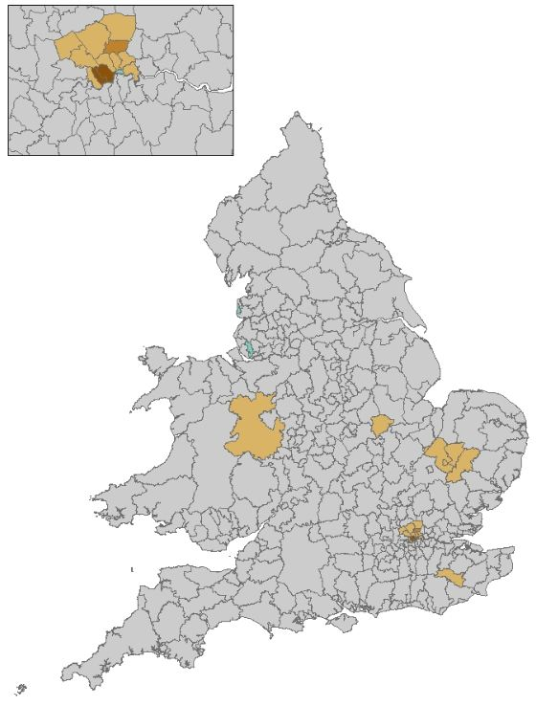
Admin data based population counts (SPD v1.0) compared to the 2011 Census
Admin data method lower than 2011 Census
Admin data method higher than 2011 Census
94% of LA total population counts within 3.8% of Census estimate in 2011
13

Slide 14
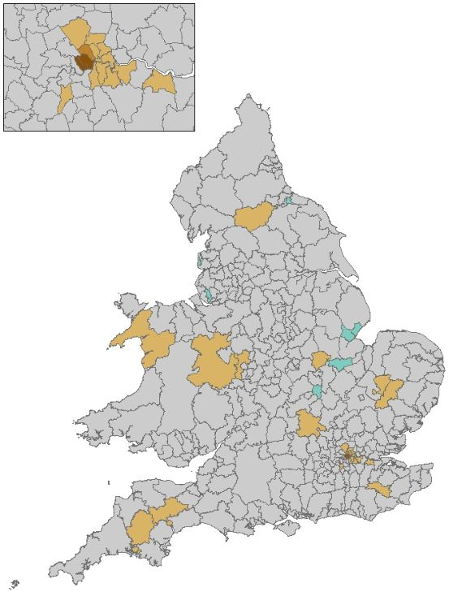
Admin data based population counts (SPD v1.0) compared to the 2014 MYEs
Admin data method lower than 2014 MYE
Admin data method higher than 2014
MYE
90% of LA total population counts within 3.8% of mid-year estimate in 2014

Slide 15
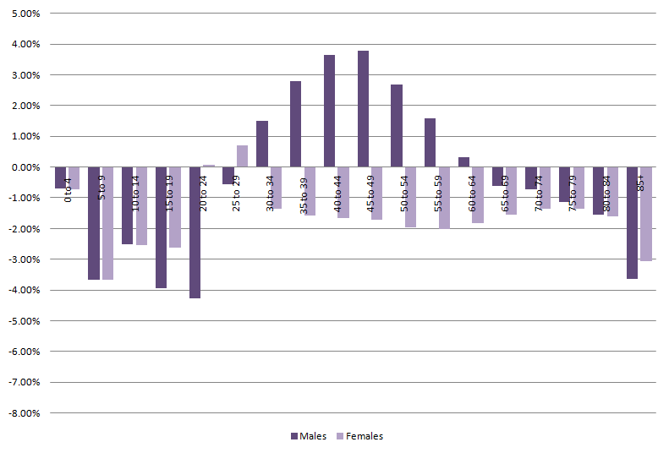
Admin based population counts (SPD v1.0) compared to 2014 mid-year estimates by age/sex
Males and females (where comparison data is higher or lower than official estimates) %

Slide 16
Plans for 2016 Research Outputs
Population estimates down to small area level and by single year of age
Improvements to the methods used to produce administrative data population estimates
Outputs on the number of households
Research on income from combined PAYE and benefits data
We are aiming to expand the accuracy, breadth and detail of these outputs over time

Slide 17
Annual cycle
Assessment
Review evaluation criteria
Review outputs and statistical design
User feedback
Assessment
Publish assessment
Each Spring
Research
Outputs
Production and analysis
Publish outputs
Review available data
Plan
Research and develop
Establish feedback loop
Review requirements
Revise acquisition plan
Decision: ongoing/
Revisions/ needs not met
Acquire and feasibility research
Data
QUALITY
Each Autumn

