Slide 1
Internet versus paper mode effects in the 2011 Census of England and Wales: analysis of Census Quality Survey agreement rates
Cal Ghee
26 September 2014

Slide 2
Overview
Census Quality Survey background and results
Modes of collection
Causes and effects
Results by mode
Conclusions

Slide 3



Census Quality Survey
CQS was face-to-face CAPI sample survey.
Census responses already received were sampled and households asked majority of census questions again.
Sample stratified (region, hard to count, mode)
Interviewed households representative
Individuals weighted (age, sex, ethnic group, mode)
CQS
Responses were matched and answers compared to calculate agreement rates.
CQS
What is your date of birth?
CQS answers assumed correct as research shows face-to-face tend to result in more accurate answers than those from self-completion.
01
01
1977

Slide 4
Census Quality Survey
CQS
7,490 households in sample
5,170 matched households
5,260 households interviewed
9,650 matched usual residents (no CQS adult proxy responses)
12,400 people interviewed
proxy
proxy

Slide 5
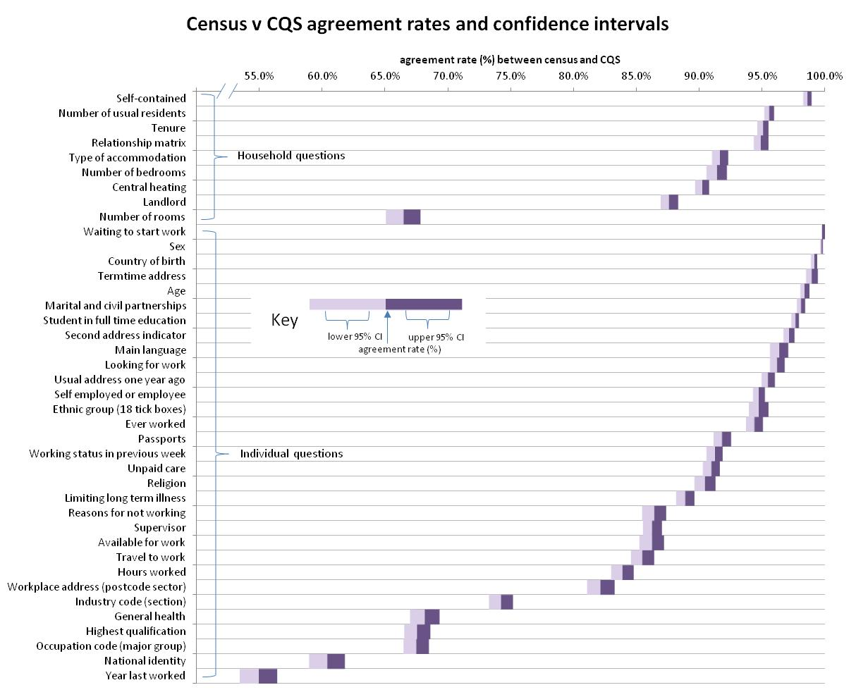
Possible reasons for differences:
Clarification by interviewer;
Respondent embarrassed to tell interviewer;
Different combination in multi-tick question;
Made a mistake;
Subjective questions/different self-perception;
Recall error;
Proxy error;
Item edit and imputation

Slide 6
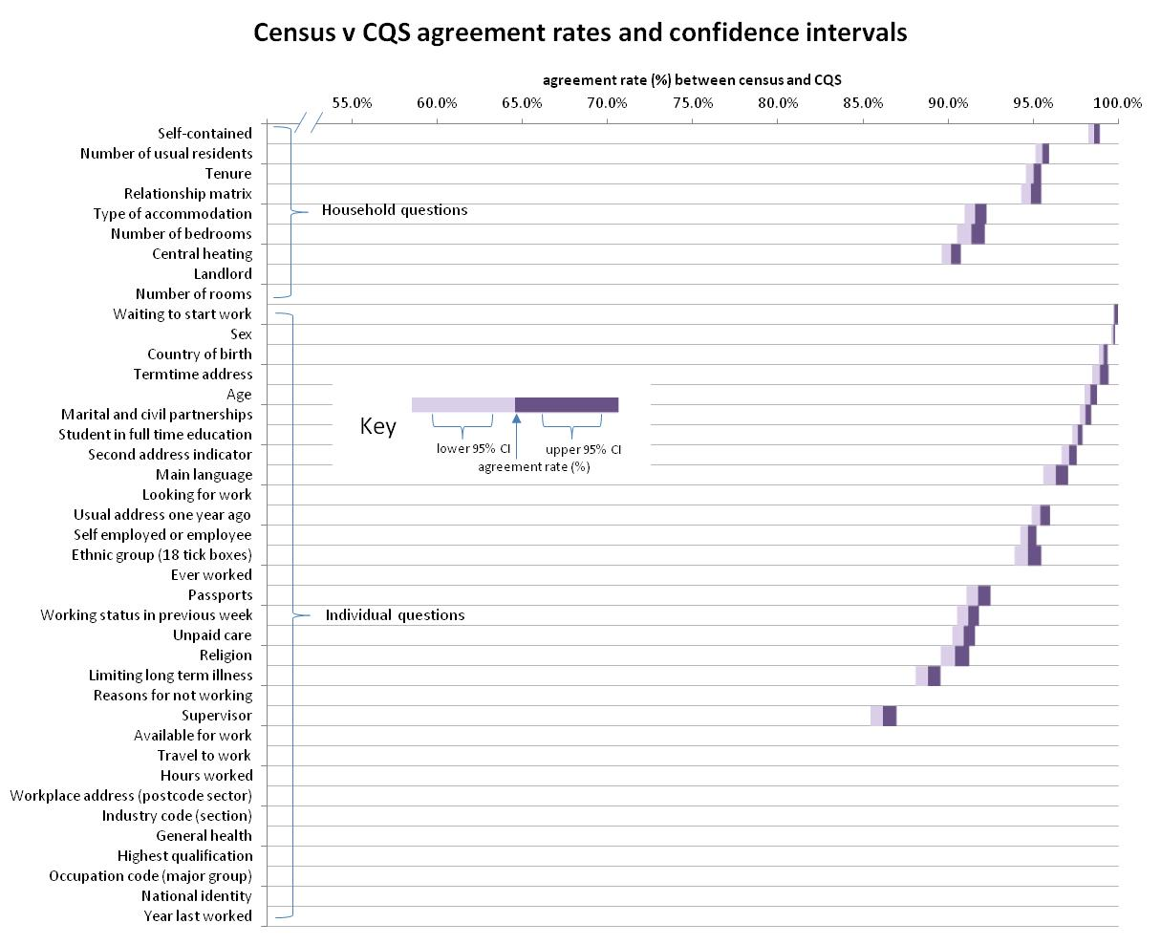
Not all questions had large enough sample size to enable analysis by mode of return

Slide 7
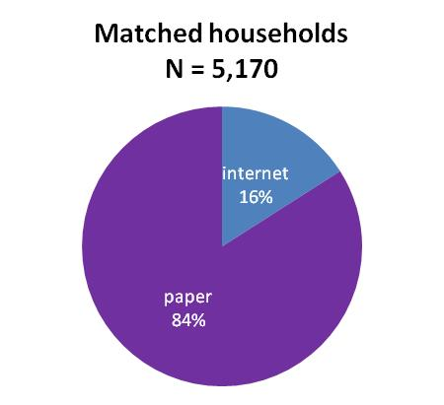
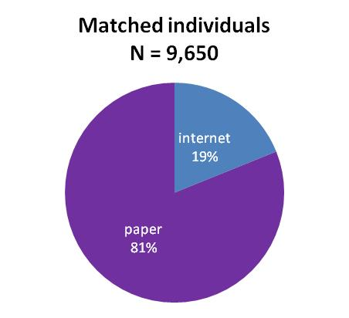

Modes of collection
2011 Census self-completion by paper (by default) or internet (by choice).
CQS sample representative of modal split for households, and weighted to be representative for individuals
CQS face-to-face CAPI interview: assumed to gain more accurate responses, but possibly subject to social desirability bias
CQS

Slide 8
Comparisons
Mode effect: if you gave the same respondent two different modes of return, they would respond differently on each.
We can’t compare directly responses by paper and internet, but can compare agreement rates paper/CQS and internet/CQS
2011 Census: self-completion
Paper forms sent out to all
... but respondents could return via the internet
Paper/CQS agreement rate
2011 Census Quality Survey: face-to-face CAPI sample survey
Compare agreement rates
Internet/CQS agreement rate
CQS

Slide 9
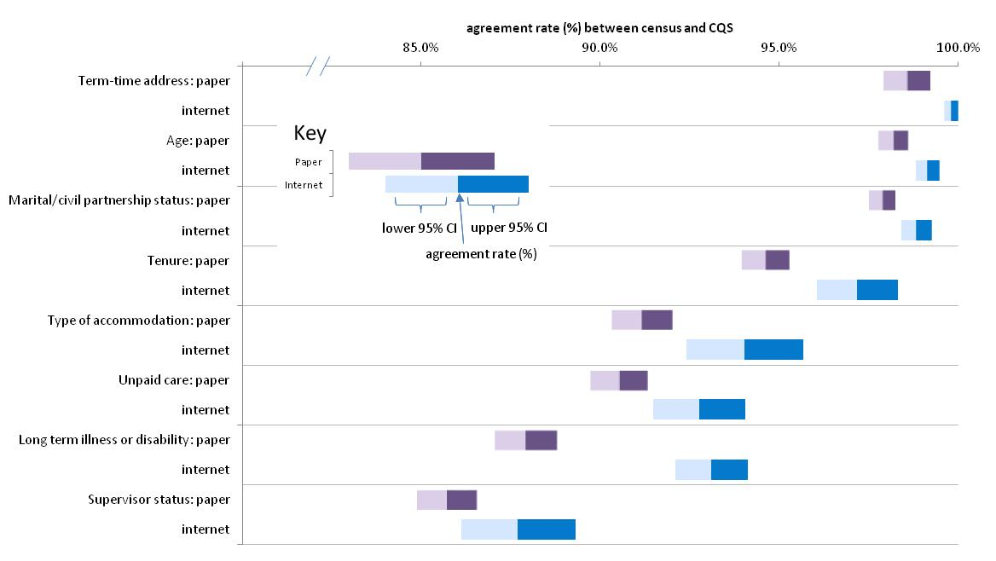
Internet significantly higher agreement rate

Slide 10
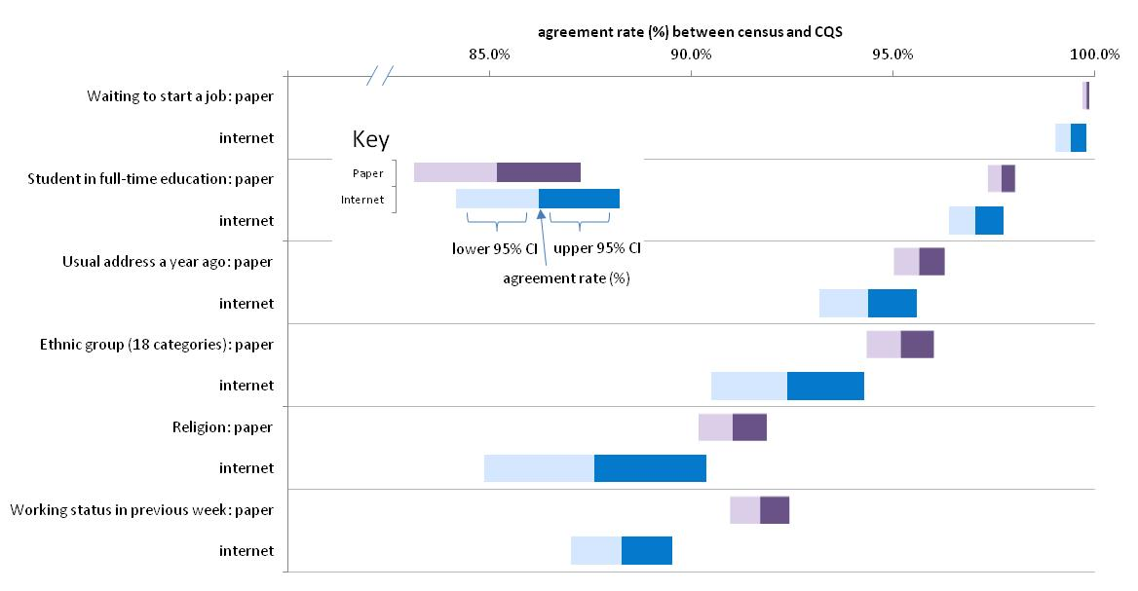
Paper significantly higher agreement rate

Slide 11
Causes and effects
Internet form was designed to minimise mode effects, but some features may have caused some differences in results between the modes...
Internet better?
Soft reminders
Scanning errors
Radio buttons
Paper better?
Display on screen
Easier to look forward
But analysis shows that the biggest differences between the paper/CQS and internet/CQS agreement rates mainly come down to differences in
Characteristics of respondents

Slide 12
Causes and effects: soft reminders
Edit and imputation rates in CQS sample
Age Marital/civil partnerships
0.4% 4.3%
0.1% 0.1%

Slide 13





Causes and effects: scanning
05/05/1956 or
05/06/1955?
08/08/2008 or
06/06/2006?
Aged 54 or 55?
Aged 2 or 4?
12/05/2006 or
17/06/2000?
01/01/1911 or
07/07/1977?
Aged 4 or 10?
Aged 100 or 33?
09/03/1953 or
09/05/1965?
17/05/1960 or
17/06/1966?
Aged 46 or 45?
Aged 50 or 44?

Slide 14
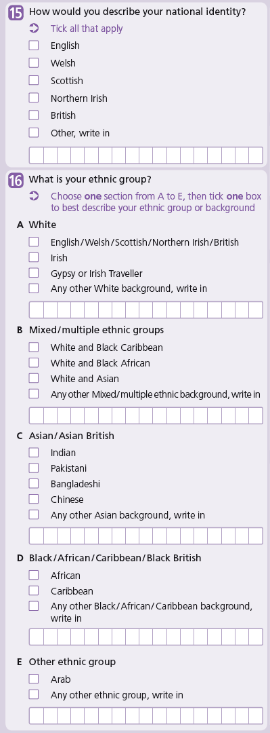
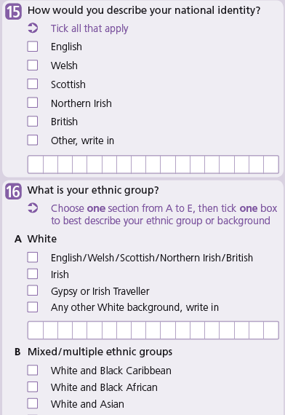
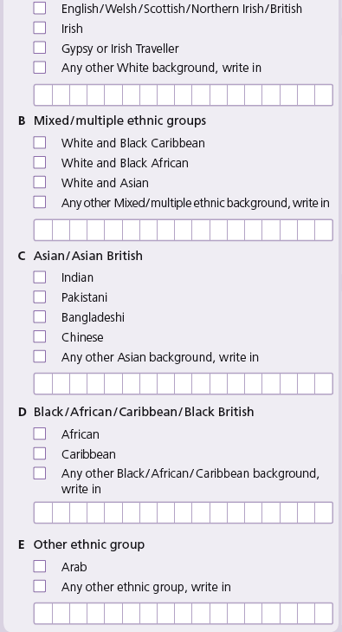
Causes and effects: display on screen

Slide 15
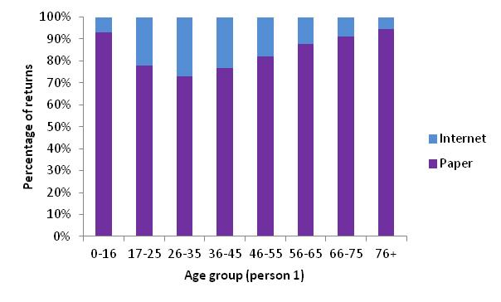
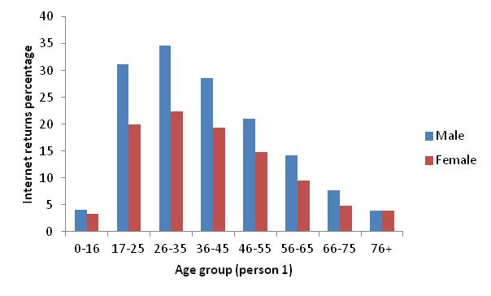
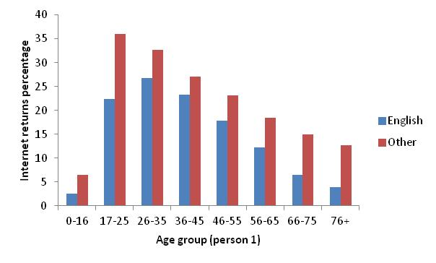
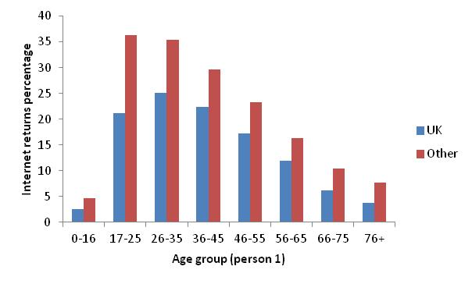
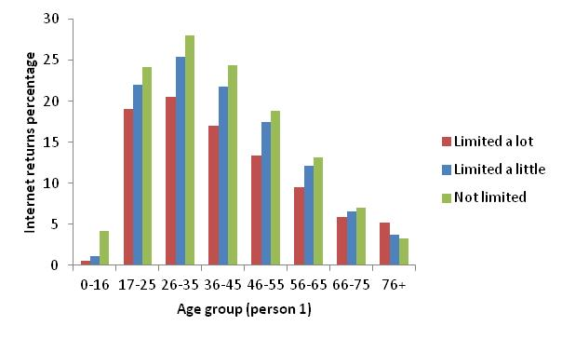
Causes and effects: characteristics of respondents
Internet response likely to be by...
Young adults
Males
English not main language
Born outside UK
Not disabled
In full-time education
Married or in civil partnership
Higher levels of qualification
In employment, with longer working hours
In larger households
Linked to economic status
  (more cars, more rooms)
average internet
average paper

Slide 16
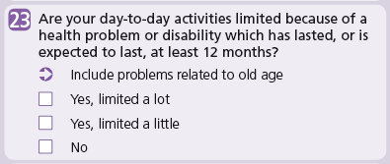
Limiting long-term illness or disability
(internet better than paper)
Social desirability bias?
CQS
Characteristics: internet responder more likely not to have limiting long-term illness or disability.
Social desirability bias affecting CQS response, so Census question likely to be better quality than reported in CQS analysis.

Slide 17
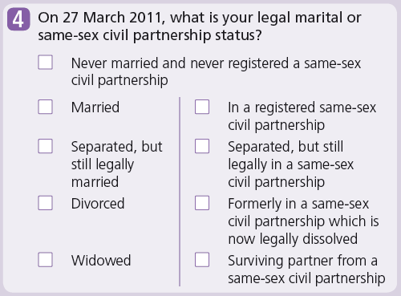
Marital/civil partnerships
(internet better than paper)
Characteristics: internet responder more likely to be married/in civil partnership.
Social desirability bias affecting CQS response, so Census question likely to be better quality than reported in CQS analysis.
Social desirability bias?
CQS

Slide 18
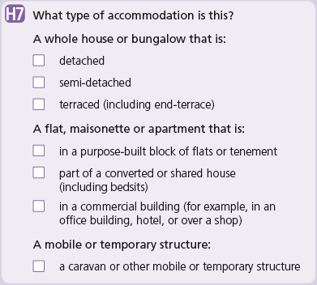
Type of accommodation
(internet better than paper)

Slide 19
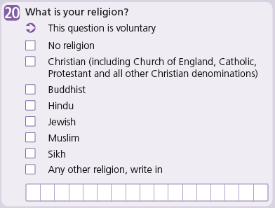
Religion
(paper better than internet)
Characteristics: internet responder more likely to be younger adult, therefore likely non-practising Christian (note this is an assumption, not in the census data), so more likely to swap between ‘Christian’ and ‘no religion’.

Slide 20
Conclusions
Minimisation of mode effects partially achieved
Characteristics of returners main driver of differences in agreement rates
2021?
Deliberately didn’t optimise for the internet (eg long ethnicity question), but did use soft reminders, eliminated scanning errors and used radio buttons.
Biggest impact likely to be due to over-use of internet respondents as donors in edit and imputation (their responses were more compete because of soft reminders).
Further analysis can be done to remove the effect of characteristics to see what differences remain.
Edit and imputation team analysing the impact of over-use of internet donors
Plans for 2021 have internet response by default rather than by choice, so mode effect elimination will have different perspective: designing for different devices.

