Slide 1
Migration Statistics in Spain
Recent developments
Antonio ARGÜESO
Socio-Demographic Statistics
Director
INE-Spain

Slide 2
Summary:
1. Migratory flows to and from Spain during the last 20 years
2. The Population Register as a source for migration statistics: lights and shadows
3. Migration Statistics: until 2008 and today
4. Measuring social conditions: National Immigrants Survey 2007
5. Some conclusions and next steps

Slide 3
1. Migratory flows to and from Spain during the last 20 years
Population of Spain 1991-2011:
Total: 46,815,916
Total: 38,872,268
Total: 40,847,371
(11.2 %)
(0.9 %)
(3.8 %)

Slide 4
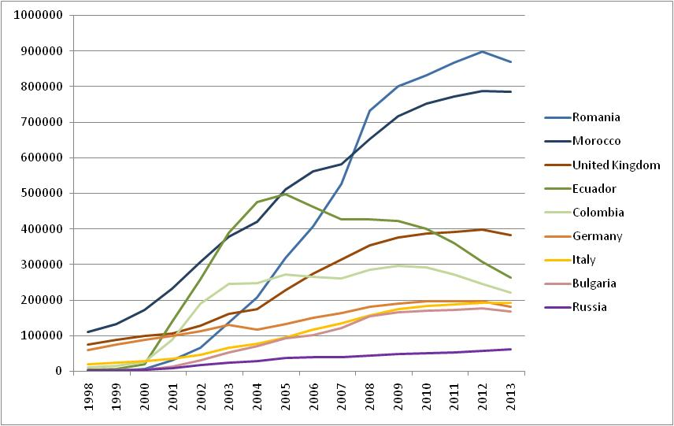
1. Migratory flows to and from Spain during the last 20 years
Stocks of foreign population 2001-2013: some selected countries
Source: Population Register

Slide 5
2. The Population Register as a source for migration statistics: lights and shadows
By Law: All persons living in a municipality of Spain have the right and obbligation to be registered in the municipal register (without any legal or administrative restriction)
(An example: a recent survey on homeless people states that 90% of them are registered, only 2,700 are not)
Until 1996: independent municipal registers (8,000), not interconnected (duplicates, out-of-date): The population figures provided by the (sum of) Population Register(s) were too high
Since may 1996: Integrated municipal registers (control of duplicates, births, deaths at national level by INE).
But it took many years to have it done (and still today it is not 100% perfect)
Spanish population is “under control” but foreign population is more difficult to count:
Why are people interested in getting registered?:
Because it provides access to education, social services, health system, it’s a proof of residence for all purposes
So… Why are people interested in getting deregistered (when they leave the country)? (no benefits, not many deregistrations)

Slide 6
2. The Population Register as a source for migration statistics: lights and shadows
There is a legal (complex and evolving) process for de-registering people
Non European Union and non permanent residents (including illegal) have to renew their registration every two years. Otherwise the registration expires (Since 2004).
European Union’s and permanent residents : Every Municipality has to check their residence every FIVE years. Otherwise the registration expires (Since 2009).
The population figures obtained DIRECTLY from the population register do not reflect well the actual migration flows but the administrative process. Migration Statistics have to be calculated after some statistical treatment

Slide 7
3. Migration Statistics: until 2008 and today
Until 2008: international migrations = RAW DATA (movements in the population register)
Easy to produce, understand and explain
Demographic inconsistency
Today: international migrations = TREATED movements in the population register
(migration for year N published on June year N+1)
More difficult to understand and explain
…What is it????
Demographic consistency

Slide 8
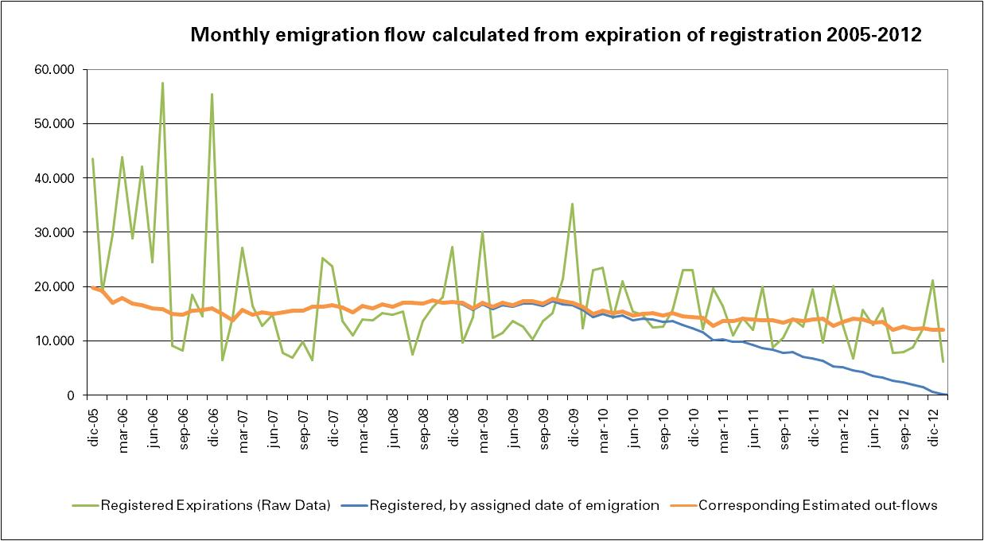
3. Migration Statistics: until 2008 and today
Example: Expiration of registrations and actual emigration estimated for non permanent residents. Raw data (green line) observed in february 2013
Step 2:
Data are expanded (orange) considering the (known and regular) delay in the deregistration process
(we can estimate the number of deregistrations occured in 2012 that will be eventually received during 2013)
Step 1:
A date of actual emigration is assigned (blue)
(Registration expires in month m but actual emigration is assigned a date between m and m-24)

Slide 9
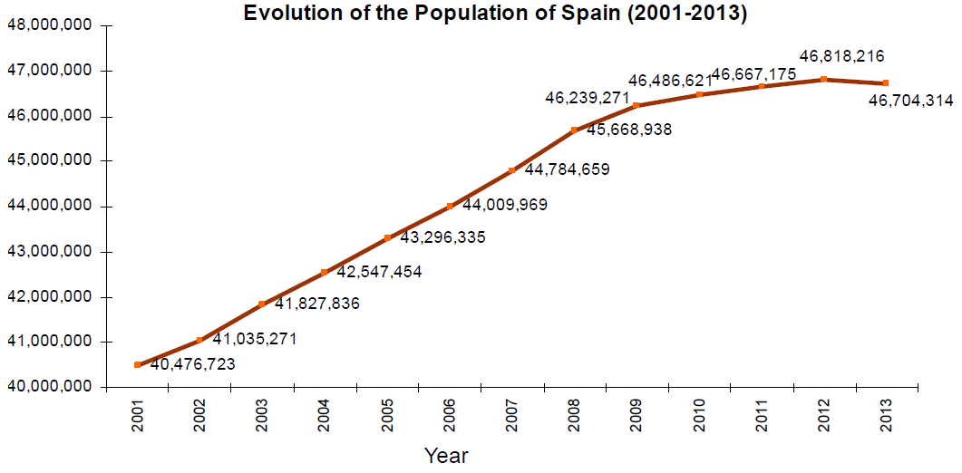
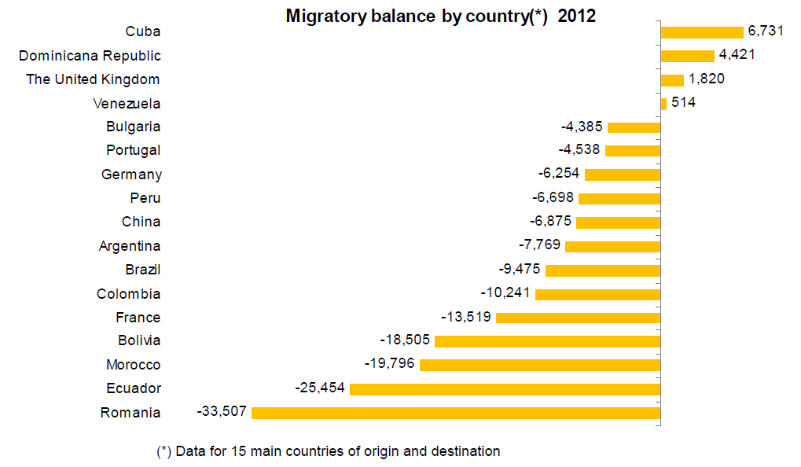
3. Migration Statistics: until 2008 and today
….But (treated or raw) what we are measuring is what the population register shows about migration
….And the question is …to what extent are we measuring real emigration?
Two new elements (adding difficulty):
The economic crisis and the new trends in emigration in Spain since 2011
And the Spaniards? If they are never de-registered how do we measure their emigration?
(the number of them getting registered in the consulates of Spain is growing)
For the first time in 40 years, in 2012 population started to decline

Slide 10
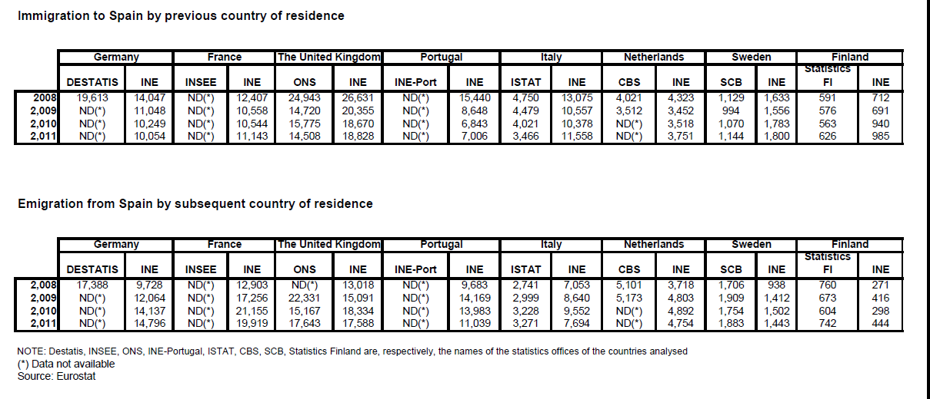
3. Migration Statistics: until 2008 and today
Mirror Statistics: We are providing more information than other Member States. But where information from other countries is available, data are rather consistent
Using “mirrored” data?: Good for checking
But has Pro’s and con’s
The risk of overestimating emigration in short term round migrations

Slide 11
A (much better) approach:
Individual Data sharing between Member States
Examples:
Spaniards getting a NIN (National Insurance Number) in UK ?
Flow of new registrations/deregistration of Spaniards in municipalities of Germany?
Can we improve figures of Germans living in Spain by matching with vital statistics in Germany?
Spanish Law allows interchange for statistical purposes with other NSIs !!
A proposal for interchange from INE-Spain will be presented during the next Working Group of Population (Eurostat) in next December
Other sources are under study: mobile telephone numbers, Health system cards…

Slide 12
4. Some conclusions (and next steps)
Investing in a population register is the key. The closer to “resident population” the concept, the better.
Migration Statistics based on a population register can be improved using models . It is better than simply counting actual movements
Mirror statistics can play a role in the near future.
But individual data interchange for statistical purposes is the best way.

Slide 13
5. Measuring social conditions: National Immigrants Survey 2007
In 2007, a survey was carried out to know more about immigrants
There was a need for information on the migration process itself and on migrants under a more general/sociological approach…

Slide 14
5. Measuring social conditions: National Immigrants Survey 2007
The questionnaire at a Glance
Basic information on all members of the household, household composition
Module 1. Socio-demographic information: place of birth, mother tongue, education, marital status, children living with parents or not, their education, brothers and sisters,parents. Information on the dwelling (tenancy, price,…) (65 questions)
Module 2. Previous Migratory Experience. Where? When? Why? How? With whom? (5 questions each)
Module 3. Living conditions before coming to Spain (11 Q)
Module 4. Arrival in Spain. Where? When? How? Why?... (9 Q)
Module 5. Employment History in Spain (25 Q)
Module 6. Residential history in Spain (18 Q)
Module 7. Relationship with country of birth (15 Q)
Module 8. Social participation (7 Q)

Slide 15
5. Measuring social conditions: National Immigrants Survey 2007
The pilot surveys
The first approach: oct 2005
500 immigrants in 50 censal sections. Two-stage sampling: selected persons taken from population register
Only 23% of visits produced an actual interview
Second try: april 2006
Three-stage sampling: section – dwelling - individuals
Two independent populations: with (A) / without (B) immigrants
(the survey showed only 3% errors in classifying from B to A)
Significant Improvement: 72 % effective sample

Slide 16
5. Measuring social conditions: National Immigrants Survey 2007
Some results:
79,6 % had “contact people” (relatives / friends) in Spain before coming
Why coming?
…due to the good weather (retirement) (63% of britons)
…for family reasons (regrouping): 42 % for germans
…looking for a better job (63% romanians, 61% bolivians)
…the quality of life (49% colombians, 43% argentinians)
Many of them had a high educational level (20% terc, 53% second.)
56 % of them were working in their countries
39 % of them send money home every month
(2% of germans, 68% of ecuadorians, 21% argentinians)
80% of them are planning to stay at least for the next five years
(70% ecuadorians, 59 % bolivians)

Slide 17
THANKS FOR YOUR ATTENTION

