Slide 1
Overview of the 2010 census round in the UNECE region and preparations for the 2020 round
Paolo Valente
High-level Seminar
on Population Censuses and Migration Statistics in CIS Countries
Gelendzhik, Russian Federation, 16-18 October 2013

Slide 2
United Nations Economic and Social Council (ECOSOC)
Resolution 2005/13:
“The Economic and Social Council…
1. Supports the 2010 World Population and Housing Census Programme, consisting of a number of activities aimed at ensuring that Member States conduct a population and housing census at least once during the period from 2005 to 2014;
2. Urges Member States to carry out a population and housing census and to disseminate census results as an essential source of information for small-area, national, regional and international planning and development…”

Slide 3
2010 Census Round in UNECE region: Countries by census year
Notes:
2008 2 Isr, Mon
2009 4 Az, Blr, Kaz, Kgz
2010 5 Lie, Rus, SaM, Taj, USA
2011 38 EU27 + Alb, Arm, Can, Cro, Ice, Mon, Nor, Ser, Mac***, Swi, Tur
2012 1 Tkm
2013 1 Bos
2014 3 And, Mold, Geo (tbc)
2015
2016 1 Ukr
No census 1 Uzb

Slide 4
Census methodology in UNECE region: Comparison 2000 and 2010 rounds
Notes:
Census Methodology 2000 round 2010 round 2000 2010
Traditional census 37 31 76% 62%
Combined census 5 10 10% 20%
Register-based census 7 9 14% 18%
Total number of countries 49 50 100% 100%

Slide 5
Census methodology in UNECE region: Comparison 2000 and 2010 rounds
Notes:
In the 2010 round, 9 countries with traditional census used data from registers to support the enumeration, as frame or control.
In total, 28 countries out of 50 (56%) used data from registers for the census, directly to produce census data, or indirectly to support the enumeration.

Slide 6
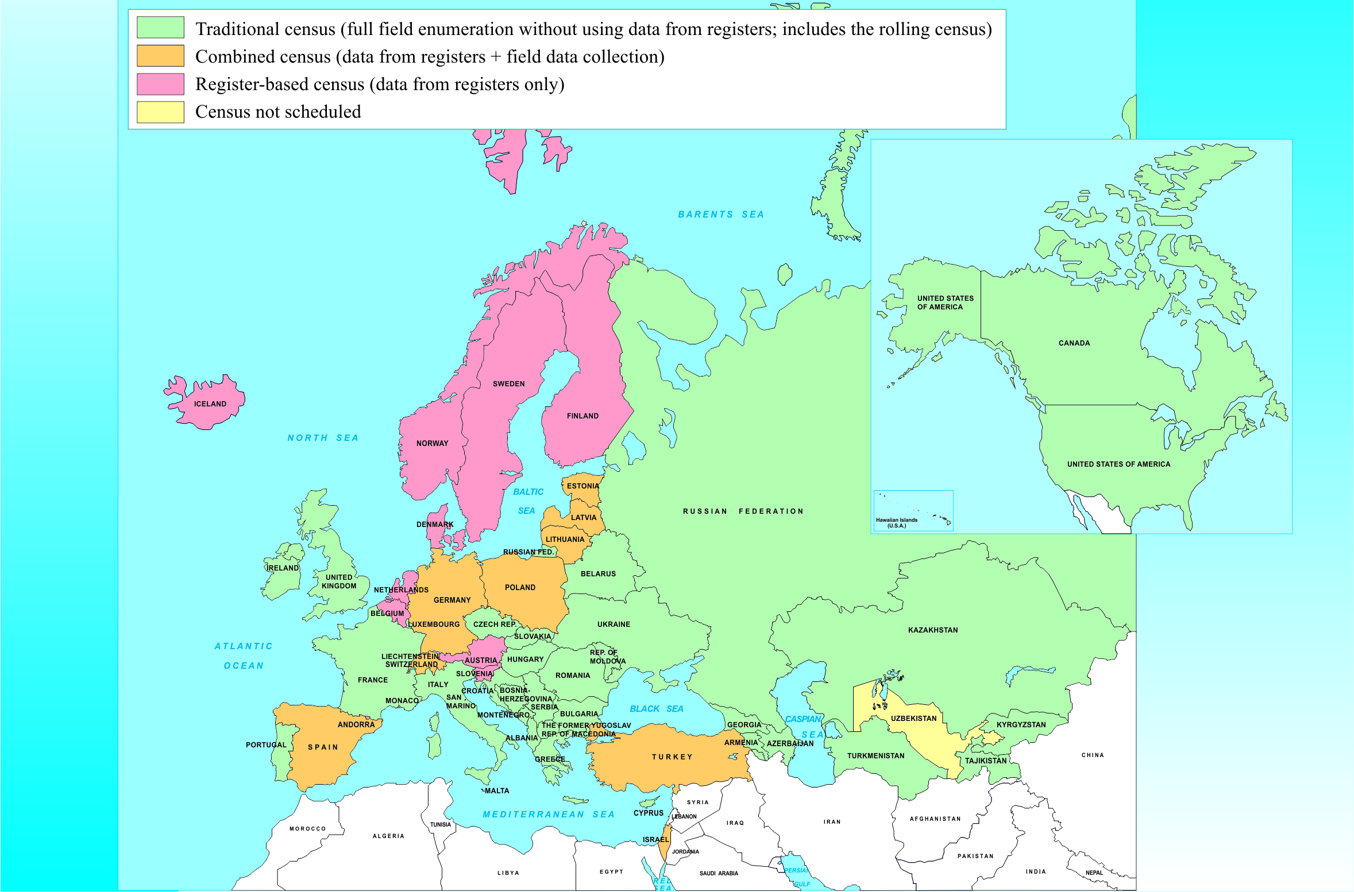
Census methodology in UNECE region: 2010 round

Slide 7
Census technology in 2010 round:
Internet census (% of data collected)
Notes:
17 UNECE countries used the internet census, including 9 countries with traditional census, and 8 countries with combined census.

Slide 8


UNECE activities on review of 2010 round and preparations for 2020 round
2012:
Work plan adopted by CES (June 2012)
9 Task forces established, on different census topics:
a. Census methodology f. Economic and educational char.
b. Census technology g. Migration and ethno-cultural char.
c. Census costs and benefits h. Household and family characteristics
Census coverage and quality i. Housing characteristics
Pop. counts and geographic char.
CES
2012 2013 2014 2015

Slide 9

UNECE activities on review of 2010 round and preparations for 2020 round
2013:
UNECE Online survey of national practices in 2010 census round (Jan-Mar 2013)
Preparation of 18 reports on review of 2010 round and proposals for new CES Rec. for 2020 round, by UNECE Steering Group and Task Forces (Apr-Sep 2013)
UNECE-Eurostat Meeting on Censuses in Geneva, to discuss the reports (Oct 2013)
2012 2013 2014 2015

Slide 10

UNECE activities on review of 2010 round and preparations for 2020 round
2014 (plans):
Preparation of draft new CES Rec. for 2020 round by Steering Group and Task Forces (by June 2014)
UNECE-Eurostat Meeting on Censuses in Geneva, to discuss the draft new recommendations (Sep 2014)
Final draft new CES recommendations (Dec 2014)
2012 2013 2014 2015

Slide 11

UNECE activities on review of 2010 round and preparations for 2020 round
2015 (plans):
Review and adoption by CES of new recommendations for 2020 censuses
  Feb 2015: Review by CES Bureau
  Spring 2015: Electronic consultation with CES
  June 2015: Adoption by CES plenary session
CES
2012 2013 2014 2015

Slide 12


Throughout the whole period:
→ Close coordination with parallel process for revision of Principles and Recommendations for 2020 Round of Population and Housing Censuses (UNSD, New York)
2012 2013 2014 2015

Slide 13
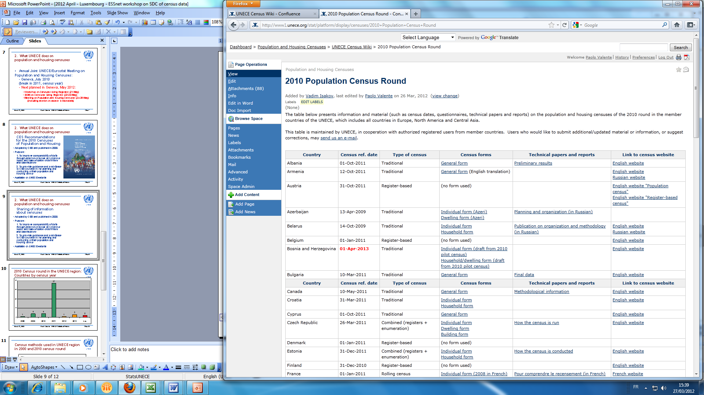
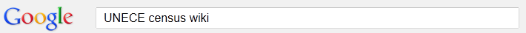
More information on censuses in UNECE:
1) UNECE Website: http://www.unece.org/stats/census.html
- Papers of October 2013 meeting and workshop on censuses
2) UNECE Census Wiki
- Table on 2010 round of censuses
in UNECE countries, including:
- Census dates
- Methodology / Use of internet
- Questionnaires (PDF)
- Technical papers and reports
- Link to national census website
Accessible from UNECE census web page or using Google:

