Slide 1
Finding a partner for GSBPM
Generic Statistical Information Model (GSIM)
Thérèse Lalor
Alistair Hamilton

Slide 2
Perspectives : Information & Process
Data (Information) Centric View :
A useful collection of well defined simple and compound data items are transformed by various processes into usable forms for the greater good of the data consumer
Process Centric View :
A set of complex transformations are carried out in the service of the user and, to that end, are fed with appropriate data
Robin Bloor: I became a process-centric bigot. But later, when struck by a vision on the road to Damascus, I changed my mind. It suddenly struck me that all forms of study seem to embody some kind of fundamental dichotomy
In physics, is it a wave or a particle? In western philosophy, free will or determinism? In eastern philosophy, is it yin or yang? In phonetics, is it a vowel or consonant? In this case – is our primary focus data or process?
Many participants in business analysis and architectural discussions have a tendency to emphasise one view or the other?

Slide 3
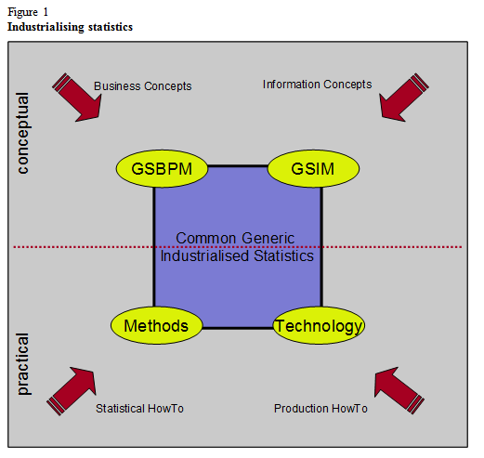
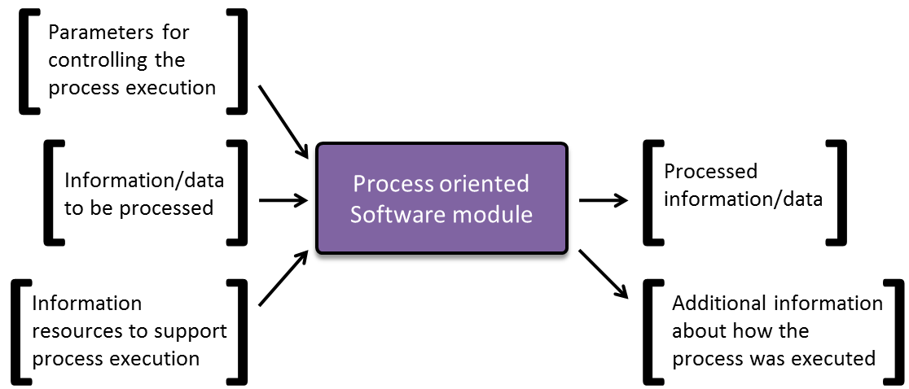
Business Information & Process
Process & information as pillars for standardisation & industrialisation
eg strategic vision of HLG-BAS
Information & Process are the nouns & verbs of statistical production
You don’t have a coherent story without both
(Statistics Sweden)

Slide 4
The way (tao) of statistical production?
Information about Processes
Process
Information
(GSBPM)
(GSIM)
Managing Information
This may be the metaphysics, but it is not a metamodel!
Notes:
This may be the metaphysics, but it is not a metamodel!

Slide 5
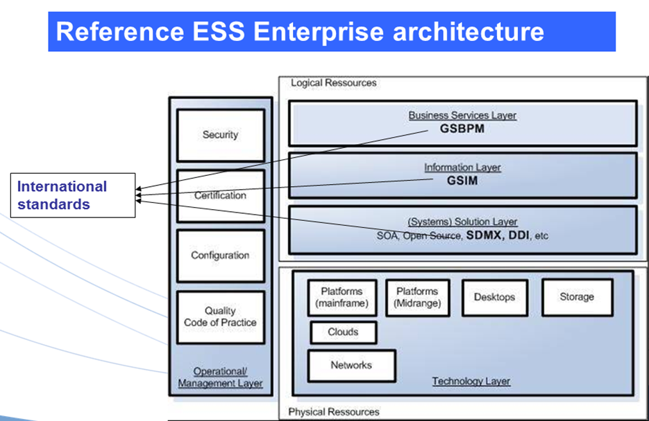
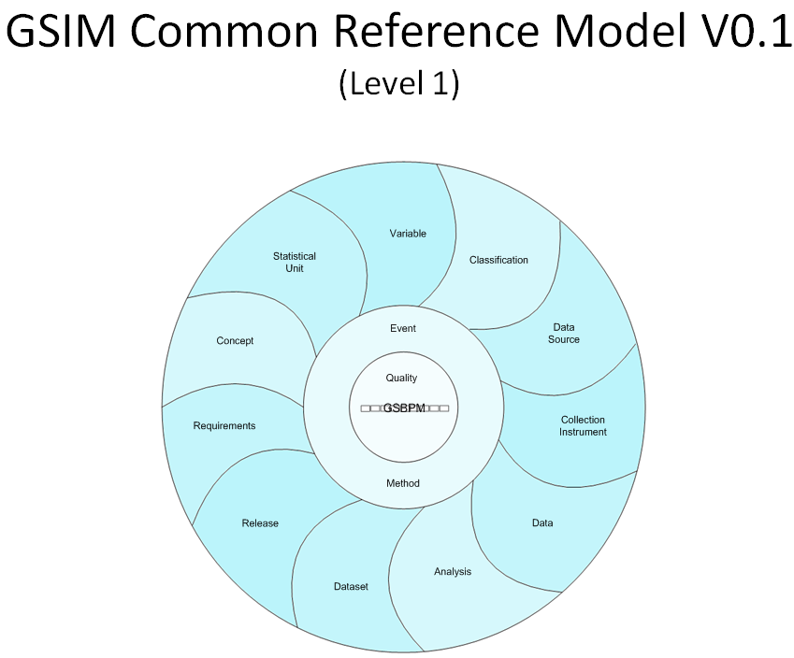
GSIM
TM
Concept
Representation
MSIS April 2010 :
The focus is on the business objects to support business processes. A “Generic Statistical Business Information Model” was proposed to provide a common view of the relationships between objects.
Focus for today’s presentation

Slide 6
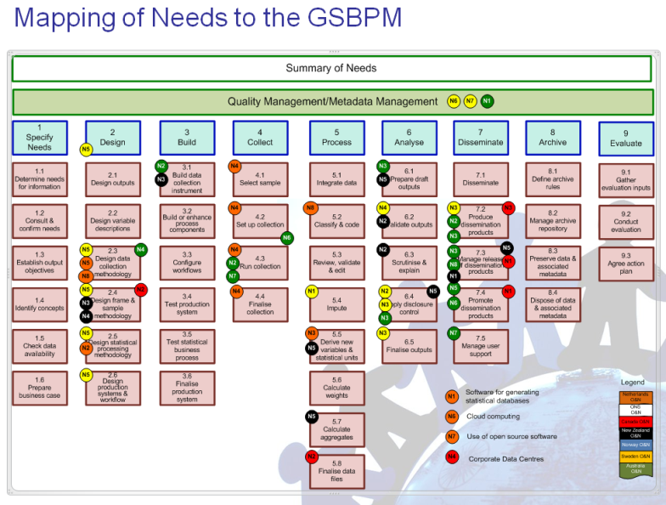
Statistical Network
Agreed at CSTAT (OECD Committee on Statistics) in 2009
Trial a collaboration approach in striving for improvement in Statistical Information Management
Statistical Network first met 7-11 June 2010.
Initial members : SE, NO, NZ, GB, CA, AU
Heads of business, methodology & IT. DGs review conclusions on final day
Purpose : Work together with pace to better meet our societies’ information needs while driving down costs.
Critical goal : "Harmonising statistical methods, systems and capabilities across statistical agencies".
Practical small steps to industrialise methods and processes to quickly and effectively benefit all participating NSIs
Building projects with sharing and re-use across the whole community, in mind
5 specific collaborations in 1st round
+ Secretariat + Steering Committee

Slide 7
Origins of SN GSIM
Developing & operationalising GSIM was agreed as highest priority strategic enabler of efficient & effective collaboration in the development & sharing of statistical information management systems.
progress through to associating GSIM with, eg, commonly agreed representation in XML
harness existing standards based representations wherever fit for purpose
SDMX & DDI-L agreed as key starting points
Collaboration project to be named OCMIMF
Operationalize a Common Metadata/Information Management Framework
Co-ordinate & collaborate with other “networks” and groups
Eg METIS, ESSnets

Slide 8
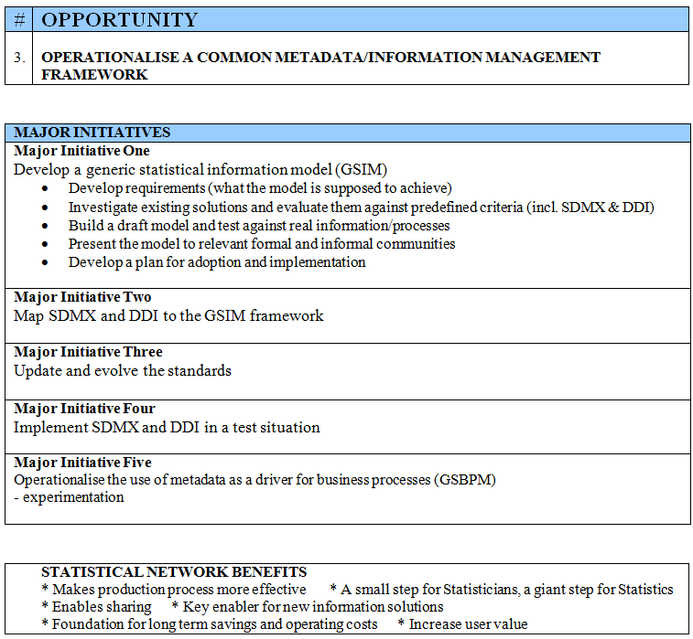

Slide 9
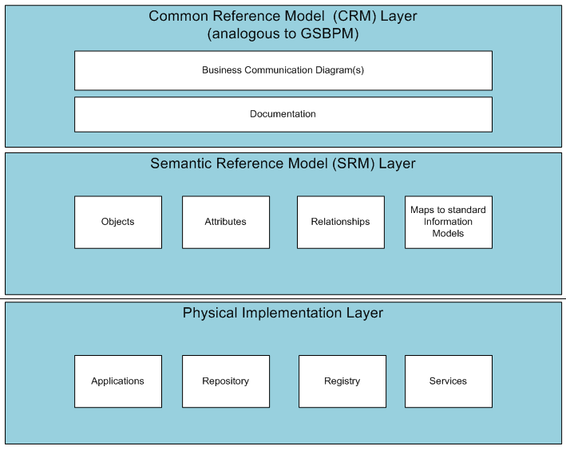
Current
Status
GSIM
Deliverable by OCMIMF
V0.1->V0.2
GSIM
Deliverable by OCMIMF
(additional level of formalisation & detail required to support consistent operationalization)
V0.0->V0.1
Deliverables from other projects

Slide 10
Purpose
Original intent was for GSIM to provide a common reference model for statistical information to assist organizations when developing statistical information systems and statistical information management frameworks.
GSIM is a reference model that can be operationalized on a consistent basis when defining the information required to drive statistical production processes as well as to define the outputs (eg statistical data) and outcomes (eg process metrics) from those processes.
Facilitates building efficient metadata driven collection, processing, and dissemination systems

Slide 11
Scope
Statistical Information spans not only metadata (including metadata about processes) but classes of data and process metrics (eg paradata)
GSIM focuses on all information objects used and/or produced in the course of various sub processes within a statistical business process.
Information models for SDMX & DDI-L do not currently have this specific purpose & coverage
Each “individual piece” of statistical information described in GSIM can be
an input to, or otherwise used by, as least one sub-process within the statistical business process, and/or
produced/output by at least one sub-process
GSIM complements GSBPM but its application in not dependent on also using GSBPM
The original motivation for GSIM, supporting interoperability (and industrialization and standardization) of statistical information management solutions, requires the level of detail and formalization to be provided by the Semantic Reference Model.

Slide 12
GSIM CRM & GSIM SRM
GSIM CRM & GSIM SRM must be consistent with each other
GSIM CRM can be used independently of GSIM SRM
a common reference set of high level terminology related to statistical information & its management
high level categorization of various types of statistical information

Slide 13
Early steps (1)
First project team teleconference 2010M11
Regular teleconferences every 4-5 weeks after that
(time zones!)
“Lotus Live” collaboration space within team
Much interest in 2011M03 from SDMX/DDI Dialogue & ESSnet sessions (Lisbon)
Working Notes approved by Statistical Network Steering Committee 2011M04
Permission to harness UNECE wiki (METIS domain) for communication external to team

Slide 14
Early steps (2)
Designing from the top down…
division of metadata and data into high level classes
…and bottom up
Jenny Linnerud mined the text of the GSBPM for references to objects that become Information Object Candidates (IOCs)
100->70->48
Early challenges
Consistent levels and sensible numbers of object
How many boxes on the GSBPM (47)?
Establishing the most intuitive “organising principle”
Not as straightforward as GSBPM
Sourcing appropriate agreed definitions (re-use principle)

Slide 15
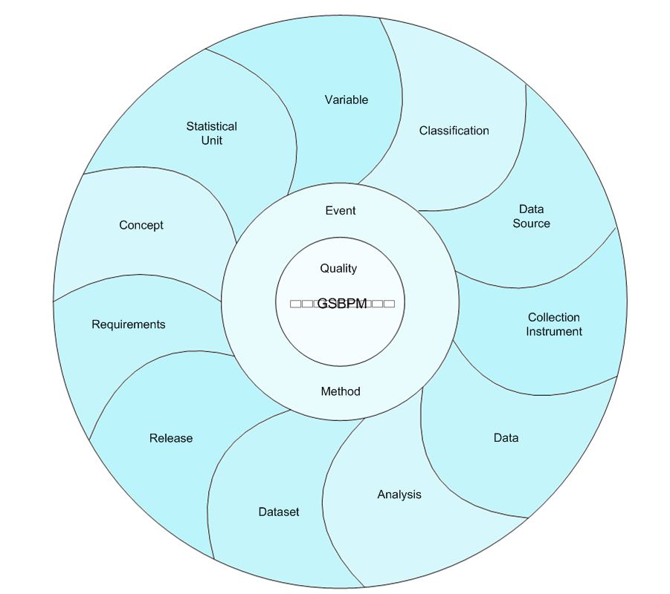
GSIM Common Reference Model V0.1
Level 1

Slide 17
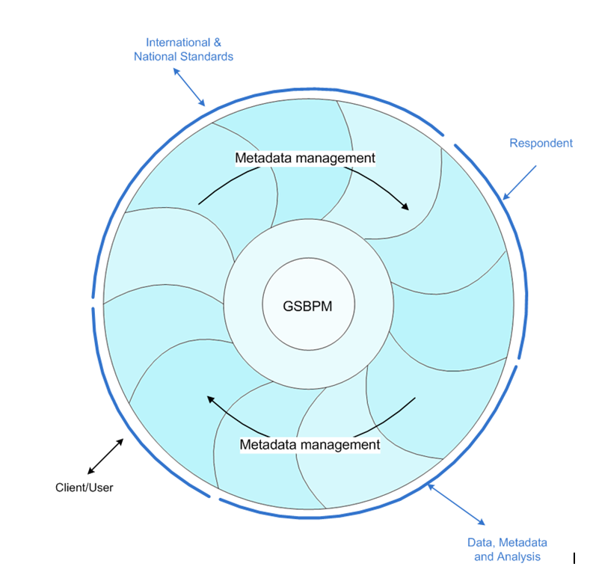
Level 0 : Information Environment
Information environment for GSIM includes
Client/User
International & National Standards
Respondents
Third party analysis, data and metadata

Slide 18
The first release…
GSIM Common Reference Model V0.1 released for comment on 20 June 2011
Structure of documentation paralleled GSBPM
Sought input directly from members of METIS Steering Committee, CORE ESSnet, etc
12 sets of comments received ranging from
highly complimentary, with suggestions for improvement
suggestions for improvement
3 sets of comments “re-envisage” approach to L1
Other comments on choice & definition of specific information objects, editorial improvements etc

Slide 19
Moving forward
Connection with process
Not everyone favours “core” approach at Level 1
Next step is to integrate with the CORE IM!
Further engagement with MCV Ontology work from SDMX ESSnet
Collaborating beyond the OCMIMF team
Future “home” for GSIM
Ideally it would live happily ever after under one roof with GSPBM?

Slide 20
Some target dates
GSIM Common Reference Model V1.0
V1.0 by 2012M05
GSIM Semantic Reference Model
V0.1 by 2012M02
V1.0 by 2012M12
Mapping to SDMX + DDI-L
by 2012M12
Guide for application
by 2013M03

Slide 21
Possible discussions starters
Best means of engaging beyond the OCMIMF Project Team from here forward.
with METIS colleagues
more broadly with future users of GSIM
“Connection with process”
How GSIM moves forward “arm in arm” (or “hand in hand”?) with GSBPM
Future “home” for GSIM

