Slide 1
The UNECE Task Force : the approach towards the set of indicators
Dr. Olivier Thunus
UNECE Task Force Vice-Chair

Slide 2
Purpose of the TF
To develop an international comparable set of key climate change-related statistics and indicators, with definitions and data sources recommended for their production.

Slide 3
Methodological approach
Agreement on basic principles
Inventory of reference documents
Identification of potential climate change related indicators
Grouping the indicators by policy questions
Prioritization of policy questions
Selection of a key set of indicators
Characterization of these selected indicators
Definition of the key climate change related statistics
Identification of the requisite data sources

Slide 4
Past activities
Agreement on basic principles
Inventory of reference documents
Identification of potential CC related indicators
Grouping the indicators by policy questions
Agreement on basic principles
Establish a common understanding on:
Scope of climate change related statistics
Focus on 5 areas: Emissions, Drivers, Impacts, Mitigation and Adaptation
=> Direct measurement of climate and weather is outside the focus of TF
Important terminology
Terms such as data, statistics and indicators are defined based on FDES
Terms such as accounts and key indicators are positioned in the “information pyramid”
=> indicators could be synthesized from accounts or directly from basic statistics and non-statistical data

Slide 5
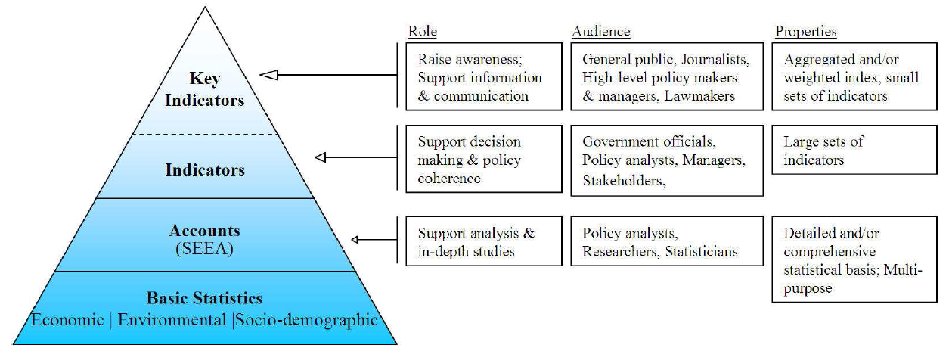
Past activities
Agreement on basic principles
Inventory of reference documents
Identification of potential CC related indicators
Grouping the indicators by policy questions
Unprocessed data
From administration, research, surveys etc.

Slide 6
Past activities
Agreement on basic principles
Inventory of reference documents
Identification of potential CC related indicators
Grouping the indicators by policy questions
Agreement on basic principles
Establish a common understanding on:
Definition of “KEY” CC related indicators and statistics
Key CC related indicators are those indicators which are needed to answer key CC related policy questions, taking into account analytical soundness and measurability. In addition, they ”paint a picture” that contains a clear representation of all five areas that have been identified as the scope of CCRS: drivers, emissions, impacts, adaptation and mitigation.
Key CC related statistics are those basic statistics, which are needed to synthesize the key CC related indicators AND those statistics which are needed to compile emission inventories
Link between the scope, the indicators, the statistics
There is a hierarchical relationship between the scope, policy questions, indicators and statistics

Slide 7
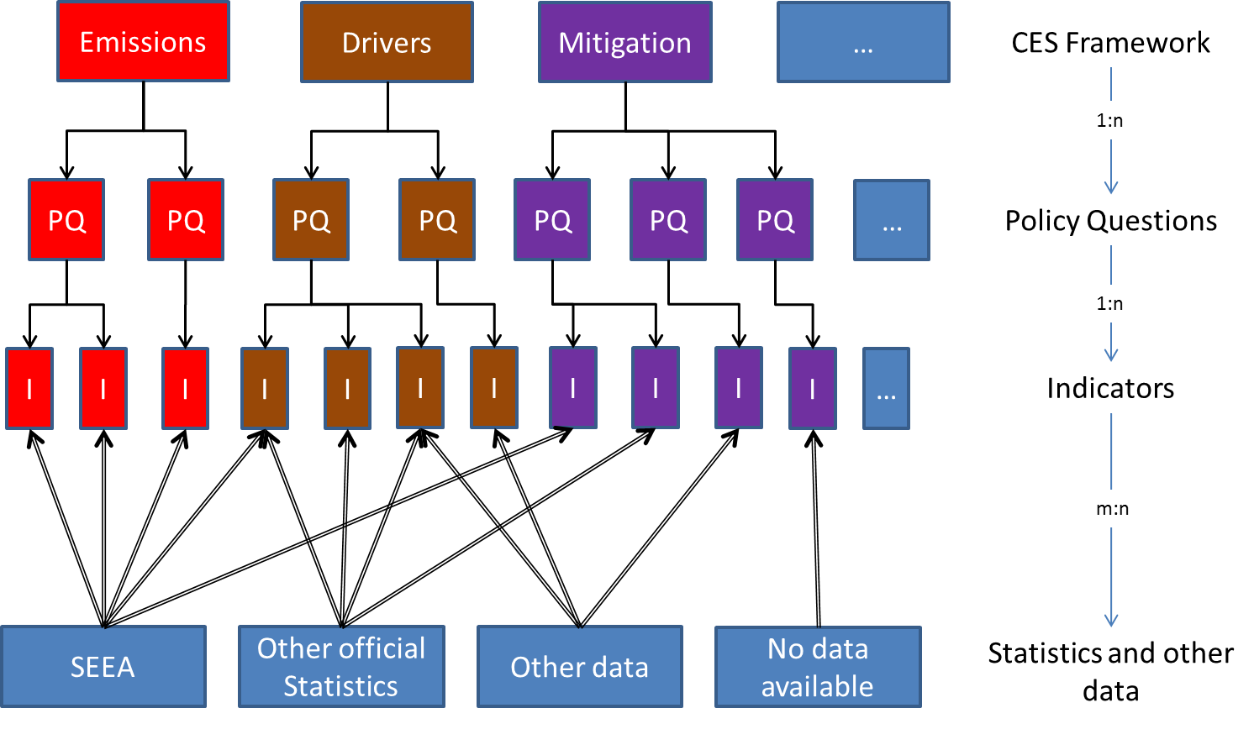
Past activities
Agreement on basic principles
Inventory of reference documents
Identification of potential CC related indicators
Grouping the indicators by policy questions

Slide 8
Past activities
Agreement on basic principles
Inventory of reference documents
Identification of potential CC related indicators
Grouping the indicators by policy questions
Inventory of reference documents
Review of literacy in the area of climate change related indicators and statistics
To analyze in deep these reference documents, three groups have been organized:
Group A: Analysis of SEEA
Group B: Identifying indicators and policy questions from other reference documents
Group C: Identifying most recent policy questions and indicators discussed within the post 2015 agenda

Slide 9
Past activities
Agreement on basic principles
Inventory of reference documents
Identification of potential CC related indicators
Grouping the indicators by policy questions
Identification of potential CC related indicators
Establish three reference tables (one per group) where potential indicators are related to:
The areas of the scope for which they are concerned
The policy questions for which they are answered
The underlying statistics or accounts

Slide 10
Past activities
Agreement on basic principles
Inventory of reference documents
Identification of potential CC related indicators
Grouping the indicators by policy questions
Grouping the indicators by policy questions
Merge the three reference tables and
Define major policy questions under which different indicators could be grouped
Add complementary information as:
The policy domain/objectives (e.g. SDG target)
The main CC related phenomena

Slide 11
Methodological approach
Agreement on basic principles
Inventory of reference documents
Identification of potential climate change related indicators
Grouping the indicators by policy questions
Prioritization of policy questions
Selection of a key set of indicators
Characterization of these selected indicators
Definition of the key climate change related statistics
Identification of the requisite data sources

Slide 12
Current activities
Prioritization of policy questions
Selection of a key set of indicators
Prioritization of policy questions
Identify key policy questions by asking the opinion of experts:
On line survey
Respondents:
members of Steering Group,
members of the TF,
participants of the Expert Forum
Method: ranking policy questions from “not important” to “very important”
Web survey on +/- 40 policy questions

Slide 13
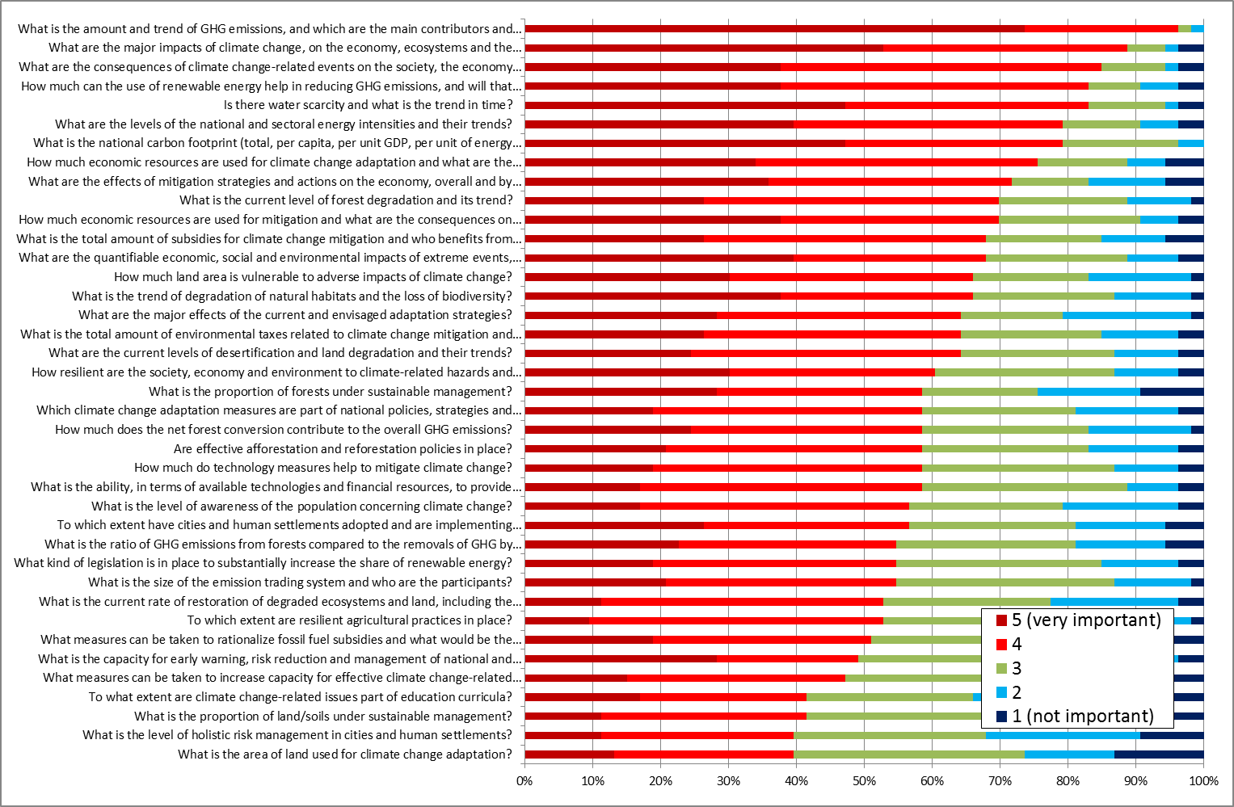
Current activities
Prioritization of policy questions
Selection of a key set of indicators

Slide 14
Current activities
Prioritization of policy questions
Selection of a key set of indicators
Highest rate - very important (level 5 or 4)
What is the amount and trend of GHG emissions, and which are the main contributors and main drivers?
What are the major impacts of climate change, on the economy, ecosystems and the society, and how should they be quantified?
What are the consequences of climate change-related events on the society, the economy and the environment?
How much can the use of renewable energy help in reducing GHG emissions, and will that be economically viable?
Is there water scarcity and what is the trend in time?
What are the levels of the national and sectoral energy intensities and their trends?
What is the national carbon footprint (total, per capita, per unit GDP, per unit of energy supply), and what are the trends in the footprint?
How much economic resources are used for climate change adaptation and what are the consequences on the overall economic performance?
What are the effects of mitigation strategies and actions on the economy, overall and by sector?
What is the current level of forest degradation and its trend?
How much economic resources are used for mitigation and what are the consequences on the overall economic performance?

Slide 15
Current activities
Prioritization of policy questions
Selection of a key set of indicators
Lowest rates – not important (level 1 or 2)
What is the level of awareness of the population concerning climate change?
What are the major effects of the current and envisaged adaptation strategies?
What is the current rate of restoration of degraded ecosystems and land, including the land affected by desertification?
What measures can be taken to increase capacity for effective climate change-related planning and management in least developed countries, including measures specifically targeted at women, youth and local and marginalized communities?
What measures can be taken to rationalize fossil fuel subsidies and what would be the consequences of taking such measures?
What is the proportion of forests under sustainable management?
What is the area of land used for climate change adaptation?
What is the level of holistic risk management in cities and human settlements?
What is the proportion of land/soils under sustainable management?
To what extent are climate change-related issues part of education curricula?

Slide 16
Current activities
Prioritization of policy questions
Selection of a key set of indicators
Selection of a key set of indicators
Establish a set of key climate change related indicators based on:
The prioritization resulting from the survey for each main area
Some relevant criteria
Relevance and utility for users, methodological soundness, measurability,…
Criteria for the set of indicator:
Consistency and complementary of indicators
Some checks: if all main CC related phenomena are addressed

Slide 17
Current activities
Prioritization of policy questions
Selection of a key set of indicators
Selection of a key set of indicators
Main area: Adaptation (SDG 13.2)
UQ: How much economic resources are used for climate change adaptation and what are the consequences on the overall economic performance?
PQ: 1. What are the annual and total costs of adaptation measures?
2. Which is the level of adaptation measures ?
3. How many economic resources are used for adaptation?
Ind: 3.1. Share of government adaptation expenditure as a percentage of total government expenditure (%)
3.2. Amount of disaster prevention expenditure linked to weather events
(mio. EUR)

Slide 18
Questions
Please give us your opinion :
What are the specific needs stemming from the SDGs process that the UNECE Task Force on a set of key climate change-related statistics should take into account when finalizing the set of key indicators?
Please provide comments and suggestions on the approach chosen by the Task Force, particularly concerning the proposed future steps of the work.
Please clarify the criteria you used when answering the questionnaire on policy questions - which criteria are important for the selection of indicators?

