Slide 1
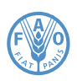
FAOSTAT Emissions Database
Capacity Development Activities
Francesco N. Tubiello
Senior Statistician, Environment
Statistics Division
Expert Forum for producers and users of climate change-related statistics
Geneva Sep 2-3 2015, UNECE

Slide 2
Summary
FAO Work on GHG Emissions from agriculture, forestry and land use change
Support to member countries to improve rural statistics and report their GHG emissions within UNFCCC requirements and IPCC GLs: NCs, BURs, NAMAs and REDD+
Underlying Issues for in-country work:
-Establishment of Tier 1 Inventories as reference for gap analysis, QA/QC, long-term sustainability
-Consistency with food security, resilience and rural development goals, SEEA and SDGs

Slide 3
Specific FAO Activities
Global, regional and country data: FAOSTAT Emissions database for AFOLU, 1961-present, with country detail
Knowledge generation: IPCC AR5 and IPCC Guidelines; IPCC, UNFCCC SBSTA, ADP, COP Processes
Capacity Development: Support member countries identify and report GHG data for UNFCCC process

Slide 4
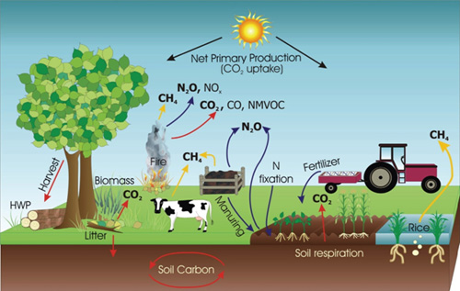


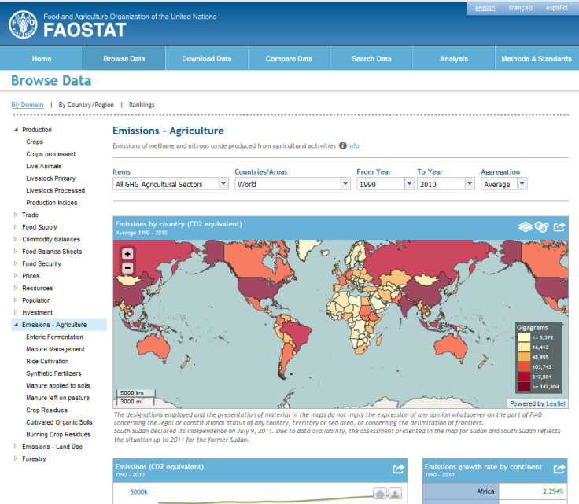
FAOSTAT Emissions Database:
A reference Tier 1 Exercise
& geo-reference data
+
IPCC 2006 Guidelines
=
Notes:
http://faostat.fao.org

Slide 5
Addressing different data analysis needs:
National, Regional and Global Assessments: Facilitate regional comparisons and trend analysis for AFOLU
Fill data gaps and QA/QC procedures: Provide a reference, Tier 1 data framework for analysis of AFOLU GHG trends for all countries–EU 28 QA/QC uses FAOSTAT Emissions data
Develop Indicators: Derive complex GHG indexes useful for analysis and policy support
Access geo-referenced data: Move beyond nationally aggregated statistics for the land use sector
Notes:
2. considering the need to report biannually (BURs), i.e., starting in 2014

Slide 6
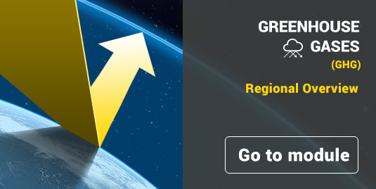
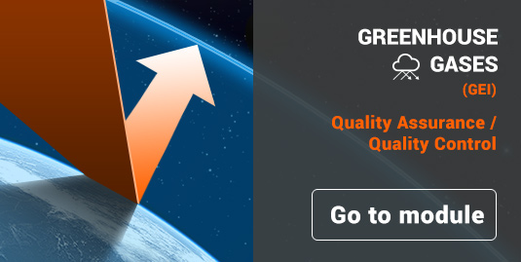
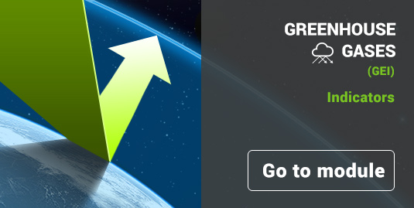
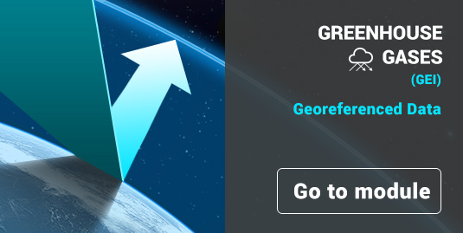
New Data Analysis Tools in
FAOSTAT Emissions Database
Per capita
Agro-meterology

Slide 7
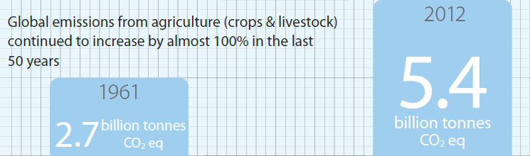
Global Agriculture Emissions, 2012
Notes:
Global growth rate is 1%
There has been a minor slowing of the growth rate compared to the past decadal average
But emissions every year are at an all-time high

Slide 8
2012 Status Against Baseline Projections
HOT AIR
GgCO2eq yr-1

Slide 9
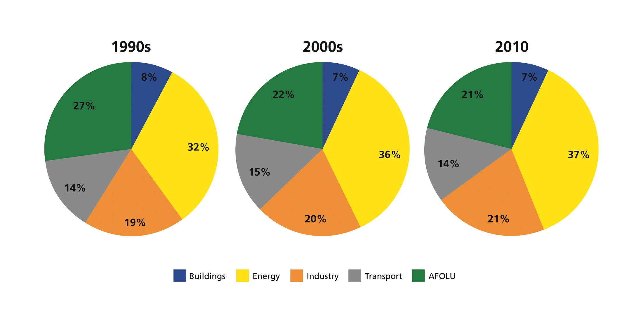

Slide 10
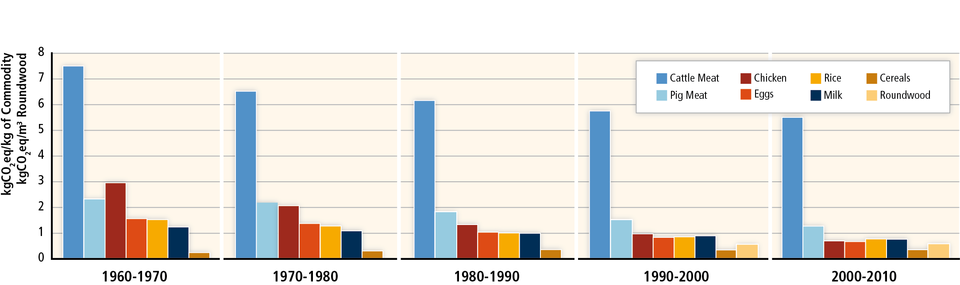
Relevant Indicators developed for IPCC AR5 (SDGs):
Emissions intensity of AFOLU commodities falling over the last several decades, as agriculture and forestry production become more efficient

Slide 11
Capacity Development-Regional Statistics
Inception Workshop on GHG Emissions Statistics
Da Lat, Viet Nam, 5 - 6 October 2012
33 participants; 18 countries (Bangladesh, Bhutan, Cambodia, China, Fiji, India, Indonesia, LAO PDR, Korea ROK, Malaysia, Myanmar, Nepal, Pakistan, Philippines, Sri Lanka, Thailand, Viet Nam)
Second FAO workshop on Statistics for GHG Emissions
Port of Spain, Trinidad and Tobago, 3 - 4 June 2013
29 participants; 18 countries (Argentina, Belize, Bolivia, Brazil, Chile, Colombia, Costa Rica, Cuba, Ecuador, Guatemala, Honduras, Mexico, Nicaragua, Panama, Dominican Republic, Peru, Uruguay, and Trinidad and Tobago)
Third FAO Regional workshop on Statistics for GHG Emissions
Casablanca, Morocco, 2 - 3 December 2013
37 participants; 23 countries (Algeria, Cameroon, Central African Republic, Congo Dem. Rep., Cote d'Ivoire, Egypt, Ethiopia, Gabon, Ghana, Kenya, Madagascar, Mali, Mauritania, Morocco, Namibia, Nigeria, Rwanda, Senegal, South Africa, Sudan, United Republic of Tanzania, Uganda, and Zambia).
Meso-American workshop with UNREDD and Mexico-Noruega REDD+
San José, Costa Rica, 24-26 Jun 2014
25 participants; 13 countries (Argentina, Chile, Colombia, Costa Rica, Cuba, Ecuador, Guatemala, Honduras, Mexico, Nicaragua, Panama, Dominican Republic, Uruguay)
Notes:
The FAO workshop brings together high-level staff of Ministries of Agriculture or Agricultural National Statistical Agencies and Bureaus responsible for national GHG reporting under international climate policy processes, to help further the conversation on how to improve statistics for GHG emissions. The workshop is a platform to exchange information on national GHG data processes, identify critical institutional and technical gaps, and explore the role that FAO can play via its new FAOSTAT Emissions database in support of its Member Countries’ needs.
Regional workshops aim to assess regional and country needs, after work has been implemented with countries

Slide 12
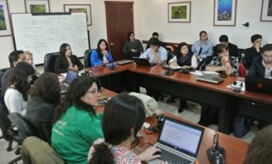
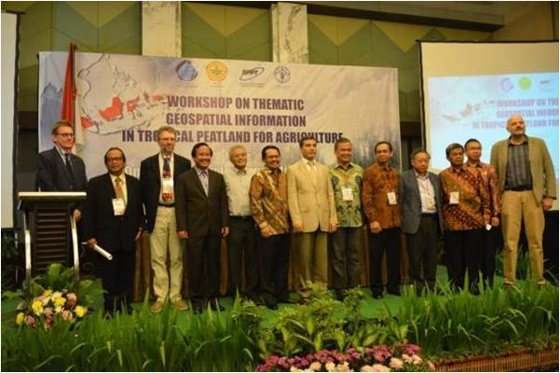
Current Capacity Development: BURs
BUR ‘’Pilots’’ QA : Mexico, Uruguay, Costa Rica
UN REDD Targeted Support: Ecuador, Colombia, Paraguay, DRC, Congo
UNFCCC West Africa Project (USDoI, USEPA, FAO): Cape Verde, Senegal, Burkina Faso, Cote D’Ivoire, Ghana, Benin, Togo
UNFCCC IPCC GHG Workshop, Namibia Oct 2015: 54 Countries
Thematic Workshop I, SEEA (Beijing Nov 2015)
Thematic Workshop II, SEEA (Rwanda, Dec 2015)
Peatlands: Indonesia
  Data Gaps; QA/QC
  National Statistical Processes
  Interagency Coordination :
  UNREDD, UNDP, UNFCCC, IPCC

Slide 13
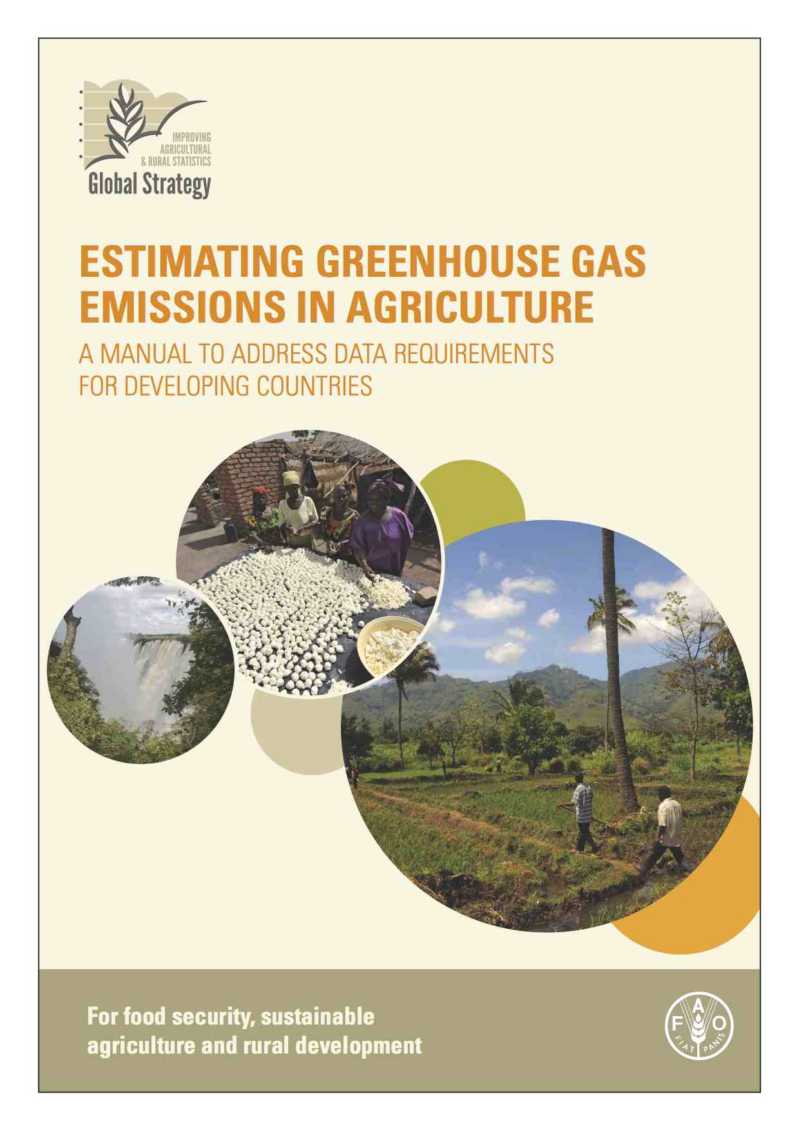
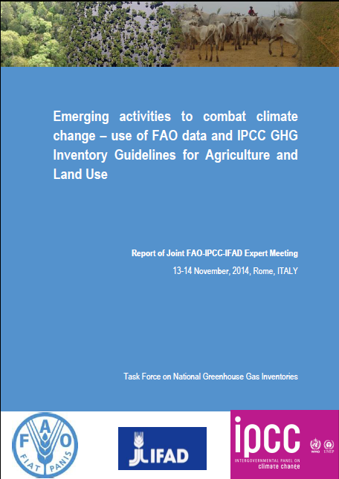
Capacity Development-Knowledge
Knowledge Generation; GHG Data Analyses, Manuals in support of GHG Inventory and submission processes
Notes:
MAGHG2
Framework for coherent cross-agency cooperation established in support of Member Countries
Capacity of member countries to submit NAMAs and BURs improved

Slide 14
Lessons Learned
Need to contribute to relevant international processes, capitalizing on specialize statistical knowledge: IPCC Guidelines and SBSTA Processes
Build on the concept of phased approach to building robust inventories: Work with countries on a reference Tier 1 as the necessary starting point to highlight gaps, implement QA/QC, and identify needed steps to higher Tiers
Interact directly with UNFCCC and other relevant agencies on CD, where possible
Notes:
2. considering the need to report biannually (BURs), i.e., starting in 2014

Slide 15
Conclusions
Availability of a global greenhouse gas emission database by country, as tool to support member countries build a robust Tier 1 for AFOLU and perform QA/QC analyses on activity data and GHG emissions
Possibility of direct work with member countries
Focus on building linkages with BURs, NAMAs, SEEA and rural development goals
Focus on coherency among relevant programmes, increase efficiency of country impacts and donor resources
Notes:
2. considering the need to report biannually (BURs), i.e., starting in 2014

Slide 16
Thank You !
francesco.tubiello@fao.org
http://www.fao.org/economic/ess/agri-environment/en
Notes:
2. considering the need to report biannually (BURs), i.e., starting in 2014

Slide 17
Example of FAO data Supporting National Mitigation Planning:
N₂O Emissions 2010
N₂O
3 GtCO₂eq
HCFCs
CH₄
Fuel Combustion
Adipic, Nitric Acid Production
CO₂
IPCC AR5 WGIII Data Sources:
EDGAR and FAOSTAT Emissions Database

Slide 18
GHG Emissions Statistics: Categories
DOMAIN | CATEGORY |  | GAS reported | Data source
Agriculture | Enteric Fermentation |  | CH₄ | FAOSTAT
 | Manure Management |  | CH₄, N₂O | FAOSTAT
 | Rice Cultivation |  | CH₄ | FAOSTAT
 | Agricultural soils | Synthetic Fertilizers | N₂O | FAOSTAT
 |  | Manure applied to soils | N₂O | FAOSTAT
 |  | Manure left on pasture | N₂O | FAOSTAT
 |  | Crop residues | N₂O | FAOSTAT
 |  | Cultivated organic soils | N₂O | HWSD, GLC2000
 | Burning - Savanna |  | CH₄, N₂O | GFED4, JRC, FRA-GEZ
 | Burning – Crop residues |  | CH₄, N₂O | FAOSTAT
DOMAIN | CATEGORY |  | GAS reported | Data source
Agriculture | Enteric Fermentation |  | CH₄ | FAOSTAT
 | Manure Management |  | CH₄, N₂O | FAOSTAT
 | Rice Cultivation |  | CH₄ | FAOSTAT
 | Agricultural soils | Synthetic Fertilizers | N₂O | FAOSTAT
 |  | Manure applied to soils | N₂O | FAOSTAT
 |  | Manure left on pasture | N₂O | FAOSTAT
 |  | Crop residues | N₂O | FAOSTAT
 |  | Cultivated organic soils | N₂O
 | Burning - Savanna |  | CH₄, N₂O
 | Burning – Crop residues |  | CH₄, N₂O | FAOSTAT
DOMAIN | CATEGORY | GAS reported | Data source
LULUCF | Forest land | CO₂ | FRA
 | Cropland | CO₂ | HWSD, GLC2000
 | Grassland | CO₂ | HWSD, GLC2000
 | Burning Biomass | CH₄, N₂O, CO₂ | GFED4, HWSD
 | Wetlands | CO₂
 | Settlements | CO₂
 | Other land | CO₂
DOMAIN | CATEGORY | GAS reported | Data source
LULUCF | Forest land | CO₂ | FRA
 | Cropland | CO₂
 | Grassland | CO₂
 | Burning Biomass | CH₄, N₂O, CO₂
 | Wetlands | CO₂
 | Settlements | CO₂
 | Other land | CO₂

