Slide 1
Current and emerging data needs of the global climate change regime - requirements/guidelines for data reporting - the review/verification processes for the data - “entry points” for NSO inputs/involvement

Slide 2
Background: from Rio (1992) to Paris (2015)
UNFCCC (Climate Change Convention), with 196 “Parties”:
one of the three “Rio Conventions”, adopted at “Rio Earth Summit” (1992); entered into force in 1994
ultimate aim = preventing “dangerous” human interference with the climate system
Two major groups of Parties under the UNFCCC:
Annex I Parties (“developed countries”)
Non-Annex I Parties (“developing countries”)
Kyoto Protocol, with 192 Parties:
a “Protocol” to the Convention, adopted in Kyoto, Japan, in 1997; entered into force in 2005
under the Kyoto Protocol: legally-binding targets/commitments to reduce/limit GHG emissions and more stringent reporting/review requirements
these targets and rules apply only to Annex I countries
Anticipated new agreement (Paris, 2015):
Since 2011: “a process to develop a protocol, another legal instrument or an agreed outcome with legal force under the Convention applicable to all Parties”

Slide 3
Requirements for data reporting:
Foundation: Articles 4 and 12 of the Convention
Each Party, taking into account their common but differentiated responsibilities … to develop, periodically update, publish and communicate, national inventories of anthropogenic emissions by sources and removals by sinks of all greenhouse gases not controlled by the Montreal Protocol, using comparable methodologies… ”
The provisions for reporting are detailed in many decisions
GHGs to report on:
Direct GHGs: CO₂, CH₄, N₂O, HFCs, PFCs, SF₆, NF₃
Indirect GHGs: CO, NO_{x}, NMVOCs, SO_{x}
Annex I / non-Annex I Parties have different requirements
Different methodological basis (versions of IPCC guidelines)
More extensive and frequent reporting for Annex I Parties
Reporting by non-Annex I Parties is conditioned by funding
Annex I Parties have a rigorous review process for GHG data
* IPCC = Intergovernmental Panel on Climate Change
Notes:
Direct (a “shall”) requirement:
carbon dioxide (CO2), methane (CH4), nitrous oxide (N2O), perfluorocarbons (PFCs), hydrofluorocarbons (HFCs) and sulphur hexafluoride (SF6); nitrogen trifluoride (NF3)
.
Indirect (“should”):
carbon monoxide (CO), nitrogen oxides (NOX) and non-methane volatile organic compounds (NMVOCs), as well as sulphur oxides (SOx).
Optional:
Annex I Parties may report indirect CO2 from the atmospheric oxidation of CH4, CO and NMVOCs.
Annex I Parties may report as a memo item indirect N2O emissions from other than the agriculture and LULUCF sources. These estimates of indirect N2O should not be included in national totals.
For Parties that decide to report indirect CO2, the national totals shall be presented with and without indirect CO2.

Slide 4
The review/compliance process under UNFCCC*
UNFCCC checks and manages the submissions
UNFCCC coordinates the work of the ERTs
UNFCCC coordinates and publishes the reports
Parties submit mandated information/data
Submitted info is reviewed by ERTs (“expert review teams”)
Review reports by ERTs: - usually with issues and recommendations
Annual reports (GHG inventories): ~40 reports/year
Periodic reports (NCs): ~40 reports every 4 years
Update reports (BRs): ~40 reports every 2 years
Multilateral assessment process… (for all Annex I Parties)
Compliance process… (for KP Parties only)
* This process is for Annex I (developed) Parties; a somewhat different, “lighter” process of “consideration” (not review) is being launched for non-Annex I (developing) Parties

Slide 5
What exactly is being reported / reviewed?
Annex I Parties (44):
Very detailed GHG inventory annually:
Data in formatted tables (CRF)
Methodological report (NIR)
Additional information*
Policy-related information (mitigation, adaptation, funding):
every 4 years (“national communication”),
with an interim update in 2 years (“biennial report”)
Methodological basis:
2006 IPCC guidelines
Non-Annex I Parties (152):
Less detailed GHG inventory:
every 4 years in a “national communication” and an update in 2 years (“biennial update report”), depending on funding
Policy-related information (mitigation, adaptation, funding and capacity building needs):
every 4 years in a “national communication” and an update in 2 years (“biennial update report”), depending on funding
Methodological basis:
1996 Revised IPCC guidelines
Can also use IPCCs good practice guidance (2000, 2003)
* There is additional reporting for Kyoto Protocol Parties
** IPCC = Intergovernmental Panel on Climate Change

Slide 6
Data needs for GHG inventories and NCs
General info: population/GDP/land data,
For GHG inventory: national energy balance, industrial statistics, agricultural data, waste collection/management data, forest inventory, land-use data…
For national communications: policy-related information (GHG-related actions/measures), information on vulnerability to climate change, data on funding (provided/received), information on adaptation measures…
Usual data sources: national statistical offices, ministries, agencies, companies, research institutes…

Slide 7
“Entry points” for national statistical offices
UNFCCC checks and manages the submissions
UNFCCC coordinates the work of the ERTs
UNFCCC coordinates and publishes the reports
Parties submit mandated information/data
Submitted info is reviewed by ERTs (“expert review teams”)
Review reports by ERTs: - some with issues - some without
Dialogue with ERTs on their findings
Dialogue with ERTs on their findings
National focal points / national focal organization(s) for UNFCCC
National stat. offices,
other data providers…
Preparation of GHG inventory and/or other data for UNFCCC
Feedback on data needs and data quality => changes

Slide 8
Upcoming additional challenge: INDCs
INDCs = “intended nationally determined contributions” [towards achieving stabilization of GHG concentrations in the atmosphere] (2013)
First INDCs to be communicated “well in advance” of the UNFCCC conference in Paris (Dec.2015) or “by the first quarter of 2015 by those Parties ready to do so”
At present (24 Aug.2015): 29 INDCs from 57 Parties (including EU, USA, Russia, China, Japan) covering 69% of world’s emissions
Informational content: INDCs “may include”:
quantifiable information on the reference point (may include a base year)
time frames and/or periods for implementation
scope and coverage, planning processes
assumptions and methodological approaches including those for estimating and accounting for anthropogenic greenhouse gas emissions/removals
how the Party considers that its intended nationally determined contribution is fair and ambitious, in light of its national circumstances, and how it contributes towards achieving the objective of the Convention as set out in its Article 2

Slide 9
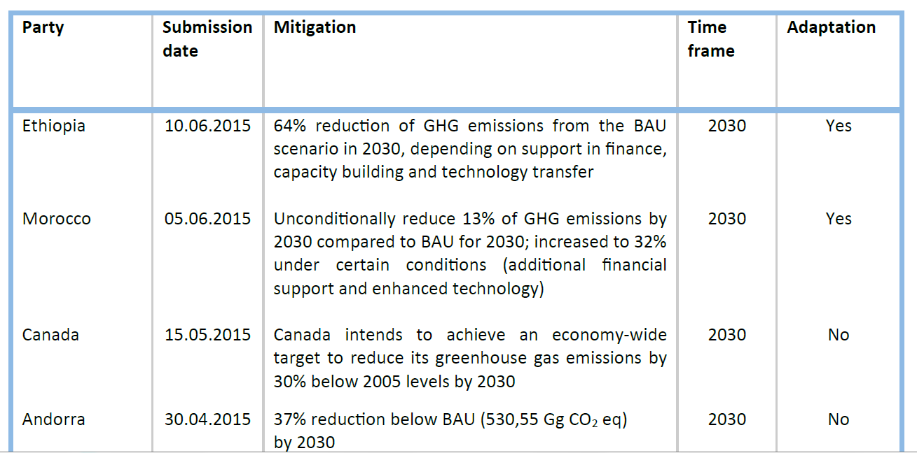
INDCs: examples

Slide 10
Conclusions
There are already extensive reporting/review requirements under the UNFCCC; they differ between developed and developing countries but are challenging for both
For those existing requirements, comprehensive and accurate statistical data are indispensable
The anticipated new climate-related agreement in Paris in Dec.2015 is expected to result in more requirements, such as the reporting in the form of INDCs
The information required for INDC preparation does not differ significantly, in present understanding, from the information required under the UNFCCC now
However, depending on the outcome of the Paris conference and the legal character of the new agreement, the need to be accurate, consistent and timely in providing such information may increase
There are still large uncertainties about what INDCs will eventually be and what they will require; it is important to monitor the process closely and react timely

