Slide 1
Getting the Facts Right: Metadata for MDG and other indicators
UNECE
Tbilisi, Georgia, 5 July 2013

Slide 2
Statistics and Data
Statistics: the collection, organization, analysis, interpretation and presentation of data
Use of data:
Commercial: improve sales
Science: test hypotheses
Policy making: improve the life of the people

Slide 3
Evidence-based decision making
Data for national policy making:
Where are the problems and has the government to intervene
Are government policies effective
What can we learn from other countries
Data for international policy making:
Where is help needed
Are countries fulfilling their obligations (treaties, declarations etc.)

Slide 4
Metadata for tracking development progress
Did we make progress?
Are the trends real?
Are we measuring what we think we are measuring?
Is the improvement significant?
How do we compare to other countries and regions?

Slide 5
Millennium Development Goals (MDGs)
Largest international effort to reduce poverty and improve livelihood
➔ Time-bound Goals and quantified Targets for addressing poverty operazionalized into 60+ Indicators
Monitoring at heart of MDG framework
Unprecedented international cooperation in statistics development and monitoring
National monitoring with additional Goals, Targets and Indicators

Slide 6
Monitoring progress towards the MDGs
Both National MDG Reporting as well as International monitoring
National and International estimates are (most) often different
Differences in: definition, methodology, reference population, primary data source, reliability/uncertainty/bias?
But: In both national and international reporting, metadata is largely missing and inadequate

Slide 7
Coverage 2.1 Total net enrolment ratio in primary education

Slide 8
Inter-agency Group for Child Mortality Estimation (IGME), 2012

Slide 9
Available Sources and Methods:

Slide 10
What are the real Facts?
Metadata should explain difference
Metadata indicates the comparability of data in time and between countries
Without metadata, we can not judge if data is reliable or comparable
Without metadata, we do not know if progress is real
Without metadata we can not interpret data

Slide 11
Getting the Facts Right
Metadata turns digits and numbers into data
Metadata turns data into information
Metadata turns information into facts

Slide 12
Possible Metadata
Information needed to interpret the data
What do we measure
How accurate is our measurement
What is the comparability of the data
What is the: Exact definition, reference population, sample size, methodology applied, corrections made, primary data source, indications of the quality, checks for bias etc.

Slide 13
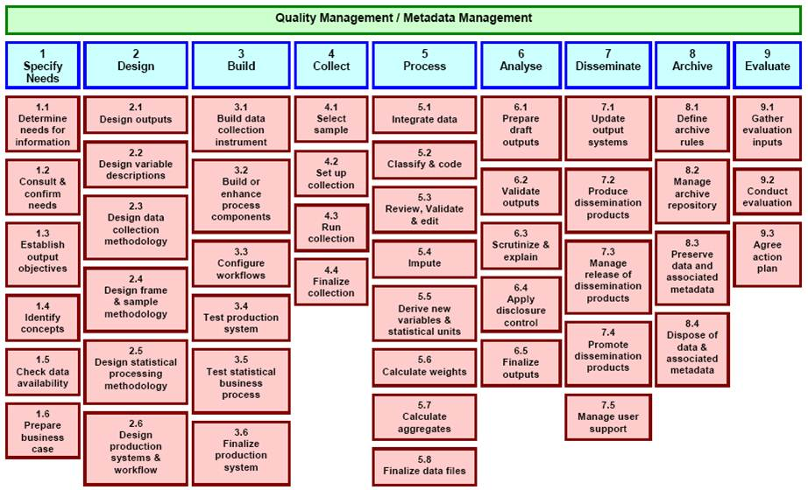
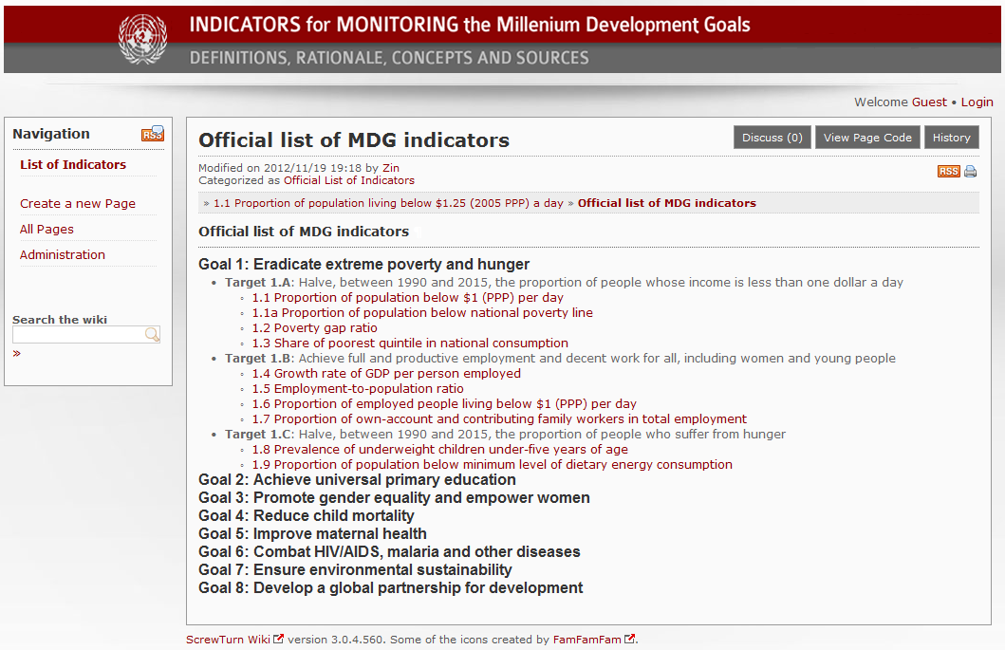
Identifying metadata

Slide 14
Systematic Identification of metadata
Identify important information during the whole process from planning to publishing data:
Concepts and definitions used, sample design, interviewer instructions, design of the questionnaire, scanning tools and software, data entry, corrections to the data, methodology applied etc.

Slide 15
Selecting Metadata
There should be a systematic identification, collection, storage and retrieval system to manage metadata
But: We cannot and do not have to list all possible metadata each time we publish a figure
Challenge: Each time data is published, which metadata should be presented along with the data and in what format or location?

Slide 16
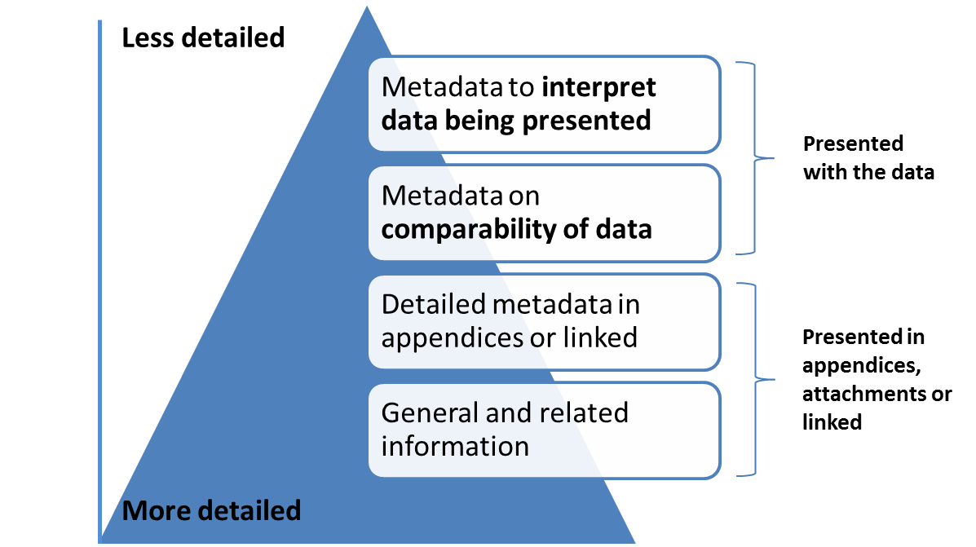
Format and location depends on type of publication and audience
No clear boundaries but continuum
General audience / short articles
Mandatory
Policy Makers / MDG report
Conditional
Optional
Experts / scientific

Slide 17
Selecting Metadata: Mandatory - Conditional
Mandatory: Important details have to be published with the data
Basic: Clear definition, units, time references etc.
Interpret data: comparability within graph or table might be influenced
If different from what users might expect, e.g. if not according to international recommendations
Quality, uncertainty, bias of data
Conditional: Understand comparability and data issues
Mandatory
Conditional

Slide 18
Selecting Metadata: Optional
Details that are not necessary to understand the data or details that (most probably) do not have a strong influence on the comparability and quality of the data:
References to accuracy and quality of the data (for specialist, not of concern for general users and policy makers)
References to further more general information
Information about the agency that produces or publishes the data

Slide 19
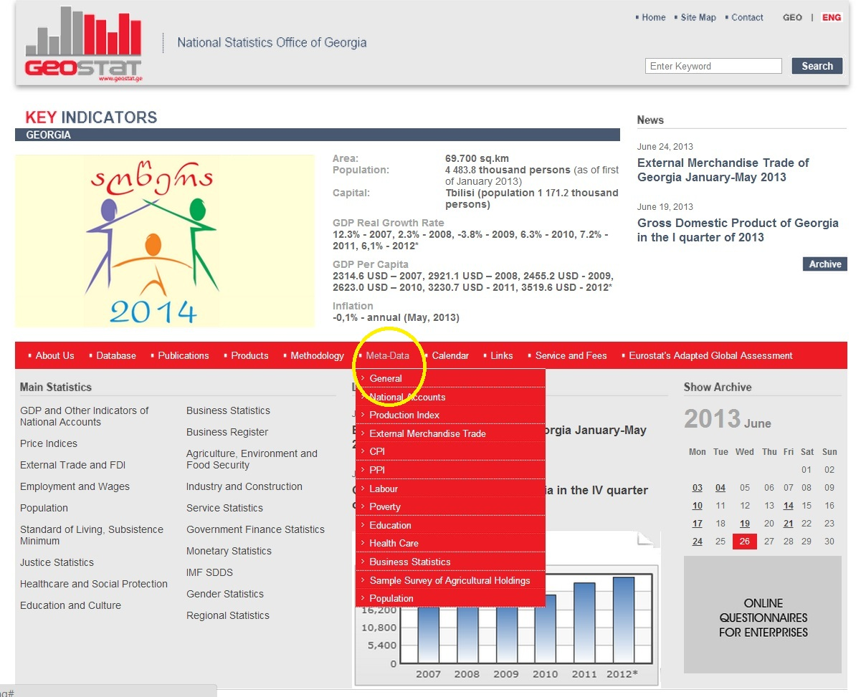
Metadata at website of The National Statistical Office of Georgia (1)

Slide 20
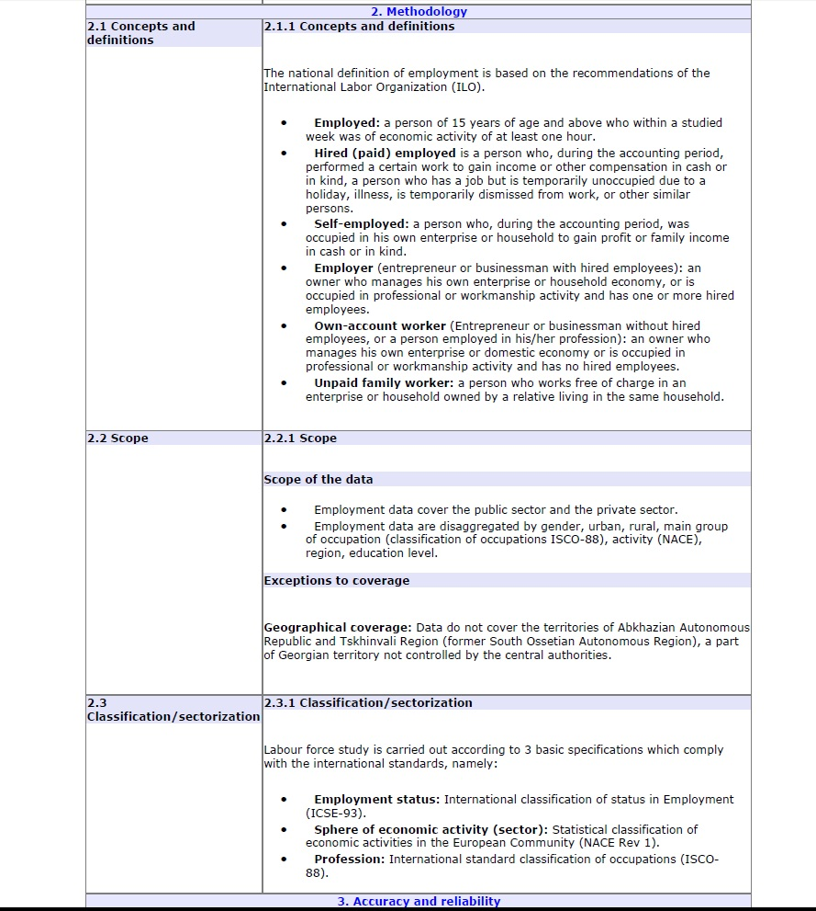
Metadata at website of The National Statistical Office of Georgia (2)
Detailed metadata in pdf file
Also: links to methodological documents are provided

Slide 21
UNECE MDG Database
Decent employment by Indicator, Country, Reporting level and Year
 | 1999 | 2000 | 2001 | 2002 | 2003 | 2004 | 2005 | 2006 | 2007 | 2008 | 2009 | 2010 | 2011
Employment-to-population ratio, total (%)
Georgia
National | 56 | 58.5 | 58.8 | 56.8 | 58.6 | 56.7 | 55.2 | 53.8 | 54.9 | 52.3 | 52.9 | 53.8 | ..
International | 56.9 | 60.1 | 58.8 | 56.8 | 58.4 | 56.6 | 55.2 | 48.7 | 47.1 | 44.2 | .. | .. | ..
Definition of the indicators: Explanations on the indicators are listed below. Deviations from the standard definitions provided here are specified in the country-specific footnotes.
Indicator: Employment-to-population ratio, total (%)
Definition: The employment-to-population ratio is the proportion of a country’s working-age population that is employed. The working-age population is defined as persons aged 15 years and older.
National Series Reference: 1999 to 2010: UNECE Questionnaire Sept 2011; Source in Reference: 1999 to 2010: NSO; Primary Source in Reference: 1999 to 2010: Integrated Household Survey;
Latest update: 12/12/2012 12:45:00
Source: UNECE Statistical Division Database
General note on the UNECE MDG Database:
The database aims to show the official national estimates of MDG-indicators used for monitoring progress towards the Millennium Development Goals. Data is shown alongside official international estimates of MDG-indicators (as published on the official United Nations site for the MDG Indicators: http://unstats.un.org/unsd/mdg). Besides the international MDG-indicators, other indicators and disaggregates that are relevant for the UNECE-region are included.

Slide 22
Some Notes:
If more detailed (conditional and optional) metadata are published, references can be made to it
What is obvious to statisticians, might not be so for data users
Data can be in graphs, figures, tables, but also in text (including in appendices)
Metadata can also educate users
Most people assume that official data are hard facts

Slide 23
Example Metadata considerations ‘Employment to Population Ratio’:
Data provider (GeoStat)
(Primary) Data source (Labour Force Survey)
How is ‘Employed’ defined (minimum numbers of hours)
Age limits of the working age population (15+, 15-65, 15-60 etc.)
Reference period (e.g. one month before the survey period)
Break in series (Before 2003, unpaid family workers were excluded)
Impact of seasonal employment not captured by data collection method.
Inclusion or exclusion of members of the armed forces, mental, penal or other types of institutions
Sample size and sampling method
Interviewers’ instructions
Weighting of data to population structure and/or age/sex standardization

Slide 24
Example Metadata considerations ‘Employment to Population Ratio’:
Data provider (GeoStat)
(Primary) Data source (Labour Force Survey)
How is ‘Employed’ defined (minimum numbers of hours)
Age limits of the working age population (15+, 15-65, 15-60 etc.)
Reference period (e.g. one month before the survey period)
Break in series (Before 2003, unpaid family workers were excluded)
Impact of seasonal employment not captured by data collection method.
Inclusion or exclusion of members of the armed forces, mental, penal or other types of institutions
Sample size and sampling method
Interviewers’ instructions
Weighting of data to population structure and/or age/sex standardization

Slide 25
Example Policy makers/National MDG report
Mandatory (Basic information):
Title: Employment-to-population ratio*, Georgia**
Source: GeoStat, annual Labour Force Survey 1999-2014
Before 2003, unpaid family workers were excluded
Conditional (Important info on time-series)
Footnote:
* The proportion of the working-age population of 15 years and over that is employed.
** Excluding the occupied territories of Abkhazia and Tskhinval

Slide 26
Conditional: In appendix, through link or text box
Employed refers to persons age 15 and above who performed any work at all, in the reference period, for pay or profit (or pay in kind), or were temporarily absent from a job for such reasons as illness, maternity or parental leave, holiday, training or industrial dispute. Unpaid family workers who work for at least one hour are included in the count of employment.
Census based revised population estimates by sex and age were used to reweight the 2004-2014 employment-to-population ratios
Detailed info on Labour Force Survey
Contact details GeoStat

Slide 27
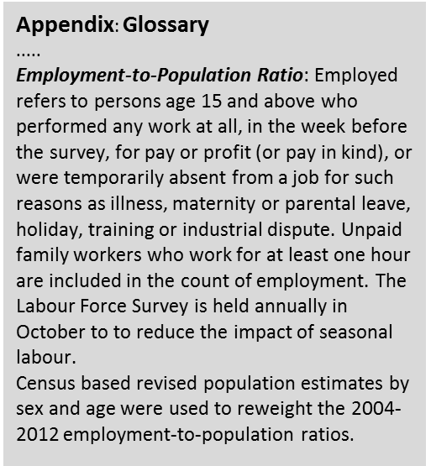
Example Graph (hypothetical):

Slide 28
Example ‘Employment to Population Ratio’ for MDG report

Slide 29
Indicators
National Poverty line
Net enrolment in primary and secondary
Infant and child mortality rate
Proportion using improved water sources
Internet users per 1000 population

